Slide 1
MapRefuge By Kelvin Lin, Olivia Ma, Avdeep Kaur, Brian Zeng

Slide 2
Agenda
Brief Overview
Cloudflare Privacy Focused Proxy
Google Maps API
AI Powered Chatbot

Slide 3
What is MapRefuge?
MapRefuge is a comprehensive software to direct individuals to community resource organizations partnered with Urban Refuge with a focus on user-interface, privacy, and customizability
Comprehensive map filtering and plotting logic, customizability features, and with a AI powered Resource Assistant

Slide 4
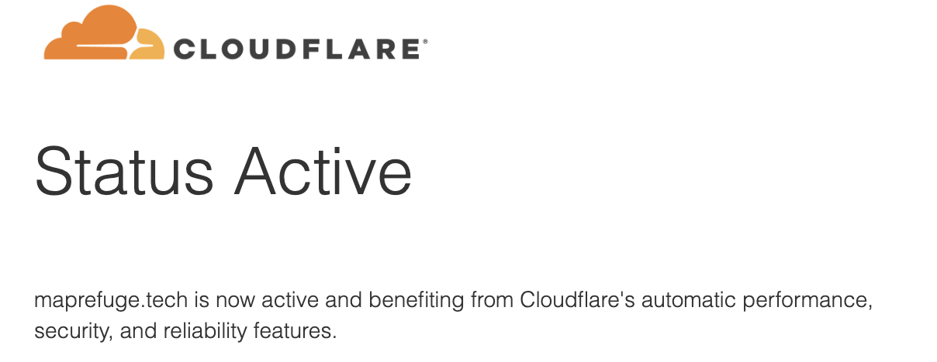
Privacy Focused Proxy
Client: the user’s device, or any client that’s configured to forward requests to Privacy Gateway.
Privacy Gateway: a service operated by Cloudflare and designed to relay requests between the Client and the Gateway, without being able to observe the contents within.
Application server: the origin or application web server responsible for decrypting requests from clients, and encrypting responses back.

Slide 5
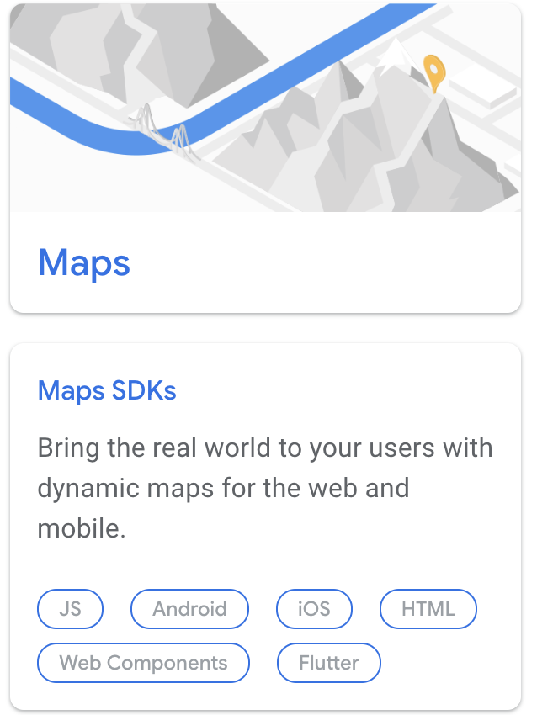
Google Maps Integration
Integrated with Google Maps API
Fully interactive map
Advanced filtering logic to determine partial (yellow pins) and full matches (blue pins)
Filtered out businesses, left in important landmarks to make organizations easier to find and less map clutter
Location radius implementation

Slide 6
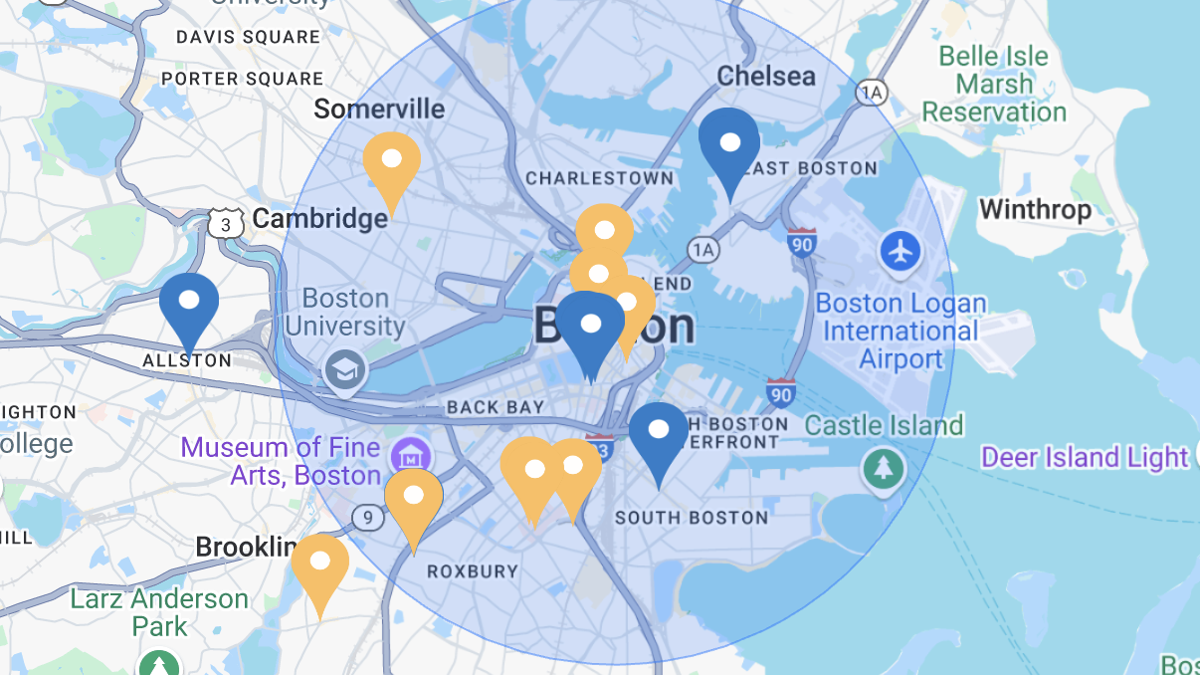

Slide 7
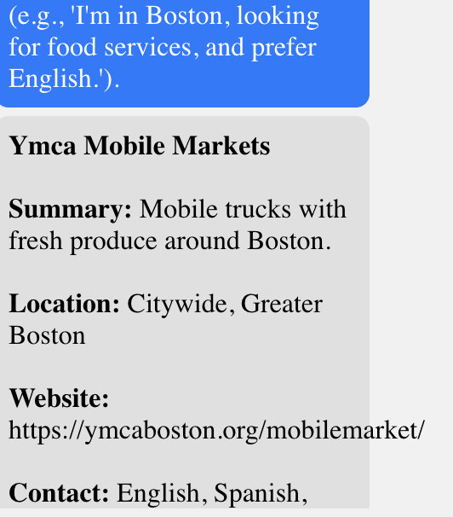
AI-Powered Resource Assistant
Takes in community resources and data
Takes user prompts and using AI, extract relevant keywords, and match them with resources
Powered by ChatGPT 3.5 Turbo
Returns applicable resources
Prompts users to interact again if wrong

Slide 8
Tech Stack
NodeJs, Javascript, HTML, CSS
Google Maps API
ChatGPT API
Custom domain (maprefuge.tech)

