Slide 1
Recursion
Avdyl Krasniqi & Albesë Matoshi

Slide 2
Problem: Given two positive integers n and k, print all increasing sequences of length n such that the elements in every sequence are from the first k natural numbers.

Slide 3
Examples
Input: n=2; k=3;
k=1 2 3
n=x1 x2
Output: 1 2 1 3 2 3
Input: n=5; k=5;
k=1 2 3 4 5
n=x1
Output: 1 2 3 4 5

Slide 4
Solution: 2 approaches! 1. Iterative
2. Recursive

Slide 5
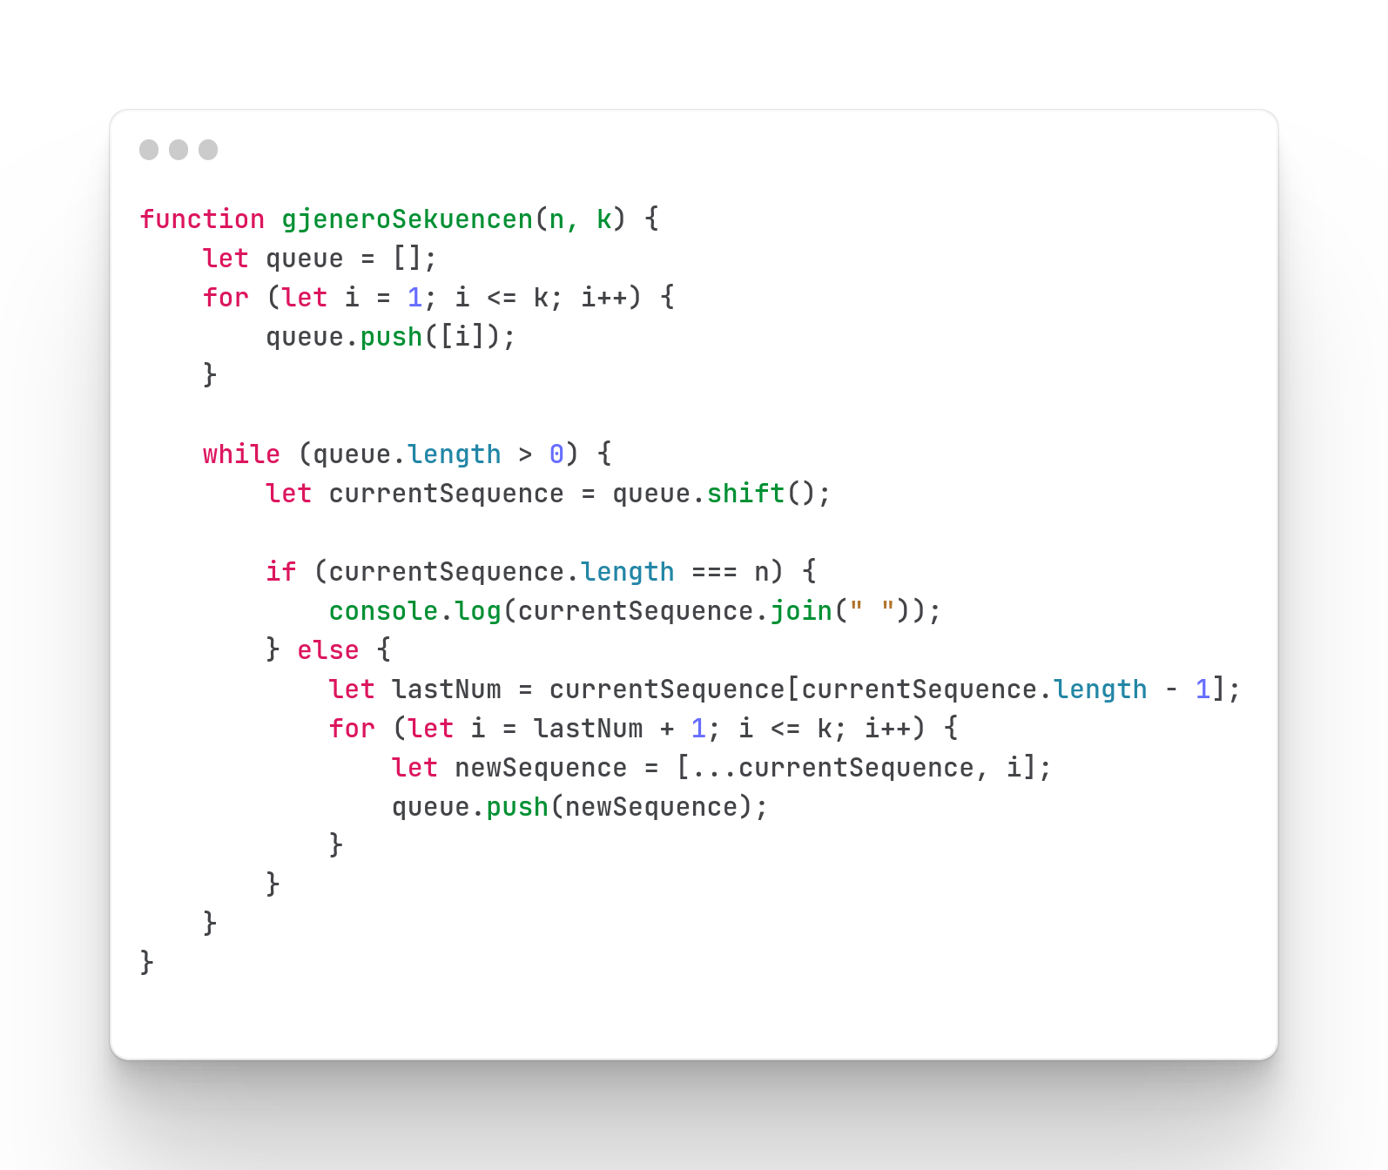
Iterative
Time Complexity
Ω(f(n,k)) = O(f(n,k)) = Θ(f(n,k))
Ku C(n,k) < f(n,k) < 2^k

Slide 6
N= 3, K= 3
Queue | Aksioni | Current sequence | New Sequence
[[1],[2],[3]] | Procesi i mbushjes | undefined | undefined
[[2],[3]] | Queue shift | [1] | undefined
[[2],[3]] | Add el to new seq | [1] | [1,2]
[[2],[3],[1,2]] | Queue push | [1] | [1,2]
[[2],[3],[1,2]] | Add el to new seq | [1] | [1,3] (local scope)
[[2],[3],[1,2],[1,3]] | Queue push | [1] | [1,3]
[[3],[1,2],[1,3]] | Queue shift | [2] (overwritten) | undefined
[[3],[1,2],[1,3]] | Add el to new seq | [2] | [2,3]
[[3],[1,2],[1,3],[2,3]] | Queue push | [2] | [2,3]
More on next slide >>>>

Slide 7
Queue | Aksioni | Current sequence | New Sequence
[[1,2],[1,3],[2,3]] | Queue shift | [3] | undefined
For loop nuk plotëson kushtin currentSequence.last() + 1 <= K, vazhdon iterimi i radhës në while loop
[[1,3],[2,3]] | Queue shift | [1,2] | undefined
[[1,3],[2,3]] | Add new el to new seq | [1,2] | [1,2,3]
[[1,3],[2,3],[1,2,3]] | Queue Push | [1,2] | [1,2,3]
[[2,3],[1,2,3]] | Queue Shift | [1,3] | undefined
For loop nuk plotëson kushtin currentSequence.last() + 1 <= K, vazhdon iterimi i radhës në while loop
[[1,2,3]] | Queue Shift | [2,3] | undefined
For loop nuk plotëson kushtin currentSequence.last() + 1 <= K, vazhdon iterimi i radhës në while loop
[] | Queue Shift | [1,2,3] | undefined
Plotësohet kushti currentSequence.length == K, dhe printohet queue. Programi përfundon pasi whileloop nuk plotëson më kushtin queue.length > 0

Slide 8
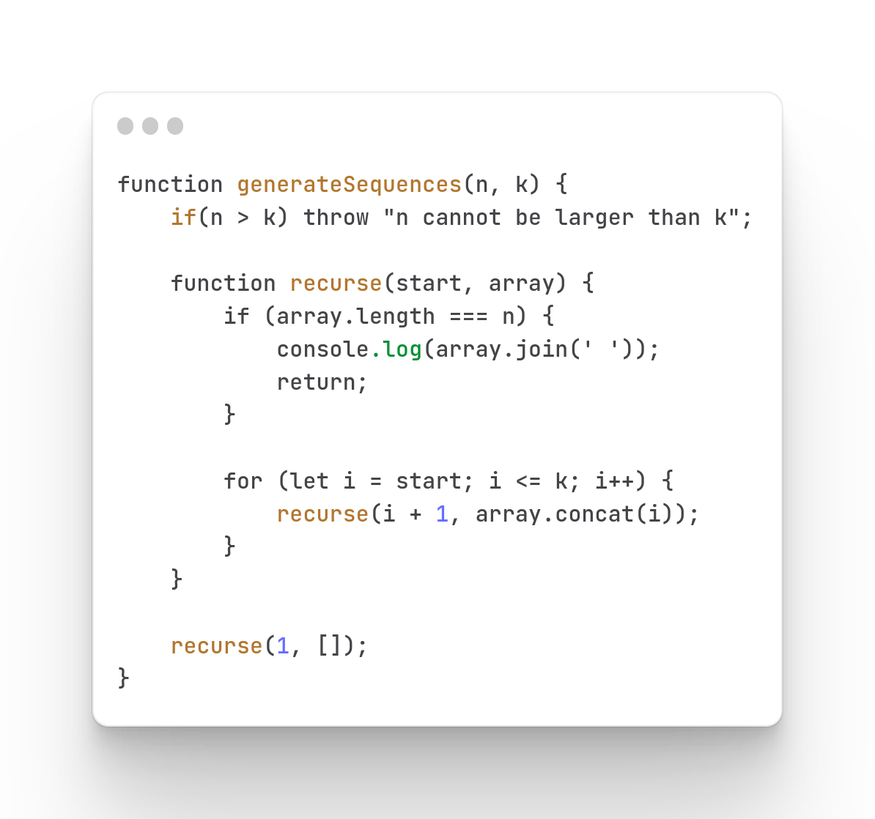
2. Recursive
Time Complexity
Ω(f(n,k)) = O(f(n,k)) = Θ(f(n,k))
Ku C(n,k) < f(n,k) < 2^k

Slide 9
N = 2, K = 3
[]
[1]
[2]
[3]
Preorder: 1 1,2 1,3 2 2,3 3
[1,2]
[1,3]
[2,3]

Slide 10
N = 3, K = 3
[]
[1]
[2]
[3]
Preorder: 1, 1,2 1,2,3 1,3 2, 2,3 3
[1,2]
[1,3]
[2,3]
[1,2,3]

Slide 11
N = 4, K = 4
Preorder: 1
1,2
1,2,3
1,2,3,4
1,2,4
1,3
1,3,4
2,
2,3
2,3,4
2,4
3
3,4
4
[]
[1]
[2]
[3]
[4]
[1,2]
[1,3]
[2,3]
[2,4]
[3,4]
[1,2,3]
[1,2,4]
[1,3,4]
[2,3,4]
[1,2,3,4]

Slide 12
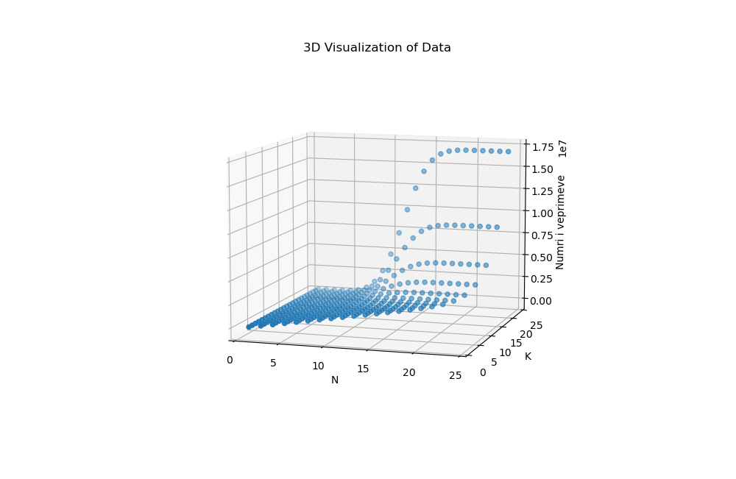

Slide 13
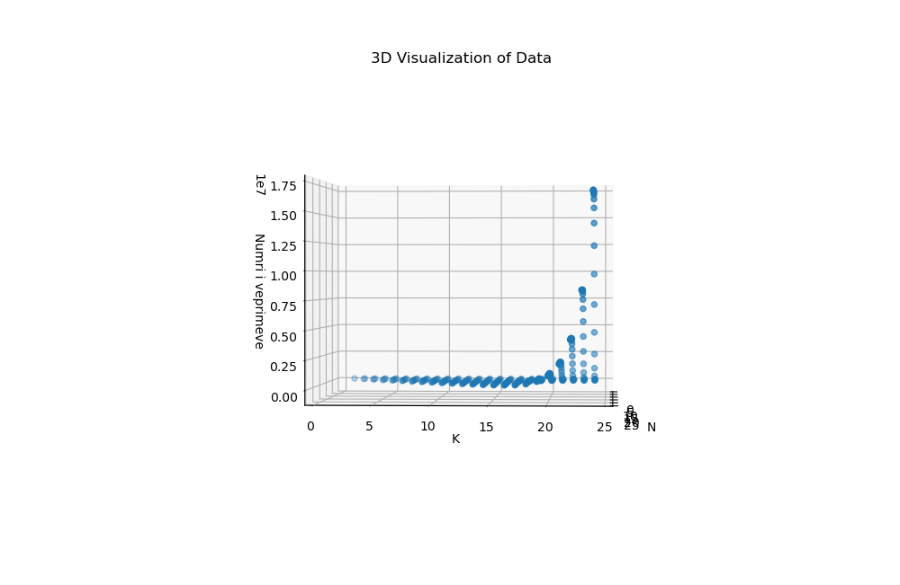

Slide 14
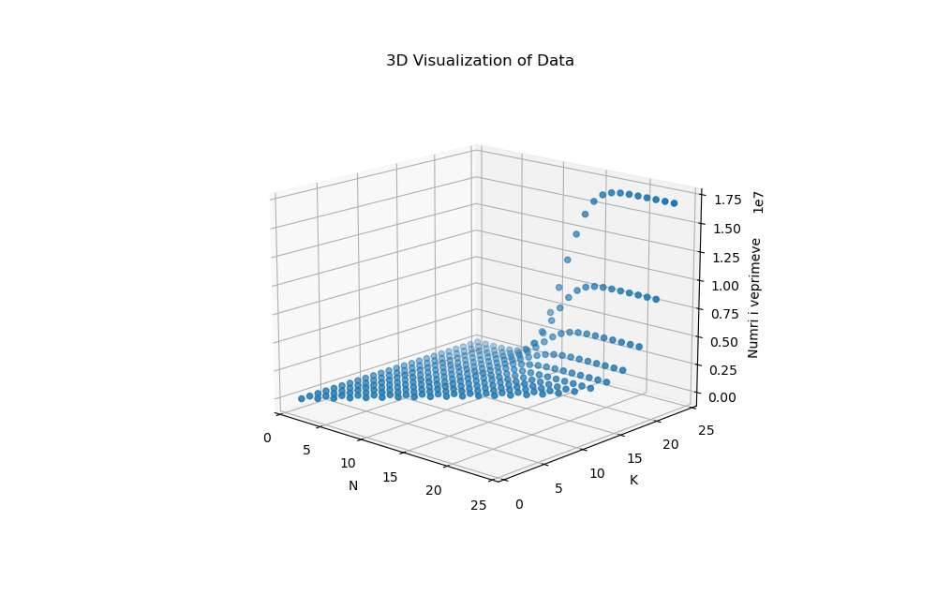

Slide 15
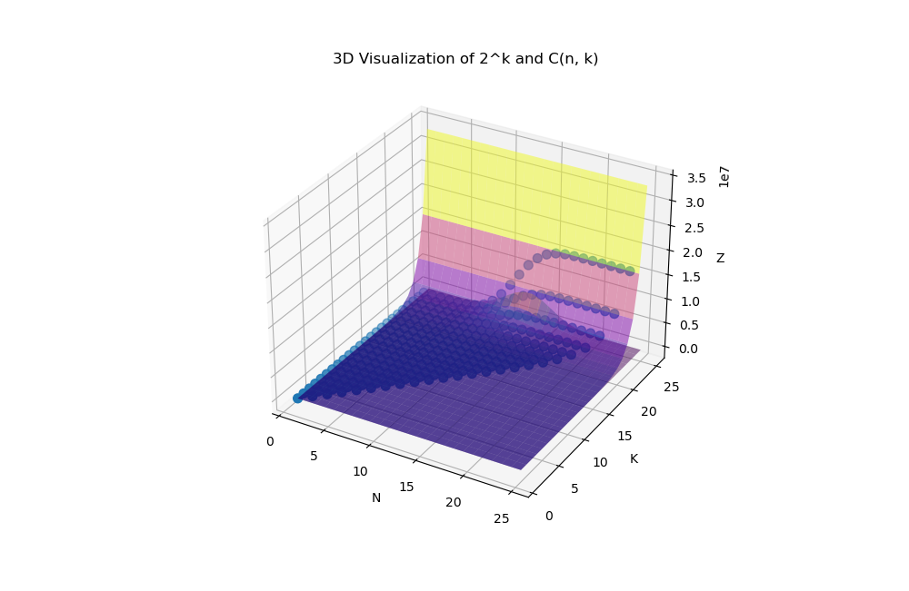

Slide 16
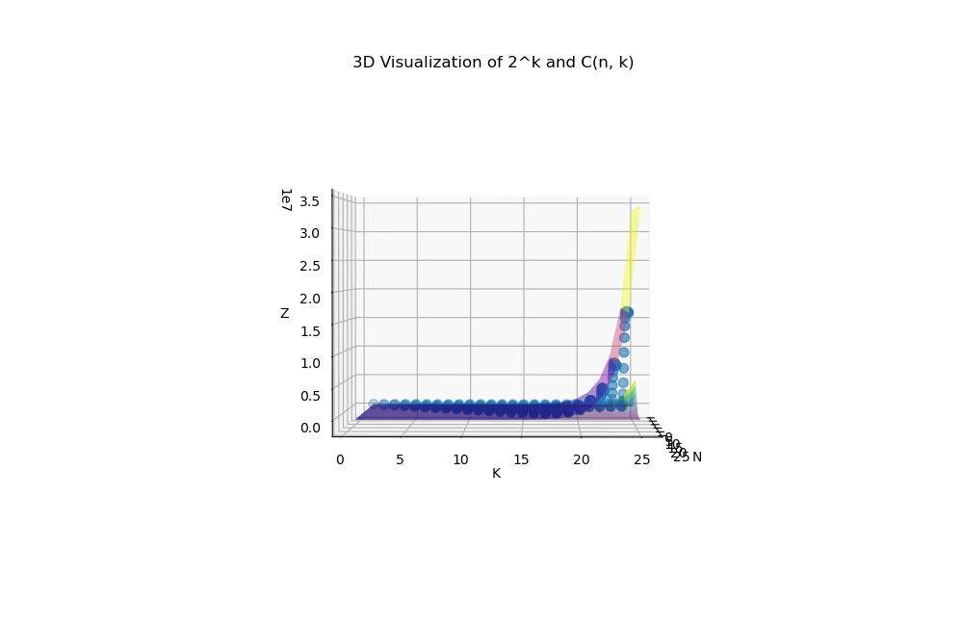

Slide 17
