Slide 1

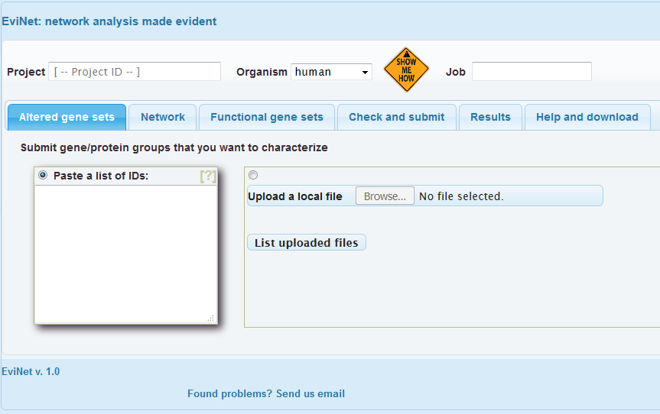
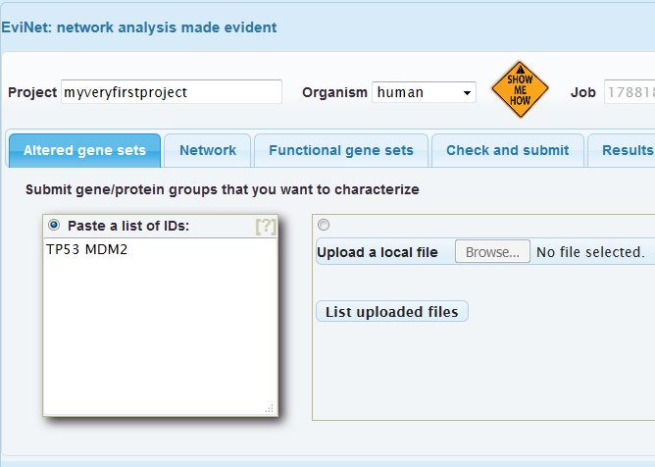
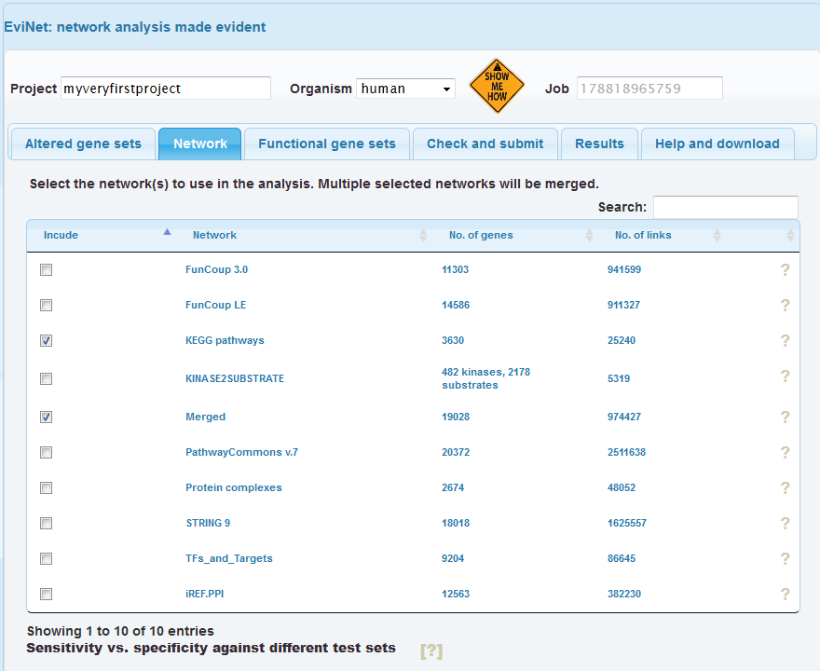
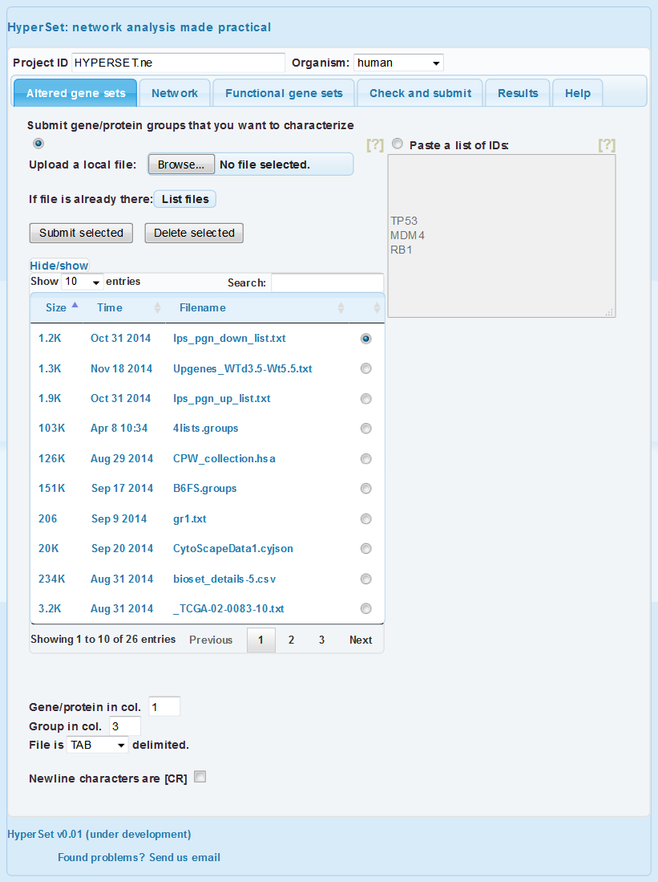
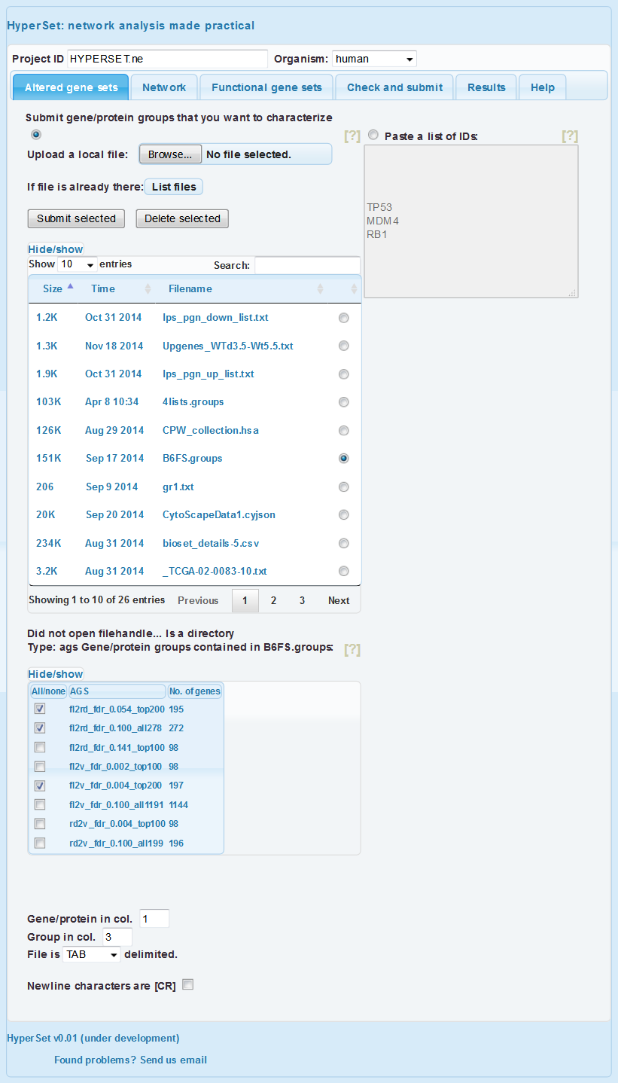
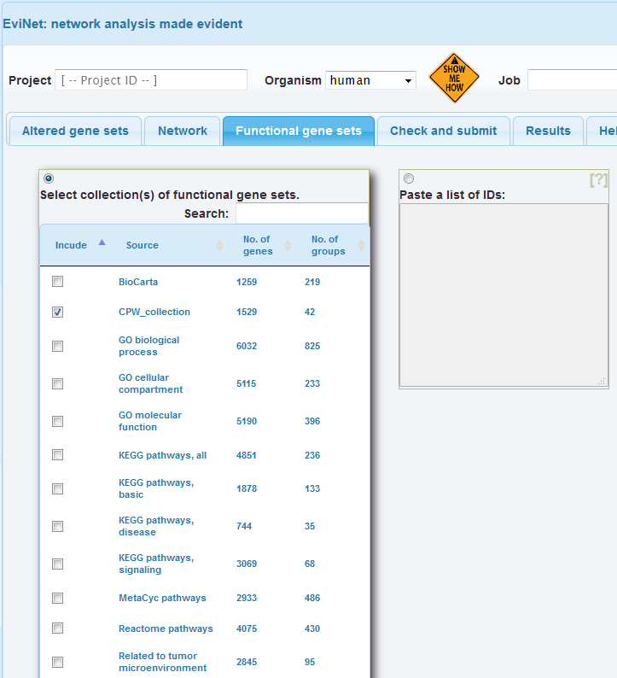
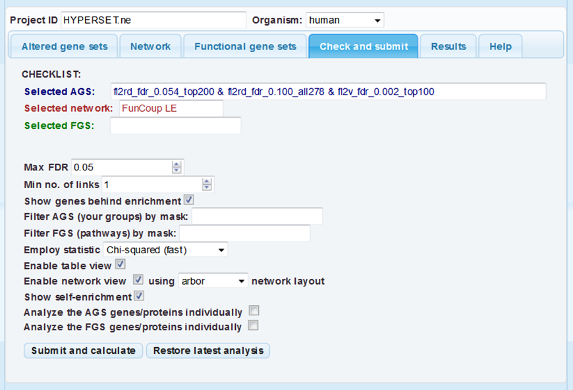
Setting up the first analysis
https://www.evinet.org
ALWAYS start from setting your project ID and the organism. Otherwise your analysis might use irrelevant data. Also note that EviNet currently supports only gene symbols and not other ID types.
Type in ‘project1’ to see and try our example files.
The whole aim of network enrichment analysis (Alexeyenko et al., 2012) is characterization of certain genes or gene lists.
Hence continue by submitting your altered gene sets (AGS) by either explicitly pasting gene symbols or uploading a file.
Note: EviNet currently accepts only human and mouse gene symbols and AT*G symbols in Arabidopsis.
Once uploaded, a file might remain in your project space to be re-analyzed later.
NOTE: the file should contain at least two columns and you have to specify column roles and the column delimiter. An advantage of using files is that they might contain multiple AGSs (the AGS IDs should then appear in a special column). Our example file contains a few lists of differentially expressed genes “experiment” vs. “control”. The same file can be seen in ‘project1’ (pressing button “Display file content” will help investigating its content). You can choose desirable AGS and proceed to the next two tabs.
Another file in ‘project1’ is CPW_collection.hsa. It is one of the FGS files found in the third tab. Although, we can present any FGS (known pathway etc.) as a novel gene list and explore its functions. Note that gene symbols in this particular file are in col. 2, hence leaving the default col. 1 leads to submitting gene IDs in a wrong format (ENSEMBL – currently not supported).
Select a network. More detailed networks (FunCoup, STRING) are larger but less precise. Networks from curated resources like KEGG, CORUM, PhosphoSite are confident but much less comprehensive and hence might miss novel genes.
You can investigate comparative efficiency of the networks by looking at the ROC curves (below the table). More sensitive and specific options must be higher and shifted to the left. Note also that for each individual analysis one can create unions of networks of different types (“Merged” is a pre-compiled example of such a union). Such merging is often beneficial.
Select a collection of functional gene sets, i.e. pathways or GO terms. They should be as close to your angle of view as possible. For example, for cancer it might be our CPW_collection. (alternatively, you submit a general collection and then filter the output in the next tab). In most specific and important cases consider submitting your own pathway as a gene list in the text box.
Finally, click the button “Submit and calculate”!
It might take time to get the job finished, thus we recommend starting from smaller networks (< 10000 links) and smaller FGS/AGS collections. In order to re-plot the results, you can return and click the button “Restore latest analysis”. NOTE: options “Analyze …individually” and “Employ statistic” can alter the output only if you press “Submit and calculate”.
As long as you try different options and parameters on your AGS files, executed analyses accumulate in your project directory and can be seen in the “Archive” tab. See example analysis output in ‘project1’.
Check if the three components of the analysis correctly appear at the “Check and submit” tab.
NOTE: here you can only see them, but not edit. For editing, return to respective tabs.

Slide 2
Interpreting output
https://www.evinet.org
Download a version of R package NEArender and install it with the usual commands. The only recommendation is to install first the required package ROCR (it might be sensitive to some other dependencies):
We first could create a set of AGS that distinguish each cell line sample in the collection from the others.
Plotting the gene frequency distribution demonstrates that the most of the genes are quite unique (below). Next, we run the network enrichment analysis, analyzing enrichment of each of these cell-line specific AGSs against each of the 330 pathways in the FGS collection:
The two pathways seems to have discovered a global trend: correlation coefficients from the two drug screens correlate with each other, too.

Slide 3
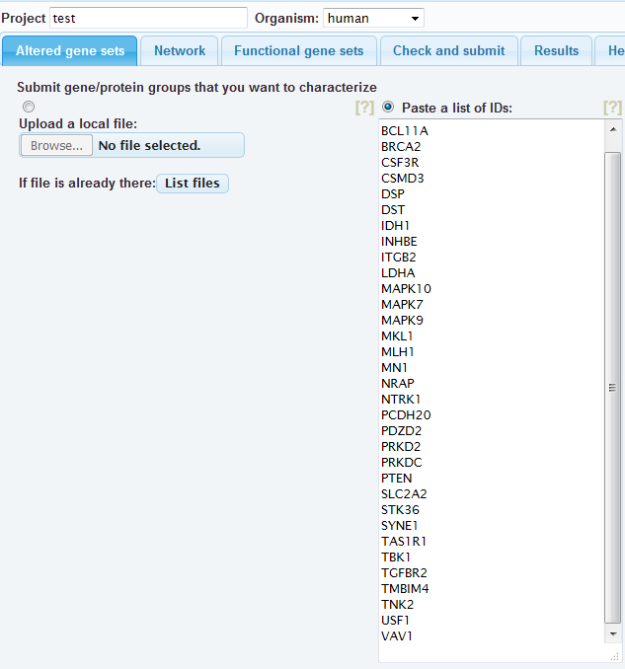
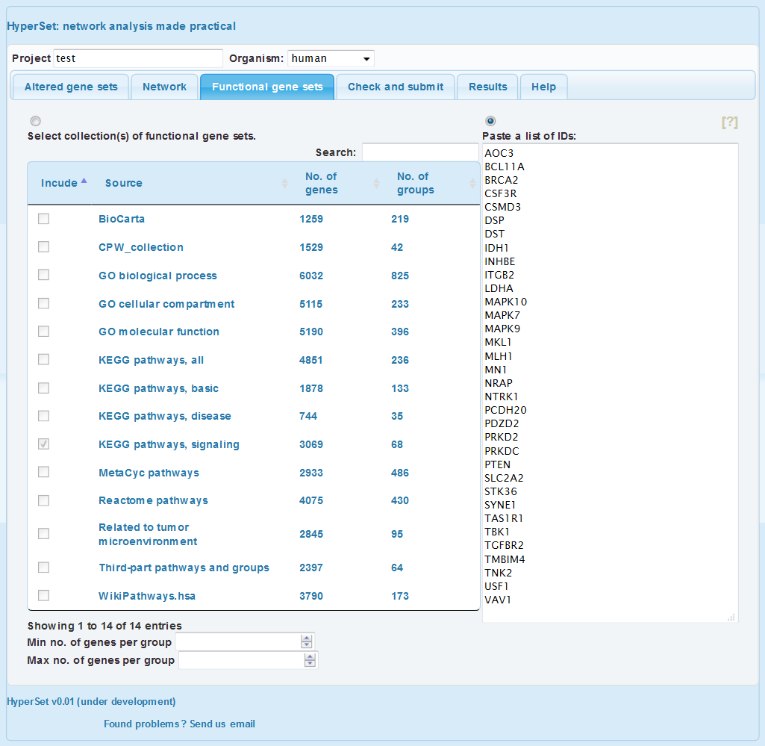

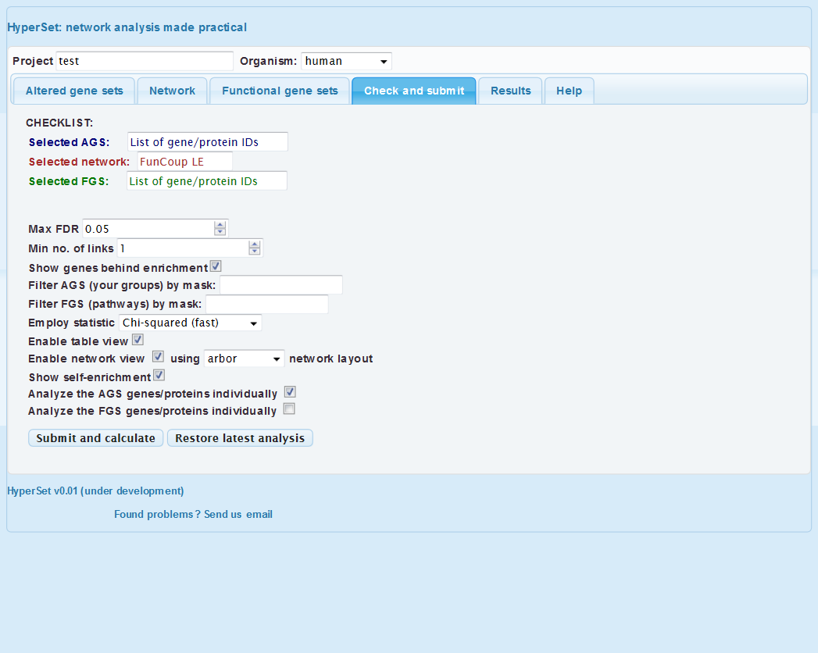
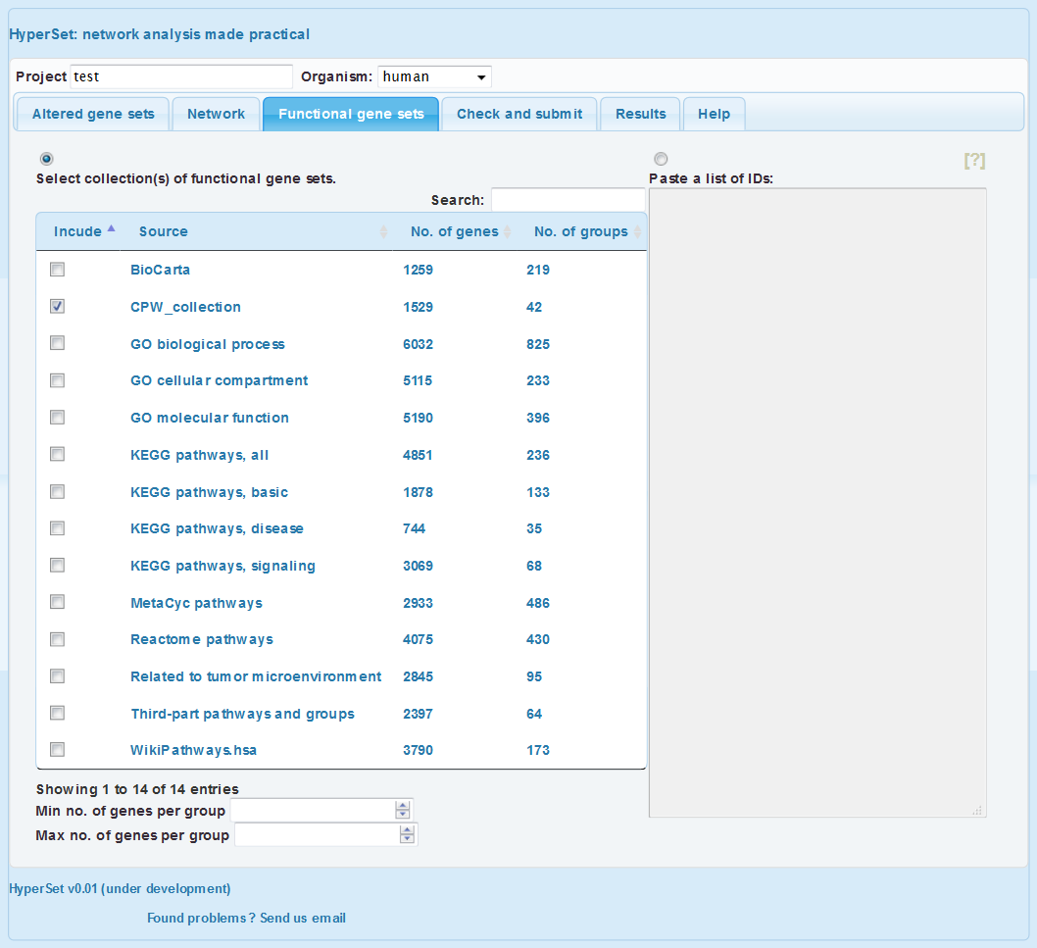
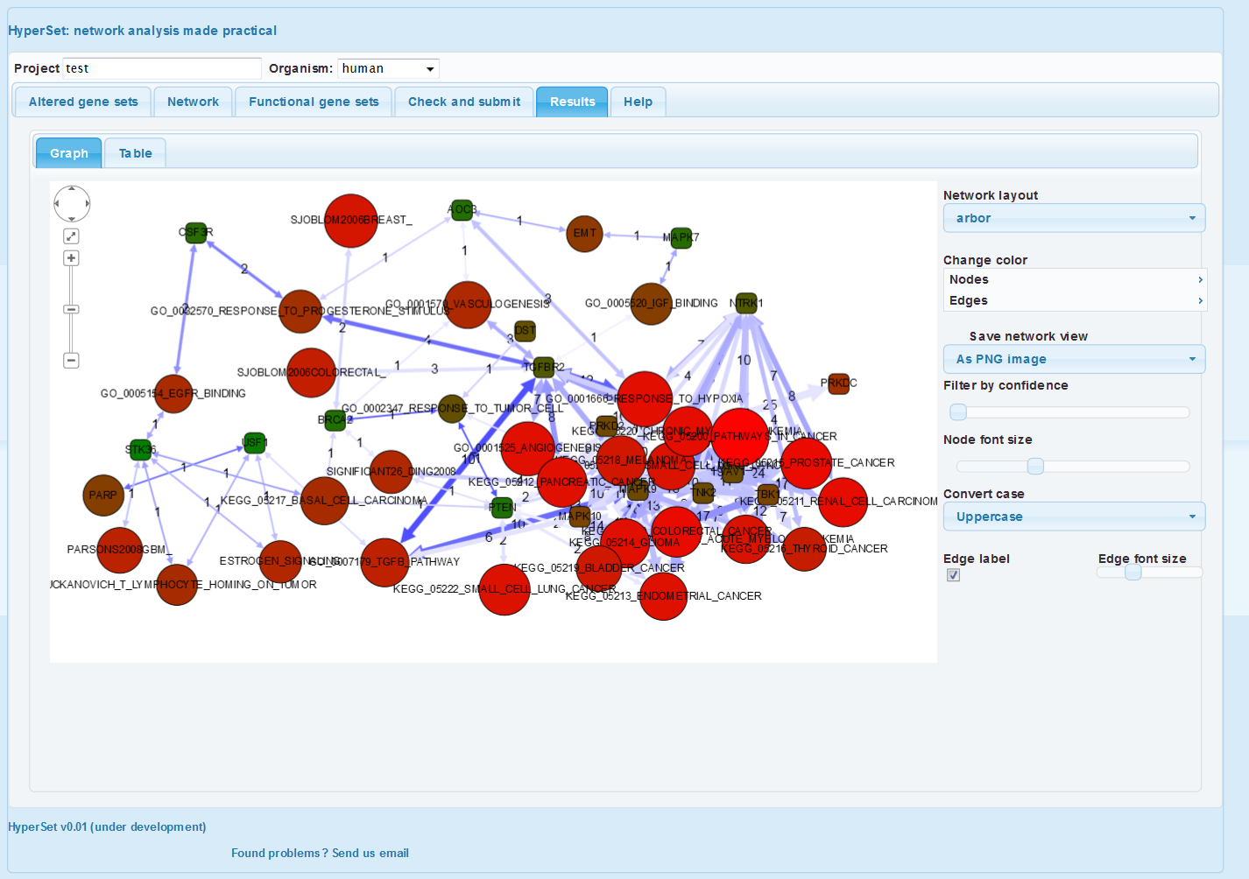
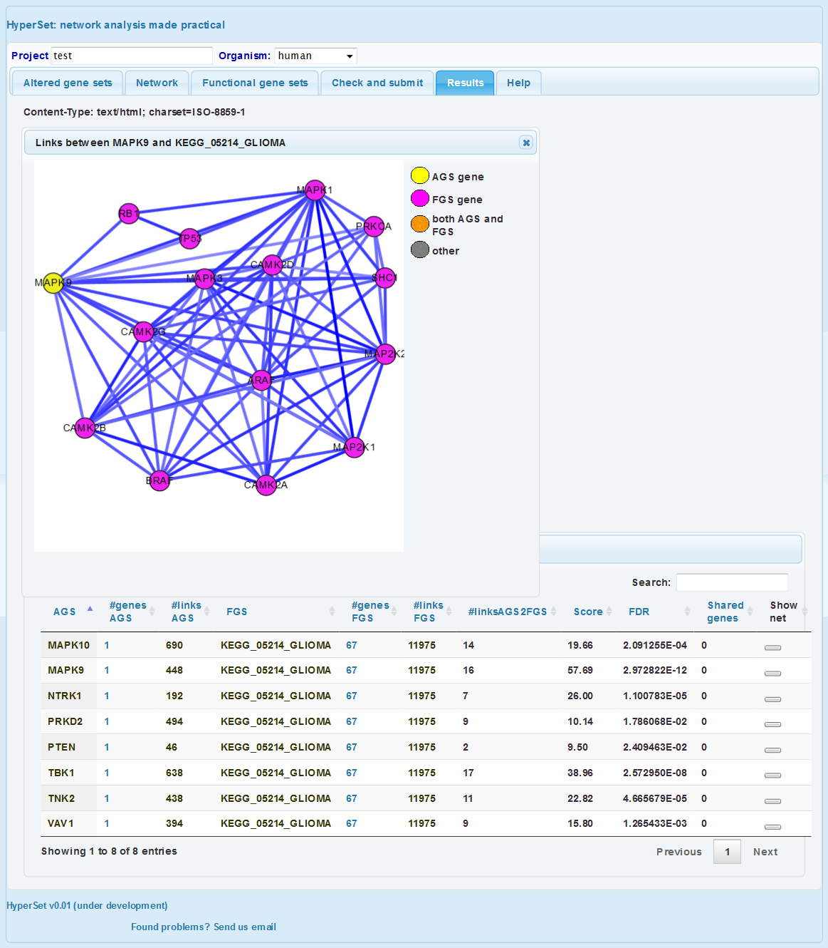
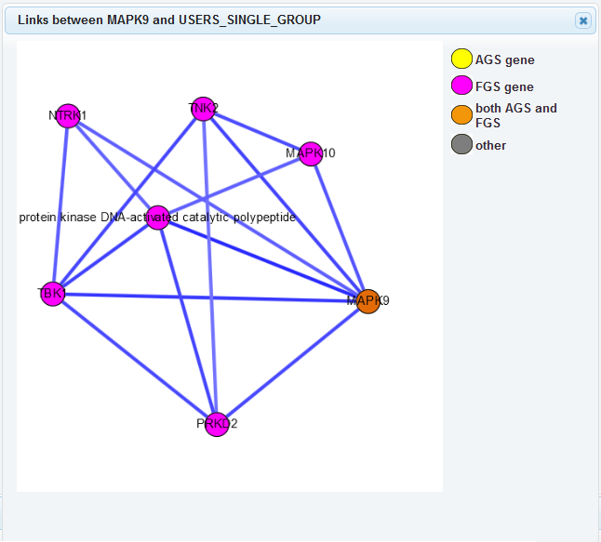
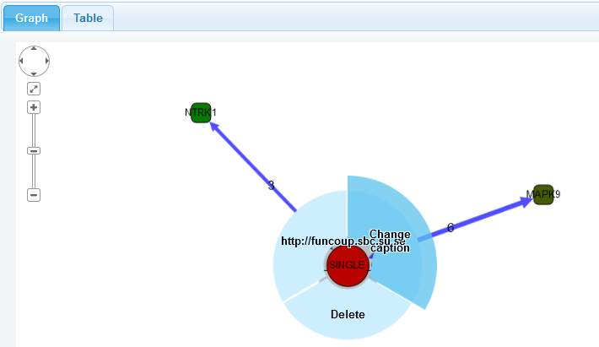
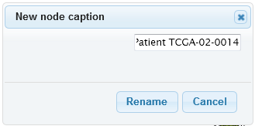
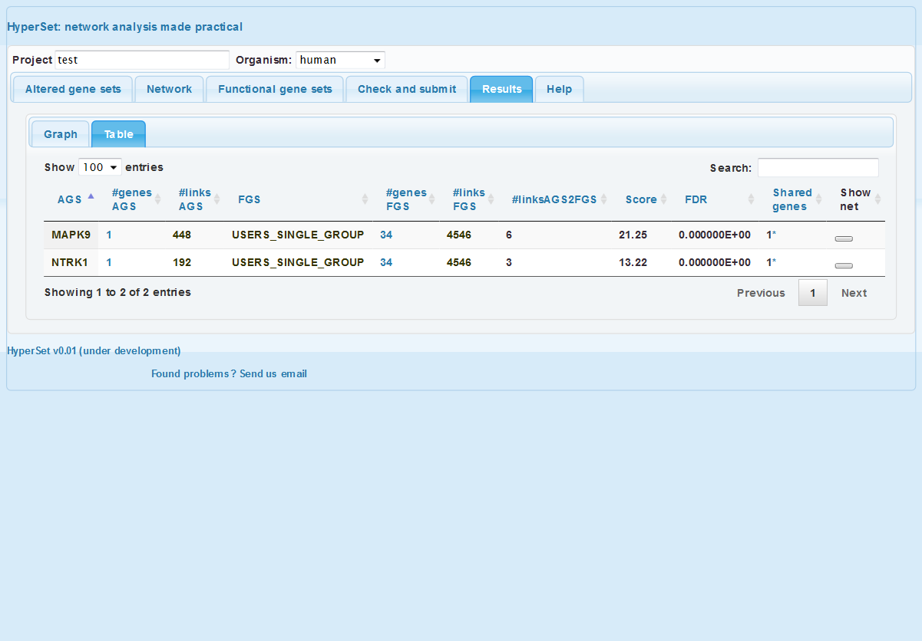
How to evaluate driver roles of candidate disease genes?
https://www.evinet.org
The idea of network-based functional analysis is in assuming that multiple genes involved in the disease would appear connected in the global network. Hence we should formulate gene-specific requests so that the answers confirm or reject respective hypotheses. The analysis is most applicable to cancer mutations (because of their abundance), but can well be applied to other diseases where candidate genes were derived in GWAS etc.
Example applications can be found in
Merid et al., 2014 (cancer driver genes) and
Bennet et al., 2011, Hong et al., 2010, Reynolds et al., 2010 (Alzheimer’s disease).
As an example, we investigate roles of point mutations in one somatic genome of glioblastoma multiforme. We start by pasting the whole list of 34 mutations in the first tab “Altered gene sets”. Although, each gene is going to be analyzed separately (submitting the list would just save time). Note that you can also submit them as a text file, e.g. this one and select mutations for particular cancer genome (column 3). Second, we will select a network in the next tab (see details in tutorial “How to begin?”).
Following scenario 1, we then ask which of the genes manifest enriched network connectivity to their fellow mutations. In order to do that, we paste the same list in the tab 3 “Functional gene sets”. The FGS menu on the left is not used.
There are two major modes in the analysis that can be run separately or in parallel. We can evaluate connections between a given candidate gene and a group of genes that together are likely to be implicated in the disease. Such a group can be either:
a set of altered genes discovered experimentally (typically the whole set of mutations, genetic variants, or differentially methylated or expressed genes), or
a curated gene set with well characterized functional role in the disease.
Following scenario 2, we investigate how the genes relate to known pathways. For cancer applications one can utilize the group of 42 database- and publication-based cancer pathways “CPW_collection”. Similarly to scenario 1, we use checkbox “Analyze AGS genes / proteins individually” at the next tab.
We do not know in advance which genes would interact with which. Furthermore, we want to evaluate individual genes’ relations to the whole set of mutations. For these reasons, we check the box “Analyze AGS genes/proteins individually” and do not check the other box (or vice versa - it does not matter in this case).
This gives many more findings than scenario 1 which is mostly due to using many more sets of much better characterized genes. However this approach requires a control analysis: how many such findings would be made for a randomly picked gene set of size 34?
There is more detailed information in the next tab “Table”: 6 and 3 links between either MAPK9 or NTRK1 on one side and any other mutations on the other side. This resulted in network enrichment score values 21.25 and 13.22, respectively and yielded very low probabilities of false detection (column “FDR”). Clicking buttons in the last column brings detailed, gene-level network representations of each line.
We see that only two genes appear significantly connected to the fellow mutations (in the given network). For presentation purposes one can rename nodes here.
Thus, stronger evidence was accumulated in the both scenarios for MAPK9 and NTRK1 and a few other genes scored high against multiple cancer pathways (e.g. TNK2, TGFBR2). See another analysis of the same mutation list using other parameters.
However a full-scale statistical framework should be implemented for a systematic analysis of multiple cancer genes and genomes. Examples can be found in Merid et al., 2014 and might require additional information from the same samples (methylation, copy number events etc.). Required software in R and/or perl can be downloaded from https://www.evinet.org

Slide 4
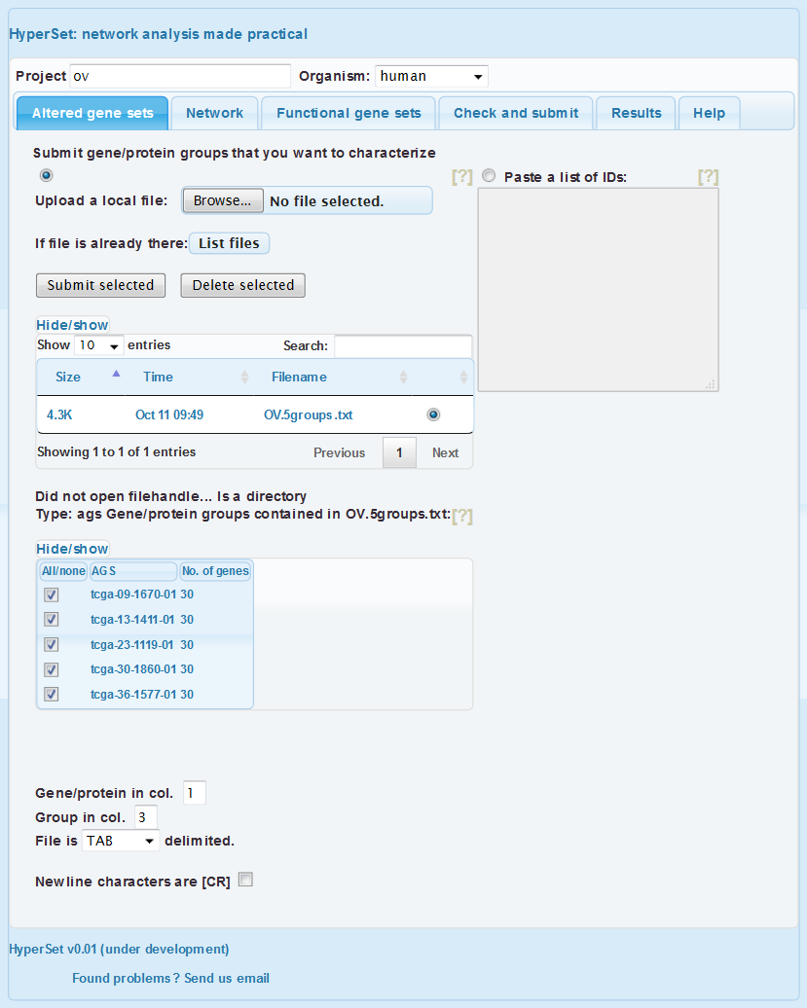
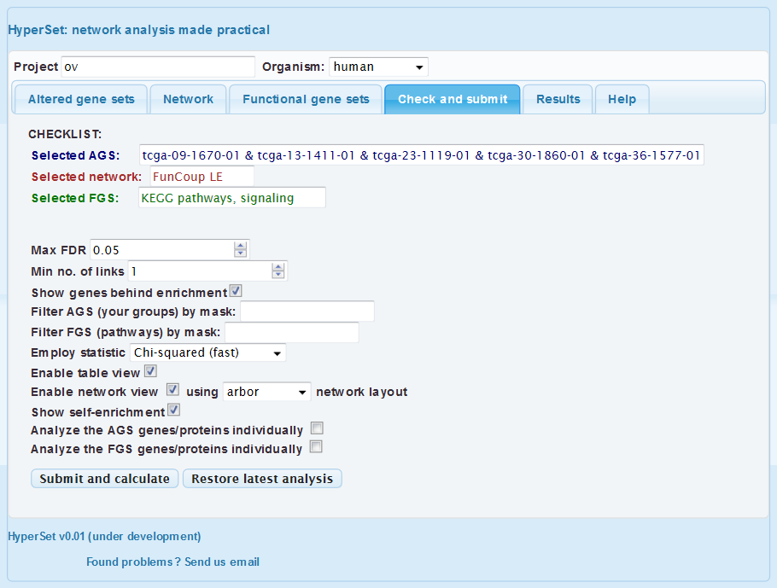
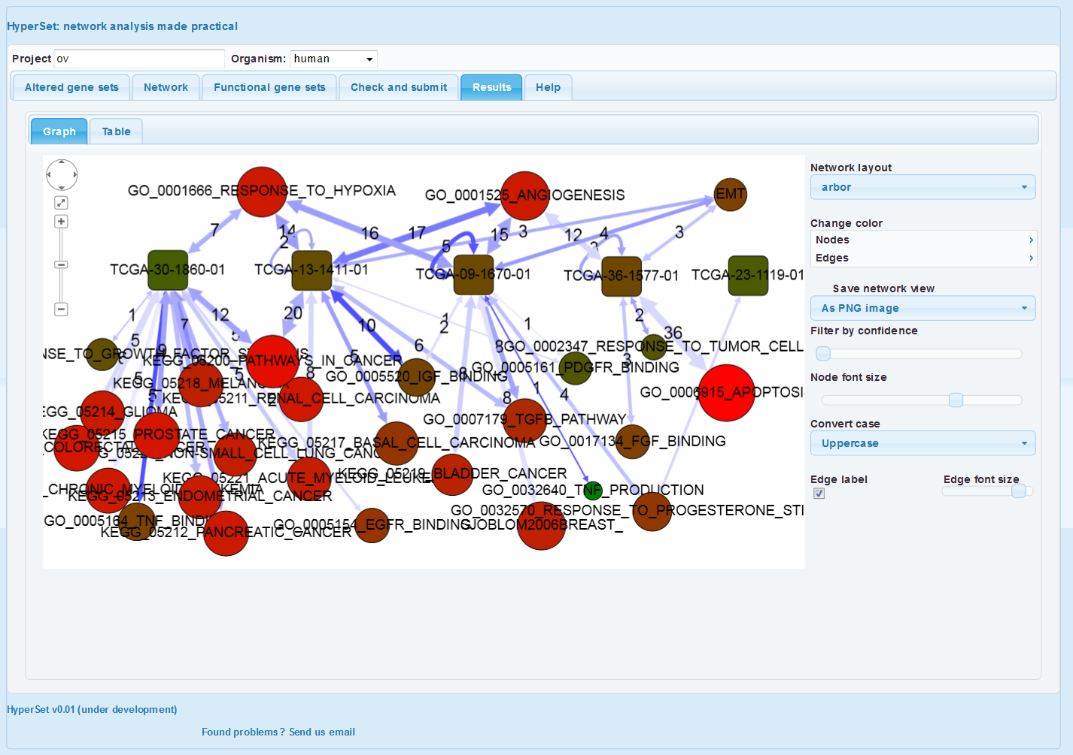
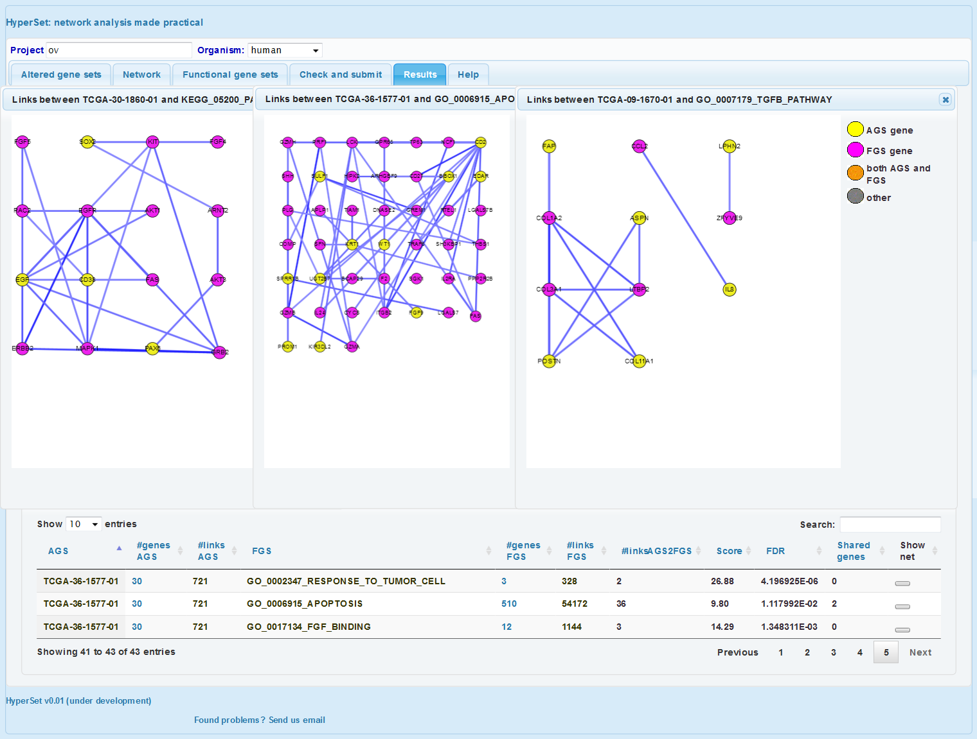
Exploration of transcriptome landscapes
https://www.evinet.org
We want to explore how do the unique features of each transcriptome appear in the space of known pathways. For the cancer application we can utilize our group of 42 database- and publication-based cancer pathways “CPW_collection”. We also select a network in the neighbor tab (see details in tutorial “How to begin?”).
Cancer samples are known to be highly heterogeneous across patients. In order to characterize them, one can choose the strategy described in Alexeyenko et al., 2012: in each ‘omics’ sample, select top N genes by which it differs from the rest of the cohort. We can do that with e.g. following R code (see more details in tutorial “Using R package NEArender in data analysis pipelines”):
Next, we submit the obtained text file with N=30 genes per sample using the first tab.
As was explained in tutorial “How to begin?”, we overview the selected parameters and click “Submit”.
> library(“NEArender”);
> dim(Data$OV$GE$Agilent)
[1] 17813 589
> m0 <- Data$OV$GE$Agilent[,sample(colnames(Data$OV$GE$Agilent), 5)];
> ov1 <- samples2ags(m0, method="top“, Ntop=30);
> print.ags.list(ov1, File = "OV.5groups.txt");
The first observation we can make is that, indeed, the 5 transcriptomes differ in their pathway patterns. 30-1860 is enriched in connections to multiple cancer pathways (which pretty much say ditto given the pathway overlap); this is mostly due to the presence of EGF , PAX5, SOX2, and CD38 in the list of 30. On the other hand, both 13-1411 and 09-1670 are distinguished by enrichment of signaling pathways. 36-1577 is the only sample with apoptosis enrichment. 23-1119 could only be characterized by “response to progesteron”. As possible next steps we could consider using another FGS collection, increasing the AGS sizes, or adding altered genes from other platforms (methylation, exome sequencing etc.)
See the saved results here.
Graph legend
Rounded rectangles: AGS
Circles: FGS
Double-headed arrows: summarized AGS-FGS connections (both directed and undirected)
Arrow thickness and label: no. of individual gene-gene links between AGS and FGS genes
Arrow transparency: confidence of enrichment (each one is confident at the FDR level set in the tab “Check and submit”)
AGS/FGS size: node size, i.e. no. of genes that have any links in the global network.
AGS/FGS color: overall “network activity” of the node, i.e. total no. of links in the global network.

Slide 5
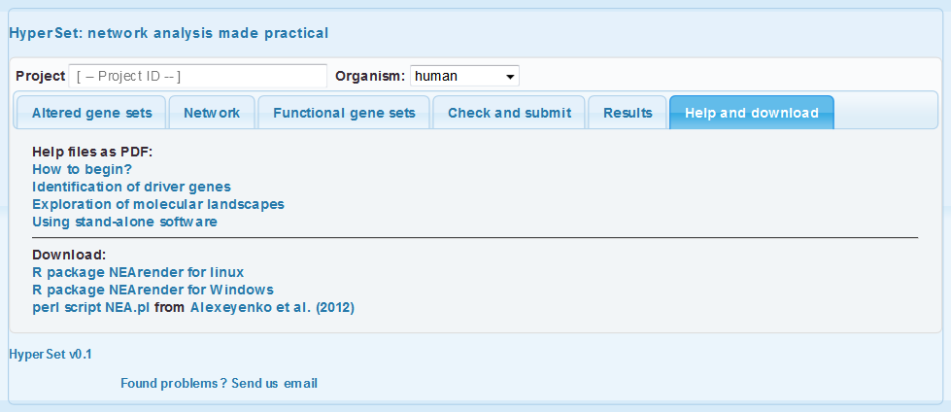
How to use stand-alone R software for NEA?
https://www.evinet.org
The same procedures that run at the web site can be more systematically implemented using the package NEArender. It contains basic functions for network and gene set enrichment analyses, creating, re-formatting, and saving gene set lists, as well as benchmarking the networks.
We now are in the position to identify pathway-level correlates of drug sensitivity, such as these two pathways associated with resistance to lapatinib. Furthermore, this correlation can be traced between two independent drug screens (Barretina et al., 2012 and Garnett et al., 2012). While using original gene expression values, such correlation would be much weaker.
d1 <- "lapatinib"
sc1 <- "Garnett"; sc2 <- "Barretina";
drug1<- Data$CTD$CLIN$DRUGSCREEN[[sc1]];
drug2<- Data$CTD$CLIN$DRUGSCREEN[[sc2]];
expr <- Data$CTD$NEA$top.200.affymetrix1;
usedSamples1 <- commonIdx(drug1, expr, Dir="col")
usedSamples2 <- commonIdx(drug2, expr, Dir="col")
pw1 = "kegg_04115_p53_signaling_pathway";
pw2 = "kegg_00140_steroid_hormone_biosynthesis";
par(mfrow=c(2,2))
plot( expr[pw1,usedSamples1], drug1[d1,usedSamples1], xlab=pw1, ylab=paste("Sensitiivty to ", d1, sep=""), main=sc1)
plot( expr[pw2,usedSamples1], drug1[d1,usedSamples1], xlab=pw2, ylab=paste("Sensitiivty to ", d1, sep=""), main=sc1)
plot( expr[pw1,usedSamples2], drug2[d1,usedSamples2], xlab=pw2, ylab=paste("Sensitiivty to ", d1, sep=""), main=sc2)
plot( expr[pw2,usedSamples2], drug2[d1,usedSamples2], xlab=pw2, ylab=paste("Sensitiivty to ", d1, sep=""), main=sc2)
Download a version of R package NEArender and install it with the usual commands. The only recommendation is to install first the required package ROCR (it might be sensitive to some other dependencies):
We first could create a set of AGS that distinguish each cell line sample in the collection from the others.
Plotting the gene frequency distribution demonstrates that the most of the genes are quite unique (below). Next, we run the network enrichment analysis, analyzing enrichment of each of these cell-line specific AGSs against each of the 330 pathways in the FGS collection:
install.packages(“ROCR");
install.packages("NEArender_1.1.zip");
library(“ROCR");
library("NEArender");
m0 <- Data$CTD$GE$Affymetrix1
AGS<-samples2ags(m0, Ntop=200, method="top", Lowercase = 1)
save_gs_list(AGS, File="CTD.Affy1.top200.txt")
hist(table(unlist(AGS)), breaks=100, main="Gene occurrence in top-200 AGS", xlab="No. of cell lines", ylab="No. of genes")
FGS <- import.gs ("Related_and_CAN_MET_SIG_GO2", Lowercase=1, col.gene = 2, col.set = 3, gs.type = 'f');
NET <- import.net("merged6_and_wir1_HC2");
Data$CTD$NEA$top.200.affymetrix1 <- nea.render(AGS = AGS, FGS = FGS, NET = NET, echo=1, Parallelize=1);
The two pathways seems to have discovered a global trend: correlation coefficients from the two drug screens correlate with each other, too.
plot(
cor(drug1[d1,usedSamples1], t(expr[,usedSamples1]), use="pairwise.complete.obs", method="spearman"),
cor(drug2[d1,usedSamples2], t(expr[,usedSamples2]), use="pairwise.complete.obs", method="spearman"), main=NA, ylab="Pathway-drug correlation in Barretina", xlab="Pathway-drug correlation in Garnett", col=ifelse(rownames(expr) %in% c(pw1, pw2), "red", "grey3"));

Slide 6
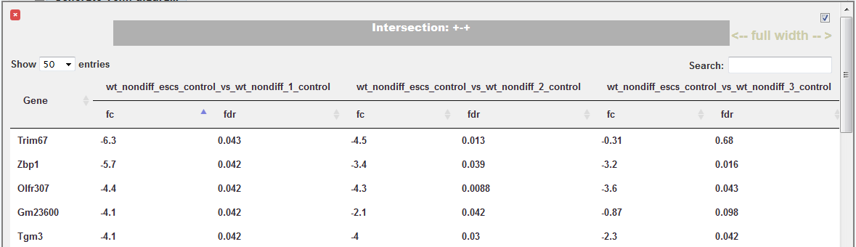
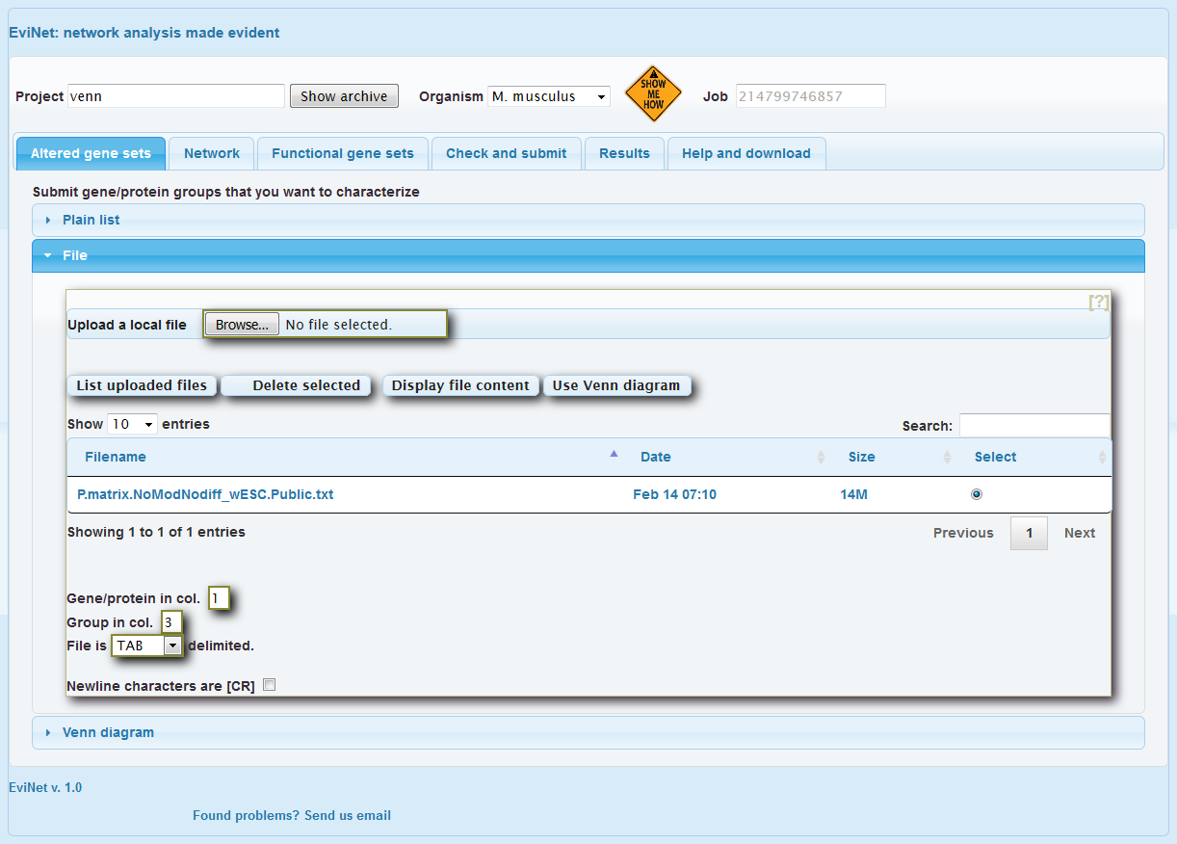
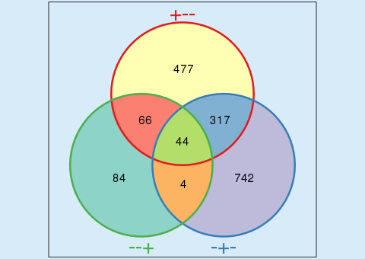
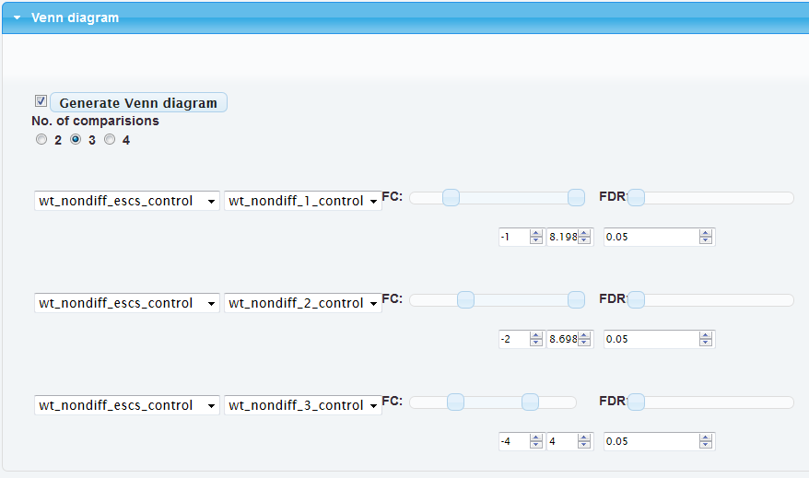
Using Venn diagrams
https://www.evinet.org
The idea of Venn diagram tool is to allow users working with a pre-computed file of differential expression (DE) values. Often, there are more than one contrast (comparison), and preparing DE lists off-line (e.g. in Excel) and then uploading them to EviNet is not very convenient. And again, there are no Venn diagrams in Excel…
First, you have to prepare a file for the upload: it has to have columns that quantify DE and be understood by the header parser.
At the moment, we support only one DE file format, the one currently used in the example in the project “stemcell” and also downloadable from the downloads directory. Note that the file should contain the keyword “.VENN” (or “.venn”).
Given a simplest case of 3 different RNA-seq or microarray samples A, B, and C, your file might have contrasts “A vs. C” and “B vs. C”. And you might have compared “A vs. B” as well, if it fits the idea of your experiment. If you caclulated fold change values and accompanied them with p-values and adjusted p-values (FDR), then the header should have at least the following column headers:
Gene
1
The most important elements here are the delimiters:
condition names should be separated with “vs” and then
the value type (one of FC, P, FDR) is separated with “-”.
FYI, the regular expression for that is
You can have arbitrary delimiters “_” between the words, e.g.
The parser is case-insensitive.
More examples of valid column headers:
The file is submitted in “Altered gene sets” -> “File” -> “Upload local file” by pressing buttons “Display file content” and then “Use Venn diagram”. Be patient, uploading can take time and even get crashed. But as soon as it is done, you can always find it in the same section and quickly read its content with “Use Venn diagram”.
The labeling of diagram areas might look confusing. And it is indeed not trivial to label them without sacrificing readability. We thus propose this convention: labels consist of pluses and minuses which indicate that genes satisfy conditions of respective contrasts (lines of sliders). The order of +/- characters is the same as in the lines. For example,
“+--” means that the genes fell within the criteria of contrast 1,
“WT_Nondiff_ESCs_Control_vs_WT_Nondiff_1_Control”, and did not within those of contrasts 2 and 3.
By clicking at the intersection areas, you can get respective gene tables and clarify this notation even further (watch header labels).
4
3
1
You can pop up an arbitrary number of gene lists: from one to as many as there are non-zero intersections in the diagram. Each of these lists can be automatically sent to NEA (as soon as you have chosen a network and FGS set).
Note: only visible gene lists with box in the upper right corner checked will be treated as AGS.
A tip: you can also filter/sort genes and copy some/all gene symbols with “Ctrl+mouse down” and then use just these by pasting this new list in “Plain list” section above. Do not forget then to uncheck the box near the button “Generate…”. Good luck!
A_vs_C-FC
A_vs_C-p
A_vs_C-FDR
B_vs_C-FC
B_vs_C-p
B_vs_C-FDR
m/^(.+)vs(.+)-(FC|FDR|P)/i
My_promising_A_vs_tough_control_C-FDR
WT_Prog_5(sorted)_Control_vs_WT_Nondiff_ESCs_Control-FC
WT_Prog_5(sorted)_Control_vs_WT_Nondiff_ESCs_Control-p
WT_Prog_5(sorted)_Control_vs_WT_Nondiff_ESCs_Control-FDR
After pressing “Altered gene sets”, you are going to see a set of controls that reflect the content of your DE file.
The ranges of cut-off sliders are defined by min/max values of each column.
Note that the left and right fold change sliders correspond to down/up-regulation, respectively. Their ranges end/begin at 0. In other words, this would only work with log fold change values.
A tip: if you want to only look at down- or only up-regulated genes, then you should set the other (right or left, respectively) slider in its utmost position, as it is done in the 1st and 2nd lines at the screenshot. This trick should filter out any genes with expression change in that direction. The filtering criteria are applied line-wise, i.e. there will be one DE list from contrast “WT_Nondiff_ESCs_Control_vs_WT_Nondiff_1_Control”, where expression pattern of each gene satisfies both the FC and FDR criteria, then another list for “WT_Nondiff_ESCs_Control_vs_WT_Nondiff_2_Control” and yet another for “WT_Nondiff_ESCs_Control_vs_WT_Nondiff_3_Control”.
Overlaps of these three will be reflected at the Venn diagram when you press the button “Generate…”
2

