Slide 1
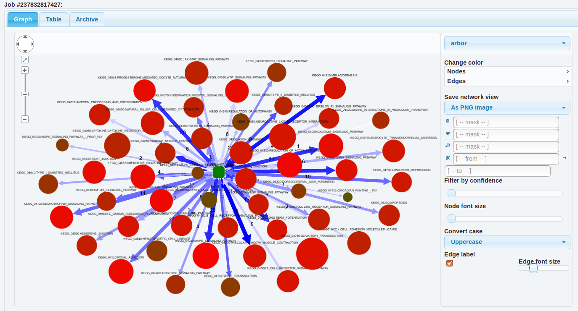
Select various network
layouts from
Drop-down menu
Zoom-in and
zoom-out to
adjust the network
User list (green at the center)
connected to various
pathways from fgs
After all modifications,
save the image
to local computer
Adjust the edge(lines)
confidence
Adjust the
size
of nodes
(circles)
Right click on the
node (circle)
to exclude
from the network
Change the labels
to upper-case
or lower-case

