Slide 1

A Mechanochemical Model for Symmetry Breaking in Hydra Spheroids
Dietmar Oelz
(School of Mathematics and Physics, UQ, Brisbane)
Collaborators:
Alistair Falconer (UQ)
Chiarisios Tsiairis, Sara Weevers, Jaroslav Ferenc (U. Basel)
Moritz Merker, Anna Marcziniak-Czochra (U. Heidelberg)

Slide 2
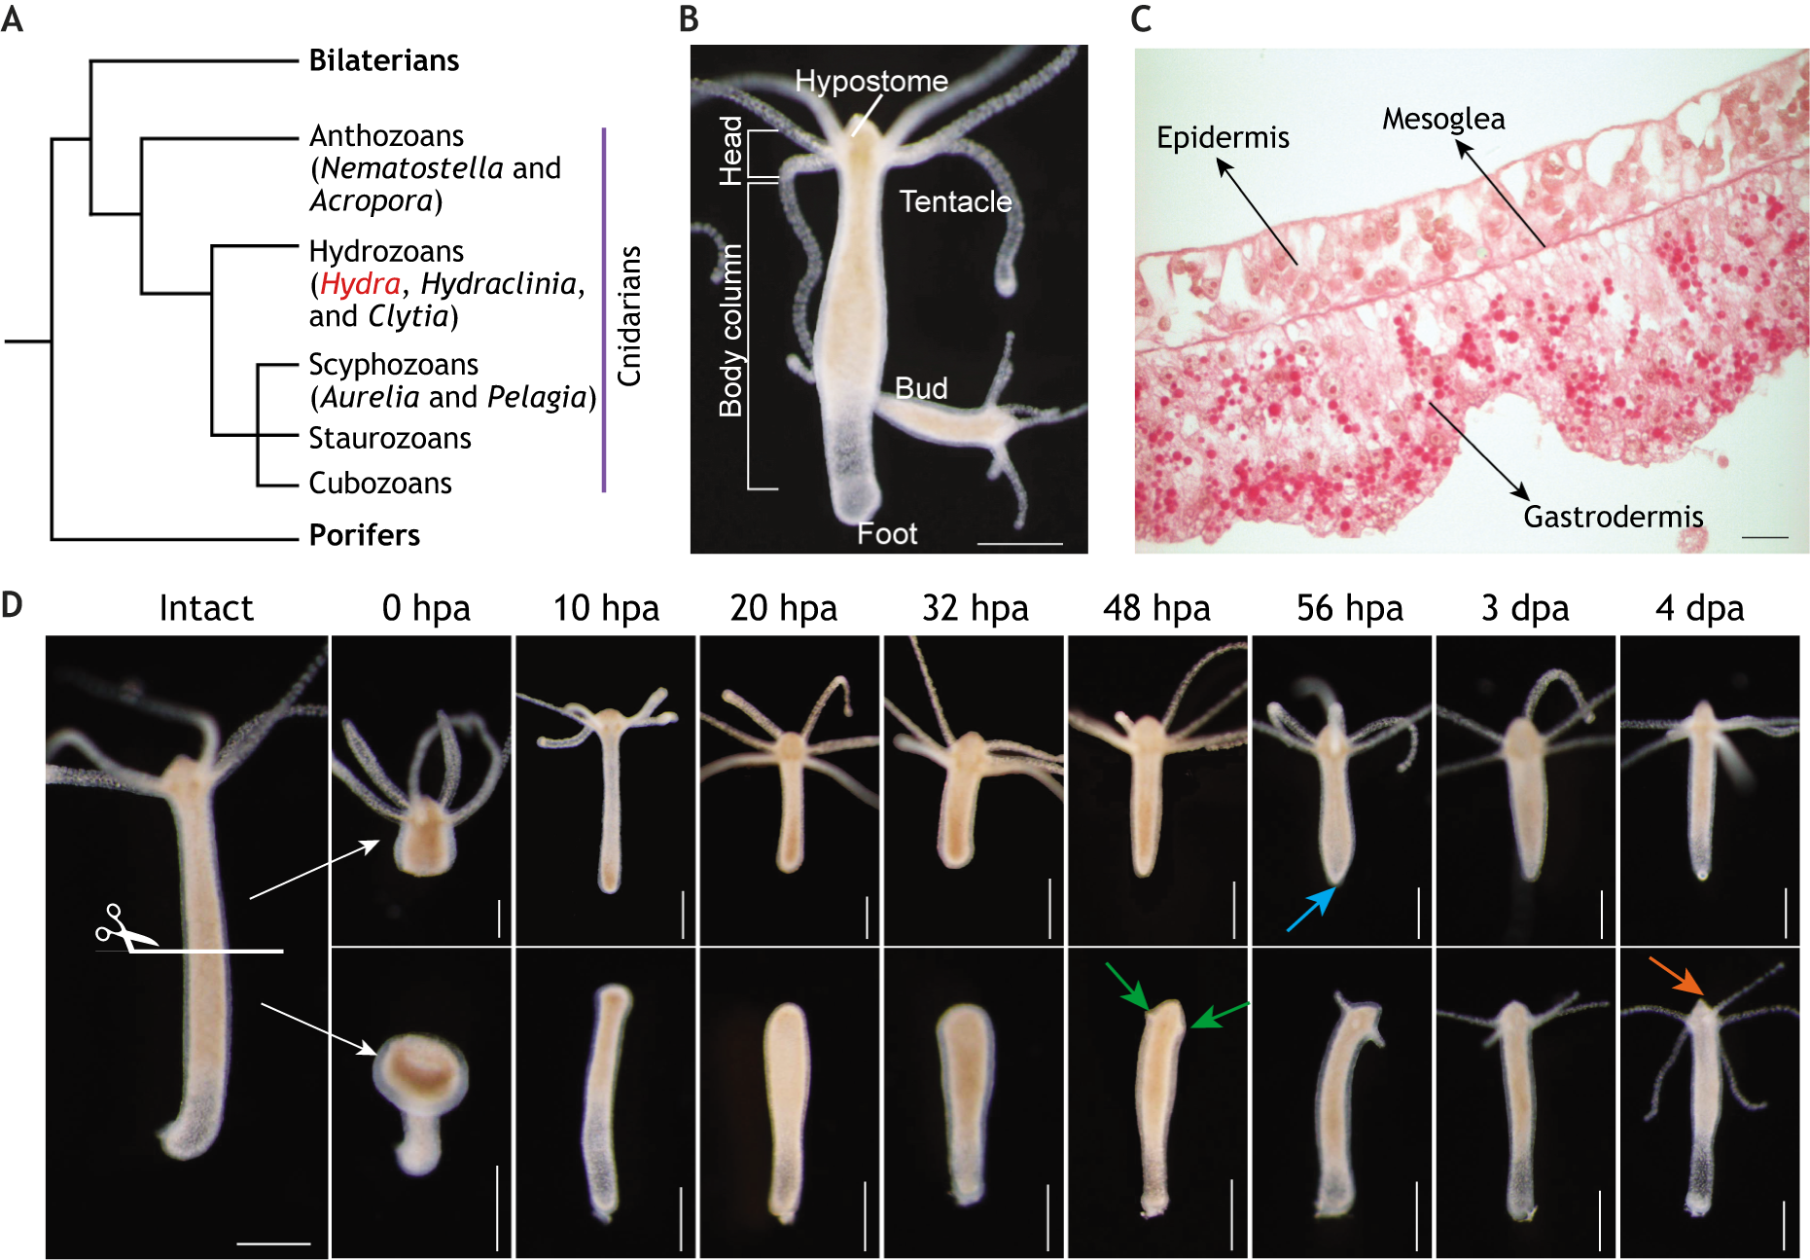
Hydra freshwater polyp
Model system to study pattern formation and regeneration.
Two cell layers (epidermis and gastrodermis) separated by the mesoglea ECM which bears most of the mechanical load.
Matthias C. Vogg,Brigitte Galliot,Charisios D. Tsiairis, Model systems for regeneration: Hydra, Development, 2019, Fig. 1.

Slide 3
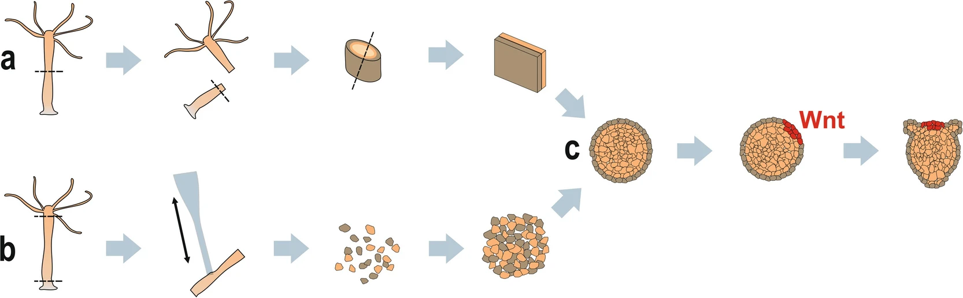
Regeneration experiments
Ferenc, J., Tsiairis, C.D. (2022). Studying Mechanical Oscillations During Whole-Body Regeneration in Hydra. In: Blanchoud, S., Galliot, B. (eds) Whole-Body Regeneration. Methods in Molecular Biology, vol 2450. Humana, New York, NY.

Slide 4
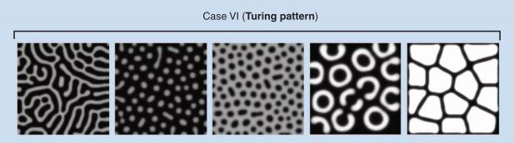
What causes symmetry breaking?
Long range
inhibitor
Turing system
(Gierer-Meinhardt model)
Short range
activator

Slide 5
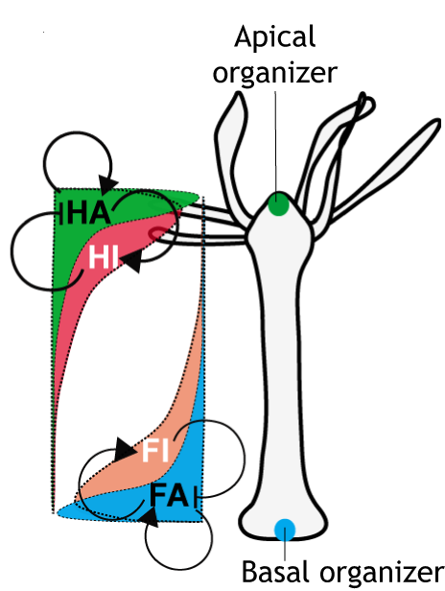
Gierer-Meinhardt system for hydra?
Matthias C. Vogg, Brigitte Galliot, Charisios D. Tsiairis. Model systems for regeneration: Hydra, Development, 2019, Fig. 1.
Hydra:
Wnt 3 is the most likely acts as head activator (HA)
HI (head inhibitor) is not know
Does mechanics play the role of a (long range) inhibitor?
Wnt3 expression is both necessary and sufficient for head organizer regeneration

Slide 6
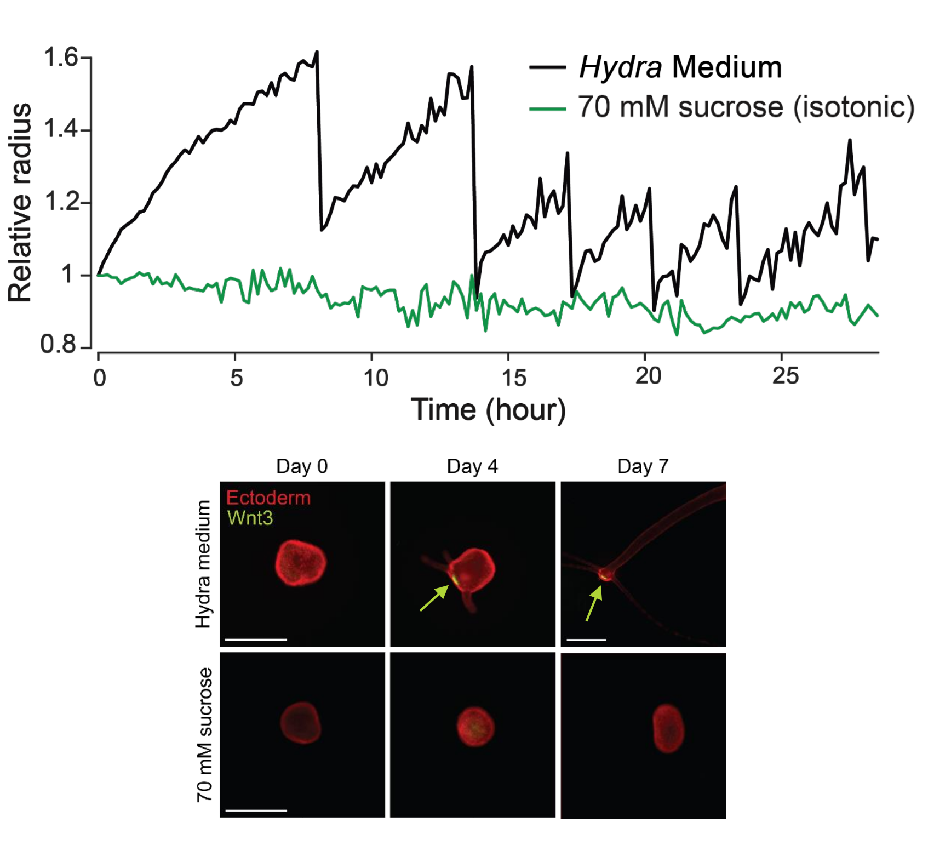
Role of mechanics
Hydra spheroids undergo osmotically driven mechanical oscillations
No oscillations in isotonic medium
Without oscillations
  no symmetry breaking
  No regeneration
Jaroslav Ferenc et al. ,Mechanical oscillations orchestrate axial patterning through Wnt activation in Hydra.Sci. Adv.7,eabj6897(2021)

Slide 7
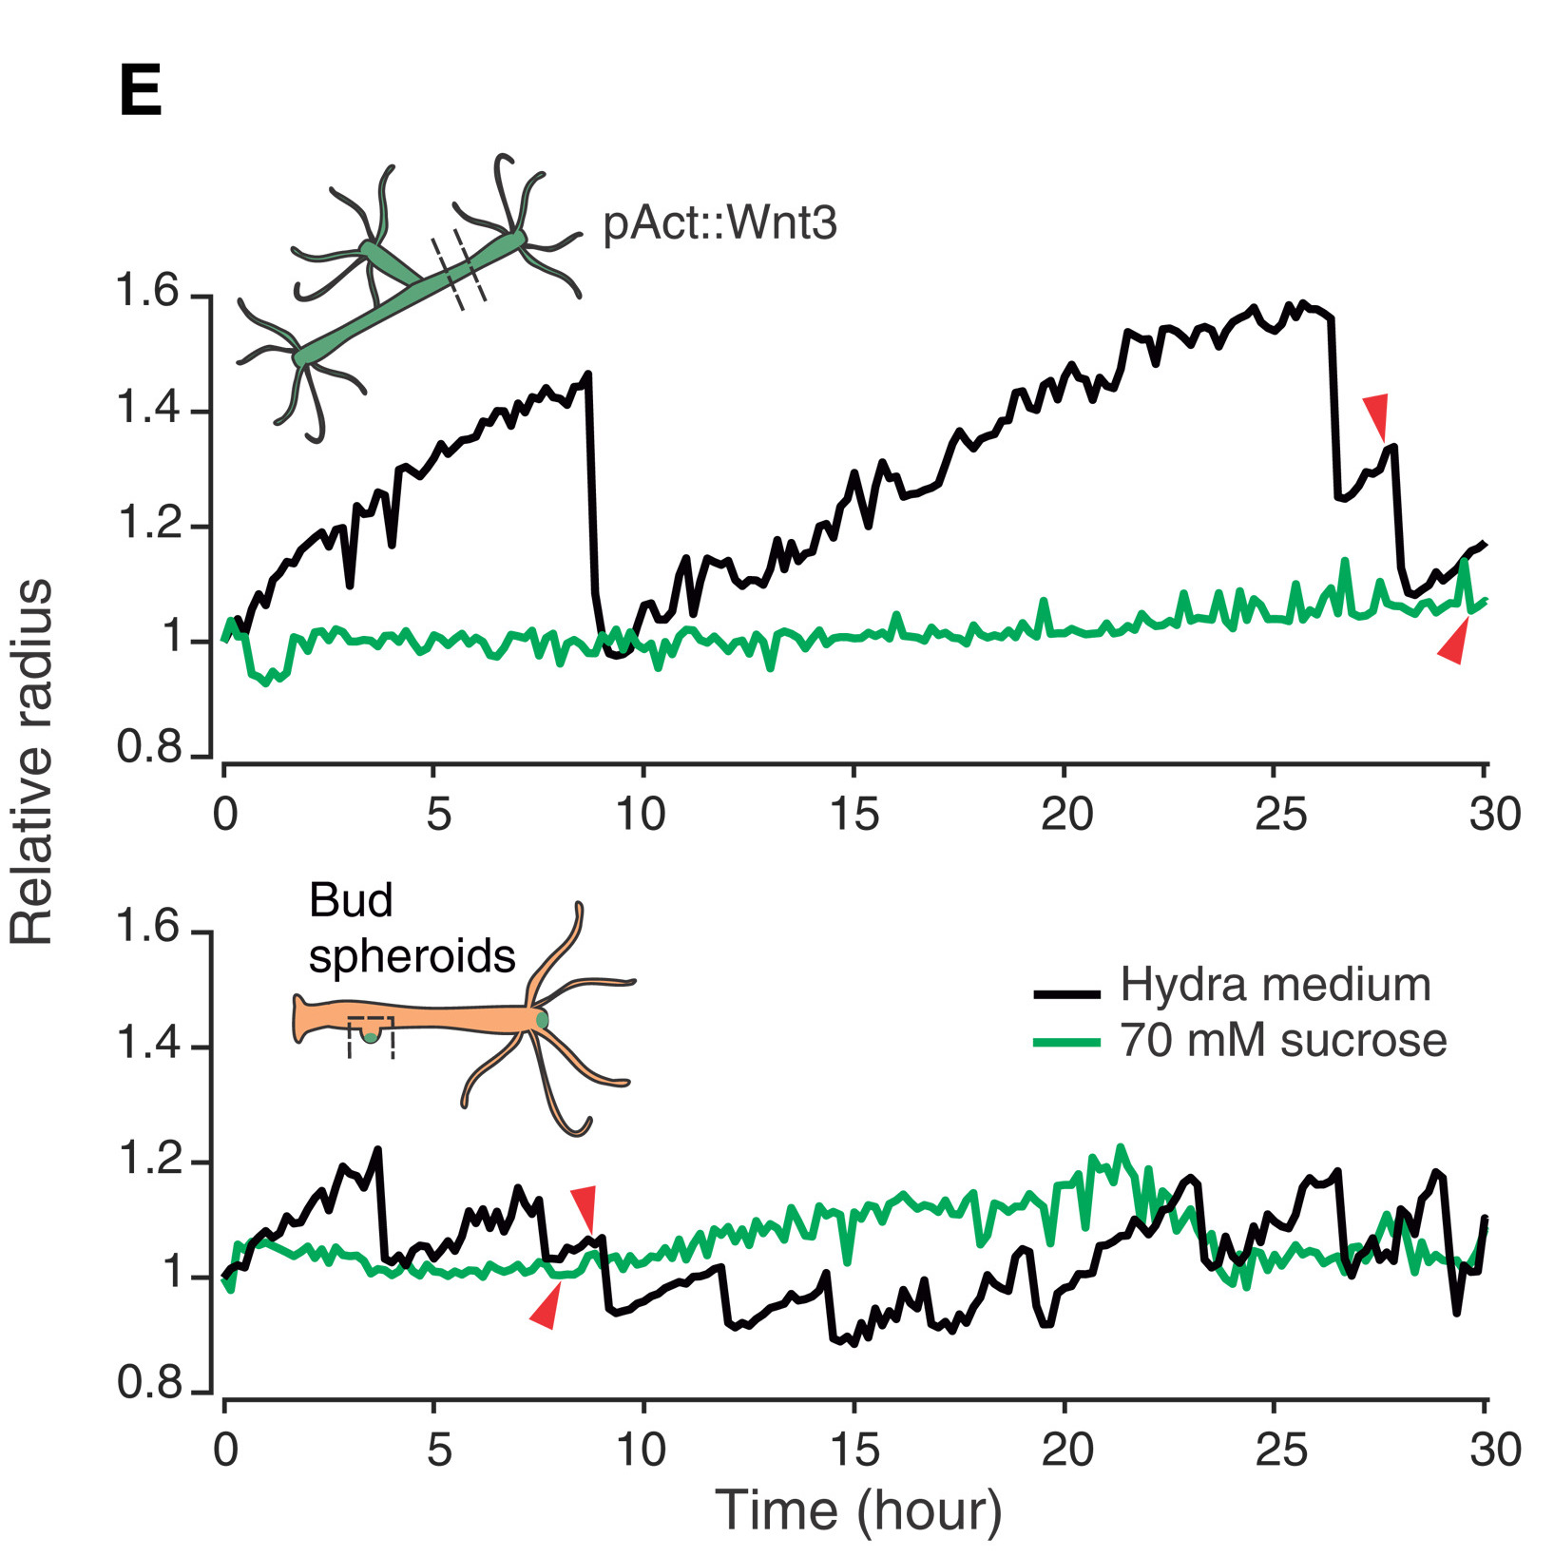
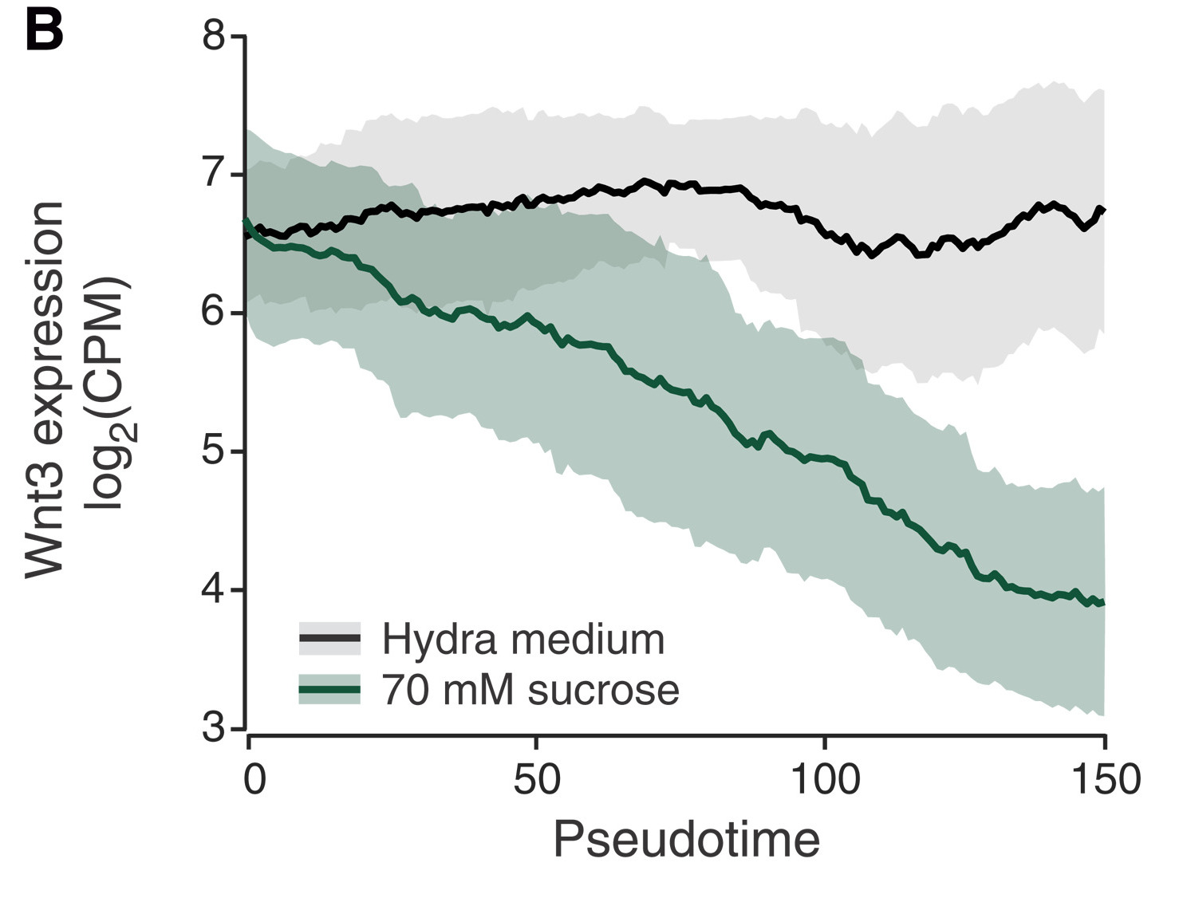
Wnt3 overexpressing hydra regenerates without stretching
Red arrow: time of emergence of first tentacle).
Wnt3 over-expressing transgenic hydra.
Spheroids generated from buds.
Wnt3 transcription is correlated with tissue stretching
Tissue stretching up-regulates Wnt3
Jaroslav Ferenc et al., Mechanical oscillations orchestrate axial patterning through Wnt activation in Hydra.Sci. Adv.7,eabj6897(2021)

Slide 8
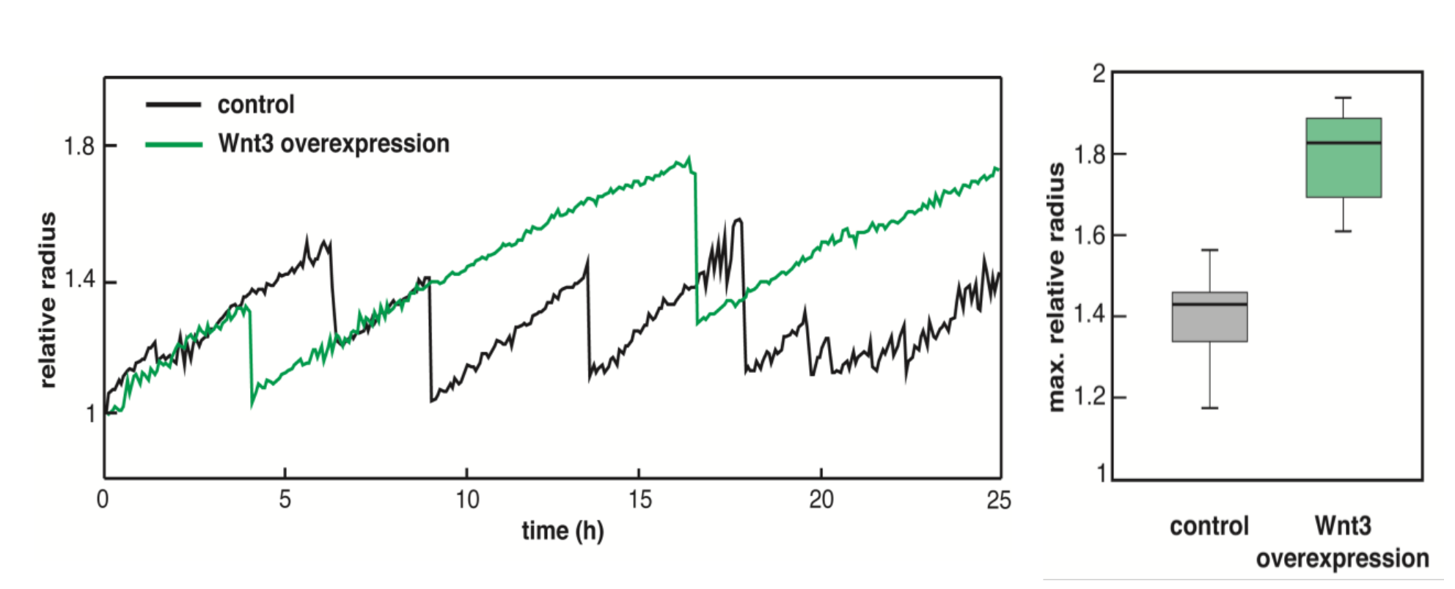
More stretch in spheroids with high levels of Wnt signalling
Jaroslav Ferenc
→ Wnt3 reduces the stiffness (elastic modulus) of the tissue.

Slide 9
Local positive feedback
Stretch (strain ε)
Modelling assumptions:
Hydra is a closed, approximately spherical surface characterised by strain ε and morphogen concentration φ.
Hydra is stretched with fixed volume (neglect oscillation)
Strain upregulates the morphogen
The elastic modulus decreases in the presence of the morphogen
Wnt signalling
(morphogen φ)

Slide 10
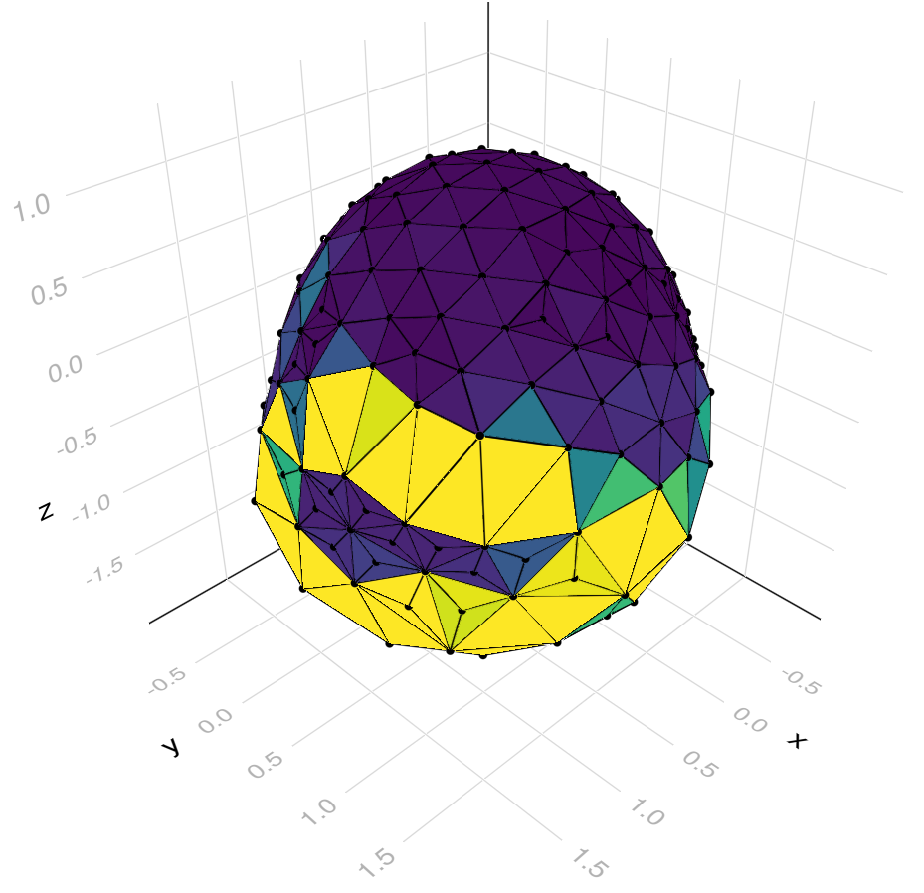
Full 3D mechanochemical model
A. Falconer (UQ)
Elastic closed surface (elastic shell) coupled to the morphogen concentration

Slide 11
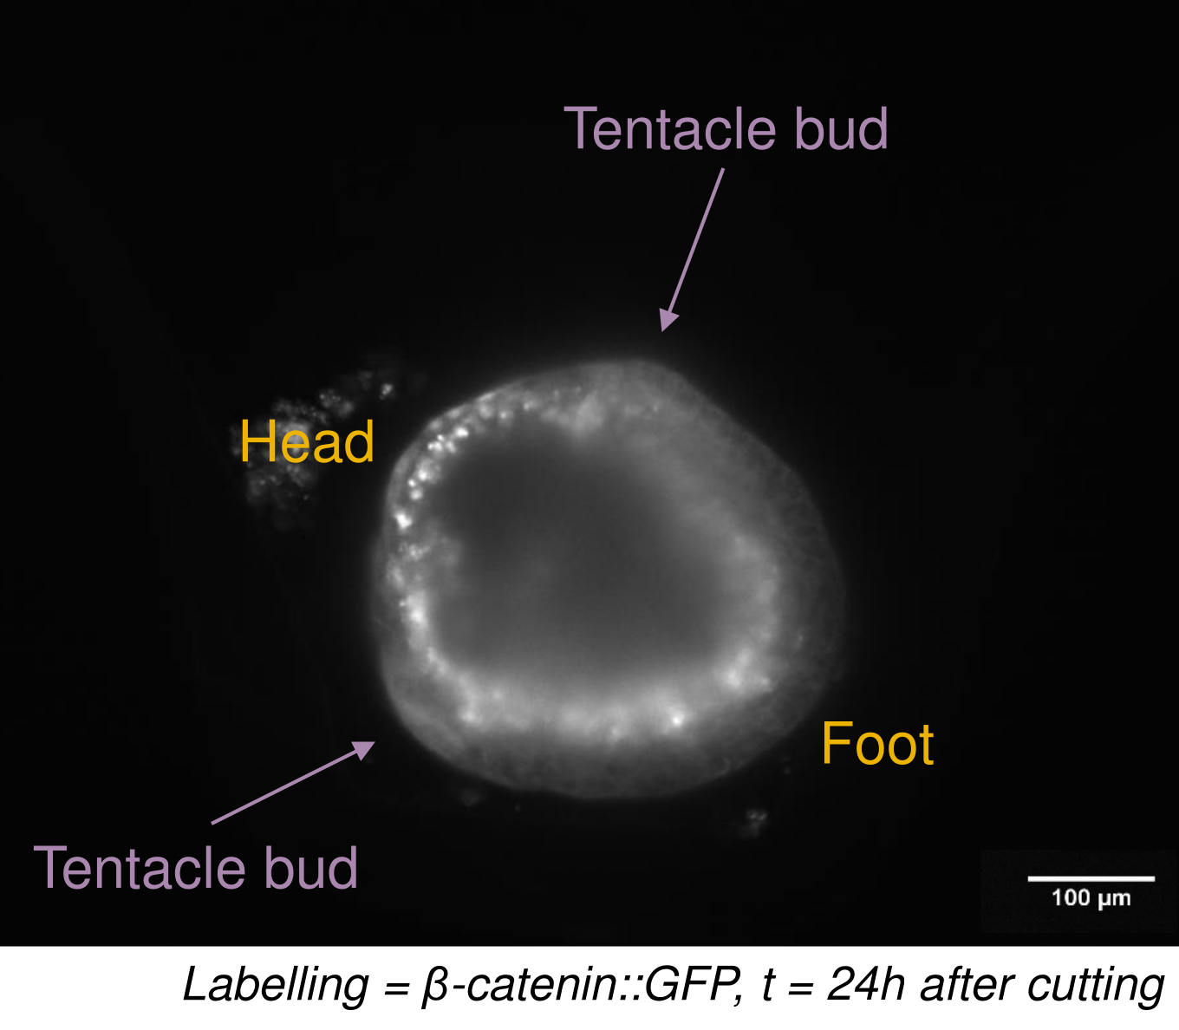
Symmetry breaking
Sera Weever
The head domain has
Wnt signalling
Significantly lower tissue thickness

Slide 12
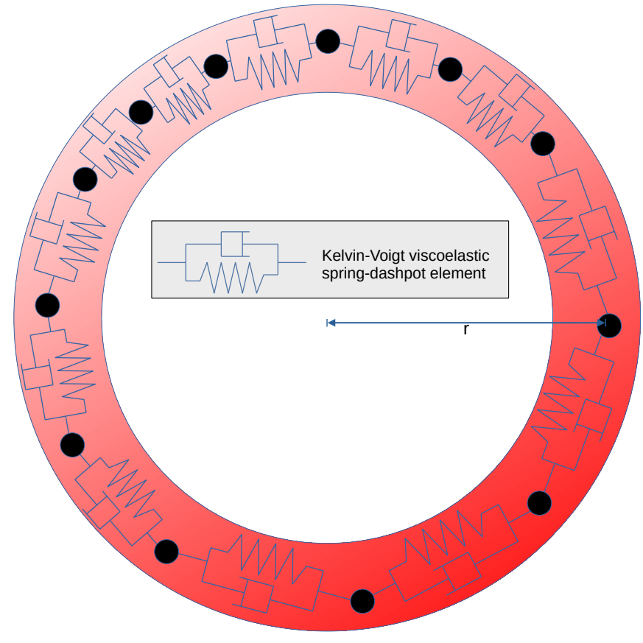
1D toy model
Constraint: circular shape with radius r>R.

Slide 13
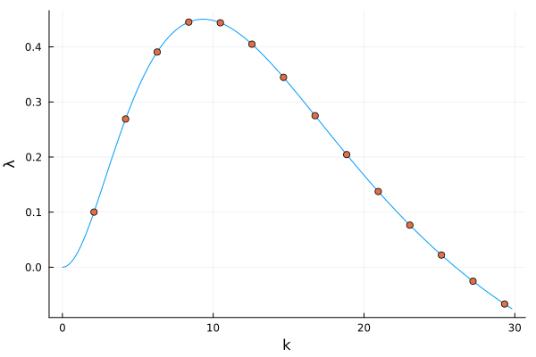
(In)stability analysis
If ξ>0 (friction):possibly many peaks appear

Slide 14
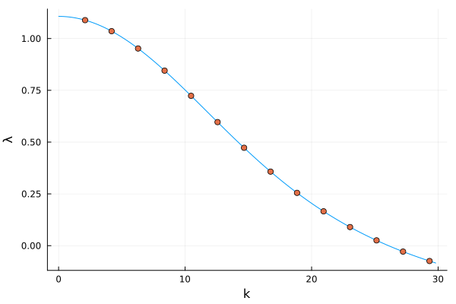
(In)stability analysis
If ξ=0 (no friction): only one morphogen peak

Slide 15
Interpretation
Strain ε:
Short range activator
Long range inhibitor
Strain ε:
Short range activator
Long range inhibitor
Morphogen φ:
Short range activator
Morphogen φ:
Short range activator
Flux: strain flows in the direction in which the morphogen concentration increases → positive feedback from the morphogen

Slide 16
Conclusion - Summary
Mechanochemical model for symmetry breaking based on
  Positive feedback between strain (stretching) and morphogen (Wnt3)
  Overall conservation of strain leads to long range inhibition
Implications
  Strain (through osmotic fluid influx) is necessary for pattern formation (consistent with observations)
  This model explains that there is only one Wnt3 focus (Turing model predicts multiple foci depending on spheroid size).
  There is a minimal size for symmetry breaking

Slide 17




Thank you
My collaborators:
Alistair Falconer (UQ)
Chiarisios Tsiairis, Sara Weevers, Jaroslav Ferenc (U. Basel)
Moritz Merker, Anna Marcziniak-Czochra (U. Heidelberg)
ARC Discovery Grant (DP180102956).

Slide 18
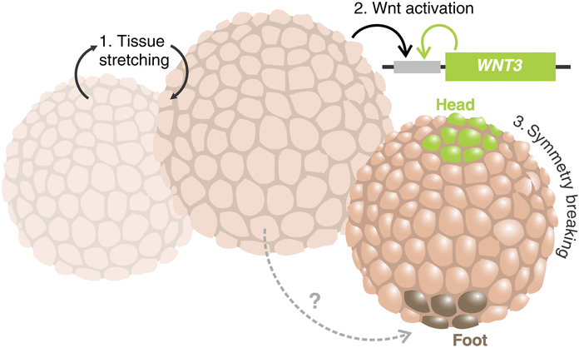
Jaroslav Ferenc et al., Mechanical oscillations orchestrate axial patterning through Wnt activation in Hydra.Sci. Adv.7,eabj6897(2021)

Slide 19
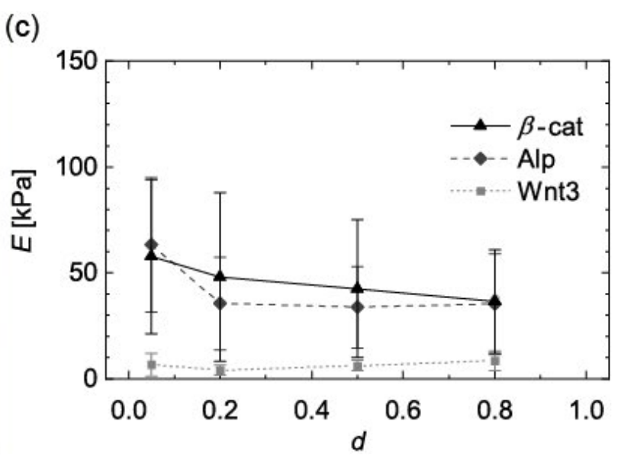
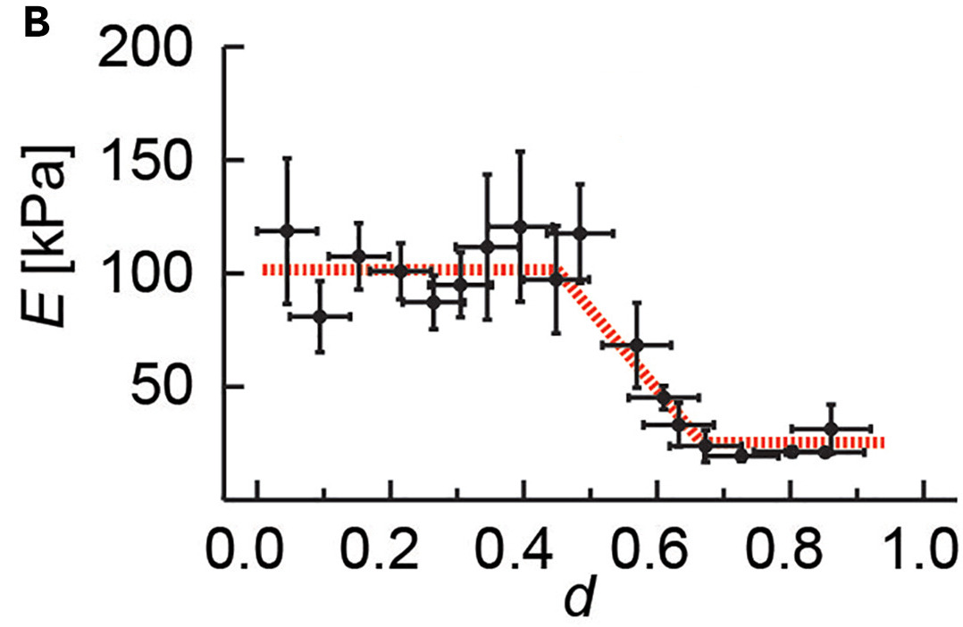
Wnt/β-catenin signalling causes softening of the ECM
Elastic modulus E between 0.0 (foot domain) to 1.0 (head domain) at age t=2-3days
Wnt3 overexpression: cells can stretch more (reduced elastic modulus)
M. Veschgini, Motomu Tanaka, et al.: Wnt/β-catenin signaling induces axial elasticity patterns of Hydra extracellular matrix, iScience, Volume 26, Issue 4, 2023,

Slide 20
Wnt3 overexpressing hydra regenerates without oscillations
The presence of Wnt3 without stretching is sufficient for emergence of tentacles/bud spheroids
(red arrow: time of first emergence).
Wnt3 over-expressing transgenic hydra.
Wnt3 transcription is correlated with tissue stretching
Spheroids generated from buds.
Tissue stretching up-regulates Wnt3
Jaroslav Ferenc et al., Mechanical oscillations orchestrate axial patterning through Wnt activation in Hydra.Sci. Adv.7,eabj6897(2021)
without oscillations no regeneration and no Wnt3 foci
Tissue grafts from close to head require more osciallations before symmetry breaking - probably due to inhibitory property of that tissue (inhibitory axial gradient)
in lower osmolarity solutions: symmetry breaking occurs after smaller number of osciallatios - keeping the amount x duration of stretching mol constant. -> consistent with model prediction

