Slide 1


Road Accident Monitoring and Emergency Response System
BY
Aditya Dhankar(2300681530006)
Arpit (2300681530024)
Arpit Nirwal (2300681530026)
Avnish Kumar Singh(2300681530034)
Bachelors of Technology
Department of Computer Science and Engineering (Artificial Intelligence & Machine Learning)
Meerut Institute of Engineering & Technology, Meerut
DR. APJ ABDUL KALAM TECHNICAL UNIVERSITY ,Lucknow
(July, 2026)

Slide 2
Introduction
Road accidents remain one of the leading causes of fatalities worldwide.
A large number of victims lose their lives not because of the accident itself, but because emergency assistance does not reach them during the Golden Hour.
Most existing emergency systems depend on the victim manually requesting help.
However, in severe accidents, victims may become unconscious or physically unable to use their mobile phones.
To overcome this limitation, this project introduces an intelligent accident response system capable of automatically detecting accidents using smartphone sensors.
It initiates emergency assistance without requiring any user interaction.

Slide 3
Literature Review
Ref | Author & Year | Domain & Methodology | Core Contribution | Key Limitations & Research Gap
[1] | Sahoo et al. (IEEE, 2022) | Smartphone Accelerometer + GPS | Impact threshold detection & auto-SMS | High false alarms on phone drops; no user cancellation timer.
[2] | Kim & Lee (IEEE Sensors J., 2023) | Multi-Sensor Fusion (Accel + Gyro + SVM) | 94.5% precision in crash classification | No community volunteer geo-broadcasting or authority sync.
[3] | Patel & Mehta (IEEE IoT J., 2023) | Real-time Mobile Sensor Stream | Feature extraction for motion anomalies | Requires continuous internet; fails under offline SMS modes.
[4] | Garg et al. (IJARCCE, 2022) | Computer Vision & Traffic CCTV YOLO | Intersection collision detection | Limited to CCTV blind spots & rural roads; cannot notify personal contacts.
[5] | Dahiya et al. (IEEE T-ITS, 2020) | Deep Learning Two-Wheeler Safety | Helmets & impact classification | Focuses solely on two-wheelers; lacks live GPS streaming.
[6] | Zhang et al. (ECCV, 2022) | ByteTrack Multi-Object Tracking | Trajectory tracking during occlusion | Heavy memory usage; no integrated mobile emergency alerting.
[7] | Kumar et al. (IEEE, 2025) | MPU6050 + Ultrasonic + Arduino IoT | In-vehicle embedded hardware unit | High hardware deployment cost; difficult to retrofit into existing vehicles.
[8] | Fang et al. (Elsevier, 2024) | Vision-Based Collision Anticipation | Spatial-temporal crash forecasting | Purely analytical; lacks post-crash dispatch & geohashed alert pipeline.
[9] | DSGF-YOLO (MDPI, 2025) | Lightweight Neural Network | Accident severity classification | Pipeline-only model; lacks mobile sensor validation & instant SMS.
[10] | ARMS Model (IEEE Access, 2024) | Multi-Stream Deep Learning | Mixed-traffic intersection monitoring | Effective only at urban junctions; cannot pinpoint victim GPS coordinates.

Slide 4

Paradigm Shift: Legacy vs. Proposed RoadSOS
Feature Dimension | Legacy / Manual SOS Applications | Proposed RoadSOS Framework
User Intervention | High: Requires conscious victim to physically press button | 100% Zero-Interaction: Runs autonomously in background
Sensor Validation | Single Sensor: Raw accelerometer triggers false alerts | Multi-Sensor Fusion: Accel + Gyroscope + GPS Speed
False Alarm Prevention | None: Immediately dispatches unverified emergency calls | 10s Grace Window: User can cancel accidental drops
Location Tracking | Static: Sends a single, one-time SMS coordinate link | Continuous Streaming: Real-time WebSockets tracking link
Community Integration | None: Notifies only stored emergency personal contacts | Geohashed Network: Alerts nearby Good Samaritans
Authority Monitoring | None: No direct integration with traffic police dispatchers | Police Dashboard: Centralized React command portal

Slide 5
Research Gaps
Most existing systems require the victim to manually press an SOS button or make a phone call.
They are ineffective when the victim is unconscious or seriously injured.
Single-sensor detection methods often generate false alarms due to sudden phone movements or accidental drops.
Existing applications provide limited integration with emergency responders and community volunteers.
Most systems only notify emergency contacts and do not support real-time monitoring by authorities.

Slide 6
Challenges
Accurate detection of genuine accidents while avoiding false positives.
Reliable real-time location sharing.
Fast communication with emergency contacts.
Efficient coordination with nearby volunteers and police authorities.
Maintaining user privacy and data security during emergencies.

Slide 7
Aims & Objectives
To design a system for real-time accident monitoring .
To detect accidents using gyroscope and motion-based techniques .
To identify sudden orientation changes indicating a crash .
To implement a user confirmation mechanism before sending alerts .
To allow user response within a fixed time interval of 15 to 30 seconds .
To send SOS alerts if no response is received from the user .
To provide accurate location tracking using GPS .
Broadcast alerts to nearby registered volunteers.
Provide a web-based dashboard for police monitoring.
Improve emergency response time and increase survival chances during the Golden Hour.

Slide 8
Methodology / System Architecture
Smartphone sensors continuously monitor vehicle movement.
Sensor readings are analysed in real time.
Multiple conditions are verified before confirming an accident.
A 10-second cancellation countdown is displayed.
If the alert is not cancelled:
• Emergency SMS messages are sent.
• Live GPS location is shared.
• Nearby volunteers receive notifications.
• Police dashboard is updated.
Live location continues to be streamed until the emergency is resolved.
Results are displayed on a real-time monitoring dashboard .

Slide 9
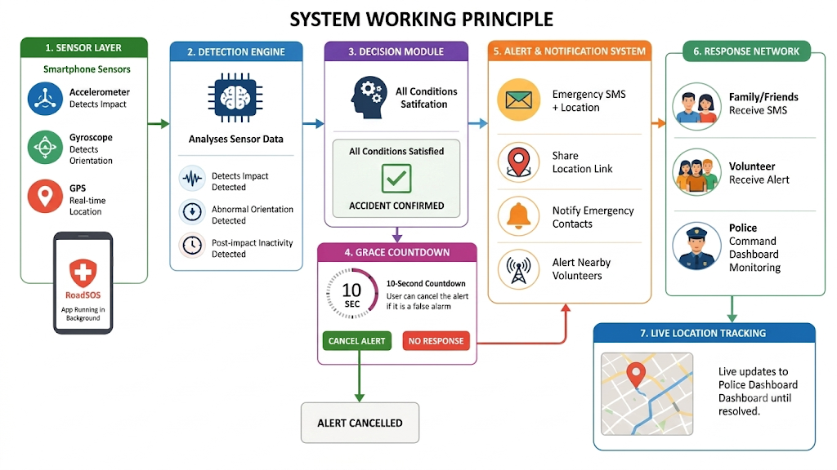

Slide 10
Technology Stack
Real-Time Communication | Socket.IO
Backend Services | Flask (Python)
Volunteer Network | Geohash-based geo-fencing
Police Dashboard | Frontend React (Vite)
Mapping | OpenStreetMap / Google Maps API
Location Services | Android Location APIs
Messaging | Android SMS Manager APIs
AI Severity Pipeline | Ultralytics YOLO (pipeline-ready)

Slide 11





Targeted Performance Metrics & Expected Outcomes
> 96.21%
< 3.51%
< 4.0s
< 500ms
Accident Detection Precision
False Alarm Rate (10s Grace)
Emergency SMS Latency
WebSockets Telemetry Delay
Expected System Impact
Golden Hour Reduction: Reduces critical medical arrival times from 35 minutes down to 10–12 minutes.
First Aid Deployment: Nearby registered Good Samaritans arrive within 2–3 minutes to stabilize victims.
Police Visibility: Command centers gain full real-time visibility over high-risk collision points in their jurisdiction.

Slide 12
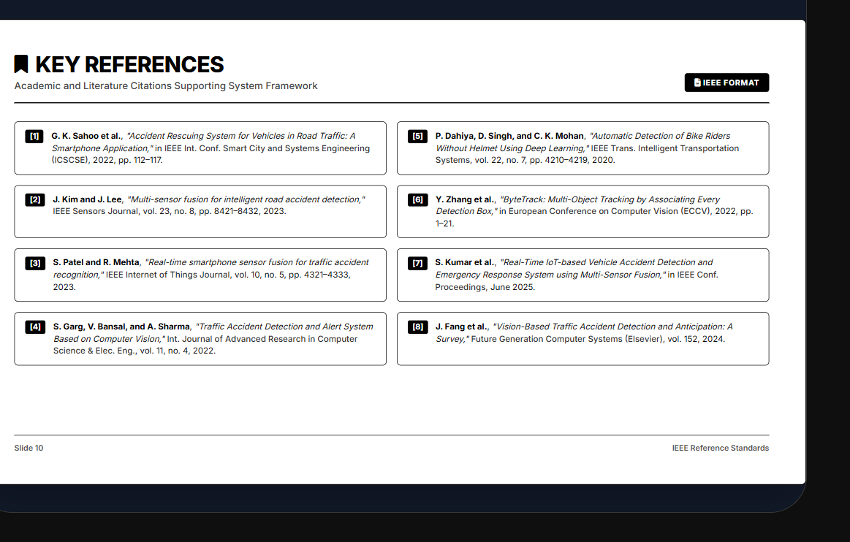
KEY REFERENCES
Academic and Literature Citations Supporting System Framework
G. K. Sahoo et al., "Accident Rescuing System for Vehicles in Road Traffic: A Smartphone Application," in IEEE Int. Conf. Smart City and Systems Engineering (ICSCSE), 2022, pp. 112–117.
P. Dahiya, D. Singh, and C. K. Mohan, "Automatic Detection of Bike Riders Without Helmet Using Deep Learning," IEEE Trans. Intelligent Transportation Systems, vol. 22, no. 7, pp. 4210–4219, 2020.
J. Kim and J. Lee, "Multi-sensor fusion for intelligent road accident detection," IEEE Sensors Journal, vol. 23, no. 8, pp. 8421–8432, 2023.
Y. Zhang et al., "ByteTrack: Multi-Object Tracking by Associating Every Detection Box," in European Conference on Computer Vision (ECCV), 2022, pp. 1–21.
S. Patel and R. Mehta, "Real-time smartphone sensor fusion for traffic accident recognition," IEEE Internet of Things Journal, vol. 10, no. 5, pp. 4321–4333, 2023.
S. Kumar et al., "Real-Time IoT-based Vehicle Accident Detection and Emergency Response System using Multi-Sensor Fusion," in IEEE Conf. Proceedings, June 2025.
S. Garg, V. Bansal, and A. Sharma, "Traffic Accident Detection and Alert System Based on Computer Vision," Int. Journal of Advanced Research in Computer Science & Elec. Eng., vol. 11, no. 4, 2022.
J. Fang et al., "Vision-Based Traffic Accident Detection and Anticipation: A Survey," Future Generation Computer Systems (Elsevier), vol. 152, 2024.

