Slide 1
FOOD ORDERING SYSTEM
MADE BY
AVEEK DEY
URK17CS302

Slide 2
INTRODUCTION
An ordering system is referred to as a set of detail methods that is being used in handling the ordering process. Food ordering can be computerized or done manually. Thos helps the customer to order their food themselves which is known as the customer self-ordering system.
The customer self-ordering system can be defined as a computerized system that is being used by customers to place their own orders in the restaurant .
It is known globally that, in today’s market, it is extremely difficult to start a new small-scale business and live-through the competition from the well-established and settled owners. In fast paced time of today, when everyone is squeezed for time, the majority of people are finicky when it comes to placing a food order

Slide 3
MOTIVATION
The motivation for designing this program came because I personally do not like waiting for long in the restaurant or to have to call store to place an order especially during the peak lunch or dinner hours. Moreover, I value recent learning about the python Programming language as well as seeing how powerful and dynamic they are when it comes to designing programs. The languages used to build this application are python at client facing whereas MYSQL database at the back-end because I found them to be extremely useful while working on the technologies.

Slide 4
PROBLEM STATEMENT
DUE TO GROWING OF THE INDUSTRY SECTOR
As industries are fast expanding, people are seeking for more ways to purchase products with much ease and still maintain cost effectiveness. The vendors need to purchase the products in order to sell to end users. The manual method of going to their local food sales outlets to purchase food is becoming obsolete and more tasking

Slide 5
POTENTIAL TO INCREASE COST OF OPERATION
The cost of operation of a restaurant will be increase from days to days because of the economic inflation. When the inflation comes in, the cost for each and every fresh ingredient that used to support the restaurant daily operation will be affect too. Therefore, the restaurants have to make changes to the food price accordingly in order to maintain the profit, and then all the food menu cards have to reprint to reflect the updated price. By doing so, it will raise the cost of operation to the restaurant because we will not know how frequent the inflation occur in the economy. Next, if the physical areas of the restaurants are very large. It might need to employ extra worker in order to serve their value customer and thus it will increase the cost of operation too.

Slide 6
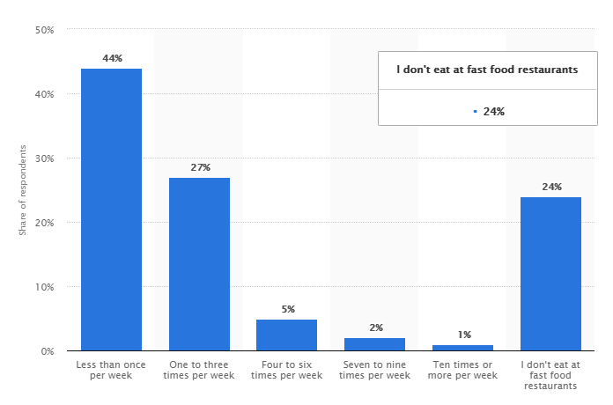

Slide 7
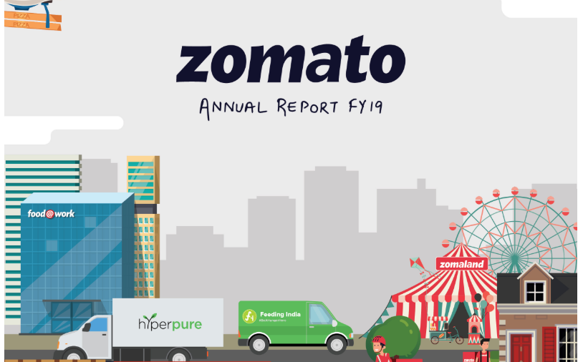

Slide 8
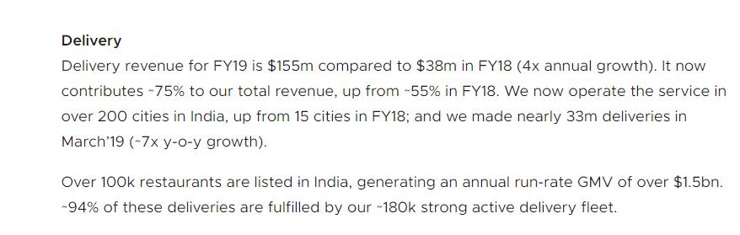

Slide 9
TOOLS USED
MYSQL
MySQL is an open-source relational database management system. Its name is a combination of "My", the name of co-founder Michael Widenius's daughter, and "SQL", the abbreviation for Structured Query Language

Slide 10
PYTHON
Python is an interpreted, high-level, general-purpose programming language. Created by Guido van Rossum and first released in 1991, Python's design philosophy emphasizes code readability with its notable use of significant whitespace.

Slide 11
SQL CONNECTOR
MySQL Connector/Python enables Python programs to access MySQL databases, using an API that is compliant with the Python Database API Specification v2.0 (PEP 249). It is written in pure Python and does not have any dependencies except for the Python Standard Library

Slide 12
XAMPP
XAMPP is a free and open-source cross-platform web server solution stack package developed by Apache Friends, consisting mainly of the Apache HTTP Server, MariaDB database, and interpreters for scripts written in the PHP and Perl programming languages.

Slide 13
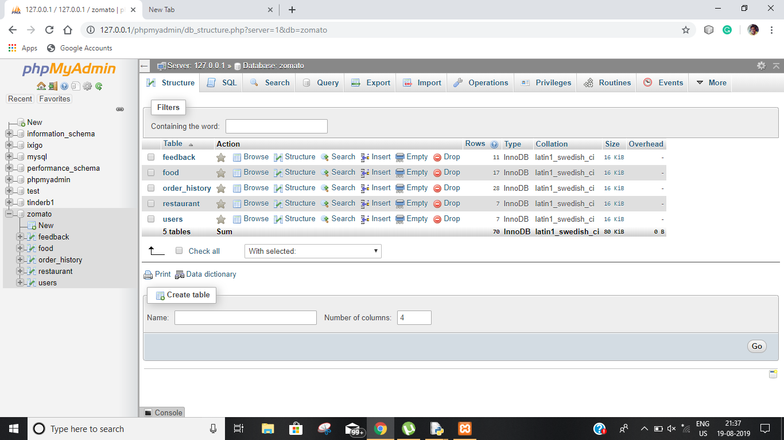
DATABASE

Slide 14
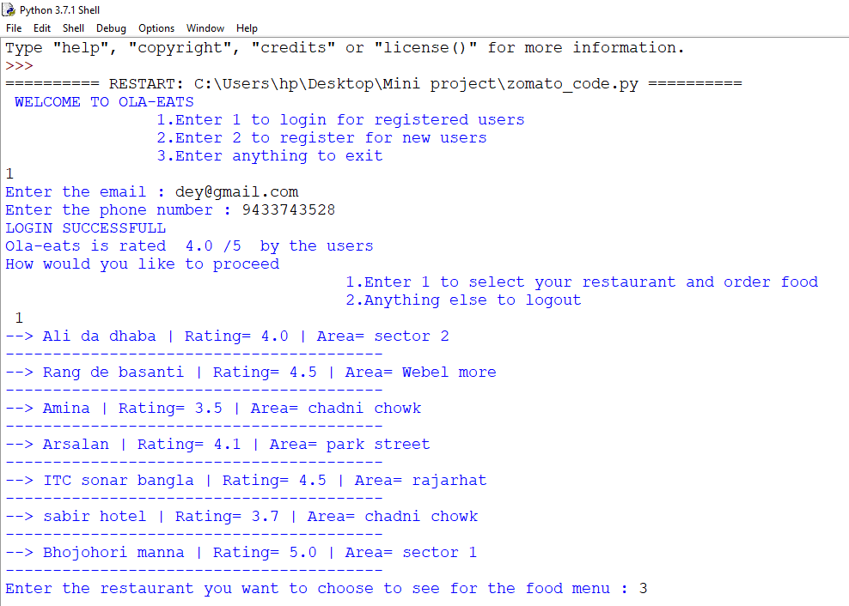
OUTPUT

Slide 15
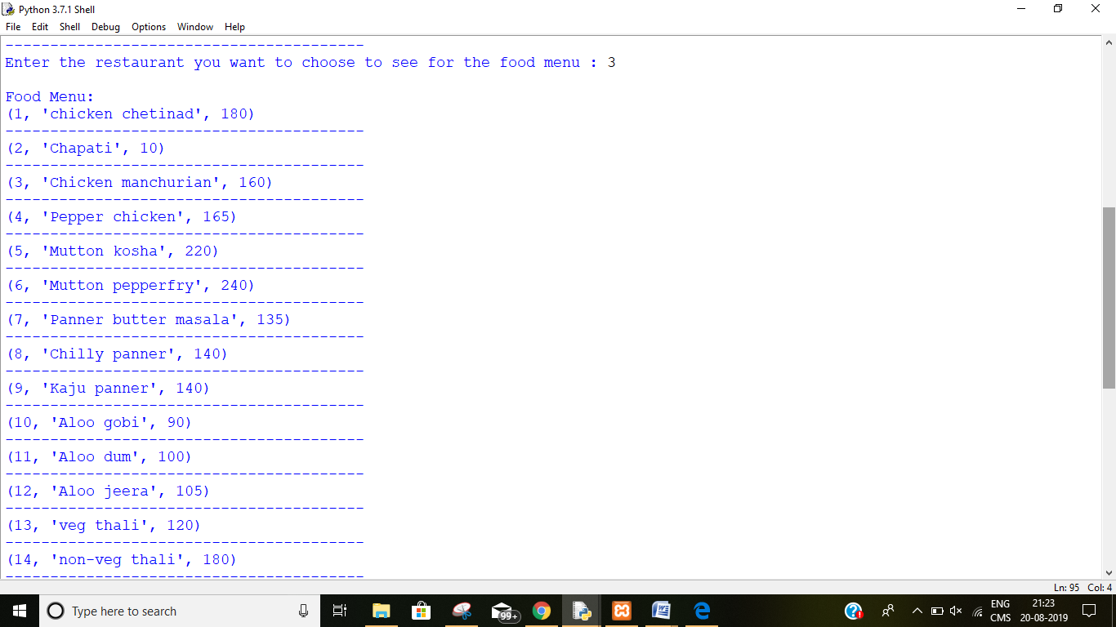

Slide 16
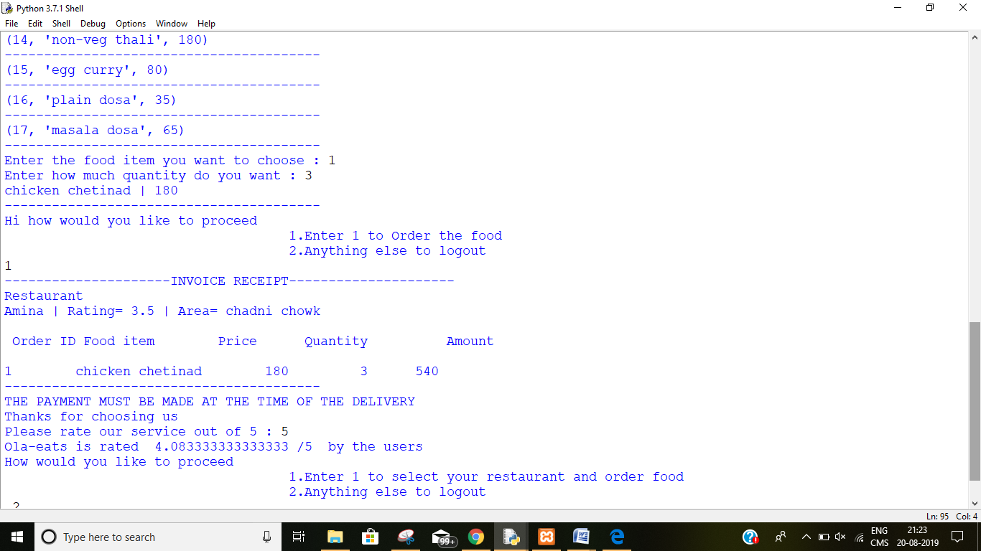

Slide 17
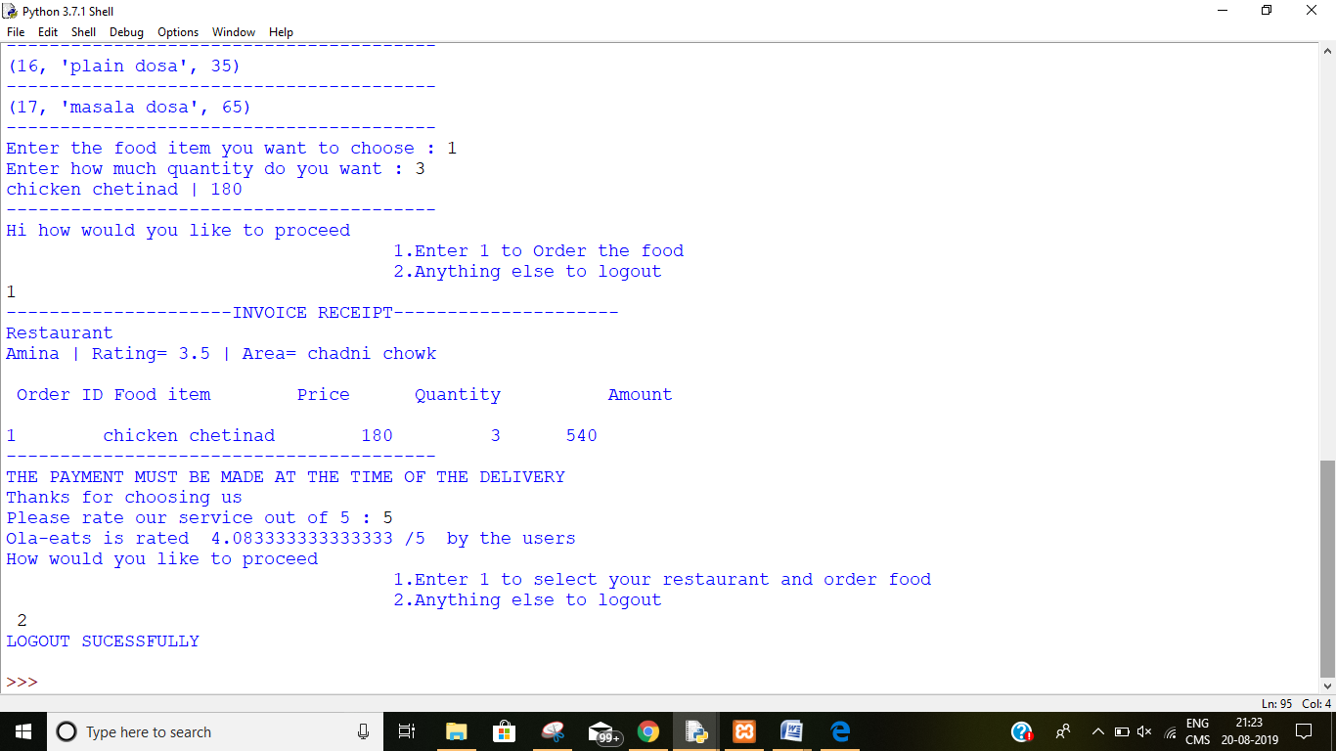

Slide 18
FURTHER SCOPE
Making it into graphical user interface .The system can implement a feature which is real time notification from the mobile phone application to the service desk. This feature enable customer to request customer service through using the mobile application rather than verbally call restaurant staff to approach them. In addition, the mobile application also can implement a feature that allow customer to update the food serve status. For example, customers fine dining at the restaurant they can request the food to be serve through using the mobile application and if the customer finish the main course and feeling full, the customer may request do not serve the following food through using the mobile application. Allow customers to customize food orders . Enhance User Interface by adding more user interactive features. Provide Deals and promotional Offer details to home page. Provide Recipes of the Week/Day to Home Page . Payment Options: add online payment option such as PayPal, Cash, Gift Cards etc. Allow to save payment details for future use. Allow to process an order as a Guest .Delivery Options: Add delivery option . Order Process Estimate: Provide customer a visual graphical order status bar .Order Status: Show only Active orders to Restaurant Employees. .Order Ready notification: Send an Order Ready notification to the customer .Restaurant Locator: Allow to find and choose a nearby restaurant .Integrate with In store touch screen devices like iPad

Slide 19
THANK YOU

