Slide 1
AML Archetype Modeling Language Improving interoperability of information models
Deepak K. Sharma
University of Minnesota
April 23, 2015

Slide 2
Agenda
The interoperability problem.
Archetypes - Constraint Modeling.
CIMI - Clinical Information Modeling Initiative.
Existing Frameworks & Tools.
AML - Archetype Modeling Language.
AML Tooling.

Slide 3
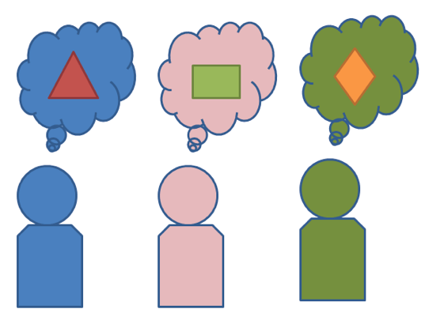
Interoperability Problem
Exchange or share information:
How to be “On The Same Page”?
Data
Semantics
Notes:
What we are trying to solve. We are trying to make two systems interoperable. It is an old problem. But with lots of information being exchanged electronically in today’s world, it becomes really really important that information that is exchanged
Does not lose it what it is and what it means. How to be on the same page? As far as data is concerned and semantics that data carries from its sender.

Slide 4
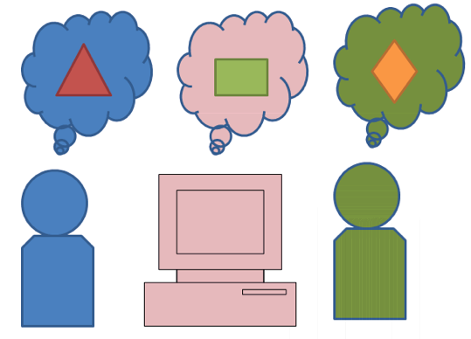
Interoperability Problem
Standards - Model/Schema/Metadata
Proprietary (not shared freely)
Finding semantics – mapping, transforms
Multiple
organizations
systems
Notes:
Standards for data information exchanged have been developed and being utilized, but standards don’t always mean interoperability.
We have models, schemas, metadata that two systems exchange (if they can exchange)
We have been using modeling approaches, sharing schemas and meta data in various ways

Slide 5
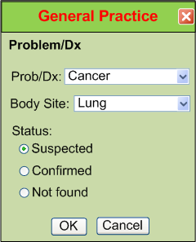
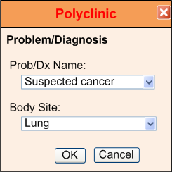
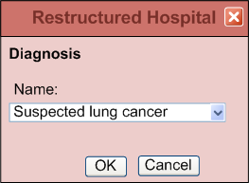
IsoSemantic Models – Example of Problem (from Dr. Linda Bird)
e.g. “Suspected Lung Cancer”
Courtesy: Dr. Stanley M. Huff (Intermountain Healthcare), and Dr. Linda Bird
Notes:
This slide shows how information about a diagnosis might be stored. Even though these three different healthcare providers are storing the same diagnosis, but how different they are as far as
UI element goes and how the values are coordinates and stored. Some people say that Oh may be they are not using the same model.

Slide 6
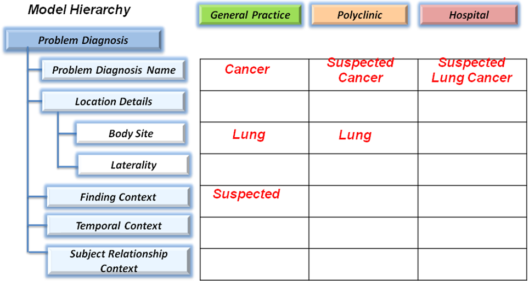
IsoSemantic Models – Example Instances (from Dr. Linda Bird)
e.g. “Suspected Lung Cancer”
Courtesy: Dr. Stanley M. Huff (Intermountain Healthcare), and Dr. Linda Bird
Notes:
But here they seem to be using the exactly same model hierarchy but the values are stored. So what can be done? There has to be a way to constrain the way things are stored and described.

Slide 7
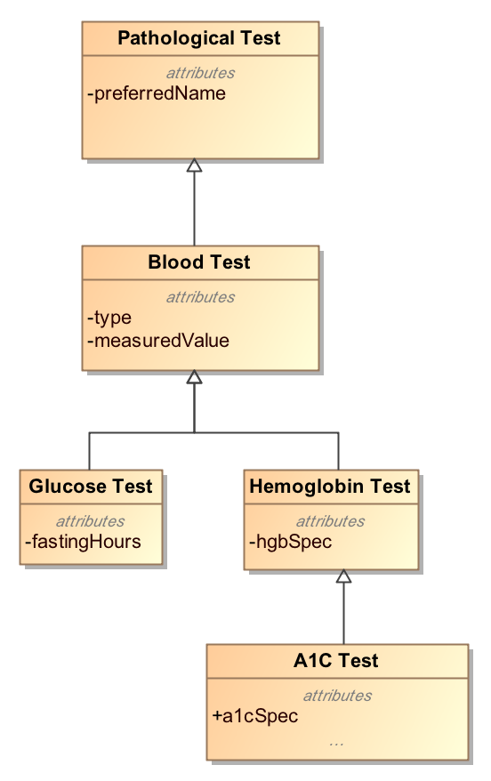
Modeling Approach
Top-Down Modeling
Generic → Specific
At each level we specialize
Properties
Associations
Notes:
In a typical modeling approach when we model we follow the top down modeling approach.
We start with the most abstract class at the top and we create subtypes specialize the subclasses
By adding properties and relationships. We are actually keep adding more to the child classes.
When we want to send data about a class, we create instance of that class and send it.

Slide 8
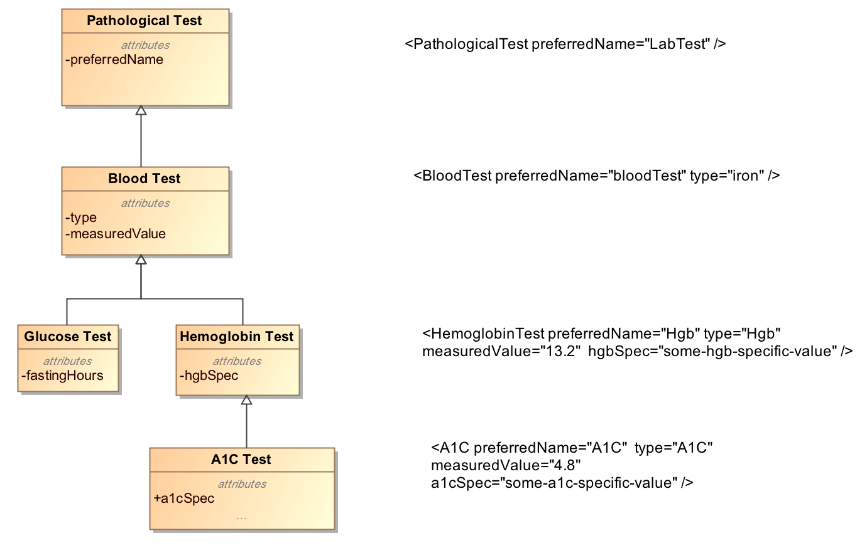
Top-Down Modeling Approach
Notes:
This slide shows the instance data that is valid for that class level. This slide was inspired by Harold Solbrig’s presentation at HL7 last year.
So you create instances of classes in your reference model and send it across.

Slide 9
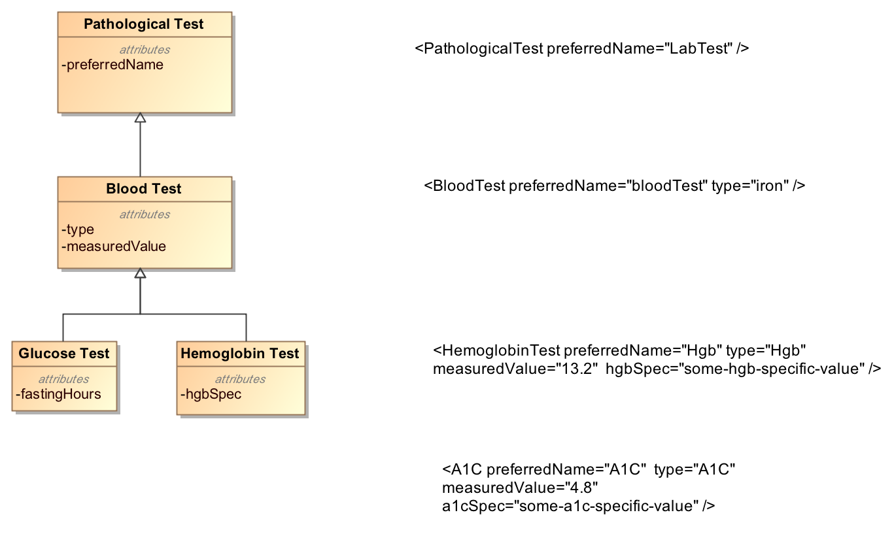
Top-Down Modeling Approach
???
Notes:
But in my world, if my model stops at Hemoglobin test then any data about A1C test will not have any meaning or value. So there is a problem. Even if there is a common model, users will extend it based on their needs and create data instances for the extensions.
How to exchange this information

Slide 10
Bottom-Up Modeling Approach
Constraint or Bottom-up Modeling
Start with a general model
Becomes the most abstract level of exchange
Specialize by
Cardinality
Values and value ranges
Optional/Mandatory/Prohibited
Enumeration subsets
Renaming
Courtesy: Harold Solbrig
Notes:
Another approach is bottom-up modeling or it is viewed as constraint modeling. This slide is replicated from Haold Solbrig’s slide because it captures Constraint modeling approach in a very concise way.
In Constraint modeling we start from a general model – model with the all the classes and that becomes the most abstract level of exchange. We specialize these classes by narrowing down by constraining
Elements on cardinality of their attributes, values and value ranges that they can be assigned. Whether the class members are optional , mandatory or prohibited. Any instance of our narrowed down view will be valid
At the recipient's end of this shared model. Enumeration subsets, renaming

Slide 11
Bottom-Up Modeling Approach
Example
Abnormal A1C Test = Set of Constraints
Pathological Test {0..*}
Has measuredValue {1..*}
measuredValue > Some_Threshold_Value
Type == “A1C”
Notes:
A Quick example of an archetype which defines an abnormal A1C test by defining constraints on the reference model classes and attributes.

Slide 12
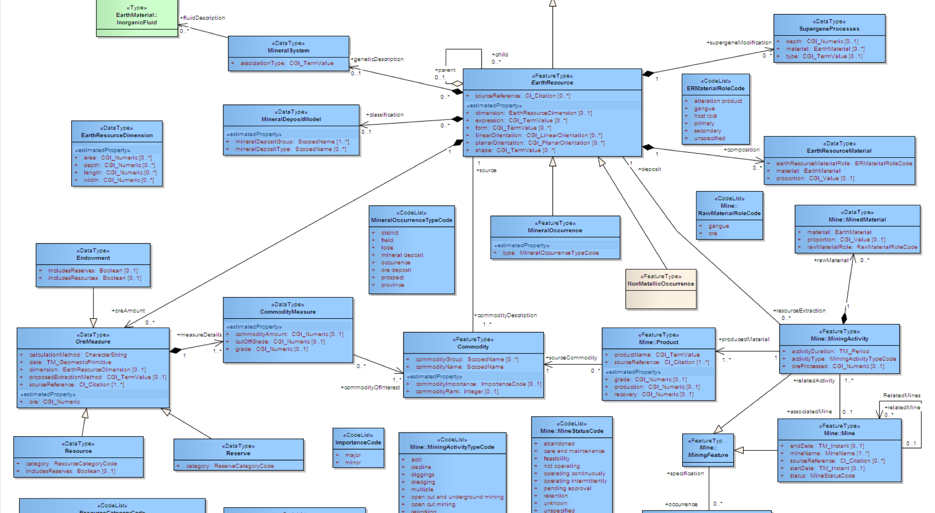

Archetype
“about”
Reference Model
Constraints on Reference Model Elements
Archetype
Notes:
So we have a model which participating entities aware of and ‘reference’, it is called a reference model – A reference model defines classes, data types, modeling patterns. We see that we define constraint(s) based on our needs and what and how we want to use the RM. These constraints talk “About” the reference model and its elements. Constraint do not affect RM in any way. And that is how we have an archetype. An archetype talk about only ONE reference model.

Slide 13
Archetypes
Reference Model
Archetype
Library
Notes:
We can have an archetype library which is a set of archetypes of all sizes – that are all about a reference model. Archetypes comes in all sizes, they can be just a simple, single constraint or can be lots of constraints and also by reusing existing archetypes.

Slide 14
Without Archetypes
Reference Model
Application
codes constraints:
Pathological test == “A1C”,
measuredValue > threashold value
….
Other constraints
Notes:
Lets look at a situation where an application works with a RM and implements the constraints without dealing with an archetype. The constraints are Inside the application itself – It is not very flexible.

Slide 15
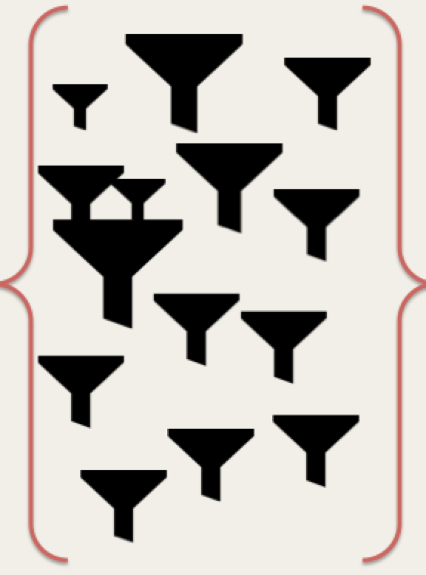
With Archetypes
Reference Model
Application
Archetypes
Notes:
With archetypes where an application employs with an archetype/archetype library as an external resource and just references RM to validate incoming instances by using archetypes.
Archetype libraries can be switched or constraints cab be changed without affecting the application itself.

Slide 16
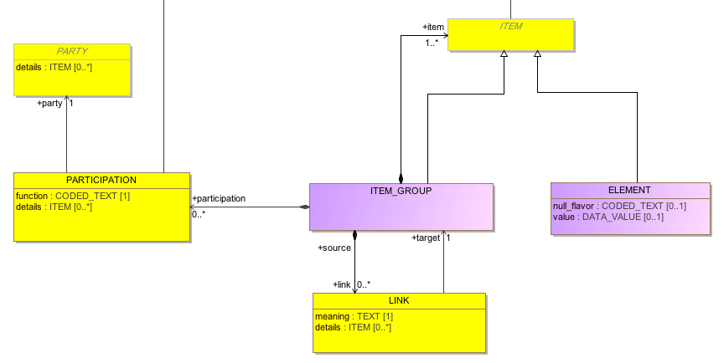
Reference Model Example
Notes:
Here we show an example of how an archetype might be created. First of all we have shared reference model. This is a very simple model where element is the leaf node and item group is a collection of more item-groups or leaf nodes (ELEMENT). Each item group can have a a meaning associated with it – tells what it means., using LINK. And a node item-group can have participation by a party – for example – and organization, patient, or care-giver.

Slide 17
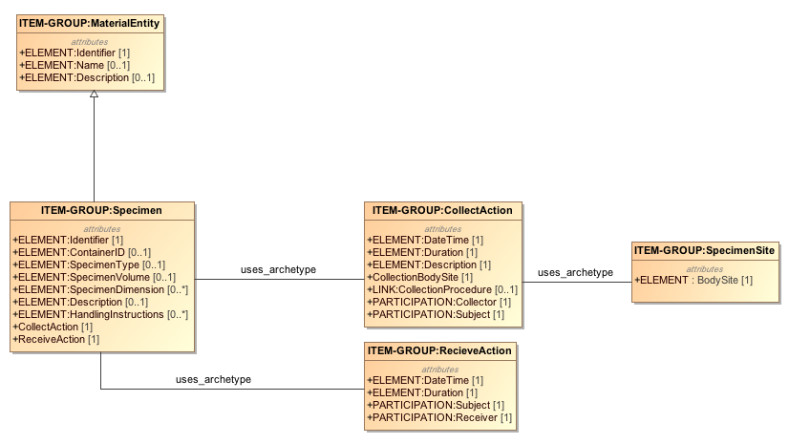
An Archetype Example
Simple Example: Specimen collection from a body site.
RM
Notes:
This example is about an archetype for patient’s specimen collection. You can see that simples archetype on the right is show the what body site the specimen comes from. Collecting a specimen is described by an archetype collection action and similarly receiving a specimen is by ReceiveAction archetype. Please note that Collection action uses an existing archetype to defined itself. Similarly Specimen itself is an archetype composed by using other smaller archetypes. It specializes a parent archetype “Material Entity”.

Slide 18
Detailed Clinical Models
We can create …. For example
A Clinical Model => Laboratory Test
Diagnostic Service
Specimen
Diagnosis
Conclusions
And others like… Clinical Statements, Reports, Procedures, …..so on
“Shared Detailed Clinical Information Models”
Notes:
Similarly we can create more and more, as needed, the clinical models like Lab test, clinical statements, reports and what not.
So a single global collection of shared clinical models is of great value to achieve improve interoperability.

Slide 19

Clinical Information Modeling Initiative
Since 2011
http://www.opencimi.org/
Mission Statement:
Improve the interoperability of healthcare systems through shared implementable clinical information models.
(A Single Curated Collection)
Notes:
In 2011 meeting of Modelers, participants concluded that having a shared repository of shared clinical information models will be of high value for interoperability. They felt that the newly formed group would be independent of any standards group and ensure that models that are created are open and free to use.

Slide 20
CIMI – Strategic Goal
Be able to share data, applications, reports, alerts, protocols, and decision support modules with anyone in the WORLD.
To have “plug-n-play” interoperability.
Source: http://www.opencimi.org/

Slide 21
CIMI – Deliverables
Shared repository of detailed clinical information models.
Using a single formalism (now support of two!) – ADL & AML.
Based on a common set of base data types.
With formal bindings of the models to standard coded terminologies.
Repository is open and models are free for use at no cost.
Models that support multiple contexts.
Source: http://www.opencimi.org/

Slide 22
CIMI – Target Domains
EHR data storage.
Message and service payload.
Decision logic (queries of EHR data).
Clinical trials data (clinical research).
Quality measures.
Normalization of data for secondary use.
Creation of structured data entry screens.
Capture of coding output from NLP.
Source: http://www.opencimi.org/

Slide 23
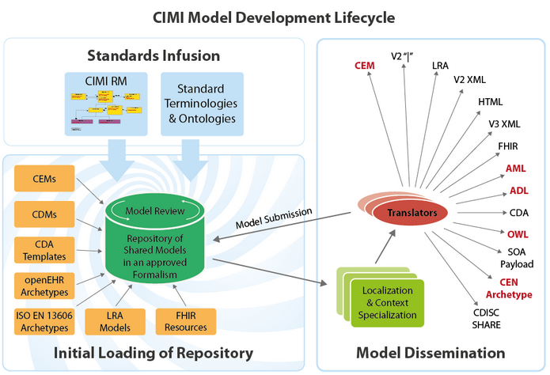
CIMI – Shared Repository
Source: http://www.opencimi.org/
Notes:
CIMI shared repository enables developers of Health information system to re-use existing models that are reviewed. Initial load of models comes from OpenEHR archetypes and from IHC CEMs, about which we talk about shortly.
So to get started with the models, a smaller but very generic reference model has been created – CIMI RM. Archetypes are based on CIMI RM and bound to standard terminology and ontologies. Models can be downloaded as-is for the use in EHRs.
Translators will be added to import and export models in canonical model formats.

Slide 24
CIMI – Coded Elements
Model Elements are bound to Standard Terminologies and Ontologies:
SNOMED CT - primary and preferred.
Systematized Nomenclature of Medicine – Clinical Terms
LOINC - approved.
Logical Observation Identifiers Names and Codes
CIMI SNOMED CT Identifier for extension.
Value-sets only by reference.

Slide 25
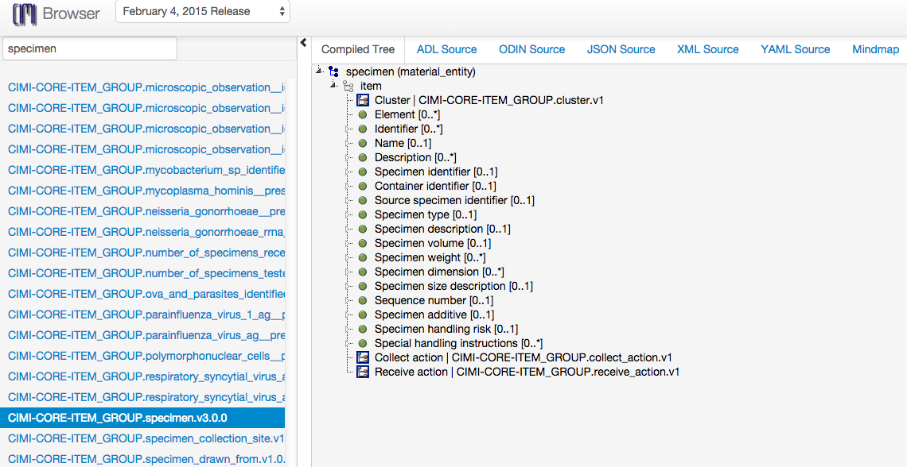
CIMI – Model Browser
Source: http://www.clinicalelement.com/cimi-browser
Notes:
CIMI shared repository enables developers of Health information system to re-use existing models that are reviewed. Initial load of models comes from OpenEHR archetypes and from IHC CEMs, about which we talk about shortly.
So to get started with the models, a smaller but very generic reference model has been created – CIMI RM. Archetypes are based on CIMI RM and bound to standard terminology and ontologies. Models can be downloaded as-is for the use in EHRs.
Translators will be added to import and export models in canonical model formats.

Slide 26
Frameworks & Tools
Similar Solutions ?
Existing
HL7: Templates.
OpenEHR: Archetype Definition Language (ADL).
GE-Intermountain Healthcare : Clinical Element Modeling Language (CEML).
New
CIMI: Archetype Modeling Language (AML).

Slide 27
HL7 Templates
Templates are similar to Archetypes.
Detailed Clinical Model with HL7 templates.
Bridge the gaps between technical representational formats - HL7 v3 templates and OpenEHR archetypes.
DCM’s in UML
HL7 “Flavored” non-normative UML.
Not sure if is successful?

Slide 28
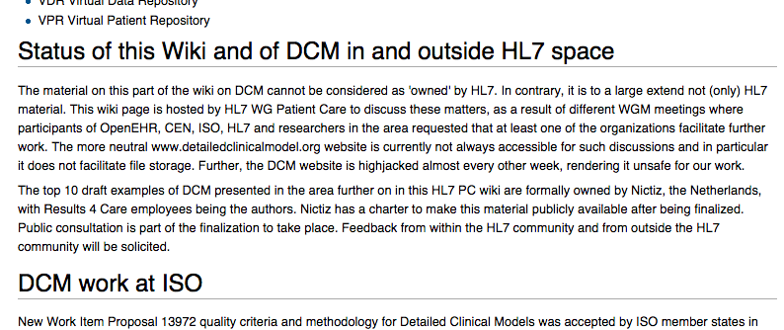
HL7 DCMs

Slide 29
Archetype Definition Language
OpenEHR - http://www.openehr.org
Open source tools by Ocean Informatics
ADL 2.0 (AOM - ADL object model).
Format: ODIN – Object Data Instance Notation.
Proprietary tools to absorb archetypes in ODIN. Open now??
Multiple tools – Editor, ADL Workbench – written in Eiffel language.

Slide 30
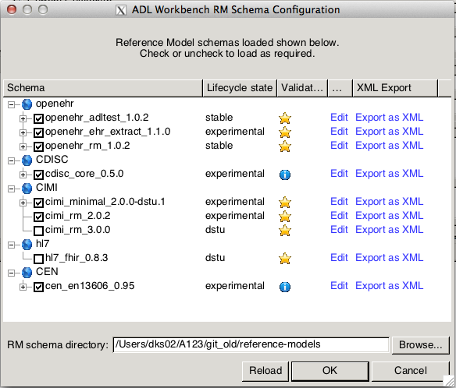
ADL Workbench

Slide 31
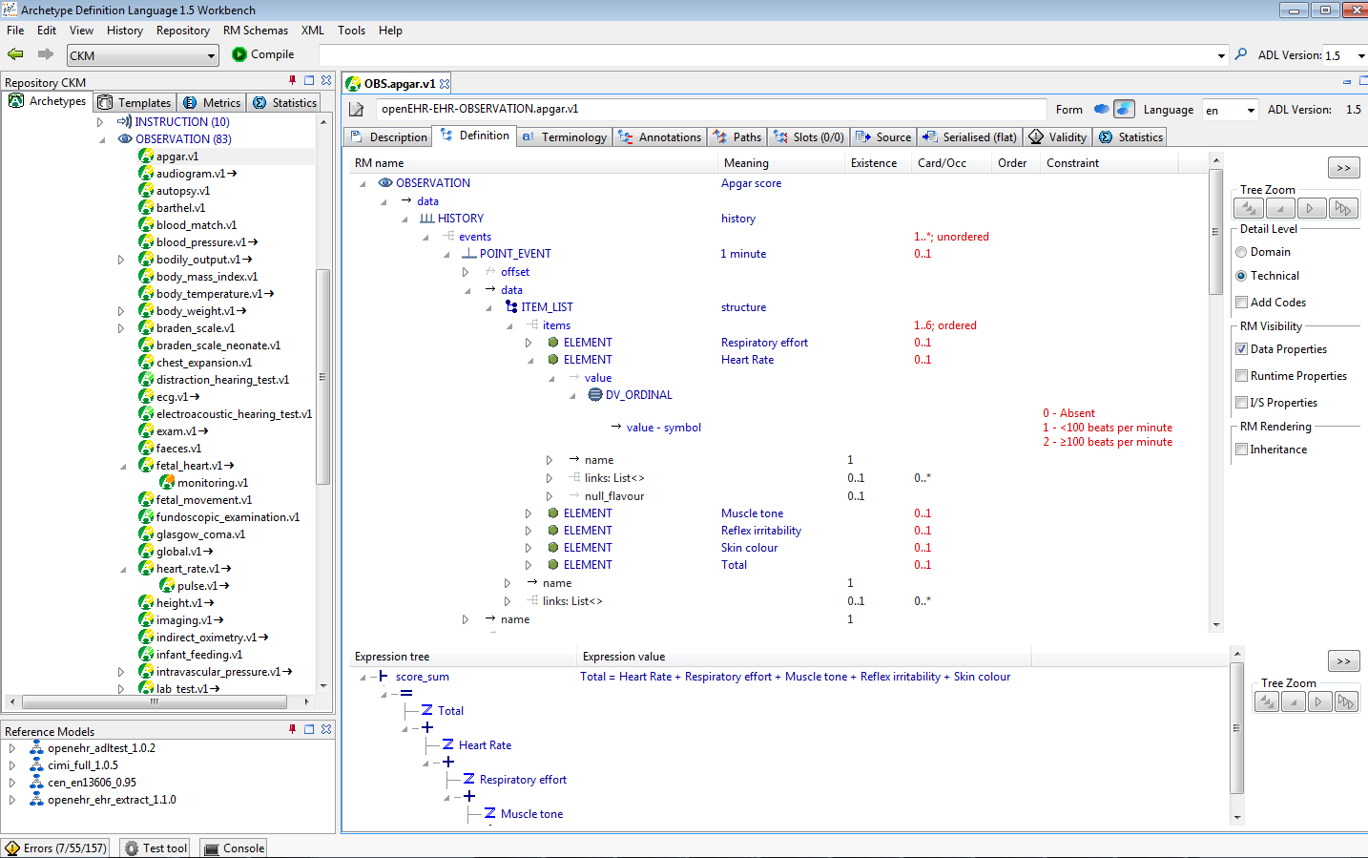
ADL Workbench

Slide 32
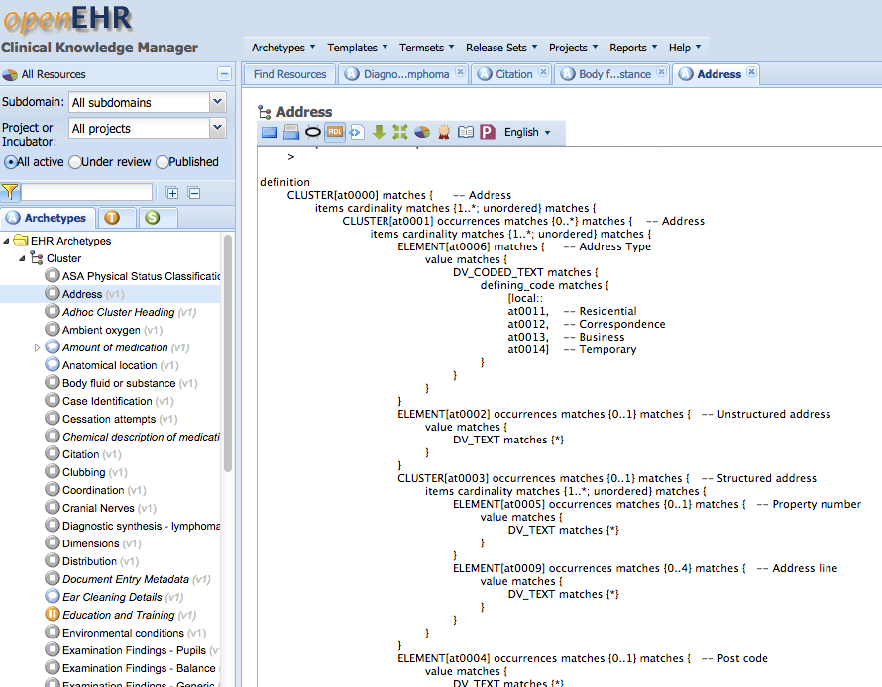
OpenEHR - CKM
http://openehr.org/ckm/
ADL1.5
Notes:
Clinical Knowledge Manager is an online collaboration portal for ADL archetypes.

Slide 33
OpenEHR ADL
Most traction.
Get started with rich set of tools.
Leverage with existing archetypes.
Issues
Proprietary
No easy gateway
Translation needed:
your Reference model to ADL compatible format.
Convert models back.
Challenging setup ?

Slide 34
GE-Intermountain Healthcare
Clinical Element Modeling Language – CEML.
Modeling at IHC
1994 – ASN.1
2000 – XML Schema
2004 – CEML (5000+ Models)
2009 – CDL (Constraint Definition Language)
2013 – Back to CEML
2014 – Converted models to ADL, FHIR profiles
Courtesy: Stan Huff at IHC

Slide 35
GE-Intermountain Healthcare
IHC Models at www.clinicalelement.com
Contributions to:
CEML models to ADL 1.5
CEML models to CIMI
Issues:
CEML (or CDL) compilers → proprietary.
Process to get resources from IHC –
Data normalization working with CEMs (sharpn.org)

Slide 36
Frameworks & Tools
Similar solutions?
Existing
HL7: Templates. ✔
OpenEHR: Archetype Definition Language. ✔
GE-Intermountain Healthcare : Clinical Element Modeling Language (CEML). ✔
New
CIMI: Archetype Modeling Language (AML).

Slide 37
AML : An OMG Standard
Object Management Group (OMG) is a standards consortium.
Preliminary submission in November 2014.
Currently being revised…
AML specification is collection of UML artifacts:
Profiles, stereotypes
Data types
Classes, Packages
https://github.com/opencimi/AML

Slide 38
Unified Modeling Language
UML is an OMG standard.
Creating and exchanging Models.
Create:
Classes
Properties
Associations
Generalization / Specialization
Enumerations
Stereotypes, tags, constraints.
Profiles (domain specific extension).

Slide 39
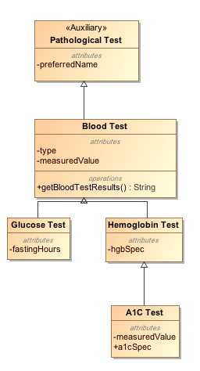
UML Example
Class
Stereotype
Property
Operation
Specialization

Slide 40
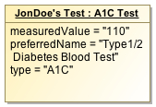
UML Instance Example
Class
Stereotype
Property
Operation
Instance
(of Class “A1C Test”)
Specialization

Slide 41
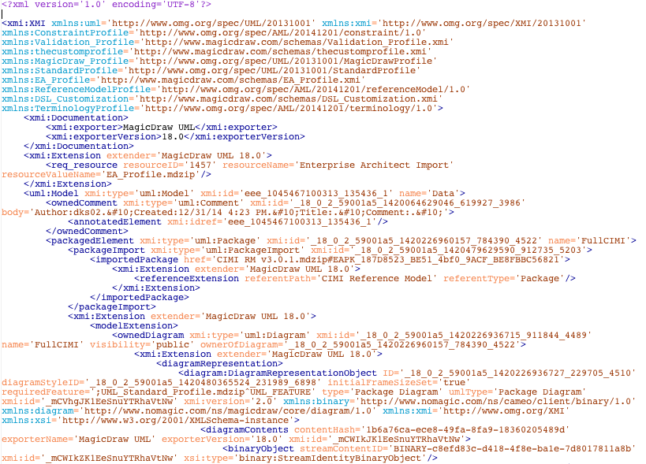
XMI – XML Metadata Interchange
Format for exchange UML models

Slide 42
UML Extension mechanism
UML Meta-model
UML Model
Stereotypes
Tags
Constraints

Slide 43
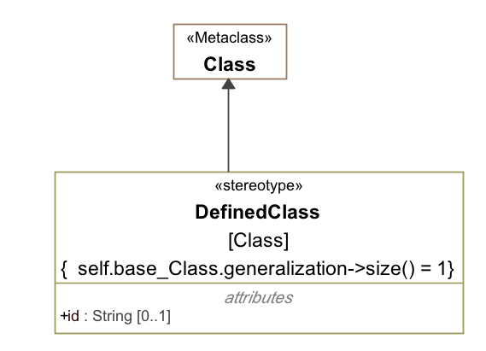
UML Extension mechanism
Restriction
Tag
Courtesy: Harold Solbrig

Slide 44
UML Profile
A Profile is a Collection of Stereotypes and Classes.
The (or “A”) GOAL is to have UML model vendors incorporate profiles as first class items into their tools…
Courtesy: Harold Solbrig

Slide 45
Archetypes in UML
Advantages:
UML is OMG standard, non-proprietary.
UML is familiar to most modelers.
Model-Driven Architecture/UML tools.
Future CIMI support.
AML allows directly work with UML RMs.
Data Query and Validation
Existing and future UML tools can be used.

Slide 46
Clinical Models
UML Meta Model
AML
RM
MDA
UML Profiles
Application Template
Meta-model
UML
Generate
about
Transform
Clinical Model
Clinical Model
Clinical Model
Application
Clinical Model
UML
Validates
UML
Archetypes
Instance Data

Slide 47
Clinical Models
UML Meta Model
AML
RM
MDA
UML Profiles
Application Template
Meta-model
UML
Generate
about
Transform
Clinical Model
Clinical Model
Clinical Model
Application
Clinical Model
UML
Validates
UML
CIMI Model Repository
Archetypes
Instance Data

Slide 48
Code Generation
MOF
Reference Implementation
UML Meta Model
EMF
EMOF (Ecore)
Eclipse Modeling Framework
AML
RM
MDA
UML Profiles
Application Template
Meta-model
UML
Generate
about
Transform
Clinical Model
Clinical Model
Clinical Model
Application
Clinical Model
UML
Validates
UML
CIMI Model Repository
Archetypes
Instance Data

Slide 49
Inside AML Specifications
UML Meta Model
AML Object Model | AML Profile
Reference Model | Reference Model Profile
Archetype Model | Archetype Profile
Constraint Model | Constraint Profile
Terminology Model | Terminology Profile
Rules Model | Rules Profile
Metadata Model | Identification & Designation
AML
RM
MDA
UML Profiles
Application Template
Meta-model
UML
Generate
about
Transform
Clinical Model
Clinical Model
Clinical Model
Application
Clinical Model
UML
Validates
UML
CIMI Model Repository
Archetypes
Instance Data

Slide 50
Reference Model
Describes the characteristics a target Reference Model (RM) must have in order for the constraint model to refer to it predictably.
Reference Model Profile:
Defines the set of data types whose values can be directly constrained by an AML Model.
It also specifies a small set of stereotypes that are used to "decorate" a reference model and its various components.

Slide 51
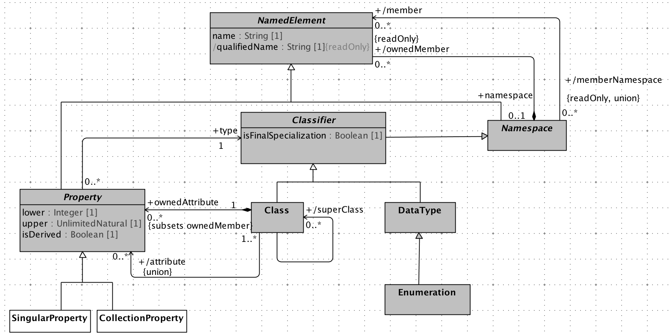
Reference Model

Slide 52
Archetype Model
Defines relationship between archetype libraries, archetypes and archetype versions.
Archetype Profile:
Constraint related to Archetype Library, Archetype and Archetype Version.

Slide 53
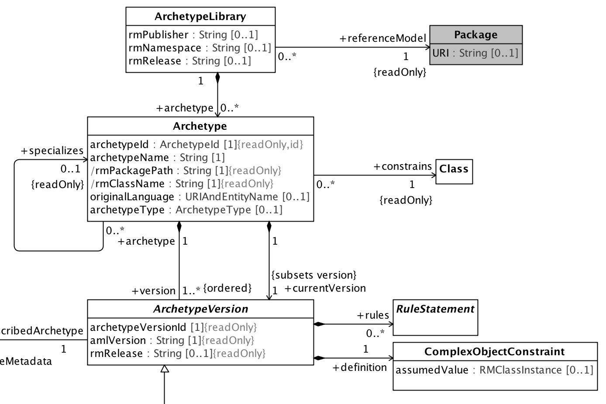
Archetype Model

Slide 54
Constraint Model
Illustrates how constraints are defined. This is core part of the AML specifications.
Constraint Profile:
Defines the modeling elements that may be applied to a reference model and archetype. These elements “constrain” the target model narrowing the semantics and syntax.

Slide 55
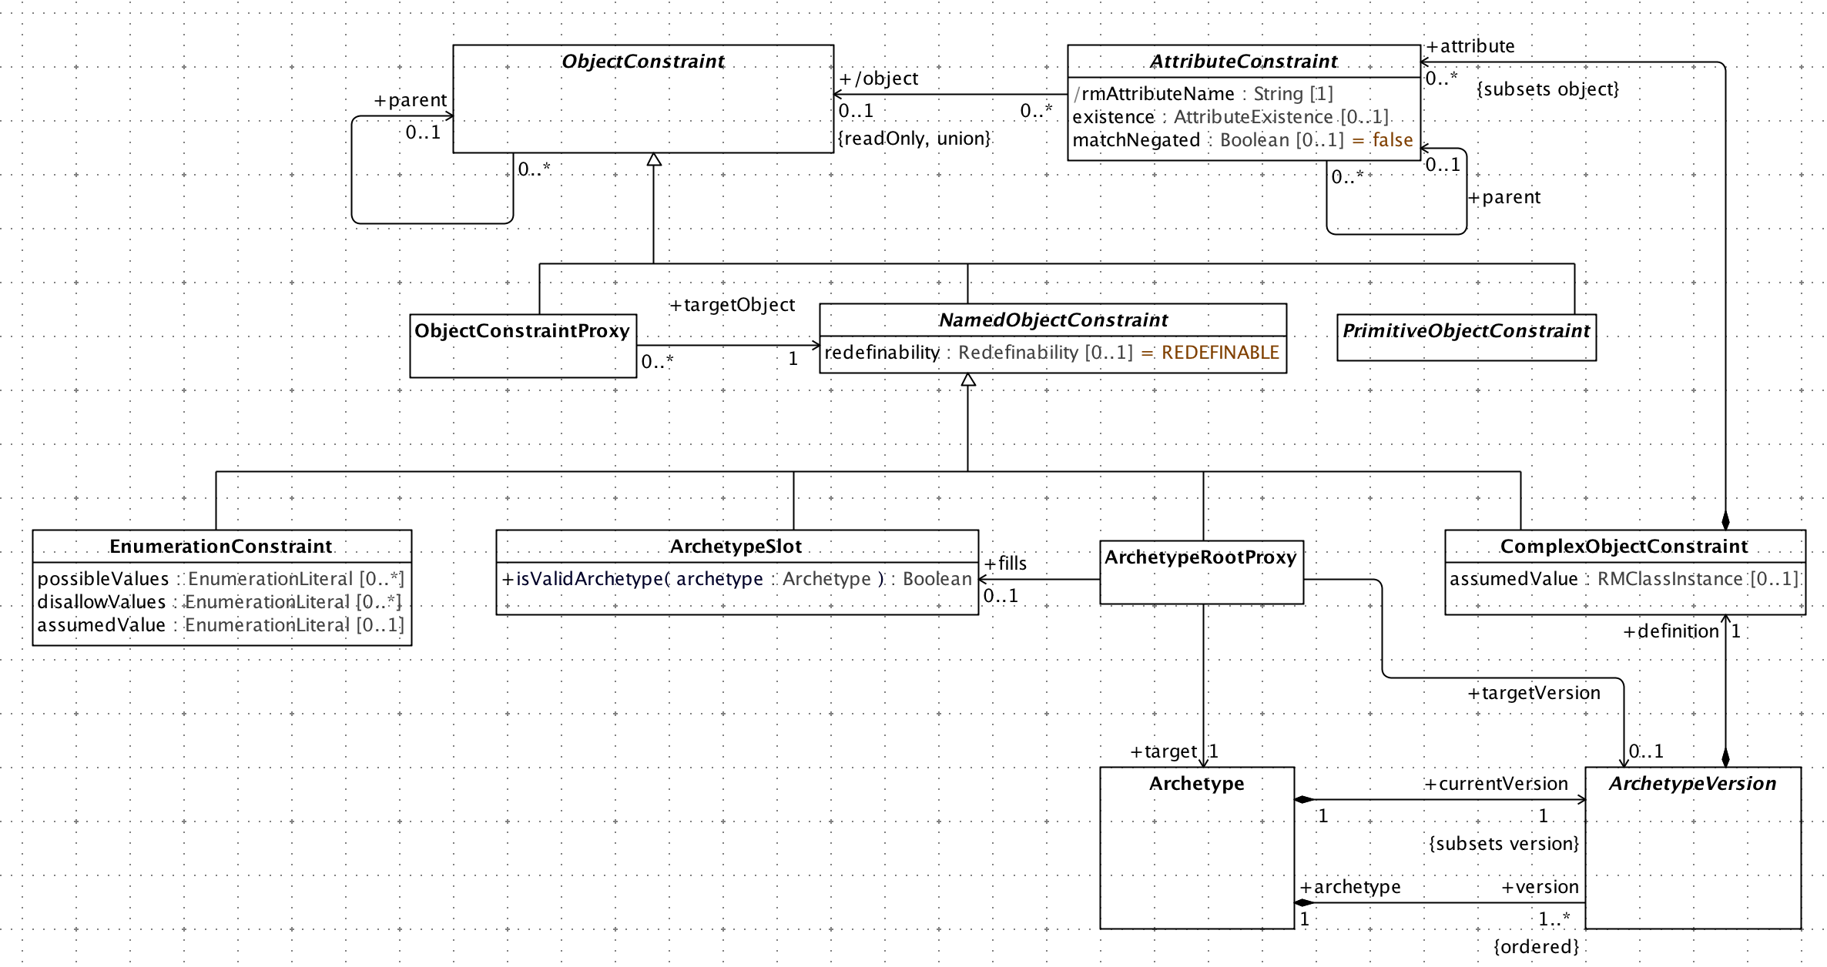
Constraints

Slide 56
Identification & Designatable
Advised by ISO 11179-3
IdentifiableItem
Namespace + id
DesignatableItem
Language + sign + [description]
Namespaces
“meaning” linkage from Class
Courtesy: Harold Solbrig

Slide 57
Terminology Profile
Describes how various elements of Standards:
Common Terminology Services (CTS2)
ISO 11179 – Metadata Repository (3rd Ed.)
can be utilized to bind identifiers and terms used (in archetypes) to terminology resources like:
Code Systems
Value Sets and Permissible Values

Slide 58
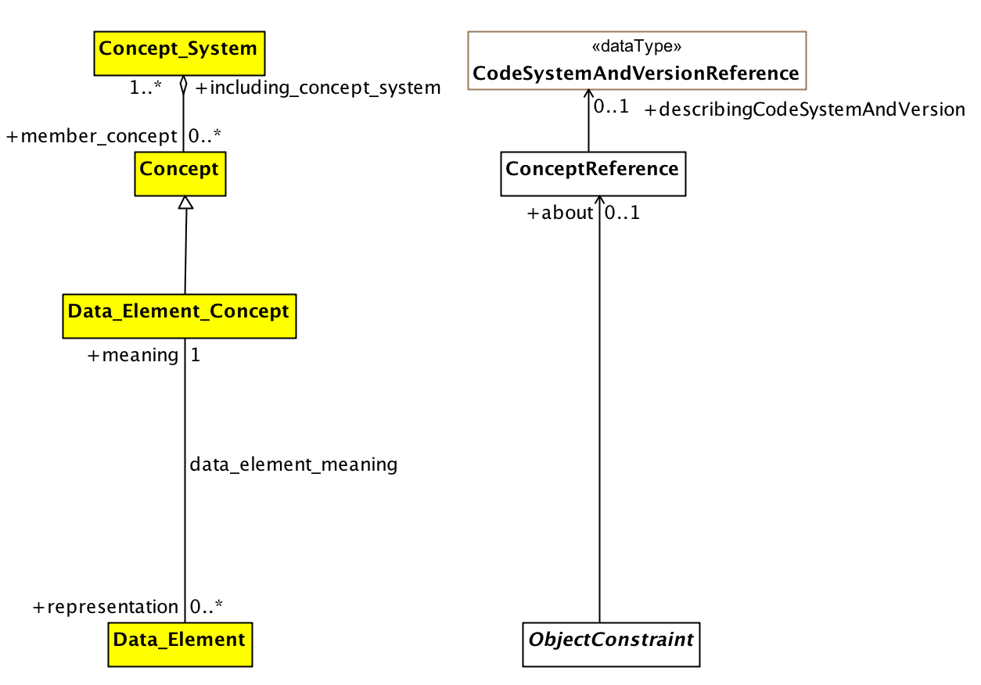
Terminology Profile

Slide 59
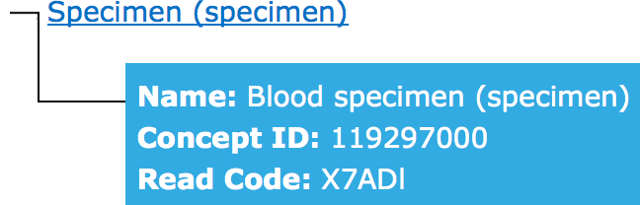
Terminology Binding
Example of term bound to a concept to define it’s meaning:
Blood Specimen – SNOMED ID: 122560006
definedBy
definedBy
ConceptReference
ConceptReference
“blspec001”
“Blood_spec”
Meaning is same

Slide 60
Common Terminology Services 2
CTS2 is a model and specification for discovering, accessing, distributing and updated terminological resources on the internet.
Code Systems,
Terminology Concepts,
Value Sets,
Access with Services API:
REST API implementation to access CTS2 resources
http://informatics.mayo.edu/cts2
OMG Standard: http://www.omg.org/spec/CTS2/

