Slide 1
AML Archetype Modeling Language Improving interoperability of information models
Pre-Thesis Seminar
By
Deepak Sharma
Master of Science
Biomedical Informatics & Computational Biology
University of Minnesota, Rochester
April 23, 2015

Slide 2



Advisers
Dr. Christopher G. Chute, MD, Dr. P.H.
Bloomberg Distinguished Professor of Health Informatics,
Professor of Medicine, Public Health, and Nursing,
Chief Health Information Research Officer,
John Hopkins Medicine Professor,
John Hopkins, Baltimore, Maryland.
Dr. Claudia Neuhauser, PhD.
Director of Informatics Institute,
Interim Director, Minnesota Supercomputing Institute,
Office of the Vice President for Research,
Director of Graduate Studies, Biomedical Informatics & Computational Biology
University Of Minnesota, Minneapolis, Minnesota.
Dr. Guoqian Jiang, MD, PhD.
Associate Professor of Biomedical Informatics,
Associate Consultant in Department of Health Sciences Research,
Division of Biomedical Statistics & Informatics,
Mayo Clinic College of Medicine,
Rochester, Minnesota.

Slide 3

Mentor
Harold R. Solbrig, MS
Technical Specialist II,
Division of Biomedical Statistics & Informatics,
Mayo Clinic,
Rochester, Minnesota.

Slide 4
Agenda
Archetypes – what, why?
Archetype Modeling Language
AML Tooling

Slide 5
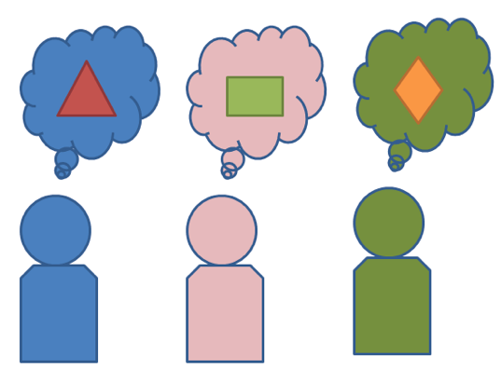
Interoperability Problem
Exchange or share information:
How to be “On The Same Page”?
Data
Semantics

Slide 6
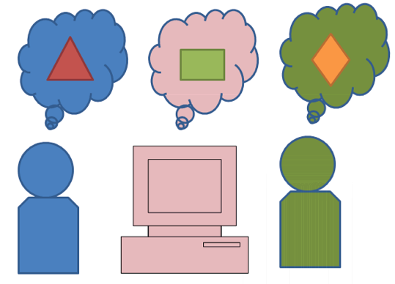
Interoperability Problem
Standards - Model/Schema/Metadata
Proprietary (not shared freely)
Finding semantics – mapping, transforms
Multiple
organizations
systems
Notes:
Yes we can set standards, create schemas, share metadata etc. but standards don’t always mean interoperability. We have models, schemas, metadata that two systems exchange (if they can exchange).
Sometimes it requires additional transforms, maps to store semantics correctly. Imagine if multiple organizations are involved and being consistent with internal external maps/transforms is not always possible.
Different ways are being used at different places to store data internally.

Slide 7
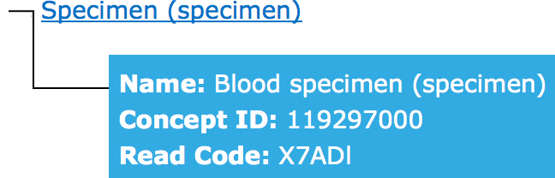
Terminology Binding
Meaning is defined with coded terms:
Blood Specimen – SNOMED ID: 122560006
definedBy
definedBy
ConceptReference
ConceptReference
“blspec001”
“Blood_spec”
Meaning is same

Slide 8
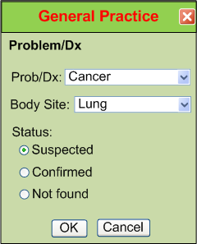
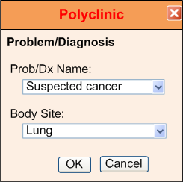
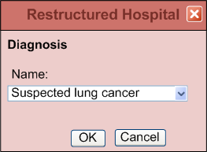
IsoSemantic Models – Example of Problem (from Dr. Linda Bird)
e.g. “Suspected Lung Cancer”
Courtesy: Dr. Stanley M. Huff (Intermountain Healthcare), and Dr. Linda Bird
Notes:
p

Slide 9
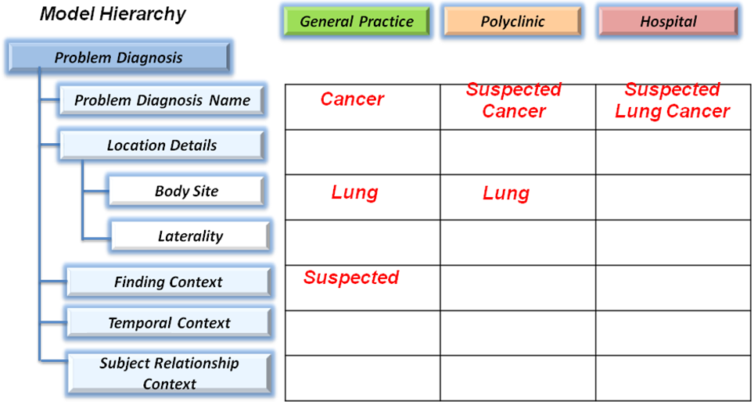
IsoSemantic Models – Example Instances (from Dr. Linda Bird)
e.g. “Suspected Lung Cancer”
Courtesy: Dr. Stanley M. Huff (Intermountain Healthcare), and Dr. Linda Bird

Slide 10
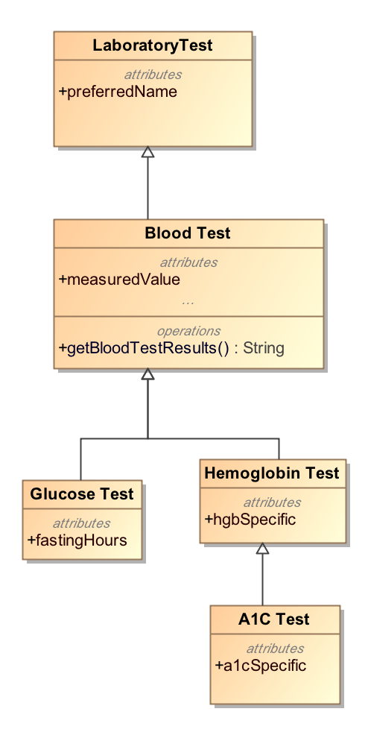
Modeling Approach
Top-Down Modeling
Generic → Specific
At each level we specialize
Properties
Associations

Slide 11
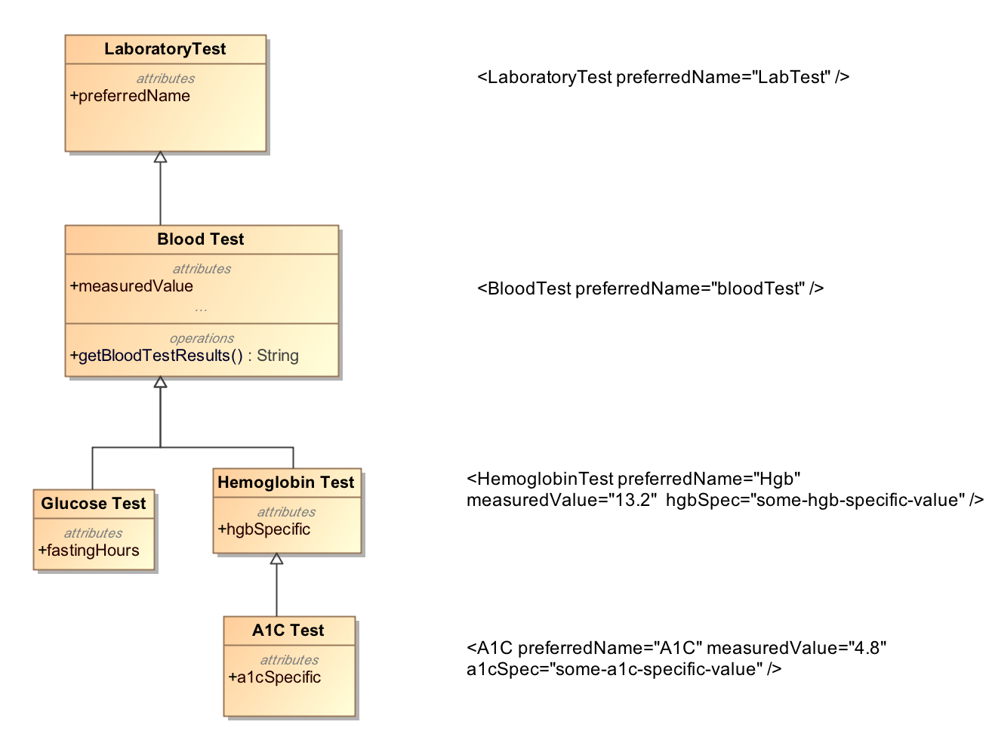
Top-Down Modeling Approach

Slide 12
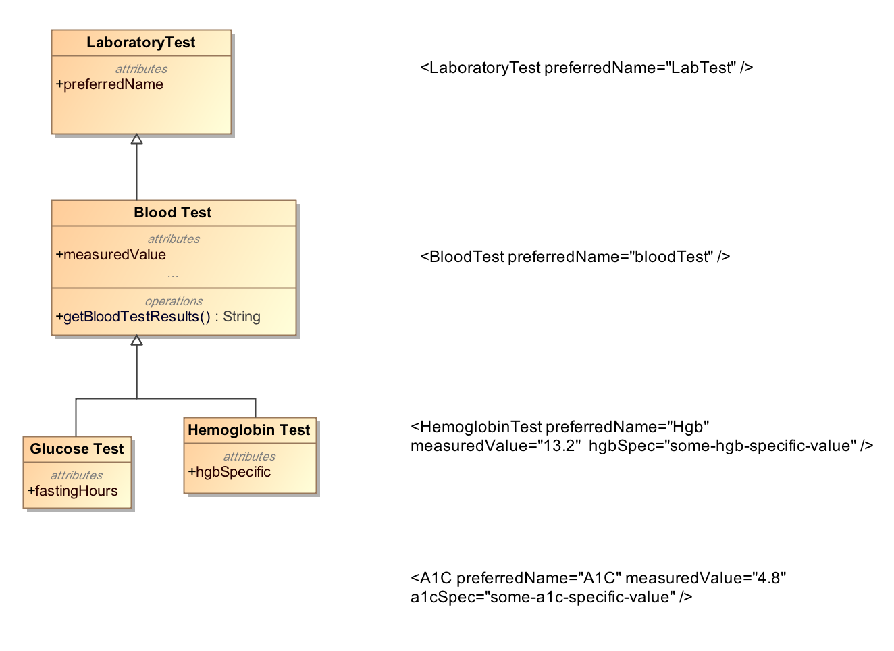
Top-Down Modeling Approach
If I have this
This does not make sense !!

Slide 13
Bottom-Up Modeling Approach
Constraint or Bottom-up Modeling
Start with a general model
Becomes the most abstract level of exchange
Specialize by
Cardinality
Values and value ranges
Optional/Mandatory/Prohibited
Enumeration subsets
Courtesy: Harold Solbrig

Slide 14
Bottom-Up Modeling Approach
Constraints on shared model:
Abnormal A1C Test = Set of Constraints
LaboratoryTest {1}
measuredValue {1..*}
{x| x in {measuredValues},
x > SomeThresholdValueforA1C}

Slide 15
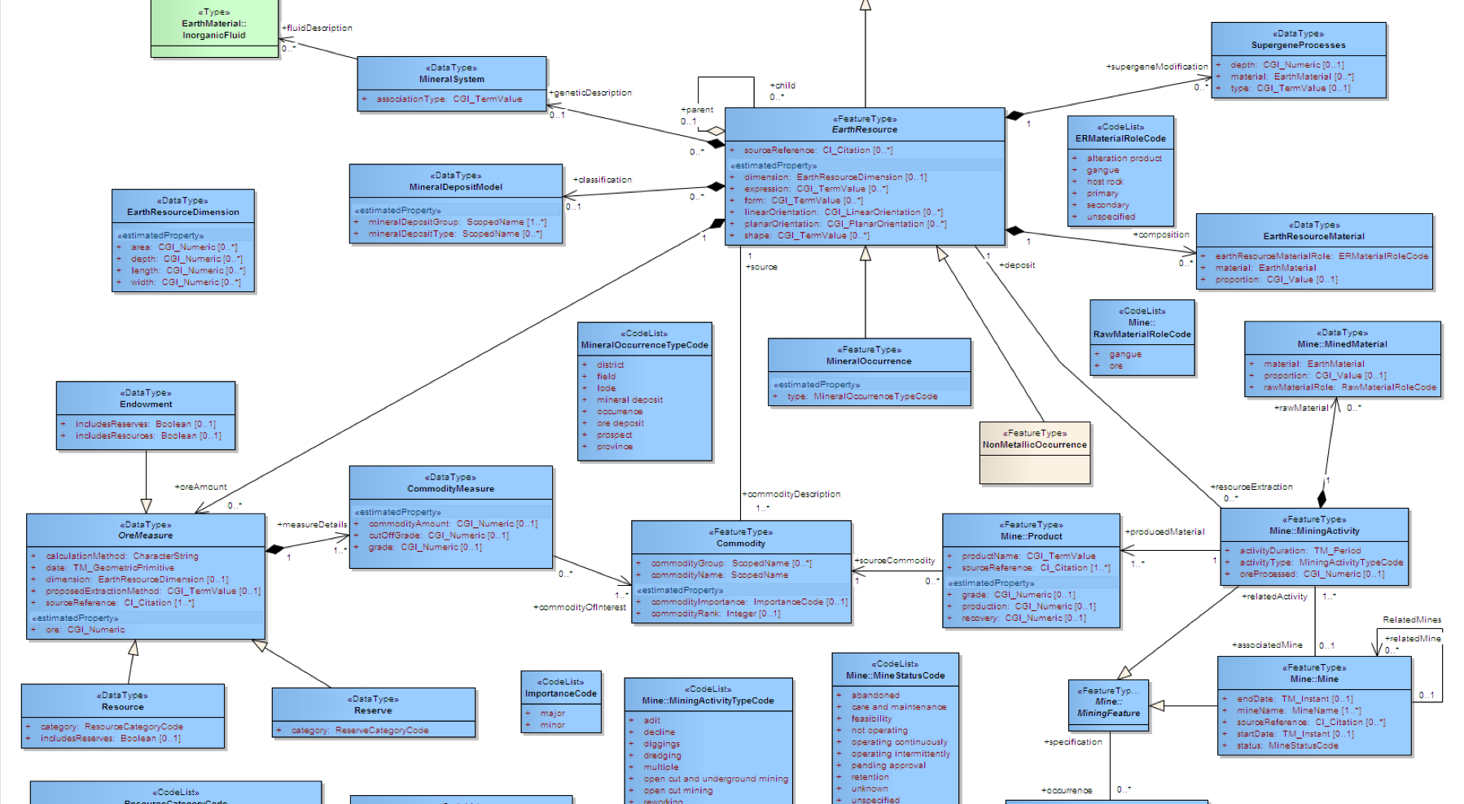

Archetype
“about”
Reference Model
Constraints on Reference Model Elements
Archetype

Slide 16
Archetypes
Reference Model
Archetype
Library

Slide 17
Without Archetypes
Reference Model
Application
codes constraints:
LaboratoryTest == “A1C”,
measuredValue > threashold value
….
Other constraints…

Slide 18
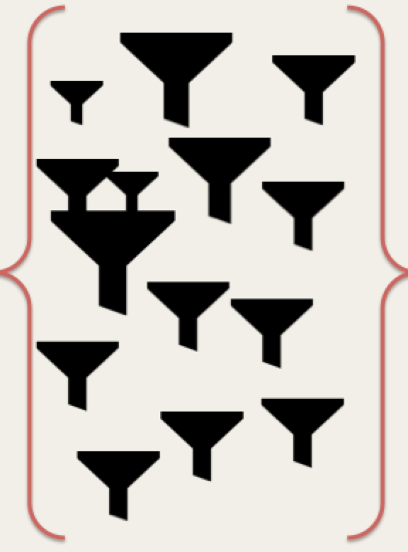
With Archetypes
Reference Model
Application
Archetypes

Slide 19
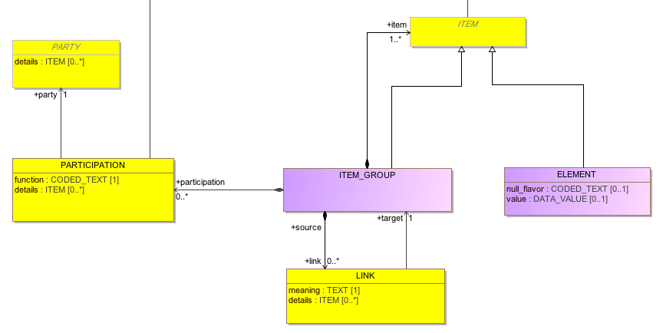
Reference Model Example
miniCIMI Reference Model

Slide 20
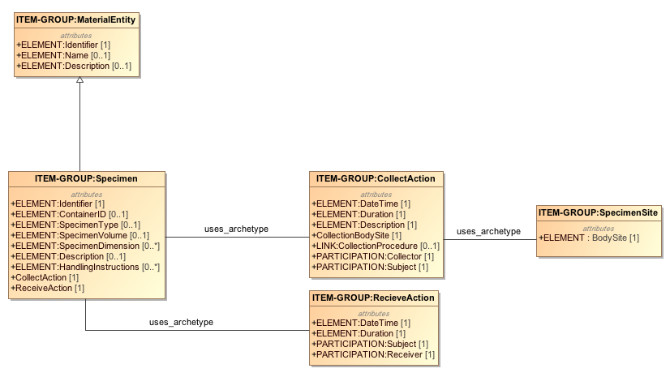
An Archetype Example
Simple Example: Specimen collection from a body site
RM

Slide 21
Clinical Models
We can create …. more Clinical Models =>
For Example:
Laboratory Test,
Diagnostics,
Specimen , and so on…
And share them
“Shared Clinical Information Models”
– help improve Interoperability

Slide 22
Agenda
Archetypes – what, why? ✔
Archetype Modeling Language
AML Tooling

Slide 23

Clinical Information Modeling Initiative
Since 2011
http://www.opencimi.org/
Mission Statement
“Improve the interoperability of healthcare systems through shared implementable clinical information models”
(A Single Curated Collection)

Slide 24
CIMI – Strategic Goal
“Be able to share data, applications, reports, alerts, protocols, and decision support modules with anyone in the WORLD”
Source: http://www.opencimi.org/

Slide 25
CIMI – Target Domains
EHR data storage
Message and service payload
Decision logic (queries of EHR data)
Clinical trials data (clinical research)
Quality measures
Normalization of data for secondary use
Creation of structured data entry screens
Capture of coding output from NLP
Source: http://www.opencimi.org/

Slide 26
CIMI – Deliverables
Shared repository of clinical information models
Single formalism with 2 representations:
ADL & AML
Formal bindings to standard terminologies
Model Repository:
Open & free for use
Source: http://www.opencimi.org/

Slide 27
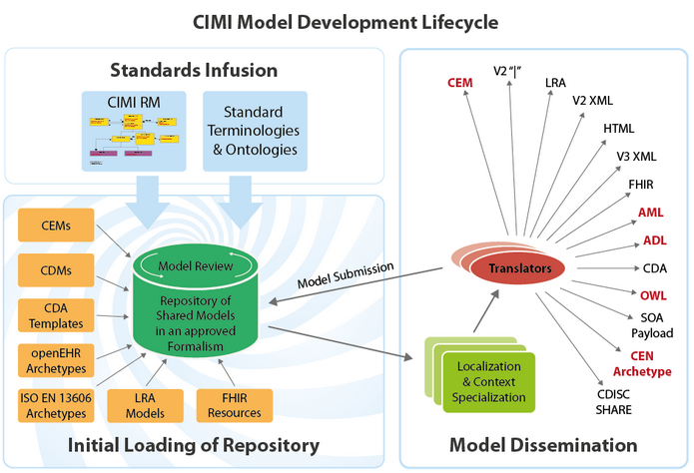
CIMI – Shared Repository
AML
Source: http://www.opencimi.org/

Slide 28
CIMI – Standard Terminologies
Model Elements are bound to Standard Terminologies and Ontologies:
SNOMED CT - primary and preferred
Systematized Nomenclature of Medicine – Clinical Terms
LOINC - approved
Logical Observation Identifiers Names and Codes
SNOMED CT CIMI Identifier for extension
Value-sets only by reference vs. list of values

Slide 29
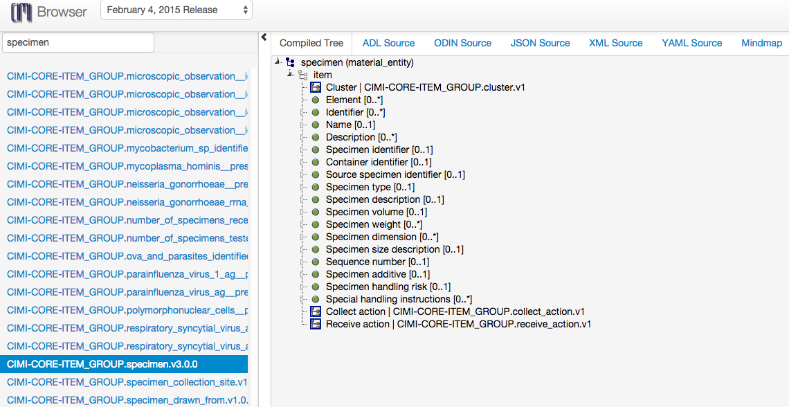
CIMI – Model Browser
Source: http://www.clinicalelement.com/cimi-browser

Slide 30
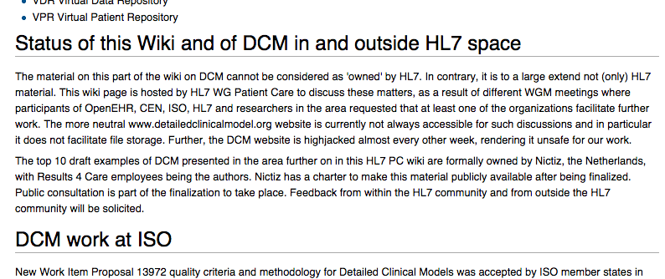
Other Efforts
HL7: Templates
OpenEHR: Archetype Definition Language (ADL)
GE-Intermountain Healthcare : Clinical Element Modeling Language (CEML)

Slide 31
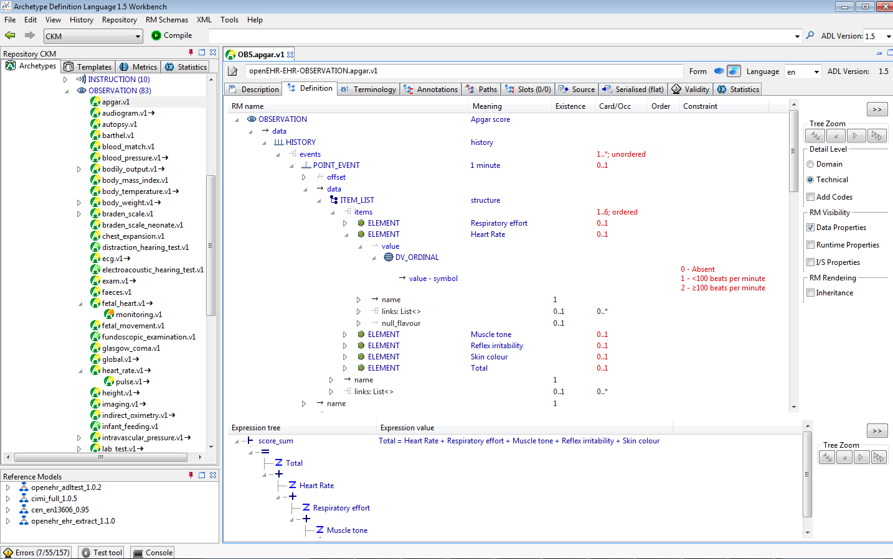
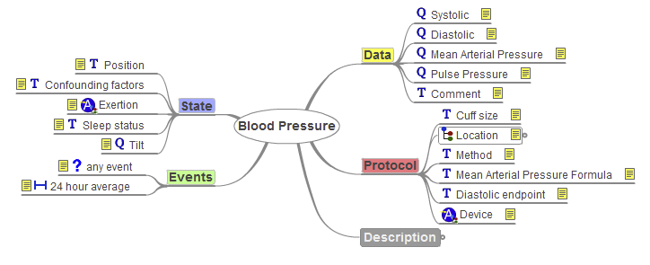
ADL Workbench

Slide 32
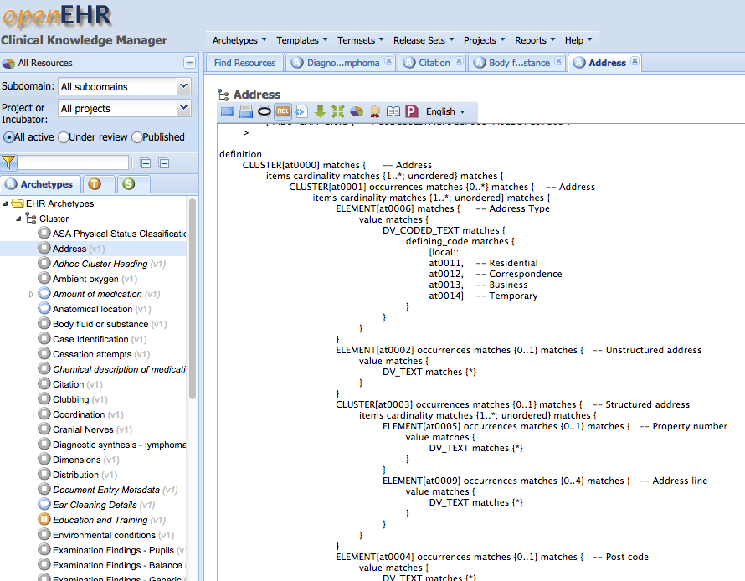
OpenEHR - CKM
http://openehr.org/ckm/
ADL1.5

Slide 33
AML
AML Preliminary submission to OMG
in November 2014
Currently being revised…
AML specification is collection of UML artifacts:
Profiles, stereotypes
Data types
Classes, Packages
https://github.com/opencimi/AML
(in a bit of disarray at the moment)

Slide 34
Unified Modeling Language
UML is an OMG standard
Creating and exchanging Models - (XMI)
Create:
Classes, Properties, Associations, Enumeration
Generalization / Specialization
Extension Mechanism
Stereotypes, tags, constraints (OCL)
Profiles
Collection of Stereotypes, domain specific

Slide 35
OCL
Constraints are in “Object Constraint Language” – OCL:
Textual Language to describe constraints, e.g.
Context=Patient
{self.age >= “18”}
Context=SingularAttributeConstraint
{(self.base_Property.redefinedProperty->size()=1)and
(self.base_Property.upper=1)}
Courtesy: Harold Solbrig

Slide 36
Archetypes in UML
Advantages:
UML is OMG standard, non-proprietary
UML is familiar to modelers
Model-Driven Architecture
AML works directly with UML RMs

Slide 37
Clinical Models
UML Meta Model
AML
RM
MDA
UML Profiles
Application Template
Meta-model
UML
Generate
about
Transform
Clinical Model
Clinical Model
Clinical Model
Application
Clinical Model
UML
Validates
UML
CIMI Model Repository
Archetype Library
Instance Data

Slide 38
Inside AML Specifications
UML Meta Model
AML Object Model | AML Profile
Reference Model | Reference Model Profile
Archetype Model | Archetype Profile
Constraint Model | Constraint Profile
Terminology Model | Terminology Profile
Rules Model | Rules Profile
Metadata Model | Identification & Designation
AML
RM
MDA
UML Profiles
Application Template
Meta-model
UML
Generate
about
Transform
Clinical Model
Clinical Model
Clinical Model
Application
Clinical Model
UML
Validates
UML
CIMI Model Repository
Archetypes
Instance Data

Slide 39
Reference Model
Describes the characteristics a target Reference Model (RM) must have in order for the constraint model to refer to it predictably
Reference Model Profile:
Defines the set of data types whose values can be directly constrained by an AML Model.
It also specifies a small set of stereotypes that are used to "decorate" a reference model and its various components.

Slide 40
Archetype Model
Defines relationship between archetype libraries, archetypes and archetype versions.
Archetype Profile:
Constraint related to Archetype Library, Archetype and Archetype Version.

Slide 41
Constraint Model
Illustrates how constraints are defined. This is core part of the AML specifications.
Constraint Profile:
Defines the modeling elements that may be applied to a reference model and archetype. These elements “constrain” the target model narrowing the semantics and syntax.

Slide 42
Identification & Designatable
Advised by ISO 11179-3
IdentifiableItem
Namespace + id
DesignatableItem
Language + sign + [description]
Namespaces
“meaning” linkage from Class
Courtesy: Harold Solbrig

Slide 43
Terminology Profile
Describes how various elements of Standards:
Common Terminology Services (CTS2)
ISO 11179 – Metadata Repository (3rd Ed.)
can be utilized to bind identifiers and terms used (in archetypes) to terminology resources like:
Code Systems
Value Sets and Permissible Values

Slide 44
Agenda
Archetypes – what, why? ✔
Archetype Modeling Language ✔
AML Tooling

Slide 45
AML Tooling
AML Object Model (AML-OM)
Inspired from ADL Object Model (AOM)
Existing ADL archetype → AML archetypes
Map AOM → AML-OM
Developing a converter is to visualize real, existing archetypes in AML programmatically
Testing and Constraints validation comes next

Slide 46
AML Tooling
Project Location:
https://github.com/semantix/AMLTooling
Sub-projects:
ADL2AMLConverter – The Converter
AML MD Library – AML Wrapper on MD Open API
AML MD Plugin – Menu Plug-in to MagicDraw IDE

Slide 47
ADL2AML Converter
Traceability Matrix
AML
UML
Export to a target format
ADL Objects
AML Objects
ADL2AML
Converter
ADL Parser
MD Open API
ADL

Slide 48
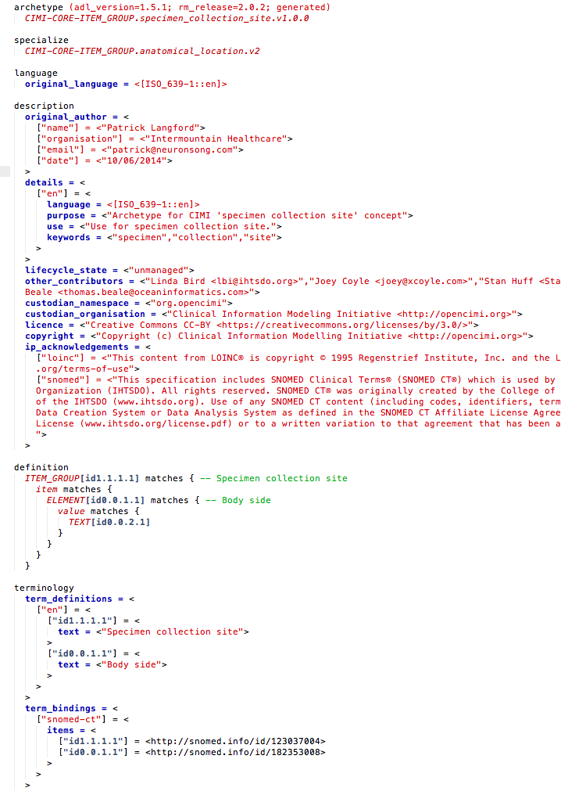
ADL
An ADL file for archetype “specimen_collection_site”

Slide 49
ADL
Archetype Metadata Section
Constraints/Definition Section
Terms & Terminology Binding Section

Slide 50
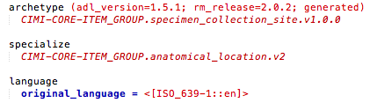
ADL

Slide 51
ADL
publisher
RM Class
Archetype Name
Version

Slide 52
ADL
Specialize
Language

Slide 53
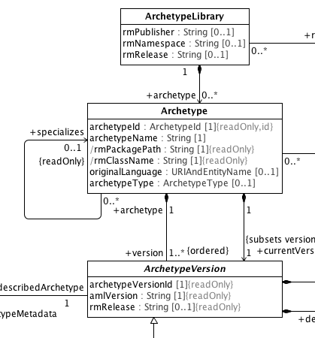
Maps to Archetype Model in AML

Slide 54
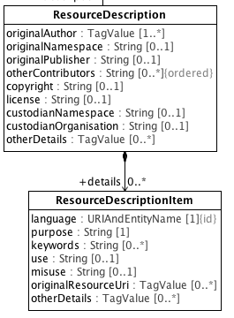
Maps to a ‘Resource’ of Archetype Model in AML

Slide 55
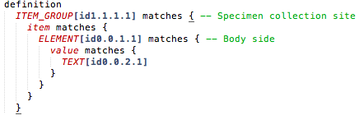
ADL

Slide 56
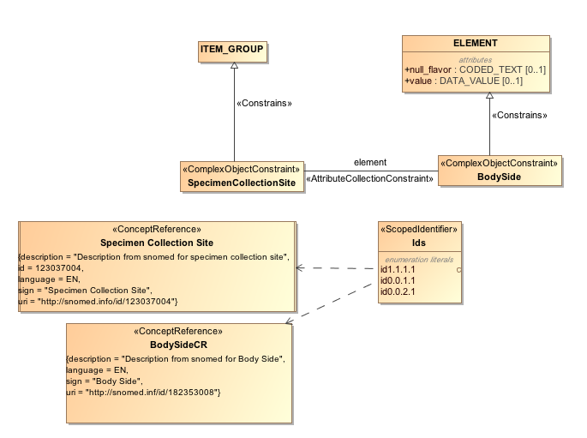
Maps to Constraint Model of AML

Slide 57
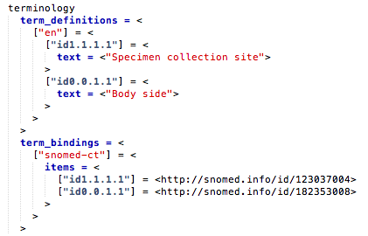
ADL

Slide 58
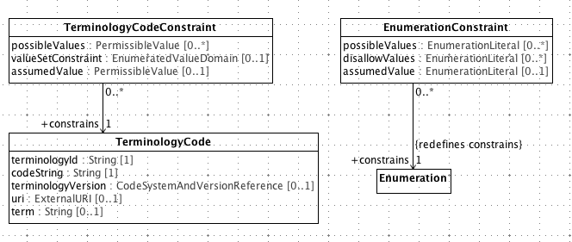
Maps to Terminology Binding Profile of AML

Slide 59
Agenda
Archetypes – what, why? ✔
Archetype Modeling Language ✔
AML Tooling ✔

Slide 60
Completed AML Spec./Tooling Tasks
Model 2 Text Transforms:
Completed IBM RSA Business Intelligence Report Tool (BIRT) Template to dynamically generate specifications
Completed Apache Velocity Template –
IBM RSA → MagicDraw
AML API Layer over MagicDraw OpenAPIs
AML Specifications
EA -> RSA -> MD, Release

Slide 61
Acknowledgements
Dr. Chris Chute
Dr. Claudia Neuhauser
Dr. Guoqian Jiang
Harold Solbrig (Mayo Clinic)
CIMI Modeling Task Force
Dr. Stan Huff (GE-Intermountain Healthcare)
Dr. Susan Van Riper (University of Minnesota)

Slide 62
Thank You
Questions & Comments

