Slide 1
AML Archetype Modeling Language Improving interoperability of information models
Pre-Thesis Seminar
By
Deepak Sharma
Master of Science
Biomedical Informatics & Computational Biology
University of Minnesota, Rochester
April 23, 2015

Slide 2



Advisers
Dr. Christopher G. Chute, MD, Dr. P.H.
Bloomberg Distinguished Professor of Health Informatics,
Professor of Medicine, Public Health, and Nursing,
Chief Health Information Research Officer,
Johns Hopkins Medicine Professor,
Johns Hopkins, Baltimore, Maryland.
Dr. Claudia Neuhauser, PhD.
Director of Informatics Institute,
Interim Director, Minnesota Supercomputing Institute,
Office of the Vice President for Research,
Director of Graduate Studies, Biomedical Informatics & Computational Biology
University Of Minnesota, Minneapolis, Minnesota.
Dr. Guoqian Jiang, MD, PhD.
Associate Professor of Biomedical Informatics,
Associate Consultant in Department of Health Sciences Research,
Division of Biomedical Statistics & Informatics,
Mayo Clinic College of Medicine,
Rochester, Minnesota.

Slide 3

Mentor
Harold R. Solbrig, MS
Technical Specialist II,
Division of Biomedical Statistics & Informatics,
Mayo Clinic,
Rochester, Minnesota.

Slide 4
Agenda
Archetypes – what, why?
Archetype Modeling Language
AML Tooling

Slide 5
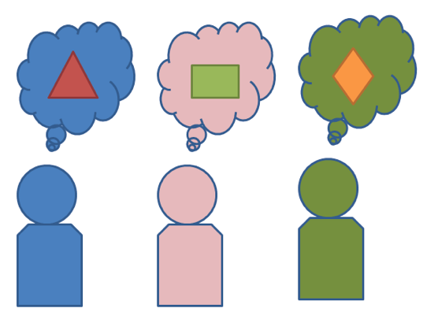
Interoperability Problem
Exchange or share information:
How to be “On The Same Page”?
Data
Semantics
Notes:
With lots of information (clinical or non-clinical) being exchanged electronically in today’s world, it becomes really really important that information that is exchanged
does not lose it what it is and what it means. How to be on the same page? In this new age of internet - semantics of the data being exchanged is equally
(and sometime more) than what data literally displays.

Slide 6
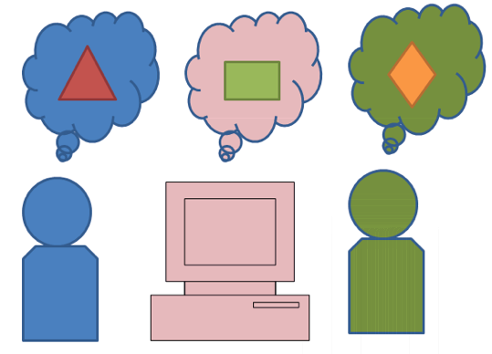
Interoperability Problem
Standards - Model/Schema/Metadata
Proprietary (not shared freely)
Finding semantics – mapping, transforms
Multiple
organizations
systems
Notes:
Yes we can set standards, create schemas, share metadata etc. but standards don’t always mean interoperability. We have models, schemas, metadata that two systems exchange (if they can exchange).
Sometimes it requires additional transforms, maps to store semantics correctly. Imagine if multiple organizations are involved and being consistent with internal external maps/transforms is not always possible.
Different ways are being used at different places to store data internally.

Slide 7
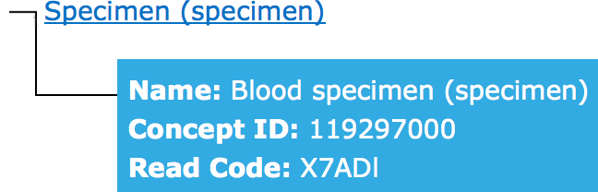
Terminology Binding
Meaning is defined with coded terms:
Blood Specimen – SNOMED ID: 122560006
definedBy
definedBy
ConceptReference
ConceptReference
“blspec001”
“Blood_spec”
Meaning is same

Slide 8
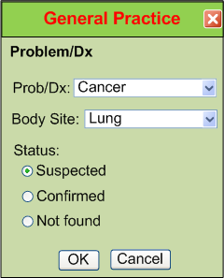
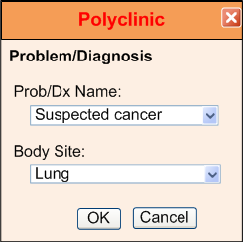
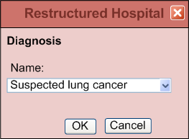
IsoSemantic Models – Example of Problem (from Dr. Linda Bird)
e.g. “Suspected Lung Cancer”
Courtesy: Dr. Stanley M. Huff (Intermountain Healthcare), and Dr. Linda Bird
Notes:
This slide shows how information about a diagnosis might be stored. Even though these three different healthcare providers are storing the same diagnosis, but how different they are as far as
UI element goes and how the values are coordinates and stored. Some people say that Oh may be they are not using the same model.

Slide 9
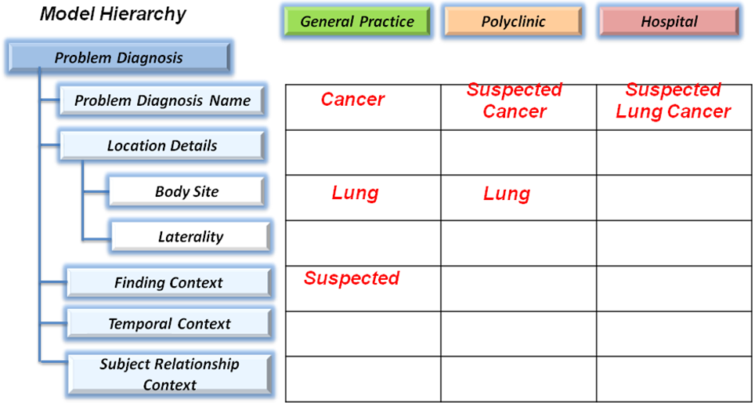
IsoSemantic Models – Example Instances (from Dr. Linda Bird)
e.g. “Suspected Lung Cancer”
Courtesy: Dr. Stanley M. Huff (Intermountain Healthcare), and Dr. Linda Bird
Notes:
But here they seem to be using the exactly same model hierarchy but the way values are stored at each level.

Slide 10
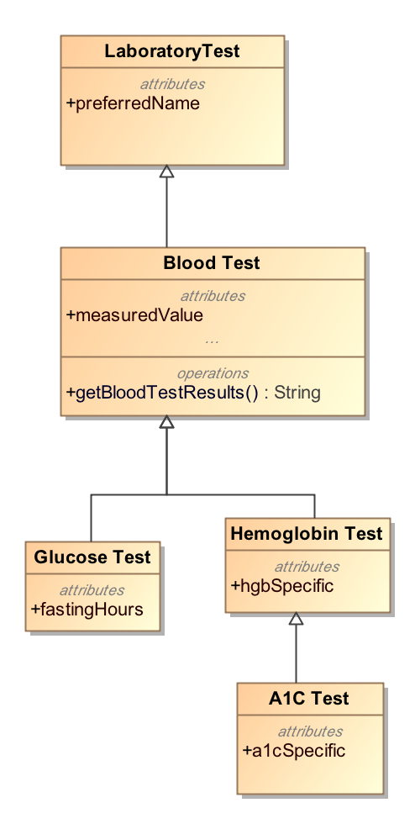
Modeling Approach
Top-Down Modeling
Generic → Specific
At each level we specialize
Properties
Associations
Notes:
May be there is something about how we model things. In a typical modeling approach
when we model we follow the top down modeling approach.
We start with the most abstract class at the top and we create subtypes specialize the subclasses
By adding properties and relationships. We are actually keep adding more to the child classes.
When we want to send data about a class, we create instance of that class and send it.

Slide 11
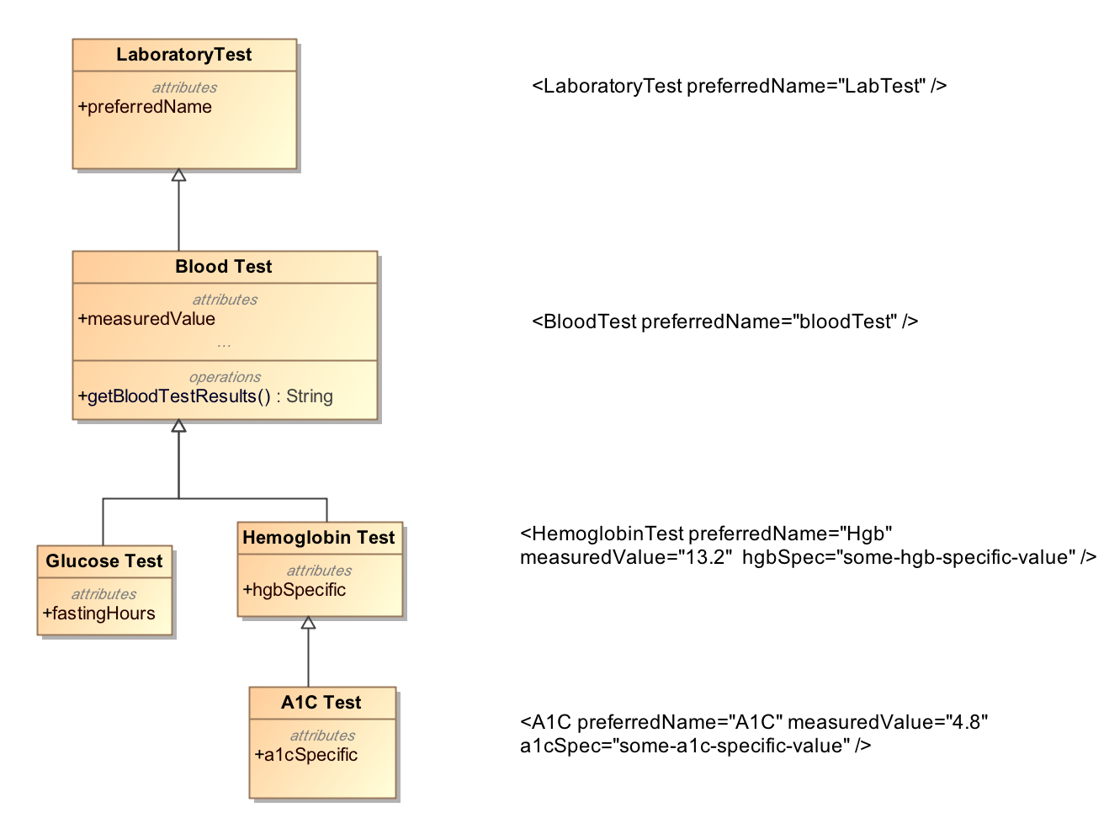
Top-Down Modeling Approach
Notes:
This slide shows the instance data that is valid for that class level. This slide was inspired by Harold Solbrig’s presentation at HL7 last year.
So you create instances of classes in your reference model and send it across.

Slide 12
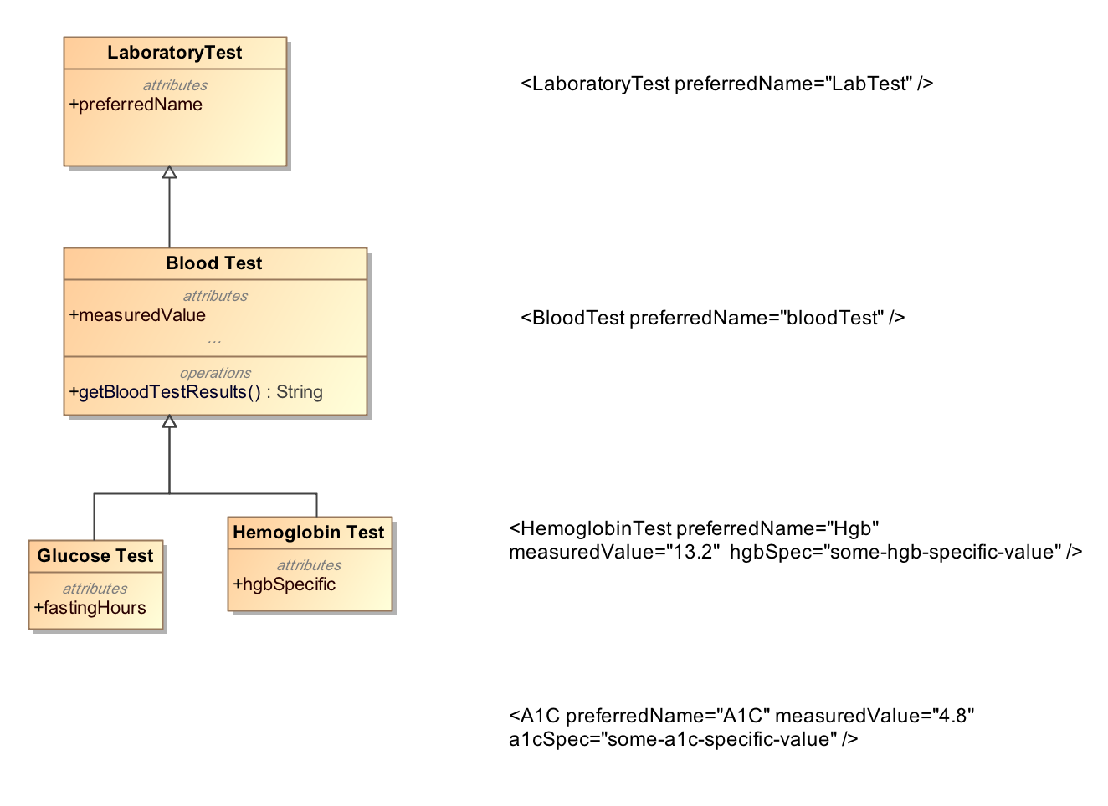
Top-Down Modeling Approach
If I have this
This does not make sense !!
Notes:
But in my world, if my model stops at Hemoglobin test then any data about A1C test will not have any meaning or value. So there is a problem. Even if there is a common model, users will extend it based on their needs and create data instances for the extensions.
How to exchange this information

Slide 13
Bottom-Up Modeling Approach
Constraint or Bottom-up Modeling
Start with a general model
Becomes the most abstract level of exchange
Specialize by
Cardinality
Values and value ranges
Optional/Mandatory/Prohibited
Enumeration subsets
Courtesy: Harold Solbrig
Notes:
Another approach is bottom-up modeling or it is viewed as constraint modeling. This slide is replicated from Haold Solbrig’s slide because it captures Constraint modeling approach in a very concise way.
In Constraint modeling we start from a general model – model with the all the classes and that becomes the most abstract level of exchange. We specialize these classes by narrowing down by constraining
Elements on cardinality of their attributes, values and value ranges that they can be assigned. Whether the class members are optional , mandatory or prohibited. Any instance of our narrowed down view will be valid
At the recipient's end of this shared model. Enumeration subsets, renaming

Slide 14
Bottom-Up Modeling Approach
Constraints on shared model:
Abnormal A1C Test = Set of Constraints
LaboratoryTest {1}
measuredValue {1..*}
{x| x in {measuredValues},
x > SomeThresholdValueforA1C}
Notes:
A Quick example of an archetype which defines an abnormal A1C test by defining constraints on the reference model classes and attributes.

Slide 15
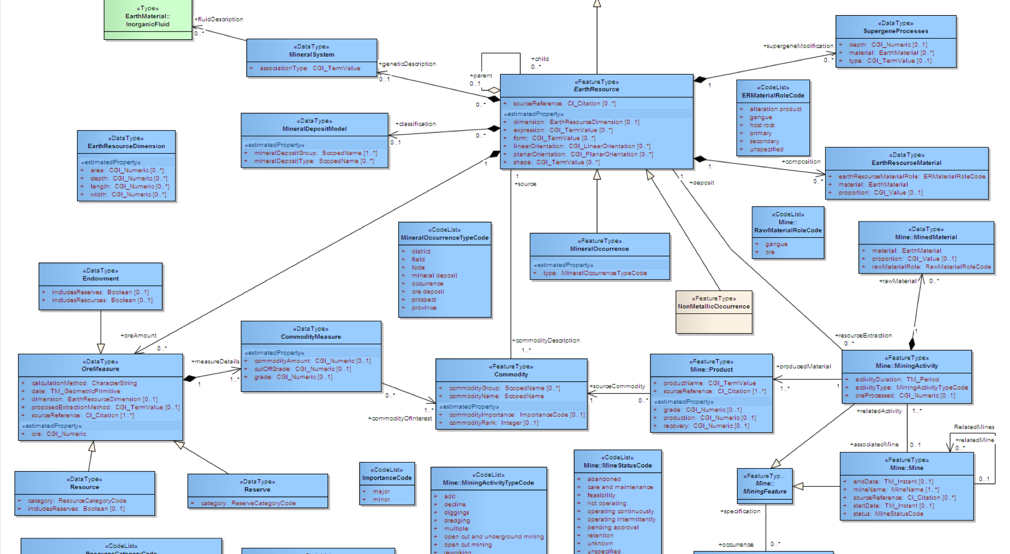

Archetype
“about”
Reference Model
Constraints on Reference Model Elements
Archetype
Notes:
So we have a model which participating entities aware of and ‘reference’, it is called a reference model – A reference model defines classes, data types, modeling patterns. We see that we define constraint(s) based on our needs and what and how we want to use the RM. These constraints talk “About” the reference model and its elements. Constraint do not affect RM in any way. And that is how we have an archetype. An archetype talk about only ONE reference model.

Slide 16
Archetypes
Reference Model
Archetype
Library
Notes:
We can have an archetype library which is a set of archetypes of all sizes – that are all about a reference model. Archetypes comes in all sizes, they can be just a simple, single constraint or can be lots of constraints and also by reusing existing archetypes.

Slide 17
Without Archetypes
Reference Model
Application
codes constraints:
LaboratoryTest == “A1C”,
measuredValue > threashold value
….
Other constraints…
Notes:
Lets look at a situation where an application works with a RM and implements the constraints without dealing with an archetype. The constraints are Inside the application itself – It is not very flexible.

Slide 18
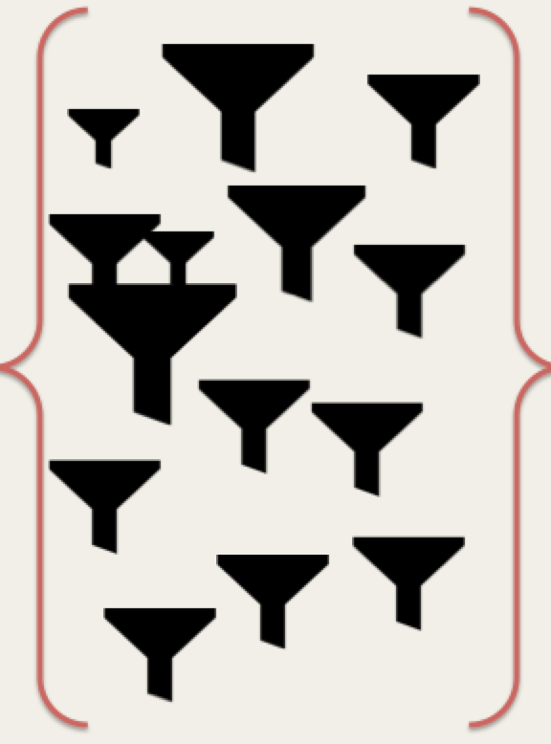
With Archetypes
Reference Model
Application
Archetypes
Notes:
With archetypes where an application employs with an archetype/archetype library as an external resource and just references RM to validate incoming instances by using archetypes.
Archetype libraries can be switched or constraints cab be changed without affecting the application itself.

Slide 19
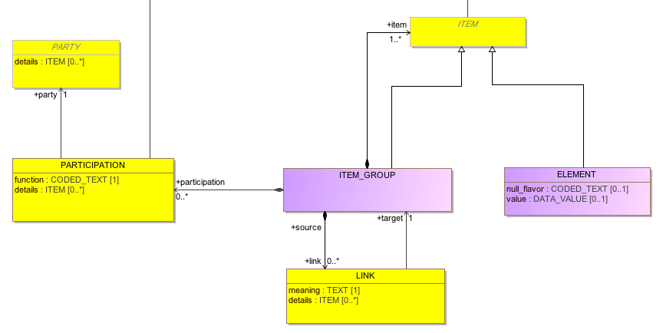
Reference Model Example
miniCIMI Reference Model
Notes:
Here we show an example of how an archetype might be created. First of all we have shared reference model. This is a very simple model where element is the leaf node and item group is a collection of more item-groups or leaf nodes (ELEMENT). Each item group can have a a meaning associated with it – tells what it means., using LINK. And a node item-group can have participation by a party – for example – and organization, patient, or care-giver.

Slide 20
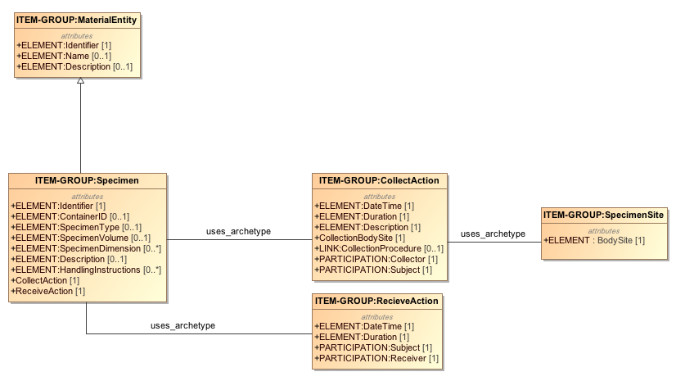
An Archetype Example
Simple Example: Specimen collection from a body site
RM
Notes:
This example is about an archetype for patient’s specimen collection. You can see that simples archetype on the right is show the what body site the specimen comes from. Collecting a specimen is described by an archetype collection action and similarly receiving a specimen is by ReceiveAction archetype. Please note that Collection action uses an existing archetype to defined itself. Similarly Specimen itself is an archetype composed by using other smaller archetypes. It specializes a parent archetype “Material Entity”.

Slide 21
Clinical Models
We can create …. more Clinical Models =>
For Example:
Laboratory Test,
Diagnostics,
Specimen , and so on…
And share them
“Shared Clinical Information Models”
– help improve Interoperability
Notes:
Similarly we can create more and more, as needed, the clinical models like Lab test, clinical statements, reports and what not.
So a single global collection of shared clinical models is of great value to achieve improve interoperability.

Slide 22
Agenda
Archetypes – what, why? ✔
Archetype Modeling Language
AML Tooling

Slide 23

Clinical Information Modeling Initiative
Since 2011
http://www.opencimi.org/
Mission Statement
“Improve the interoperability of healthcare systems through shared implementable clinical information models”
(A Single Curated Collection)
Notes:
In 2011 meeting of Modelers, participants concluded that having a shared repository of shared clinical information models will be of high value for interoperability. They felt that the newly formed group would be independent of any standards group and ensure that models that are created are open and free to use.

Slide 24
CIMI – Strategic Goal
“Be able to share data, applications, reports, alerts, protocols, and decision support modules with anyone in the WORLD”
Source: http://www.opencimi.org/

Slide 25
CIMI – Target Domains
EHR data storage
Message and service payload
Decision logic (queries of EHR data)
Clinical trials data (clinical research)
Quality measures
Normalization of data for secondary use
Creation of structured data entry screens
Capture of coding output from NLP
Source: http://www.opencimi.org/

Slide 26
CIMI – Deliverables
Shared repository of clinical information models
Single formalism with 2 representations:
ADL & AML
Formal bindings to standard terminologies
Model Repository:
Open & free for use
Source: http://www.opencimi.org/

Slide 27
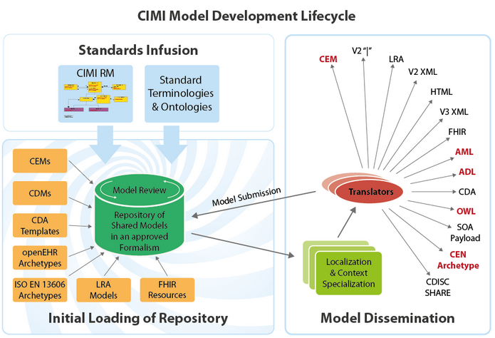
CIMI – Shared Repository
AML
Source: http://www.opencimi.org/
Notes:
CIMI shared repository enables developers of Health information system to re-use existing models that are reviewed. Initial load of models comes from OpenEHR archetypes and from IHC CEMs, about which we talk about shortly.
So to get started with the models, a smaller but very generic reference model has been created – CIMI RM. Archetypes are based on CIMI RM and bound to standard terminology and ontologies. Models can be downloaded as-is for the use in EHRs.
Translators will be added to import and export models in canonical model formats.

Slide 28
CIMI – Standard Terminologies
Model Elements are bound to Standard Terminologies and Ontologies:
SNOMED CT - primary and preferred
Systematized Nomenclature of Medicine – Clinical Terms
LOINC - approved
Logical Observation Identifiers Names and Codes
SNOMED CT CIMI Identifier for extension
Value-sets only by reference vs. list of values

Slide 29
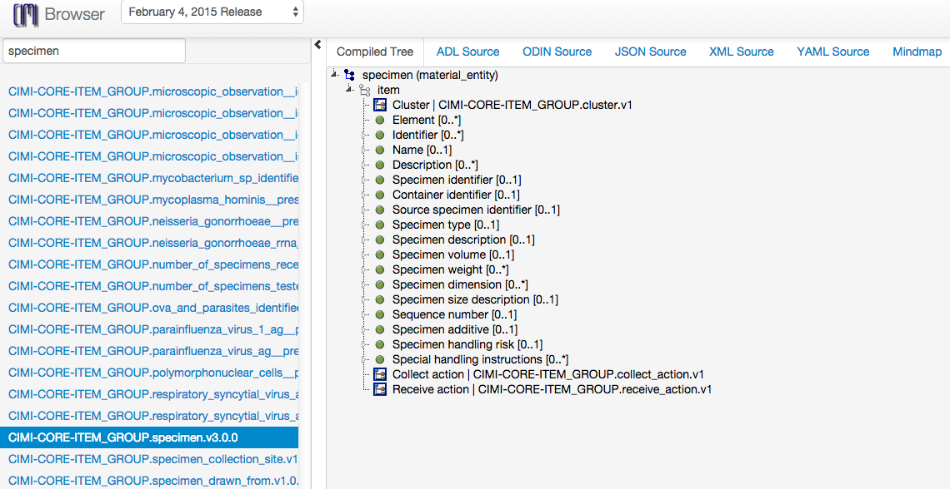
CIMI – Model Browser
Source: http://www.clinicalelement.com/cimi-browser
Notes:
CIMI shared repository enables developers of Health information system to re-use existing models that are reviewed. Jump starting the repository with models – we have models that come from OpenEHR archetypes in ADL format and the IHC CEM models converted to ADL format by GE-IHC team. They based on CIMI RM and possibly can be viewed and exported into other formats, as shown here.

Slide 30
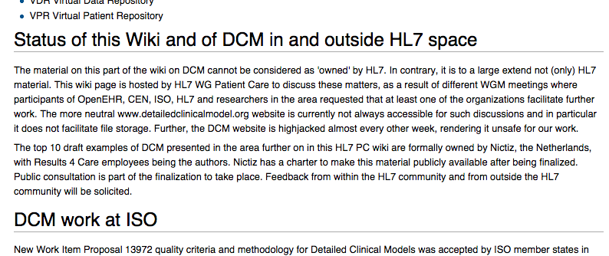
Other Efforts
HL7: Templates
OpenEHR: Archetype Definition Language (ADL)
GE-Intermountain Healthcare : Clinical Element Modeling Language (CEML)
Notes:
HL7 Templates – DCM, HL7 Flavored UML, trying to bridge some gaps between ADL and V3 Templates. Not sure how successful as their main wiki has a disclaimer.
OpenEHR has most traction so far. They have OpenEHR open source tools (by a company Ocean Informatics lead by Thomas Beale).
Released Archetype Definition Language and its object model AOM- specifications. ADL formats comes from ODIN – Object Data Instance Notation.

Slide 31
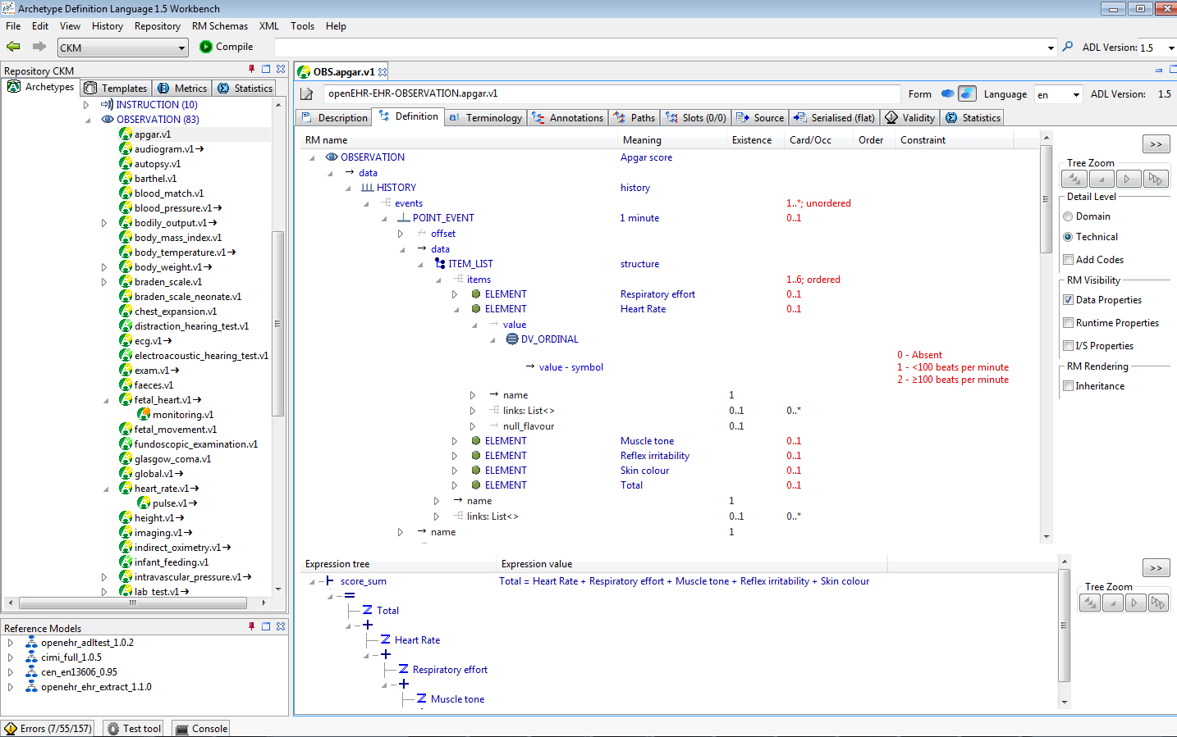
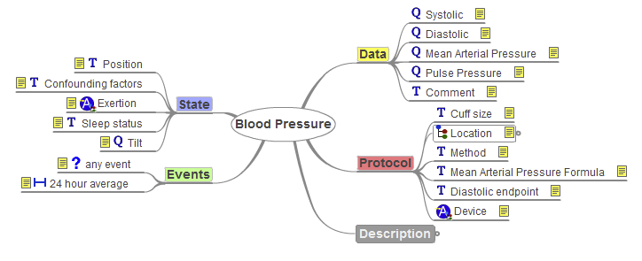
ADL Workbench
Notes:
ADL workbench – proprietary, written in Eiffel, but efforts are underway to release it in and for Java. There is no easy gateway to Model Driven Architecture.

Slide 32
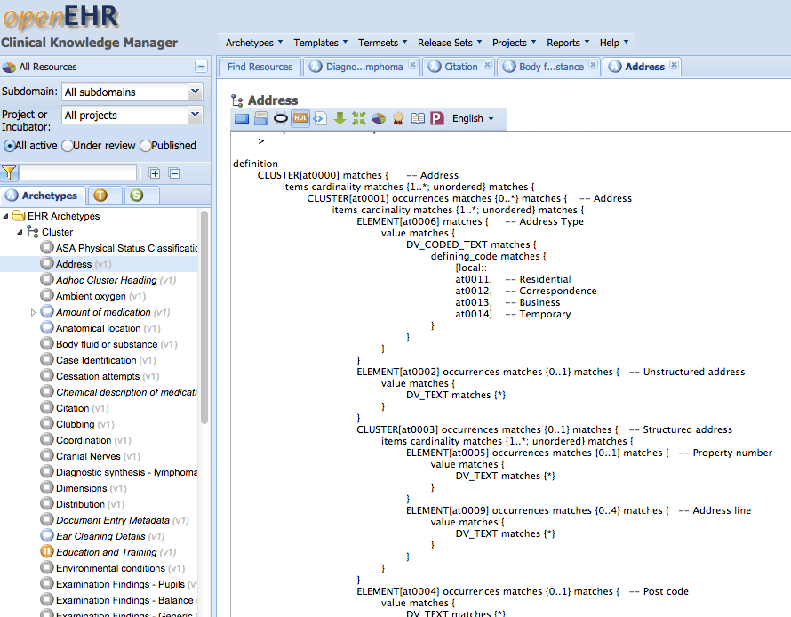
OpenEHR - CKM
http://openehr.org/ckm/
ADL1.5
Notes:
Clinical Knowledge Manager is an online collaboration portal for ADL archetypes.

Slide 33
AML
AML Preliminary submission to OMG
in November 2014
Currently being revised…
AML specification is collection of UML artifacts:
Profiles, stereotypes
Data types
Classes, Packages
https://github.com/opencimi/AML
(in a bit of disarray at the moment)

Slide 34
Unified Modeling Language
UML is an OMG standard
Creating and exchanging Models - (XMI)
Create:
Classes, Properties, Associations, Enumeration
Generalization / Specialization
Extension Mechanism
Stereotypes, tags, constraints (OCL)
Profiles
Collection of Stereotypes, domain specific

Slide 35
OCL
Constraints are in “Object Constraint Language” – OCL:
Textual Language to describe constraints, e.g.
Context=Patient
{self.age >= “18”}
Context=SingularAttributeConstraint
{(self.base_Property.redefinedProperty->size()=1)and
(self.base_Property.upper=1)}
Courtesy: Harold Solbrig

Slide 36
Archetypes in UML
Advantages:
UML is OMG standard, non-proprietary
UML is familiar to modelers
Model-Driven Architecture
AML works directly with UML RMs

Slide 37
Clinical Models
UML Meta Model
AML
RM
MDA
UML Profiles
Application Template
Meta-model
UML
Generate
about
Transform
Clinical Model
Clinical Model
Clinical Model
Application
Clinical Model
UML
Validates
UML
CIMI Model Repository
Archetype Library
Instance Data

Slide 38
Inside AML Specifications
UML Meta Model
AML Object Model | AML Profile
Reference Model | Reference Model Profile
Archetype Model | Archetype Profile
Constraint Model | Constraint Profile
Terminology Model | Terminology Profile
Rules Model | Rules Profile
Metadata Model | Identification & Designation
AML
RM
MDA
UML Profiles
Application Template
Meta-model
UML
Generate
about
Transform
Clinical Model
Clinical Model
Clinical Model
Application
Clinical Model
UML
Validates
UML
CIMI Model Repository
Archetypes
Instance Data

Slide 39
Reference Model
Describes the characteristics a target Reference Model (RM) must have in order for the constraint model to refer to it predictably
Reference Model Profile:
Defines the set of data types whose values can be directly constrained by an AML Model.
It also specifies a small set of stereotypes that are used to "decorate" a reference model and its various components.
Notes:
What core RM elements that a model must have for Constraints to work.

Slide 40
Archetype Model
Defines relationship between archetype libraries, archetypes and archetype versions.
Archetype Profile:
Constraint related to Archetype Library, Archetype and Archetype Version.
Notes:
Archetype model guides us about creating Archetype library and archetype classes along with their version information.

Slide 41
Constraint Model
Illustrates how constraints are defined. This is core part of the AML specifications.
Constraint Profile:
Defines the modeling elements that may be applied to a reference model and archetype. These elements “constrain” the target model narrowing the semantics and syntax.
Notes:
Central to AML. Define elements which constrain the target RM. ComplexObjectConstraints, AttributeConstraints, TerminologyConstraints etc.

Slide 42
Identification & Designatable
Advised by ISO 11179-3
IdentifiableItem
Namespace + id
DesignatableItem
Language + sign + [description]
Namespaces
“meaning” linkage from Class
Courtesy: Harold Solbrig
Notes:
How to create identifiable items, namespaces and meaning linkage from classes.

Slide 43
Terminology Profile
Describes how various elements of Standards:
Common Terminology Services (CTS2)
ISO 11179 – Metadata Repository (3rd Ed.)
can be utilized to bind identifiers and terms used (in archetypes) to terminology resources like:
Code Systems
Value Sets and Permissible Values
Notes:
Terminology profile binds IDs and Terms to a terminology resource.

Slide 44
Agenda
Archetypes – what, why? ✔
Archetype Modeling Language ✔
AML Tooling
Notes:
Without tooling any standard or spec usually just remains a standard and no-one really uses it and it looses its claim to the value it proposed.

Slide 45
AML Tooling
AML Object Model (AML-OM)
Inspired from ADL Object Model (AOM)
Existing ADL archetype → AML archetypes
Map AOM → AML-OM
Developing a converter is to visualize real, existing archetypes in AML programmatically
Testing and Constraints validation comes next
Notes:
AML Object model is inspired by ADL Object model AOM. We have fulfilled AML RFP requirements – in most cases, by mapping components of ADL into AML.
So it made sense to try AML specifications by creating archetypes in AML by converting ADL converting ADL archetypes into UML.
To see real archetypes in AML world – made me excited to write this converter. Once we have archetype in AML, testing them and validating constraints comes next.

Slide 46
AML Tooling
Project Location:
https://github.com/semantix/AMLTooling
Sub-projects:
ADL2AMLConverter – The Converter
AML MD Library – AML Wrapper on MD Open API
AML MD Plugin – Menu Plug-in to MagicDraw IDE

Slide 47
ADL2AML Converter
Traceability Matrix
AML
UML
Export to a target format
ADL Objects
AML Objects
ADL2AML
Converter
ADL Parser
MD Open API
ADL

Slide 48
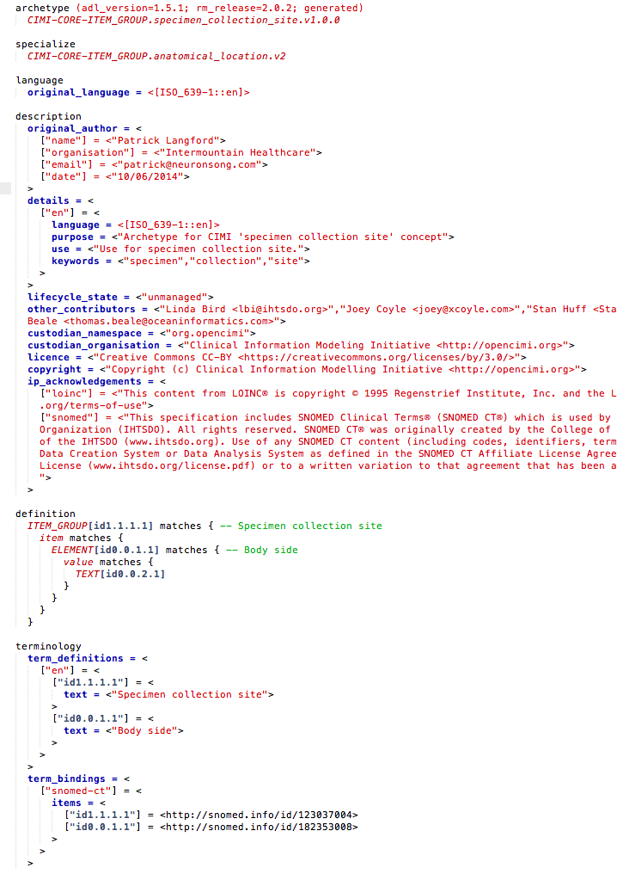
ADL
An ADL file for archetype “specimen_collection_site”

Slide 49
ADL
Archetype Metadata Section
Constraints/Definition Section
Terms & Terminology Binding Section

Slide 50
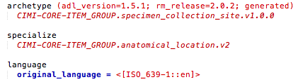
ADL

Slide 51
ADL
publisher
RM Class
Archetype Name
Version

Slide 52
ADL
Specialize
Language

Slide 53
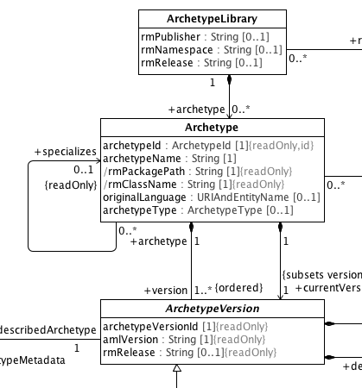
Maps to Archetype Model in AML

Slide 54
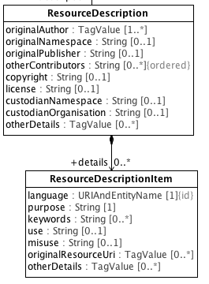
Maps to a ‘Resource’ of Archetype Model in AML

Slide 55
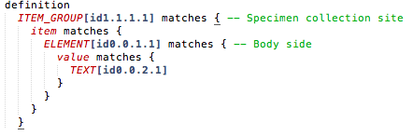
ADL

Slide 56
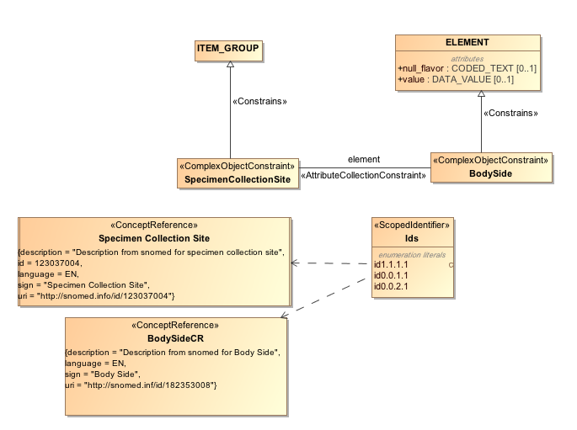
Maps to Constraint Model of AML

Slide 57
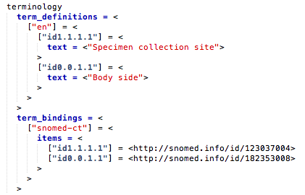
ADL

Slide 58
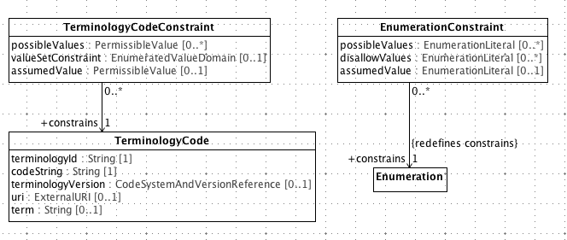
Maps to Terminology Binding Profile of AML

Slide 59
Agenda
Archetypes – what, why? ✔
Archetype Modeling Language ✔
AML Tooling ✔
Notes:
Without tooling any standard or spec usually just remains a standard and no-one really uses it and it looses its claim to the value it proposed.

Slide 60
Completed AML Spec./Tooling Tasks
Model 2 Text Transforms:
Completed IBM RSA Business Intelligence Report Tool (BIRT) Template to dynamically generate specifications
Completed Apache Velocity Template –
IBM RSA → MagicDraw
AML API Layer over MagicDraw OpenAPIs
AML Specifications
EA -> RSA -> MD, Release

Slide 61
Acknowledgements
Dr. Chris Chute
Dr. Claudia Neuhauser
Dr. Guoqian Jiang
Harold Solbrig (Mayo Clinic)
CIMI Modeling Task Force
Dr. Stan Huff (GE-Intermountain Healthcare)
Dr. Susan Van Riper (University of Minnesota)

Slide 62
Thank You
Questions & Comments
This presentation is at:
https://github.com/semantix/AMLTooling/blob/master/docs/AMLTooling_Short.pptx
Send me an email at: sharm110@umn.edu

