Slide 1
AML Archetype Modeling Language Improving interoperability of information models
Deepak K. Sharma
University of Minnesota
April 23, 2015

Slide 2
Agenda
The interoperability problem.
Archetypes - Constraint Modeling.
Existing Frameworks & Tools.
Clinical Information Modeling Initiative (CIMI)
Archetype Modeling Language.
AML Resources/Examples.
AML Tooling.

Slide 3
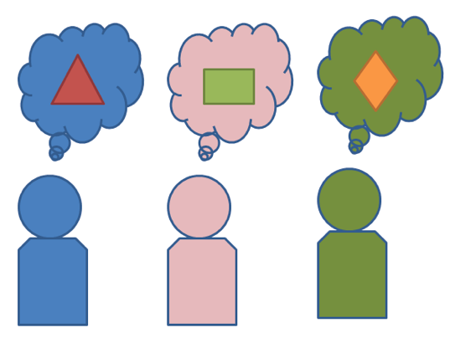
Interoperability Problem
Exchange or share information:
How to be “On The Same Page”?
Data
Semantics
Notes:
What we are trying to solve. We are trying to make two systems interoperable. It is an old problem. But with lots of information being exchanged electronically in today’s world, it becomes really really important that information that is exchanged
Does not lose it what it is and what it means. How to be on the same page? As far as data is concerned and semantics that data carries from its sender.

Slide 4

Interoperability Problem
Standards - Model/Schema/Metadata
Proprietary (not shared freely)
Finding semantics – mapping, transforms
Multiple
organizations
systems
Notes:
Standards for data information exchanged have been developed and being utilized, but standards don’t always mean interoperability.
We have models, schemas, metadata that two systems exchange (if they can exchange)
We have been using modeling approaches, sharing schemas and meta data in various ways

Slide 5
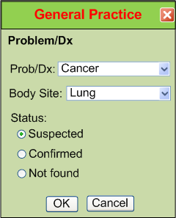
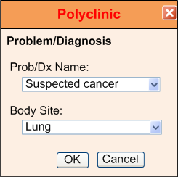
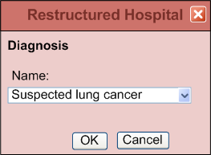
IsoSemantic Models – Example of Problem (from Dr. Linda Bird)
e.g. “Suspected Lung Cancer”
Courtesy: Dr. Stanley M. Huff (Intermountain Healthcare), and Dr. Linda Bird
Notes:
This slide shows how information about a diagnosis might be stored. Even though these three different healthcare providers are storing the same diagnosis, but how different they are as far as
UI element goes and how the values are coordinates and stored. Some people say that Oh may be they are not using the same model.

Slide 6
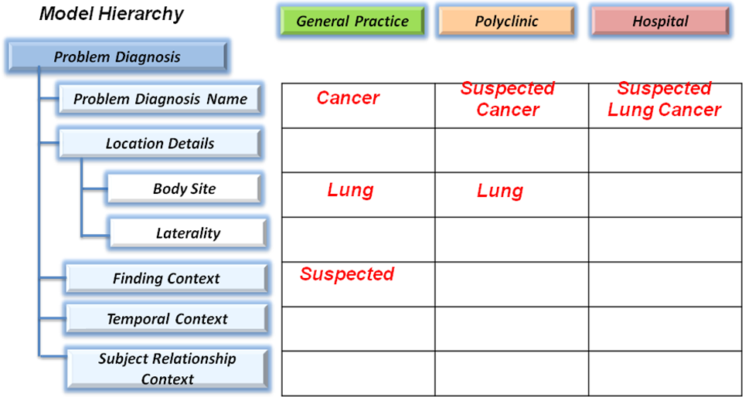
IsoSemantic Models – Example Instances (from Dr. Linda Bird)
e.g. “Suspected Lung Cancer”
Courtesy: Dr. Stanley M. Huff (Intermountain Healthcare), and Dr. Linda Bird
Notes:
But here they seem to be using the exactly same model hierarchy but the values are stored. So what can be done? There has to be a way to constrain the way things are stored and described.

Slide 7
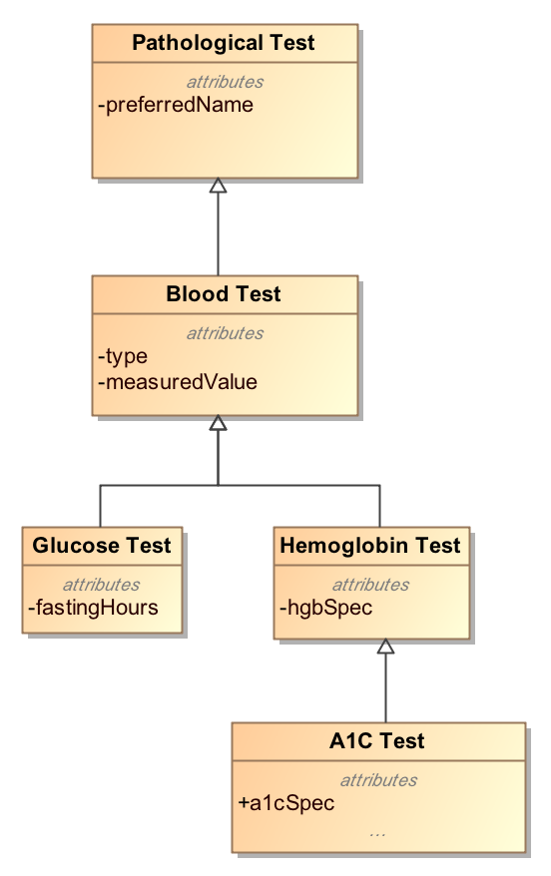
Modeling Approach
Top-Down Modeling
Generic → Specific
At each level we specialize
Properties
Associations
Notes:
In a typical modeling approach when we model we follow the top down modeling approach.
We start with the most abstract class at the top and we create subtypes specialize the subclasses
By adding properties and relationships. We are actually keep adding more to the child classes.
When we want to send data about a class, we create instance of that class and send it.

Slide 8
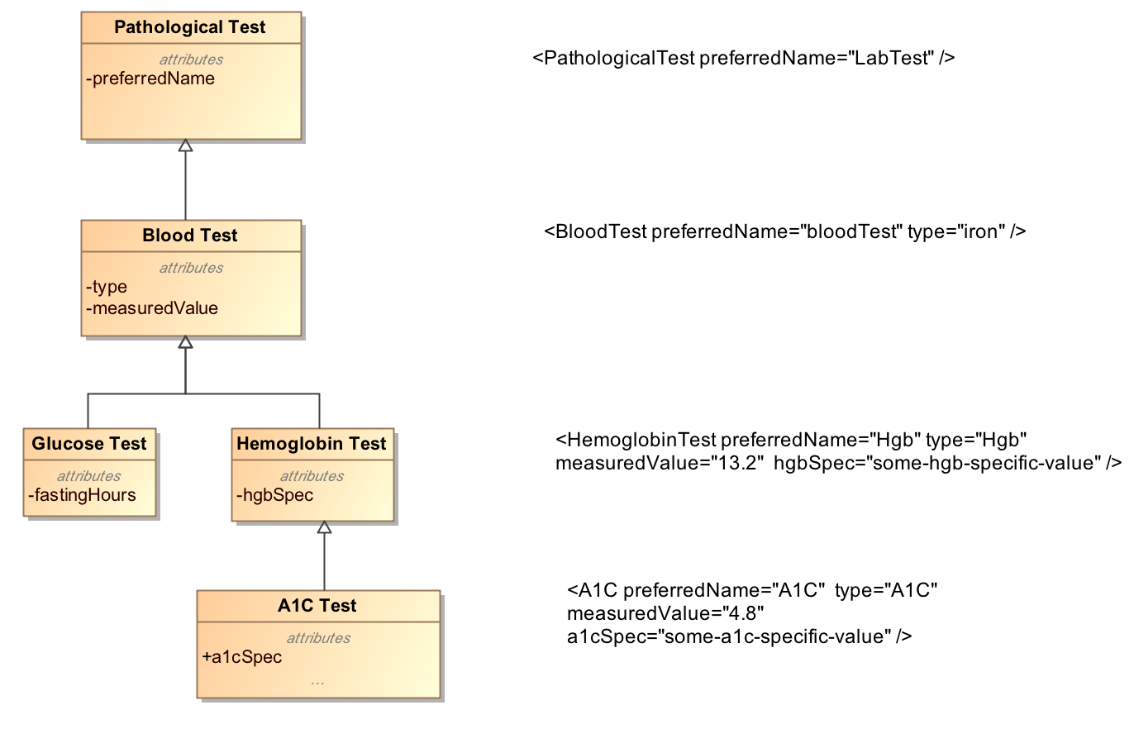
Top-Down Modeling Approach
Notes:
This slide shows the instance data that is valid for that class level. This slide was inspired by Harold Solbrig’s presentation at HL7 last year.
So you create instances of classes in your reference model and send it across.

Slide 9
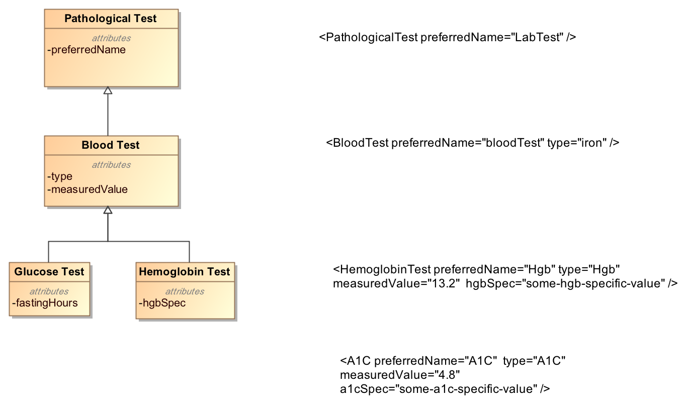
Top-Down Modeling Approach
???
Notes:
But in my world, if my model stops at Hemoglobin test then any data about A1C test will not have any meaning or value.

Slide 10
Bottom-Up Modeling Approach
Constraint or Bottom-up Modeling
Start with a general model
Becomes the most abstract level of exchange
Specialize by
Cardinality
Values and value ranges
Optional/Mandatory/Prohibited
Enumeration subsets
Renaming
Courtesy: Harold Solbrig

Slide 11
Bottom-Up Modeling Approach
Example
Abnormal A1C Test = Set of Constraints
Pathological Test {0..*}
Has measuredValue {1..*}
measuredValue > Some_Threshold_Value
Type == “A1C”

Slide 12
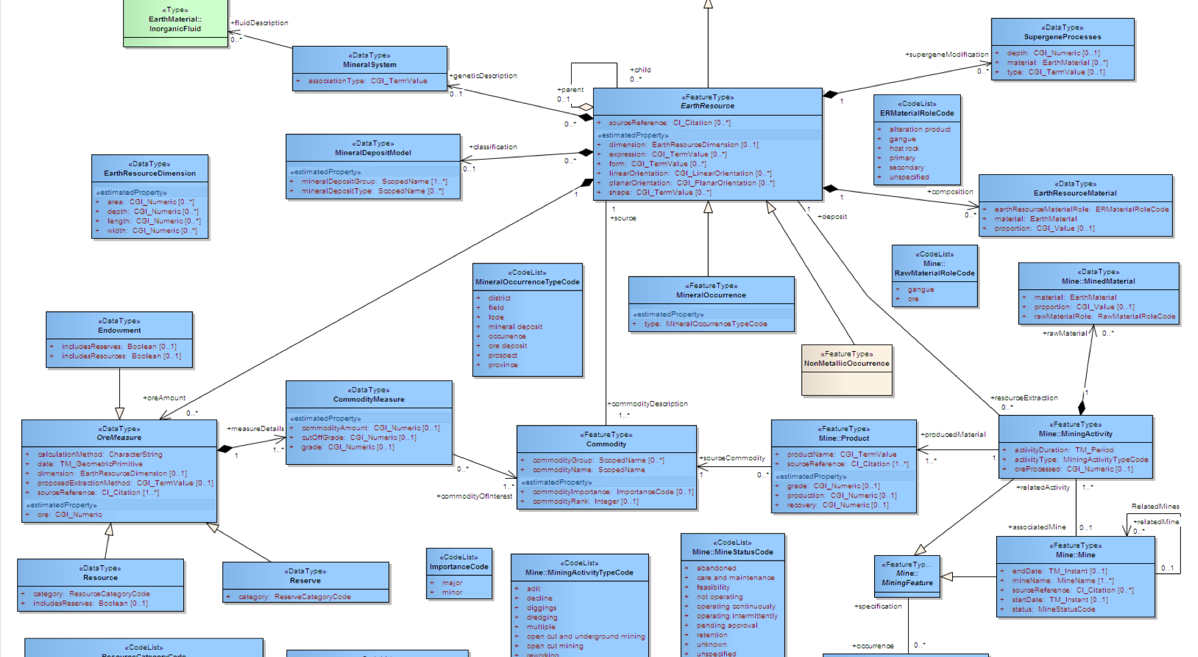

Archetype
“about”
Reference Model
Constraints on Reference Model Elements
Archetype

Slide 13
Archetypes
Reference Model
Archetype
Library

Slide 14
Without Archetypes
Reference Model
Application
Codes constraints:
Pathological test == “A1C”,
measuredValue > threashold value
….
Other constraints
Notes:
Inside application – not very flexible. brittle

Slide 15
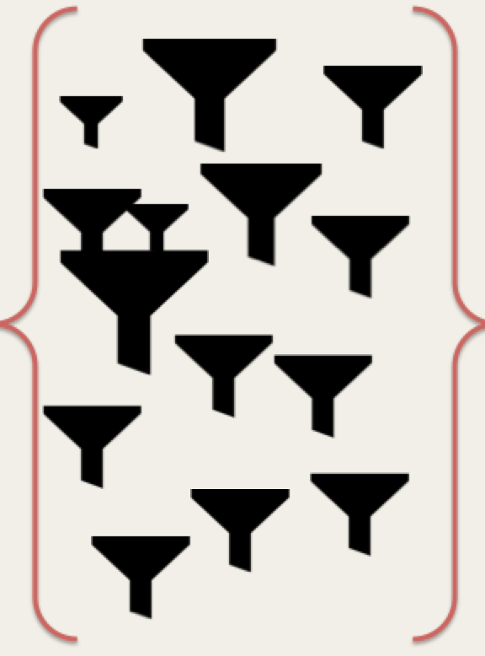
With Archetypes
Reference Model
Application
Archetypes

