Slide 1







Emerging Skills & Jobs
Anais Velazquez
November 18, 2024

Slide 2



OUTLINE
Executive Summary
Introduction
Methodology
Results
Visualization – Charts
Dashboard
Discussion
Findings & Implications
Conclusion
Appendix

Slide 3

EXECUTIVE SUMMARY
Using data from GitHub Jobs API, we will discover the trending:
Languages
Platforms
Databases
As well as the salaries through web scraping for trending languages.
Visualizing the data to show relations through
Scatter plots
Pie charts
Line charts
Histograms
Bar charts
Dashboards

Slide 4

INTRODUCTION
In this project, we will
Collect via:
APIS
Web Scraping
Explore,
Wrangle,
Normalize, and
Visualization
the data. To view trends and relationships between different data points to see for correlations.
Using dashboard, we will show to the final findings of the dataset.

Slide 5

METHODOLOGY
Collecting the GitHub Jobs API dataset
Using the Requests and Pandas packages
Exploring the dataset
Data Wrangling
Finding and Removing/Inputting
Duplicates
Missing values
Normalizing the data
Web scraping
Visualization
Jupyter Notebooks Pandas Plotting
Cognos Dashboard

Slide 6
RESULTS
The results showed:
JavaScript is the top pick for both worked with and desired language.
PostgreSQL is the top pick for database
Linux is the top pick for platform
Demographic shows that mostly respondents are:
Men
Young people (in early-20s to mid-30s)
Bachelor’s degree holders

Slide 7
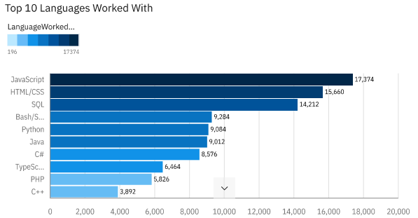
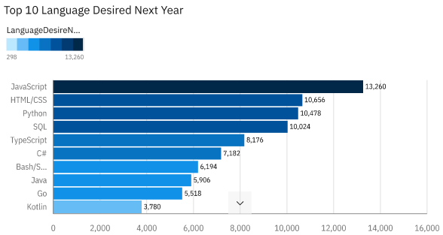
PROGRAMMING LANGUAGE TRENDS
Current Year
Next Year

Slide 8
PROGRAMMING LANGUAGE TRENDS - FINDINGS & IMPLICATIONS
The top 10 languages worked with this year were:
JavaScript
HTML/CSS
SQL
Bash/Shell
Python
Java
C#
TypeScript
PHP
C++
The top 10 languages desired with next year are:
JavaScript
HTML/CSS
Python
SQL
TypeScript
C#
Bash/Shell
Java
Go
Kotlin
JavaScript and HTML/CSS is at the top in both current and desired language to work with. This shows that JavaScript and HTML/CSS stay to most popular with users.

Slide 9
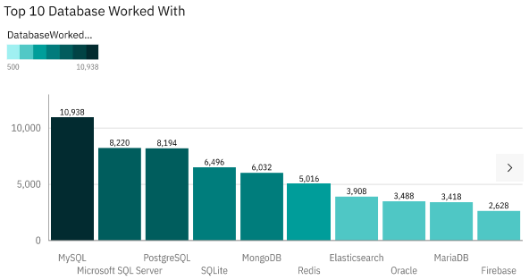
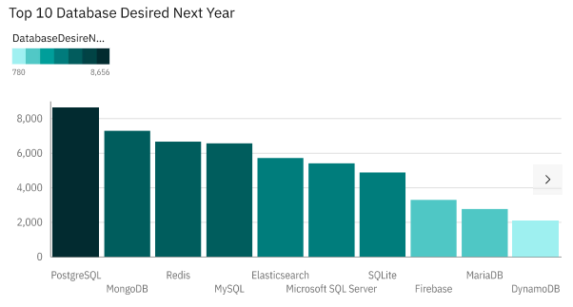
DATABASE TRENDS
Current Year
Next Year

Slide 10
DATABASE TRENDS - FINDINGS & IMPLICATIONS
The top 10 database worked with this year were:
MySQL
Microsoft SQL Server
PostgreSQL
SQLite
MongoDB
Redis
Elasticsearch
Oracle
MariaDB
Firebase
The top 10 database desired to work with next year are:
PostgreSQL
MongoDB
Redis
MySQL
Elasticsearch
Microsoft SQL Server
SQLite
Firebase
MariaDB
DynamoDB
PostgreSQL is third in current database usage and is the top desired database next year. This shows that PostgreSQL stays consistent in its ability provide functionality to its users.

Slide 11

DASHBOARD
Cognos Dashboard

Slide 12
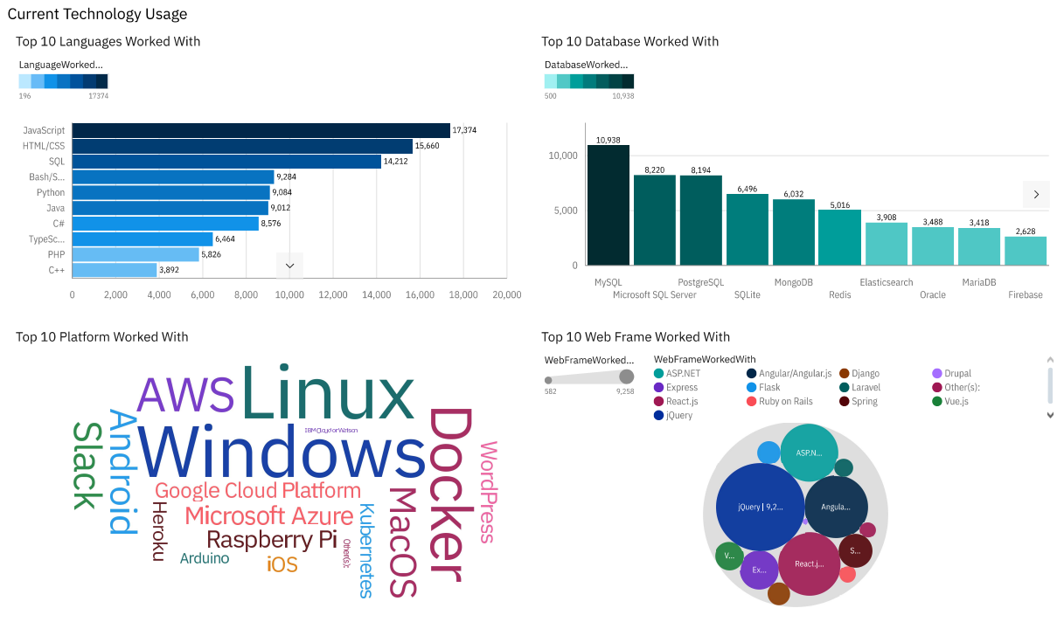
Current Technology Usage

Slide 13
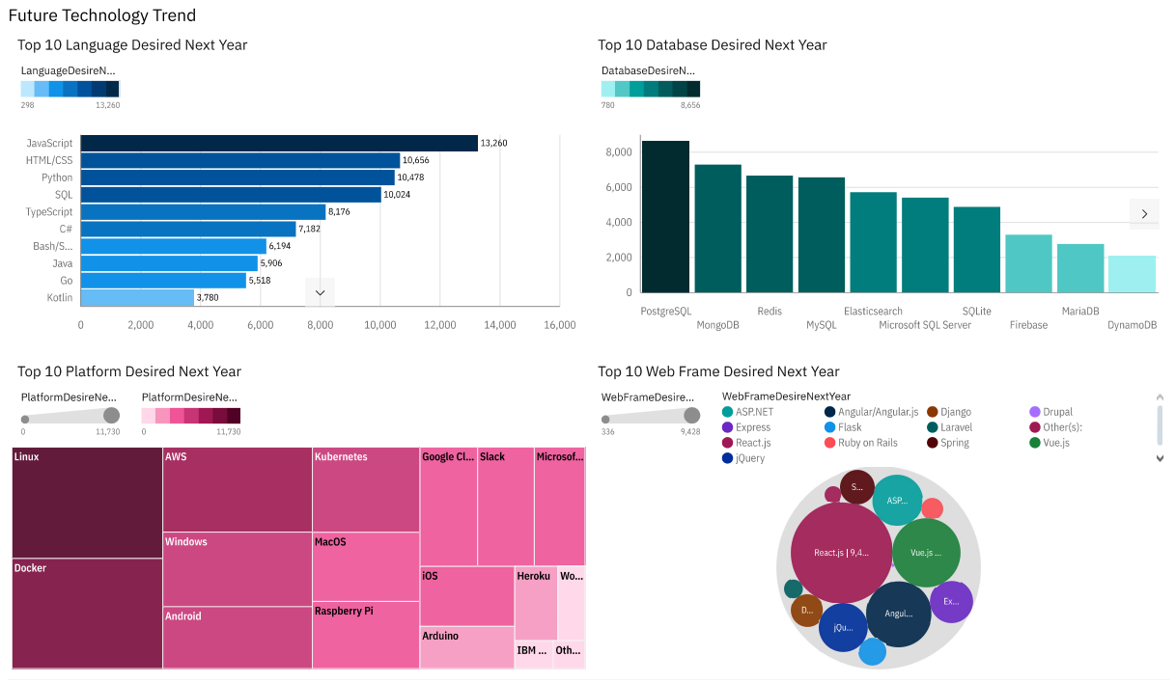
Future Technology Trend

Slide 14
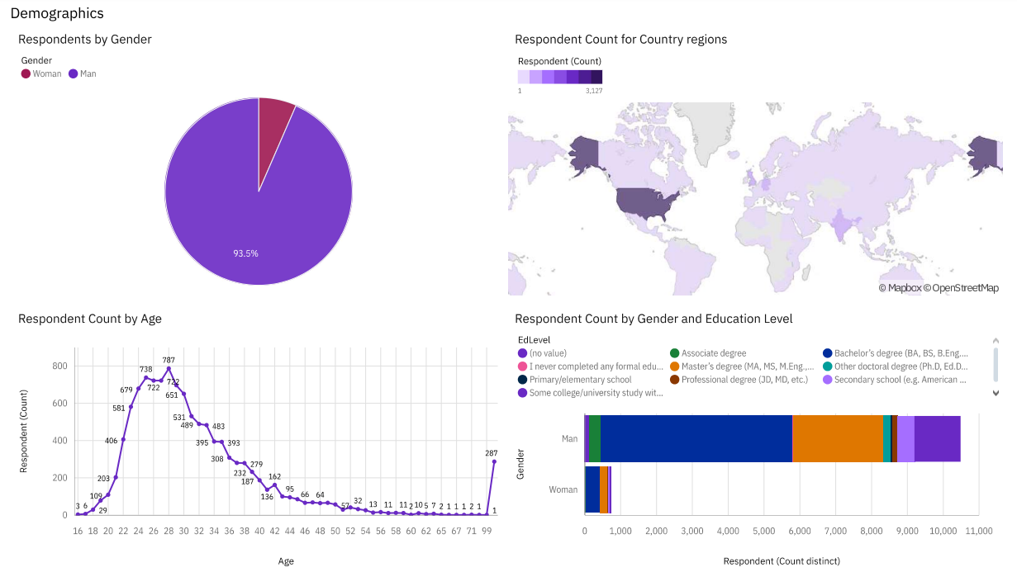
Demographic

Slide 15
DISCUSSION
In the full tabs of the dashboard, we can see:
Current Technology
Language: JavaScript
Database: MySQL
Platform: Windows
Web Frame: jQuery
Future Technology:
Language: JavaScript
Database: PostgreSQL
Platform: Linux
Web Frame: React.js
Demographic:
Men dominated the survey
The most respondents were 22-32 in age
America had the most respondents
Most respondents had bachelor's degrees

Slide 16
OVERALL FINDINGS & IMPLICATIONS
Findings:
JavaScript is the top worked with and desired when it comes to language.
PostgreSQL is the top desired and within the top 3 worked with databases.
Windows was the top platform in the current and stayed within the top 5 desired platforms to work with next year.
22- 32 aged men dominated this survey. As well as people with bachelor's degrees.
Implications:
Showing that it is a popular language to know and use.
Meaning PostgreSQL continues to provide users with the functionality needed.
Linux is the top desired platform and is in the top 3 in platforms worked with this year. Making Linux the preferred platform.
Showing that the tech field is mostly dominated by young people, people with bachelor’s degrees, and men.

Slide 17

CONCLUSION
JavaScript is a popular language for this year and the next.
PostgreSQL and Linux are the top picks for Database and Platform respectively
The tech field is dominated by
Males
People aged 22 – 32
Bachelor’s degree holders

Slide 18
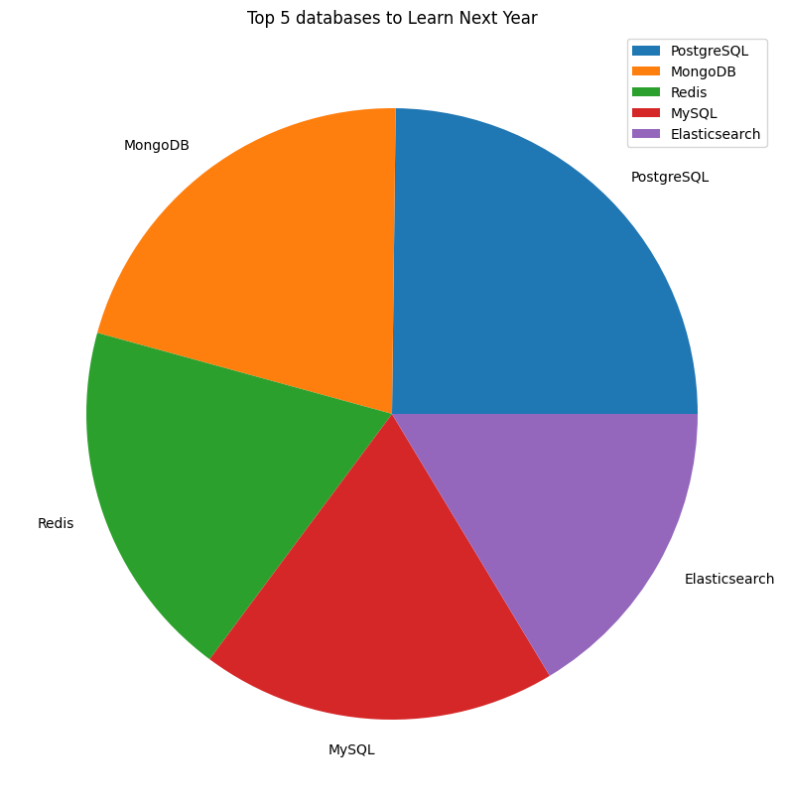

APPENDIX

Slide 19
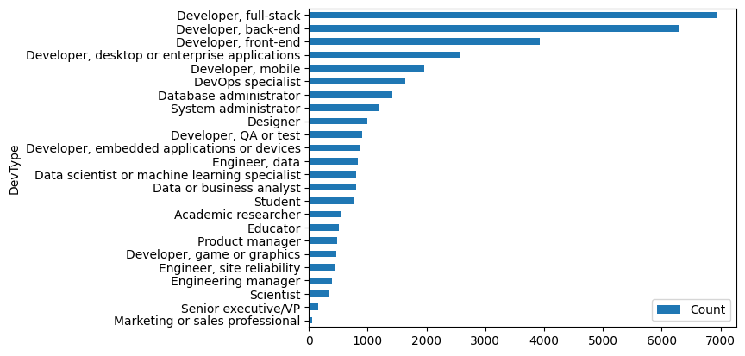
JOB POSTINGS

Slide 20
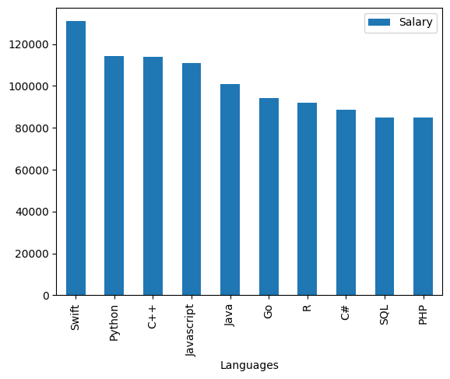
POPULAR LANGUAGES BY SALARY

