Slide 1
Smartphone Market Data
Avenash Ramnarine

Slide 2

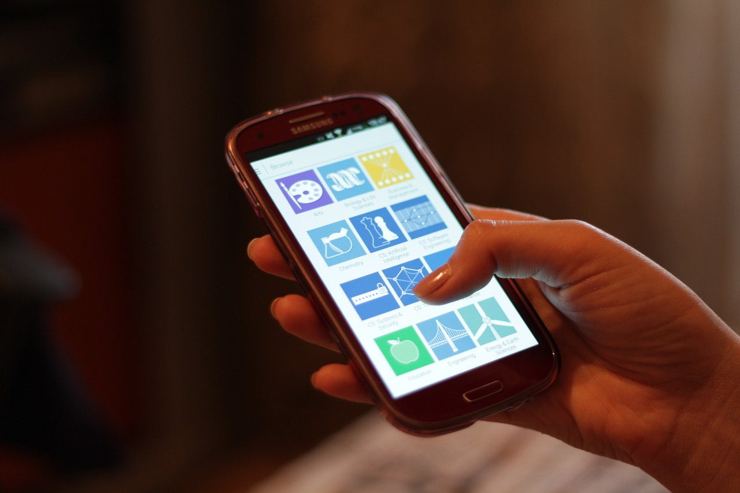
Introduction
This data set represents the market data for smartphones in India. India was specifically chosen for this survey since it contains a large population with a rapidly growing smartphone industry. The data was gathered in 2020 and compiled into this set where it contains 1513 entries of various smartphones and their attributes.

Slide 3
Attributes
Product name: The name of the product, for example: iPhone 11, Samsung S20 etc.
Product url: Product URL is the URL to the page which contains the product information.
Brand: Brand is the name of the smartphone brand, for example Samsung. Under the brand Samsung, they sell 243 models. Some of them are variants of the same model but for the sake of analysis we list them as two distinct models and they have different UPC’s.
Sale price: Sale price is the price at which the product is available on Flipkart for sale. It is the price after the discounts.
MRP: MRP is the maximum retail price of the product.
Discount percentage: Discount percentage is the discount offered by the brand for that particular product.
Ram: The Ram Capacity of the smartphone
Number of ratings: The total number of star ratings given to that particular product.
Number of reviews: The total number of reviews given to the product.
UPC: UPC or universal product code is the unique identification for a model.
Star rating: Star rating is the average rating of the product.

Slide 4
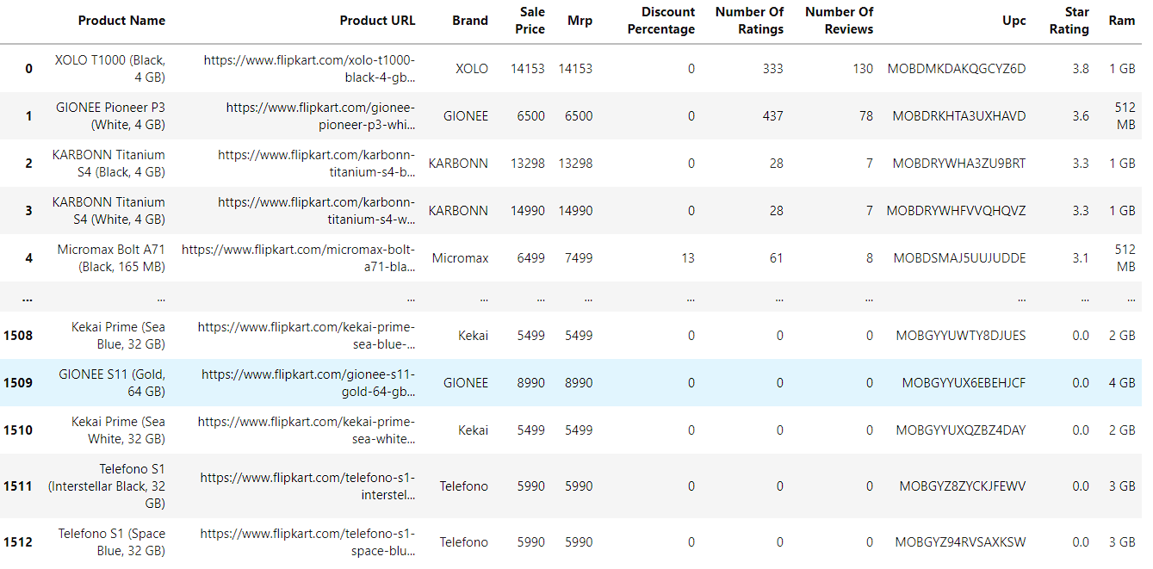
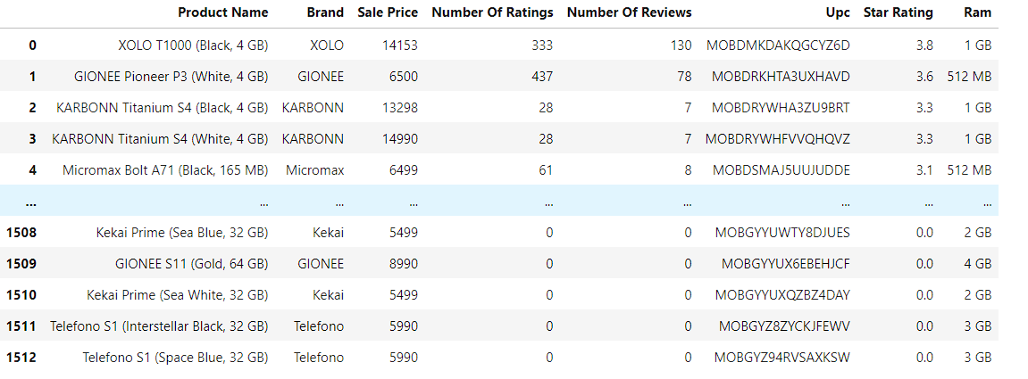
Taking a look at this data set the first thing that stands out is the amount of information contained within it. While this is usually a good thing, looking at this data set you can see that some of information given is very redundant and not of value to our analysis. For example, the product URL, Mrp and Discount Percentage all are irrelevant for this analysis, so I decided to drop those

Slide 5
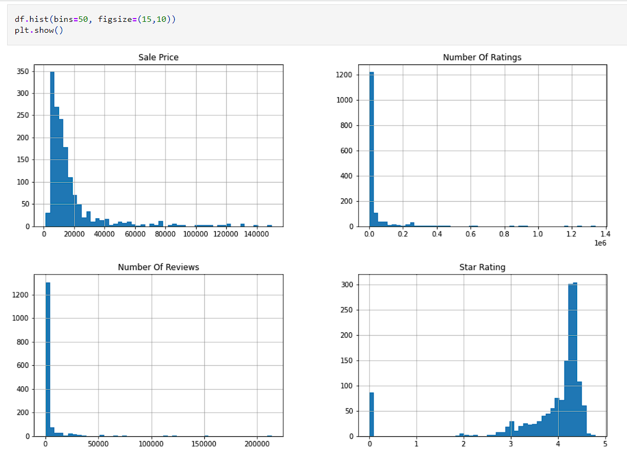
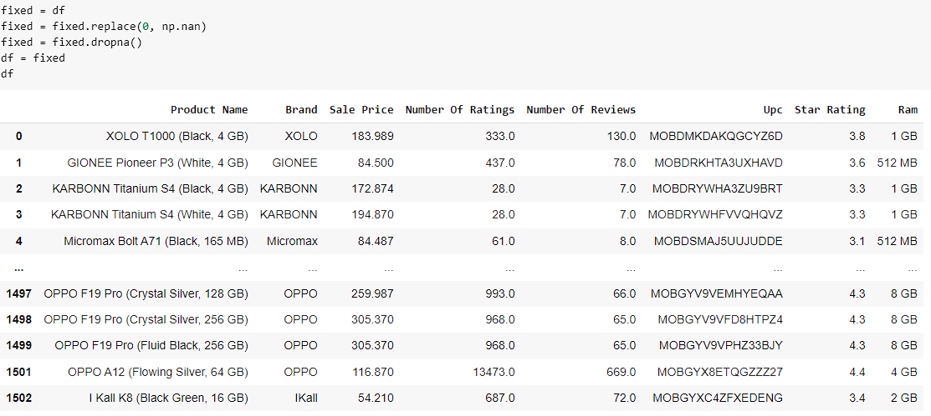
After plotting the data one thing I noticed is that there seems to be a large amount of '0' values for the Number of Ratings, Star Rating, and Number of Reviews columns. So I decided to first count how many instances of this there are, and ultimately thought it best to drop these entries since they only totaled to about 100 total

Slide 6
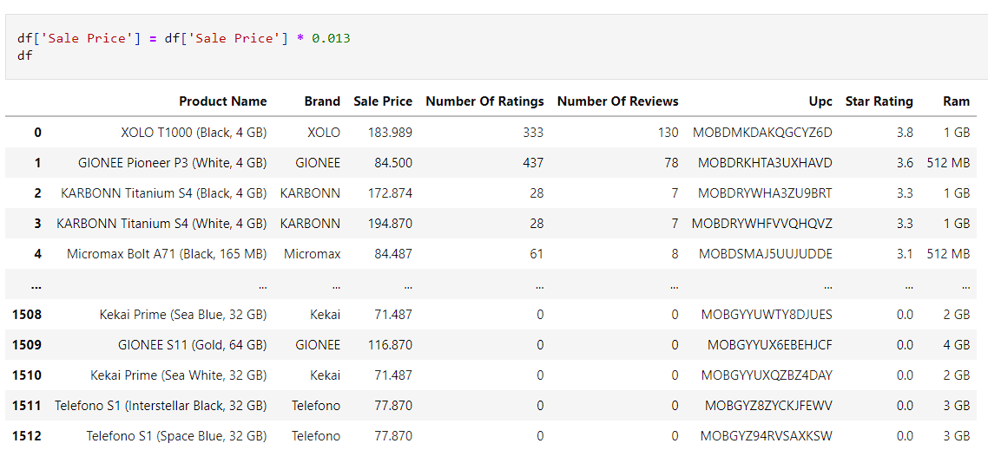
Another thing that is noticeable right away is that the sale price of the smartphones seem to be in a different currency. This makes sense as the survey was conducted in India so naturally they would use their local currency of rupees. Since we're here in the United States however, it seems appropriate to convert the data into our currency for easy of use. So I found the current conversion rate for Indian rupees online which is 0.013 and multiplied that by the values within the sale price column.

Slide 7
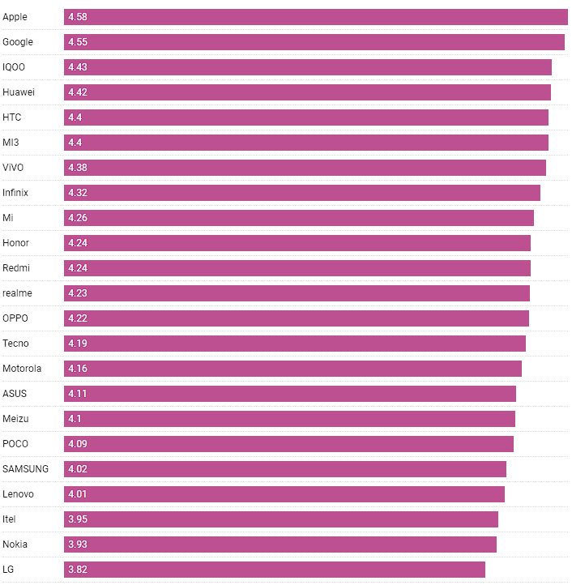
So next up since the data was now fully cleaned and fixed of issues, I started to analyze different aspects of it. For example, I decided to check the average rating per smartphone brand within. Unsurprisingly Apple came out on top however other big brands such as Samsung and LG ended up lower down the list. This may be due in part to the amount of different smartphone models those brands produce as opposed to other brands. Another factor is the location in which the survey was being conducted. In India VIVO is a much more popular smartphone manufacturer than LG or Nokia. Furthermore it much more accessible for the general population over there to have access to that brand of smartphones

Slide 8
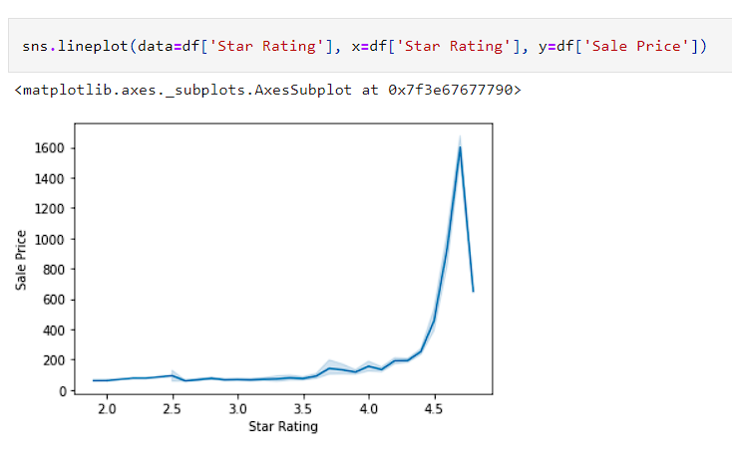
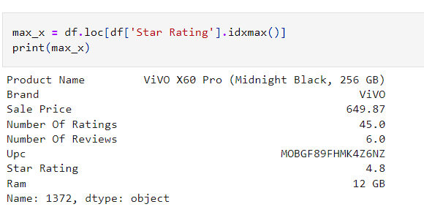
So next up I wanted to take a look at different relationships between the data attributes. I ended up focusing on the 3 numerical attributes. One relationship that was interesting was the one between Sale Price and Rating.
After locating the outlier it was made apparent that it was not truly an outlier but simply an entry that met the criteria of being very highly rated while also being at a low price point. So rather than dropping it I ultimately decided to keep it
You notice here a general curve for the higher the rating, the higher the sale price. However there is a very suspicious sharp decline near the end which may be due to an outlier

Slide 9
Regression Models

Slide 10
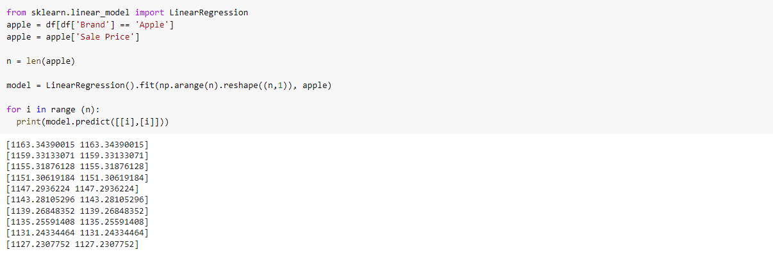
For the first model I decided to just do a simple Linear Regression using a small subset of the overall data set. I decided to choose Apple phones mainly due to the fact that they are all generally around the same price point. Other brands such as Samsung have various models with wide ranging price points, which can make it difficult to try and predict other prices. So in using Apple smartphones, we are able to test how accurate the predictions truly are.

Slide 11
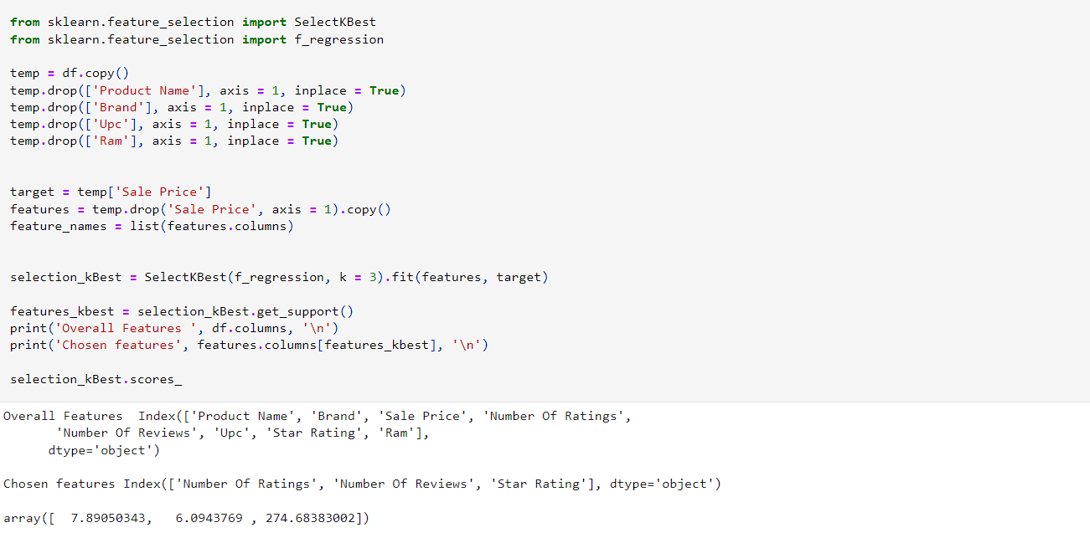
The next model that I decided to used was the K-Best using the F-Test and F-Regression. This model is an interesting one as it allows you to select specific categories of the data set and see which of them are most influential. For my purposes I was interested in seeing how the numerical attributes of the data set influence the price of the cell phone. So I decided to make 'Sale Price' my target and get the values.

Slide 12
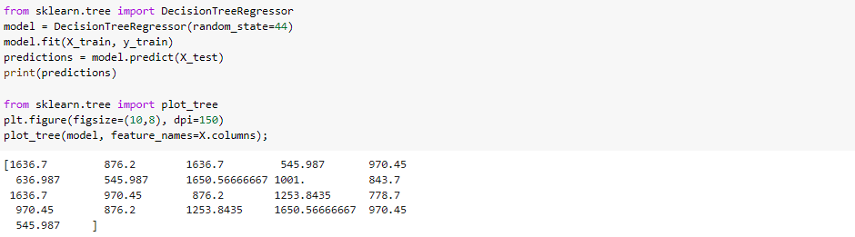
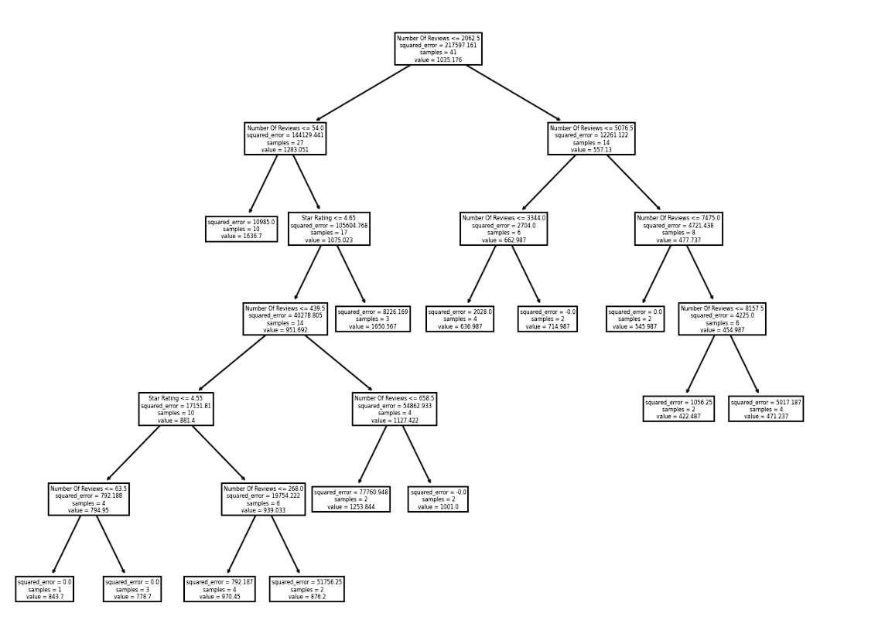
Next I wanted to experiment with the decision tree to see what kind of values this specific model would produce. Here you can see the regression tree utilizing a predictions variable and generating a tree based of the results.

Slide 13
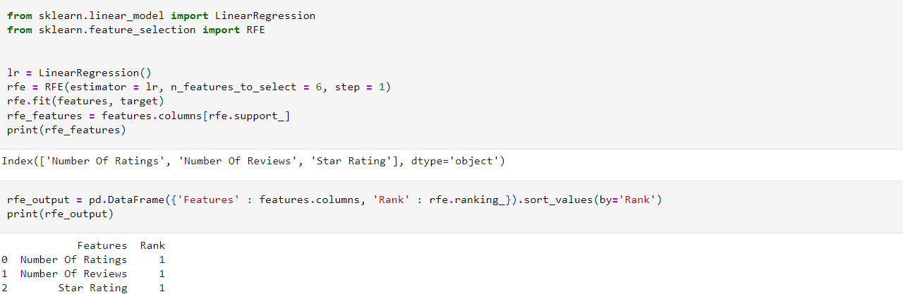
And for the final model I decided to use a RFE model. The RFE model is yet another way to measure variable importance and helps when trying to determine which variables are most influential for your target. Based on the model you can see that the Number of Ratings, Number of Reviews, and the Star Rating all hold equal rank, which is to be expected based on the results of the previous models.

Slide 14
Conclusion
So after testing all these models you can see that there are various ways to analyze a data set such as this one. Different models have different information and depending on the situation, it is very true that there is no definite 'best model'. However for our purposes, I believe the K-Best and F-Regression most accurately quantifies the Sale Price variable and its influences. I do however like the original regression model as well as it gives you a lot of valuable information regarding the data set. In conclusion, perhaps the 'best model' is actually a combination of all them.

