Slide 1
Major League Baseball (MLB) Statistics
Avenash Ramnarine

Slide 2


Introduction
This data set represents statistics from an MLB data set that contains information on every single major league team dating back to 1876. In total it contains 2784 data entries with 41 different attributes including a mix of both categorical and numerical data.

Slide 3
Attributes
Year - Year of play.
Team Name - Full name of team.
Games Played - Games played.
Wins - Number of games won.
Losses - Number of games lost.
Runs Scored - Number of runs scored during the season.
Hits - Number of hits during the season. Includes singles, doubles, triples and homeruns.
Homeruns - Homeruns by batters.
World Series Winner - Did the team win the World Series? Levels of Y (yes) and N (no).

Slide 4
EDA

Slide 5
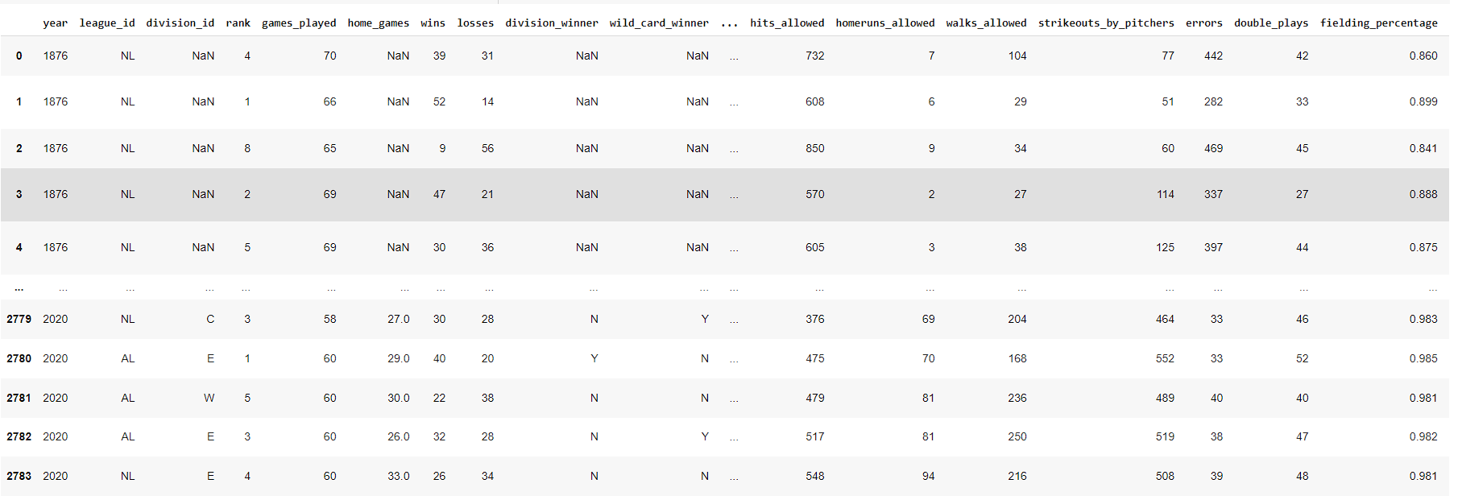
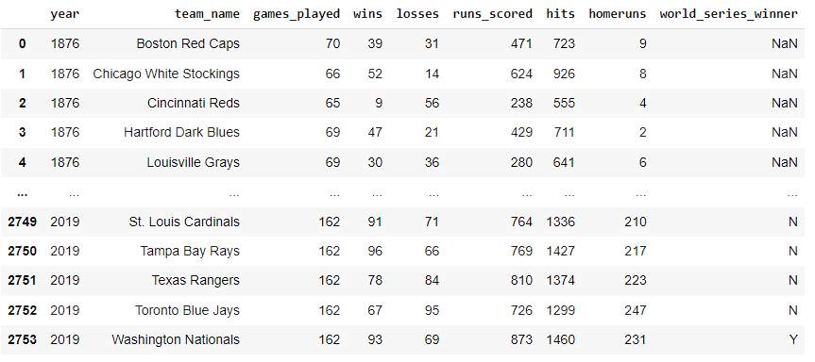
The first thing to do was to decide which elements from this data set I would like to use. Obviously to use all the metrics here would just simply be too much. So I decided to choose the attributes that most closely relate to area I am looking into. Those being year, team name, games played, wins, losses, runs scored, hits, homeruns and world series winner.

Slide 6
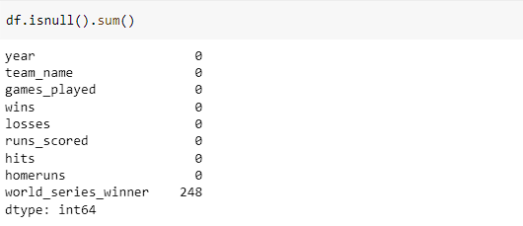

Next up I decided to do a bit of data cleaning and check for any null values. After looking into the data set I realized that most of these null values are due to missing records in the 'world series winner' column during the late 1800s and early 1900s. This is due to the fact that records from that time are old and simply do not exist anymore. So I ultimately decided to drop these entries as it wouldn't affect the data set much anyway.

Slide 7
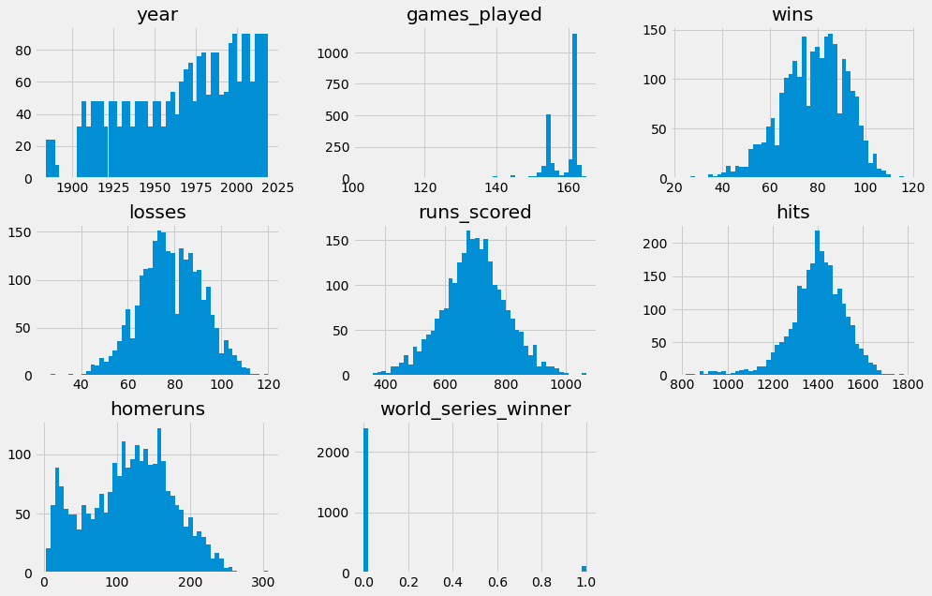
Once I finished cleaning up the data I decided to plot the attributes just so I could get a graphical representation of them. Often times by looking at the visualizations you can spot things that may have been hidden otherwise. After looking at this distribution it seems like everything correct and there are no issues so far.

Slide 8
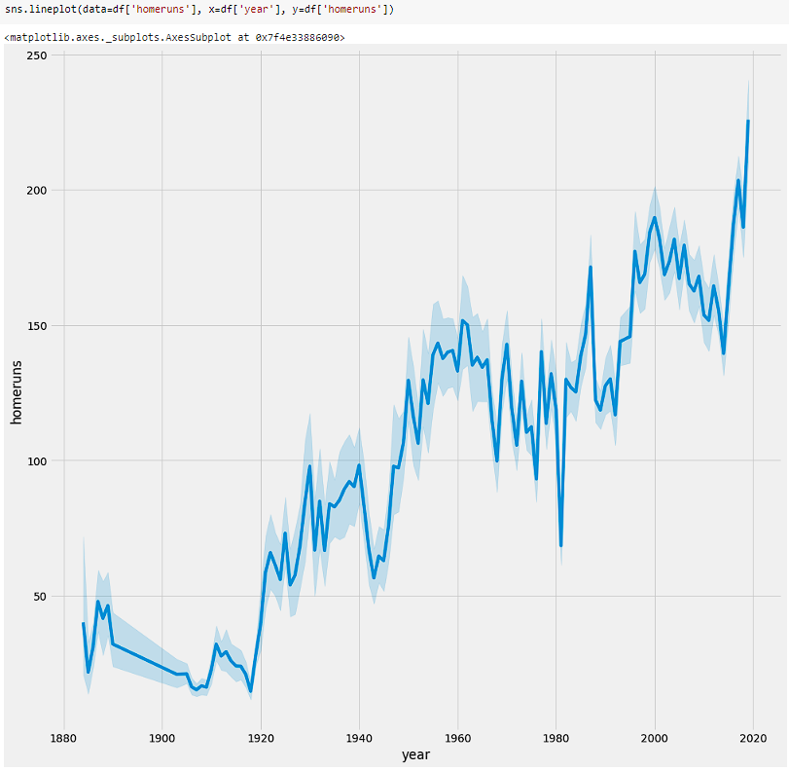
Next I wanted to just take a look at different relationships within the data set. For example one thing that intrigued me was to look at the amount of homeruns per year over time. You can see this shows an overall increase of homeruns per year as time goes on albeit with a few drops in between. However this correlates with what a lot of people tend to believe about baseball, which is that now we are hitting more home runs than ever before.

Slide 9
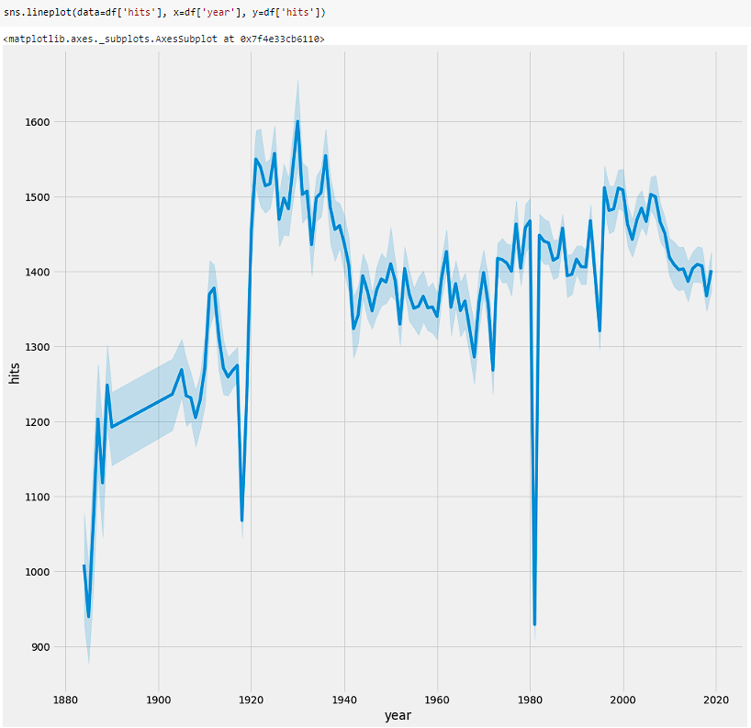
So I continued to run visualizations comparing different attributes until I encounter the Hits by Year chart here. As you can tell there are 2 distinct drops in the data from around 1918 and 1981. I immediately focused on these outliers and began to wonder why are they so different from the rest of the data.
As it turns out in 1918 the MLB actually had a shortened season due to the ongoing World War 1. Likewise in 1981 the MLB players went on strike and thus all statistics across the board for these 2 season were generally down.
This brought up an issue of if should I drop the these outlier years or not. Since these year due to historical oddities and do skew the data drastically, I decided it would be best if I dropped these entries from the data set.

Slide 10
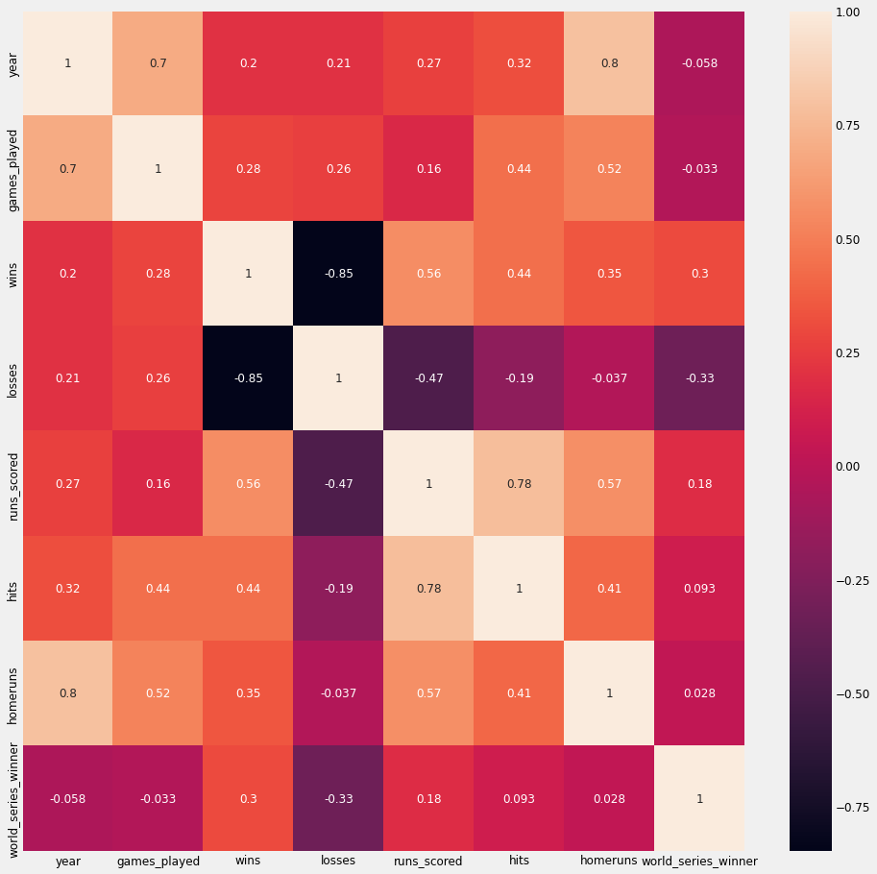
Once the data was fixed I decided to create a correlation matrix heatmap to see what kind of influence certain attributes have on each other. This helped immensely as my main goal was to see how the amount of home runs can relate to the number of wins. The heatmap would show me exactly that and also the correlation with other attributes as well. As you can see according to the heatmap the most influential attributes on wins seems to be 'runs scored' followed by 'hits' then by 'home runs'. Showing that their are much bigger factors that affect wins than just homeruns.

Slide 11
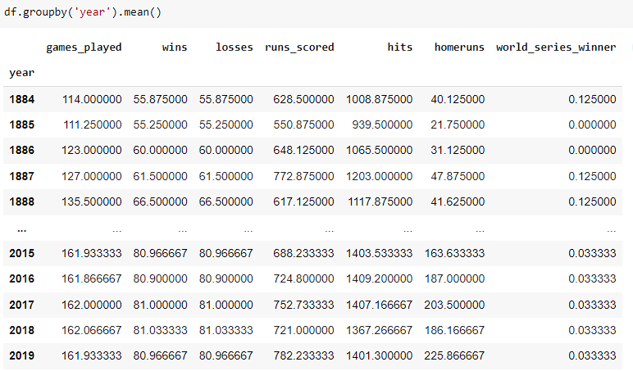
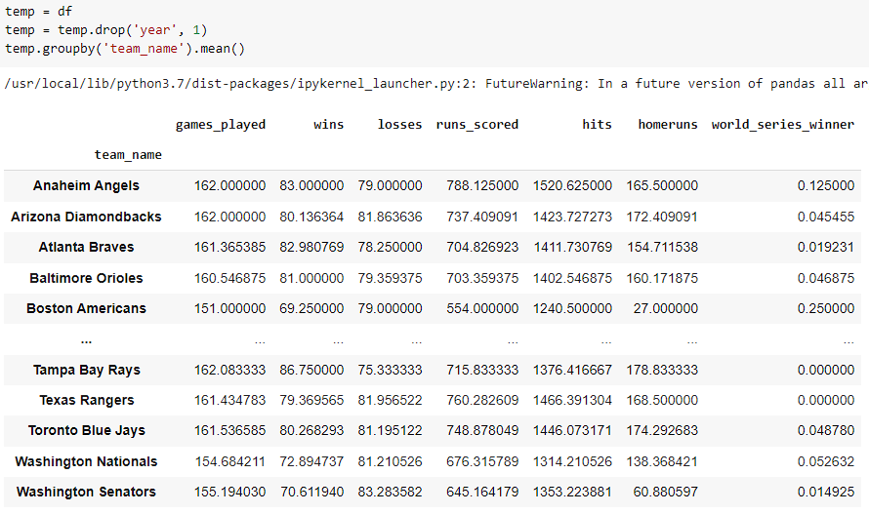
Next I figured it best if I continue to further my understanding of the data by re-grouping and reshaping it. I started by grouping by the 'year' variable so that I could see the mean average for each other attribute per year.
This showed a uniformity across the league when it comes to mean averages for any particular year. In general the numbers tend to be the same from year to year with only slight increases as time goes on.
I also wanted to evaluate the average stats per individual team. You can see here that generally some teams have higher values than others however they all tend to stay around a certain range.

Slide 12
Models

Slide 13
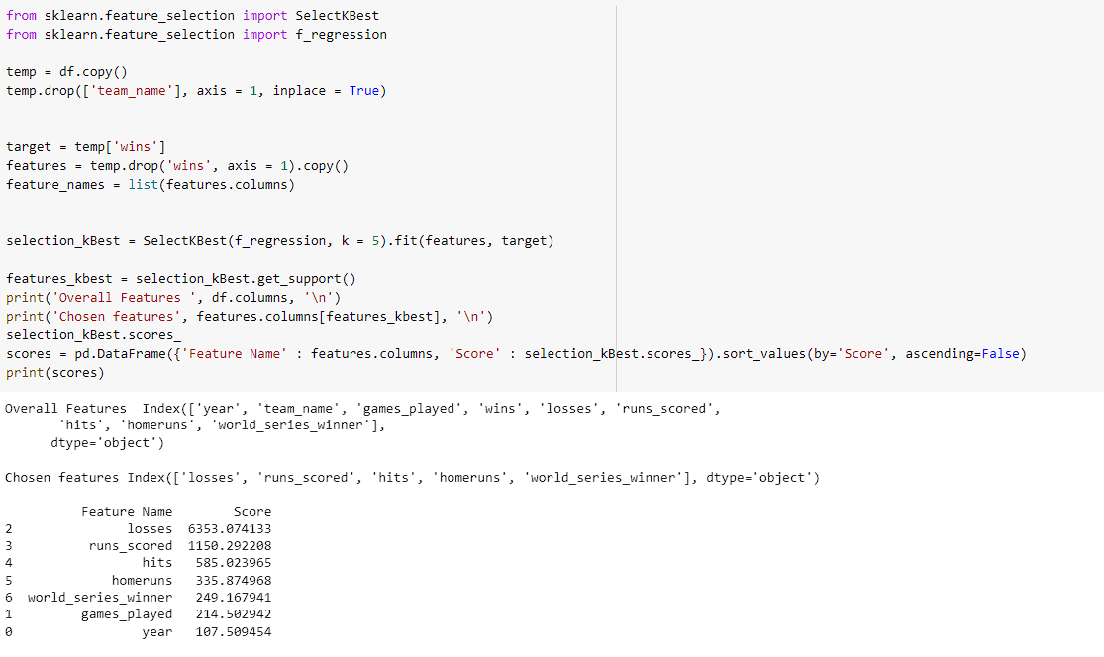
For the first model I decided to K-Best model. I chose this model because allows you to choose a target, in my case being 'wins', and directly see which other variables have the most influence on the target.

Slide 14
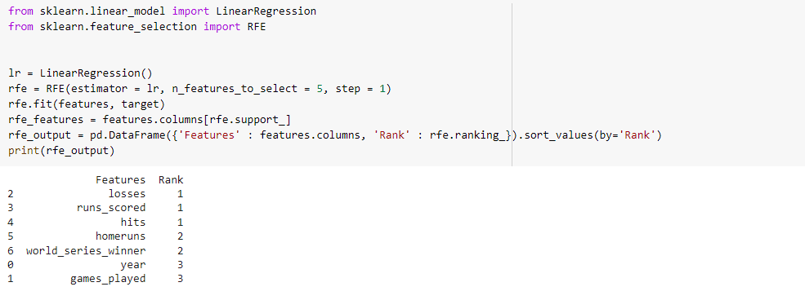
For my next model I decided to do a RFE model to show how each attribute would be ranked in respect to the target, that being 'wins'. You can see here that this model ends up ranking the variables nearly identical to the last. Showing consistency in the results.

Slide 15
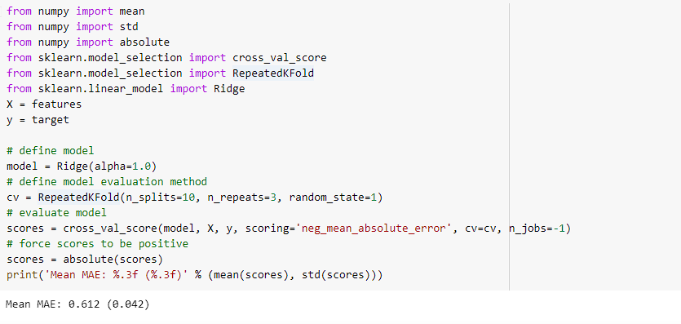
Another model I tried was the Ridge Regression Model from https://machinelearningmastery.com/ridge-regression-with-python/
The Ridge Regression Model is used to test independent variable and their correlations. They can be configured in many different ways, in this implementation it is used to calculate the Mean Absolute Error (MAE) and the Standard Deviation.

Slide 16
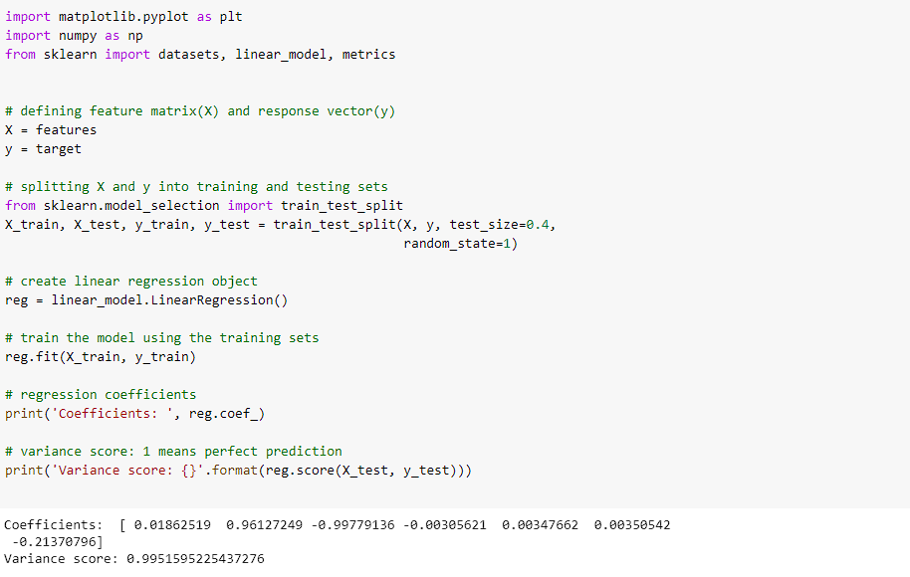
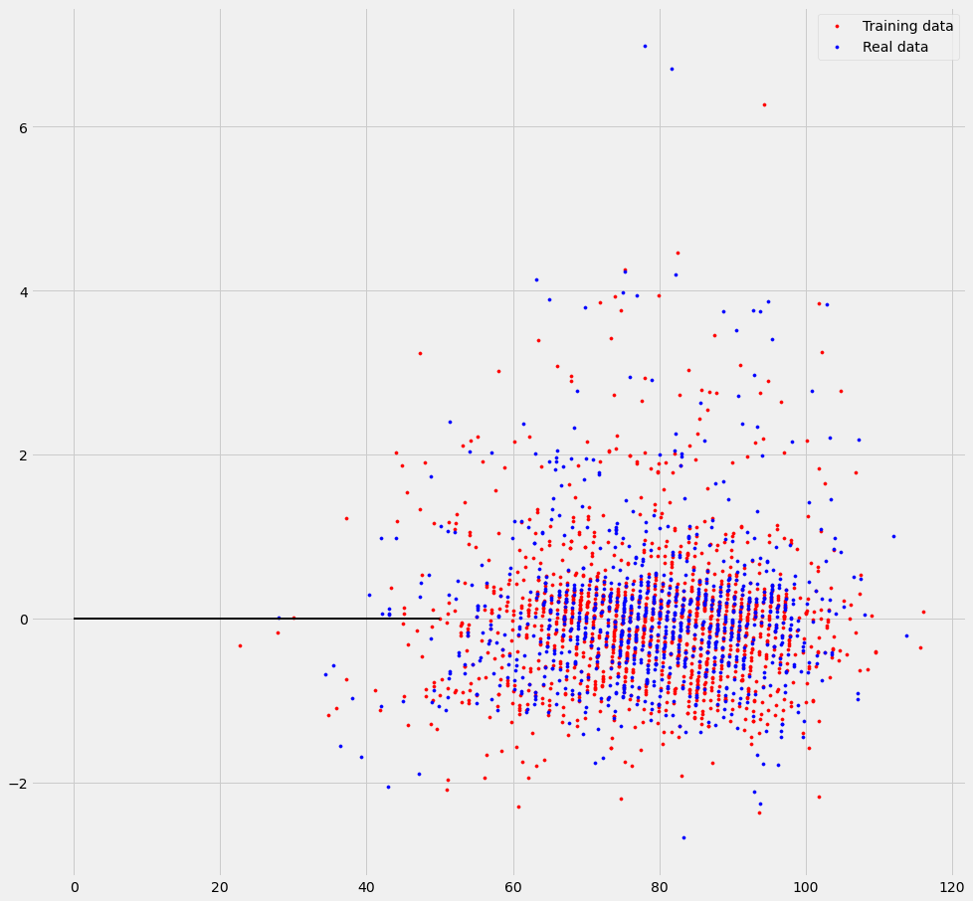
For the next model I decided to do a multiple linear regression model. It's an extension of regular linear regression however it allows you to compare more than 2 attributes. The coefficients and variance scores were calculated and displayed. The variance score was 99 which shows that this is a very accurate model for this data set.
Next the residual error was plotted to show how most of the training data was very accurate in it's predictions next to real data.

Slide 17
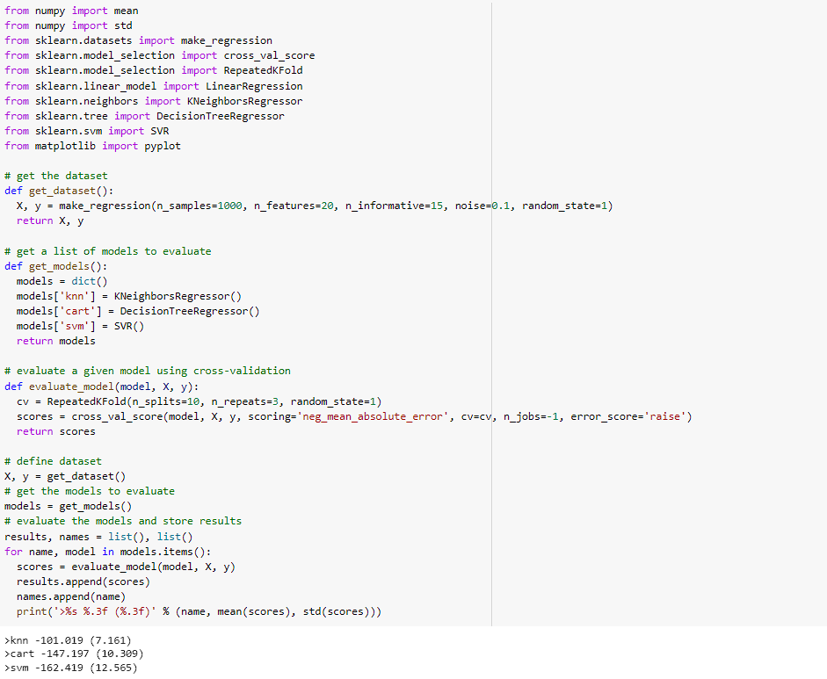
And for the final model I used the Ensemble Mode. I used an example from the website https://machinelearningmastery.com/stacking-ensemble-machine-learning-with-python/
This mode creates 3 sub-models being the KNN Model, Decision Tree Model and an SVM Model. It then stacks the models and generates the MAE (Mean Absolute Error) and the standard deviation.
Running the model you can see that out of all 3 the SVM model ends up winning with the lowest MAE number.

Slide 18
Conclusion
In conclusion by utilizing the many tools of data analytics I was able to fully explore this data set and answer all the questions I had when I first began my study. Throughout the project I was able to see many trends and recurring data which only further helped cement the conclusions that were being drawn. I wanted to look into the relationship between homeruns and wins and was able to do so successfully. And this was accomplished mostly by applying the various models and techniques we've learned all throughout the semester. One thing that I would like to do in the future is to run this analysis again but using all 41 attributes of the original data set. Perhaps in doing so I could find out more about the many factors that affect the game of baseball.

