Slide 1

Sales Performance Dashboard Analysis
Power BI Project
by Anushri

Slide 2

OBJECTIVE
Analyze overall business performance
Understand Customer behavior
Identify key revenue pattern

Slide 3
KEY PERFORMANCE INDICATORS
Total Revenue
Total Transactions
Average Bill Values
Average Tip Percentage

Slide 4
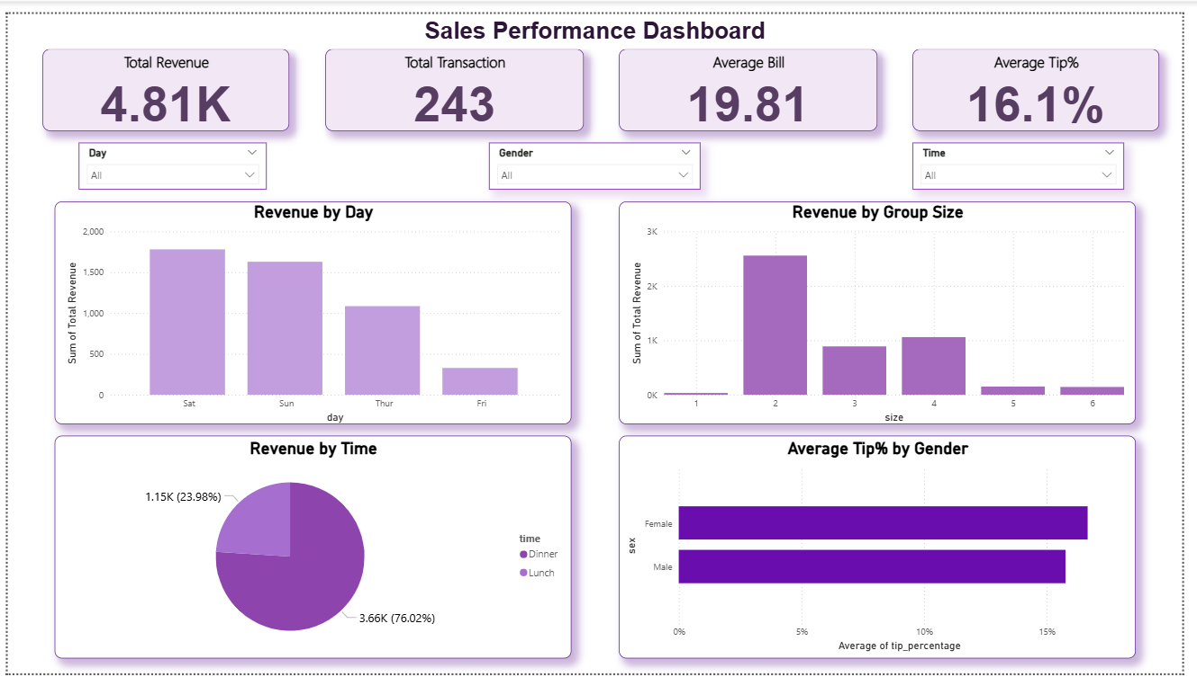
Dashboard Overview

Slide 5
DATA STORY
Understand customer behavior and revenue patterns
Identify peak business hours (Lunch vs Dinner)
Analyze performance across days and group size
Discover opportunities to increase revenue

Slide 6
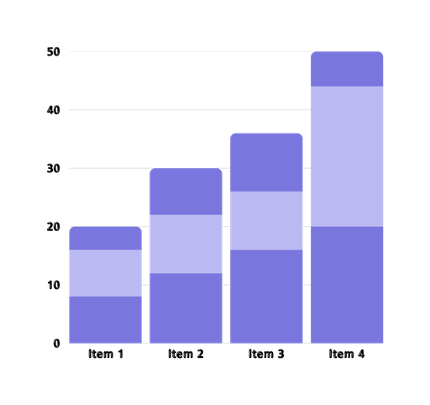
ANALYSIS PERFORMED
Revenue by Day
Revenue by Time (Lunch vs Dinner)
Tip % by Gender
Revenue by Group Size

Slide 7

KEY INSIGHTS
Dinner generates highest revenue (~76%)
Weekends drive maximum sales
Average tip is around 16%
Group size of 2 contributes most revenue

Slide 8
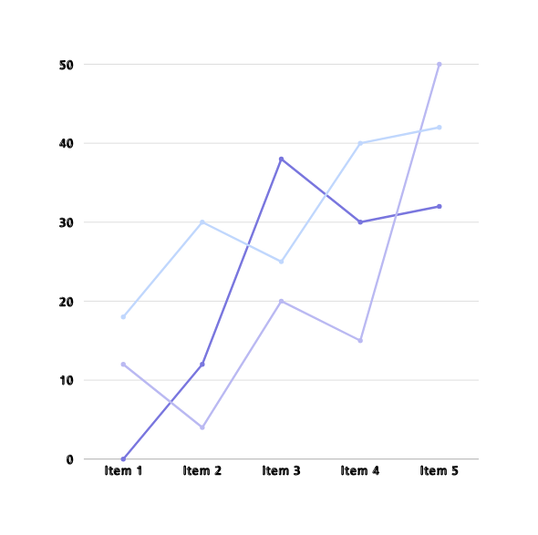
BUSINESS IMPACT
Identifies peak revenue time
Helps target high-value customers
Supports better decisions making

Slide 9
HYPOTHESIS TESTING
Hypothesis:
Dinner generates higher revenue than Lunch
Test Used:
Two-Sample T-Test
Results:
t-value = 2.93
p-value < 0.01
Conclusion:
Dinner revenue is significantly higher than lunch

Slide 10

RECOMMENDATIONS
Focus on dinner promotions
Increase weekend marketing
Encourage group bookings

Slide 11
THANK
YOU!

