Slide 1

Sales Performance Dashboard Analysis
Power BI Project
by Anushri

Slide 2

OBJECTIVE
Analyze overall business performance
Understand Customer behavior
Identify key revenue pattern

Slide 3
KEY PERFORMANCE INDICATOR
Total Revenue
Total Transactions
Average Bill Values
Average Tip Percentage

Slide 4
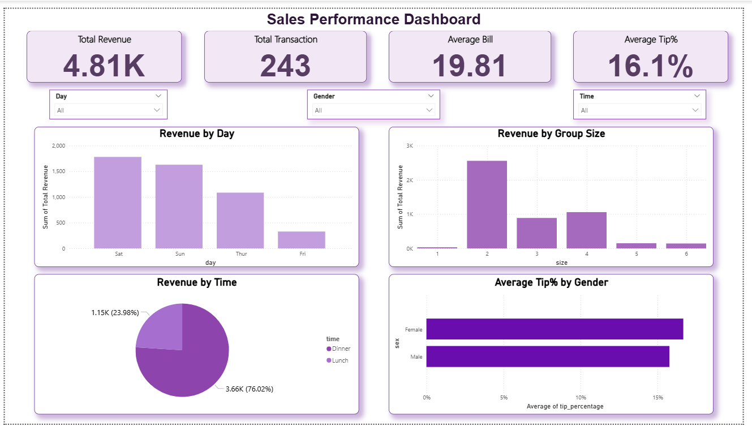
Dashboard Overview

Slide 5
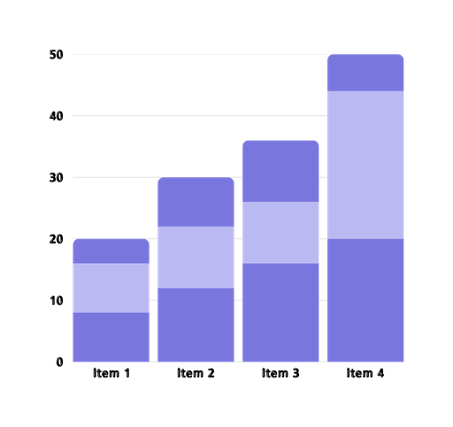
ANALYSIS PERFORMED
Revenue by Day
Revenue by Time (Lunch vs Dinner)
Tip % by Gender
Revenue by Group Size

Slide 6

KEY INSIGHTS
Dinner generates highest revenue (~76%)
Weekends drive maximum sales
Average tip is around 16%
Group size of 2 contributes most revenue

Slide 7
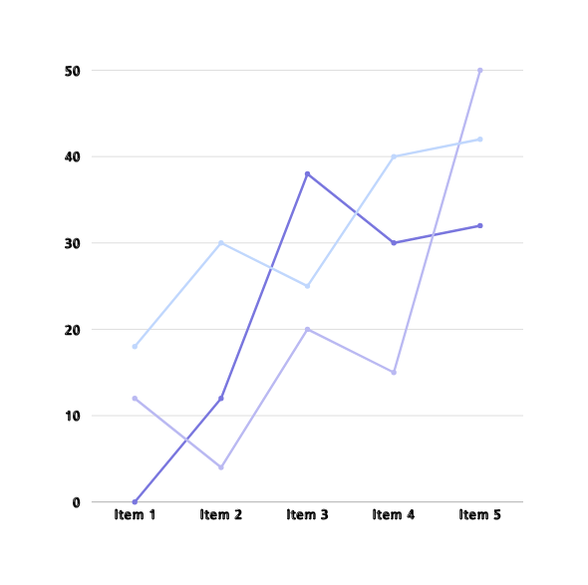
BUSINESS IMPACT
Identifies peak revenue time
Helps target high-value customers
Supports better decisions making

Slide 8

RECOMMENDATIONS
Focus on dinner promotions
Increase weekend marketing
Encourage group bookings

Slide 9

HYPOTHESIS TESTING
Hypothesis :
Dinner generates higher revenue than Lunch
Test Used:
T-Test
Result :
Dinner revenue is higher than lunch
Conclusion :
Focus on dinner to maximize revenue

Slide 10
THANK
YOU!

