Slide 1
repair thread
PITCH & BUILD STORY
Every repair.
The whole story.
Computer vision for equipment records
and property maintenance handoffs
48-hour hackathon brief / October 2026
REPAIR THREAD / COMPUTER VISION HACKATHON
01
Notes:
Repair Thread connects the details on equipment labels to the property, unit and repair history. This deck presents the hackathon build and a proposed commercial plan. The 48 hours refers to the original brief, not an independently measured development duration.

Slide 2
repair thread
01 / INSPIRATION
A practical use for computer vision
“Which dishwasher is actually
in Unit 304B?”
The idea began with hard-to-read serial and model labels.
The product became more useful when those details stayed
attached to a unit and its repair history.
REPAIR THREAD / COMPUTER VISION HACKATHON
02
Notes:
The founder received Computer Vision as a hackathon theme and wanted a digital product people would pay for. The conversation moved from serial-number scanning to unit-specific equipment records and repair handoffs. This quotation is an illustrative product question, not a customer interview.

Slide 3
repair thread
02 / PROBLEM
The repair starts with missing context
A request identifies the unit
“The dishwasher is broken” still leaves the equipment unclear.
Someone reconstructs the record
Find the label photo, transcribe identifiers and collect the issue details.
The next handoff can lose that work
The quote, decision and replacement record may live in separate places.
REPAIR THREAD / COMPUTER VISION HACKATHON
03
Notes:
Source: Repair Thread PRD sections 2 and 5. This is a problem hypothesis. We have not established the frequency or cost through paid customers or field research. The pilot should measure coordinator handling time and missing-detail follow-ups.

Slide 4
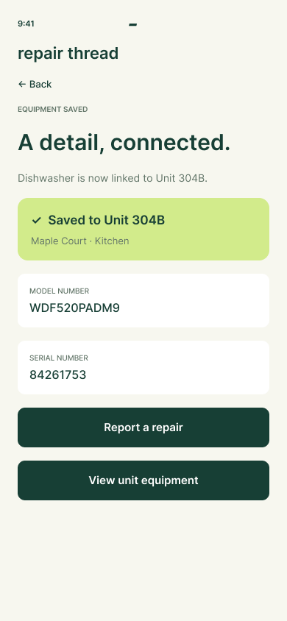
repair thread
03 / PRODUCT
A label becomes a unit record
Capture the identifiers.
Review the result.
Save it to the right unit.
Carry that record into the repair request
and preserve it when equipment changes.
REPAIR THREAD / COMPUTER VISION HACKATHON
04
Notes:
Visual: actual export of the editable Repair Thread Figma saved-equipment screen. Sample model WDF520PADM9 and serial 84261753. The Figma flow simulates saving. The web app supports local equipment records and review of OCR output.

Slide 5
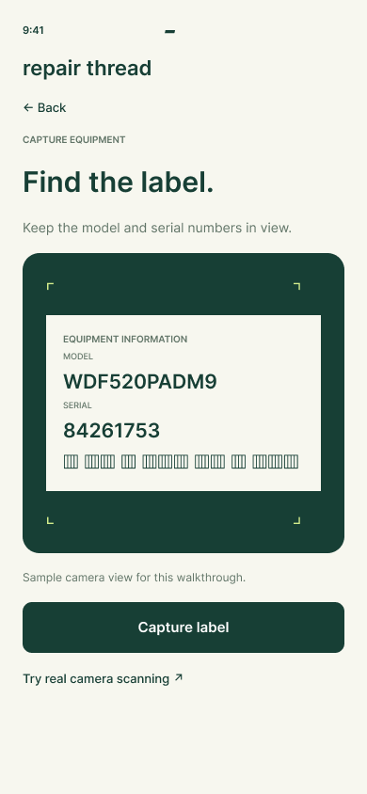
repair thread
04 / COMPUTER VISION
A camera already in your pocket
Capture
Photograph the equipment’s model and serial label.
Extract
Local OCR reads text and suggests identifier fields.
Review
Compare the result with the source before saving.
REPAIR THREAD / COMPUTER VISION HACKATHON
05
Notes:
Implementation: getUserMedia still capture, Tesseract.js local OCR and field parsing in src/CameraCapture.jsx, LandingScanner.jsx and domain.js. Images in this flow are processed locally. Glare, small text and damaged labels can cause errors. The system does not diagnose equipment faults. The screenshot is a simulated Figma camera view.

Slide 6
repair thread
05 / WORKING PRODUCT
A working path through the core workflow
Web and Windows
Live camera preview, still capture, local OCR and equipment records.
Connected repair records
Requests, proposal versions, recorded decisions and replacement history.
Evidence today
Sample OCR returned the expected model and serial. The user confirmed webcam preview.
Shared accounts, live purchasing and production approval roles are future work.
REPAIR THREAD / COMPUTER VISION HACKATHON
06
Notes:
Evidence from this build session: production scanner extracted WDF520PADM9 / 84261753; another uploaded label extracted ABC12345 / 98765432. User confirmed live preview in installed desktop app and installer wizard appearance. Do not infer full hardware OCR success or completed installation from those observations. The domain/cleanup test suite previously passed 10 tests. Current data is local IndexedDB, with simulated roles and no shared authentication.

Slide 7
repair thread
06 / CUSTOMER
The maintenance coordinator is the champion
200–1,500
Buyer
Owner or
operations director
managed units per target organization
First fit: independent residential property managers with recurring
equipment repairs and incomplete inventory records.
REPAIR THREAD / COMPUTER VISION HACKATHON
07
Notes:
Source: PRD section 4. This is the initial ideal-customer hypothesis, not a measured segment size. The buyer controls budget; the maintenance coordinator experiences the workflow. Avoid enterprises with heavy integration requirements in the first pilot.

Slide 8
repair thread
07 / POSITIONING
A focused layer around the equipment record
Fits alongside existing management software
Begin with unit lists and exports instead of requiring a platform replacement.
Competes on workflow completion
Capture once, preserve the original label and carry context into the repair.
Must prove a reason to switch behavior
Measure fewer missing-detail follow-ups and less coordinator handling time.
REPAIR THREAD / COMPUTER VISION HACKATHON
08
Notes:
Source: PRD positioning. These are intended advantages, not verified competitor gaps. Alternatives include the customer’s existing property-management system, spreadsheets and photo/message folders. No claim is made that competitors cannot support unit-level assets or approvals.

Slide 9
repair thread
08 / BUSINESS MODEL
An organization license with recurring revenue
$149
+$0.50
per month, including 200 units
per additional managed unit / month
500 units: $299/month 1,000 units: $549/month
Proposed pricing for validation. Billing and shared organization access are not live.
REPAIR THREAD / COMPUTER VISION HACKATHON
09
Notes:
Source: PRD section 15 business model. Formula: $149 + max(0, units - 200) × $0.50. The buyer licenses access for the organization. Optional standard onboarding can be priced separately; custom integrations and white-label distribution should wait for repeatable demand. No paid subscriptions or MRR have been established in the provided evidence.

Slide 10
repair thread
09 / ECONOMICS
Recurring revenue needs controlled delivery costs
$299
$59.80
Example monthly account revenue
Maximum direct cost at an
80% gross-margin target
100 accounts at this mix would equal $29,900 MRR.
Illustrative scenario, not traction or a forecast. Excludes sales, development and overhead.
REPAIR THREAD / COMPUTER VISION HACKATHON
10
Notes:
Arithmetic from proposed PRD pricing: $299 × 20% = $59.80 maximum direct cost; $299 × 100 = $29,900 MRR. Include hosting, storage, OCR/AI usage, payment fees and direct support. Local OCR avoids a per-scan cloud inference requirement for this implementation, but does not make total delivery free. Gross margin is not operating profit.

Slide 11
repair thread
10 / GO TO MARKET
A paid pilot should test the business
Recruit three design partners
Target independent managers through direct outreach and maintenance referrals.
Offer a focused 30-day evaluation
Proposed $149 pilot with guided setup and a small set of eligible repair cases.
Earn the ongoing subscription
Compare handling time, record completeness and repeat usage before renewal.
REPAIR THREAD / COMPUTER VISION HACKATHON
11
Notes:
Source: PRD pilot and go-to-market plan. Three partners is a proposed next milestone, not signed customers. The $149 pilot and any refund promise must be operationally approved before sale. PRD suggests a 25% median handling-time reduction benchmark across five eligible cases; that is a target, not demonstrated performance. Pilot fees and setup fees do not count as committed MRR. Lead generation assets: website camera demo, Figma walkthrough, sample label and coordinator discovery calls.

Slide 12
repair thread
11 / AI BUILD STORY
AI helped move the idea into working software
Discovery and product definition
Explored serial capture, unit records, positioning and requirements.
Brand and interaction design
Iterated names, visual identity, landing page and mobile walkthrough.
Implementation and validation
Built the web app, camera/OCR flow, installer, tests and deployment changes.
REPAIR THREAD / COMPUTER VISION HACKATHON
12
Notes:
Source: this project conversation and repository. The user selected the direction and Repair Thread name. AI assisted research framing, PRD drafting, branding, React/Vite implementation, Electron packaging, troubleshooting and verification. Do not imply the research proved market demand, that the name has legal clearance, or that AI independently validated the business.

Slide 13
repair thread
12 / BUILD PROCESS
Human decisions kept the build grounded
AI contribution
Human contribution
Drafted requirements and code
Created editable design assets
Investigated failures
Ran checks and deployed changes
Selected the problem and brand
Challenged weak design
Confirmed webcam preview
Chose the animation fallback
A real constraint: Higgsfield generation was unavailable on the account plan.
We built a custom 10-second web animation instead.
REPAIR THREAD / COMPUTER VISION HACKATHON
13
Notes:
Build history: Higgsfield image and video generation calls were rejected by plan restrictions; no Higgsfield media was generated. The user chose a custom browser-native animation. User feedback also led to preserving the live scanner and removing prototype-style marketing labels. Figma screens are editable and linked, but simulate camera and submission actions.

Slide 14
repair thread
13 / PRODUCT ROADMAP
A digital assistant, grounded in the record
First: prepare a shared workspace
Add authentication, organization permissions, sync, audit trails and billing.
Then: assist the coordinator
Summarize unit history, flag missing identifiers and draft request details.
Keep people in control
Show source records. Require confirmation before messages, approvals or purchases.
REPAIR THREAD / COMPUTER VISION HACKATHON
14
Notes:
Future concept requested by the founder. No conversational AI assistant has been implemented. The assistant should retrieve tenant/unit/equipment information only within authorized organization boundaries, cite records, express uncertainty and distinguish suggestions from actions. Supplier catalog access and parts compatibility need verified sources. This roadmap is not a promise of autonomous diagnosis or ordering.

Slide 15
repair thread
14 / NEXT MILESTONE
The next proof comes from real repair cases
3 design partners
One repeatable onboarding process.
A measured comparison of coordinator effort.
Evidence of willingness to keep paying.
Seeking pilot introductions and workflow feedback
REPAIR THREAD / COMPUTER VISION HACKATHON
15
Notes:
This is a proposed pilot ask rather than an invented fundraising round. An operational plan: first interview coordinators and inspect representative cases; then establish shared-access foundations; then run a bounded evaluation and review retention. Timing depends on integration and security needs. The key uncertainty is customer value and willingness to pay, not whether a sample label can be read.

Slide 16
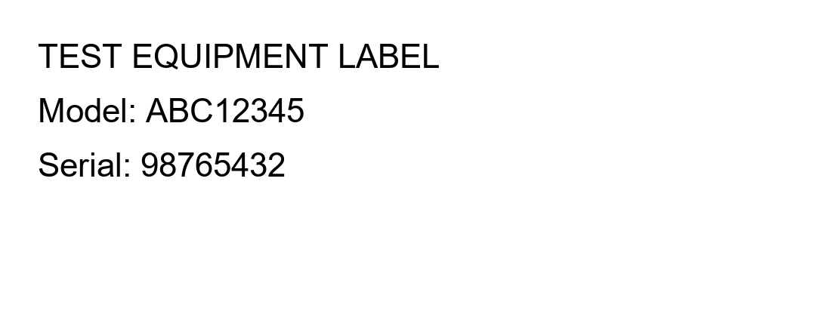
repair thread
15 / SCAN TEST
A sample label you can scan
Expected result
MODEL
ABC12345
SERIAL
98765432
Show this slide on another screen or print it. Open the live scanner on your phone,
allow camera access and capture just the label. You can also upload the label PNG.
Synthetic test data. The landing-page scanner displays identifiers without saving an equipment record.
REPAIR THREAD / COMPUTER VISION HACKATHON
16
Notes:
Image: existing generated synthetic test label, previously checked with real OCR. Expected model ABC12345 and serial 98765432. Open https://repair-thread.vercel.app/#camera-demo on a second device, then capture the label or upload the original PNG. Reduce glare and fill the camera frame with the label. This uses text recognition, not barcode decoding. Only the model and serial fields populate; property, unit and equipment type still require user input when creating an equipment record in the workspace.

Slide 17
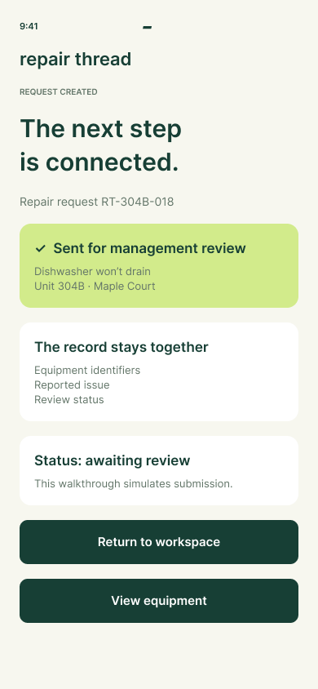
repair thread
16 / LIVE WALKTHROUGH
Try the product story
Phone demo
Open repair-thread.vercel.app
and choose “Phone walkthrough”.
Real computer vision
Choose “Try the live scanner”.
Use a label photo or the built-in sample.
REPAIR THREAD / COMPUTER VISION HACKATHON
17
Notes:
Live site: https://repair-thread.vercel.app/ . Real OCR: https://repair-thread.vercel.app/#camera-demo . Figma: https://www.figma.com/proto/XIPVueJM82EDvWHDhD8oIr/Repair-Thread-Mobile?node-id=2-12&starting-point-node-id=2%3A12&scaling=scale-down . Source: https://github.com/AverageCC/repair-thread . Demo path: Scan equipment, Capture label, Save equipment, Report a repair, Send for review. The Figma walkthrough uses sample data and does not submit a live request.

