Slide 1
SQLite

Slide 2
What is SQLite?
SQLite is a relational database management system contained in a C programming library. In contrast to many other database management systems, SQLite is not a client–server database engine. Rather, it is embedded into the end program.

Slide 3
Architecture

Slide 4
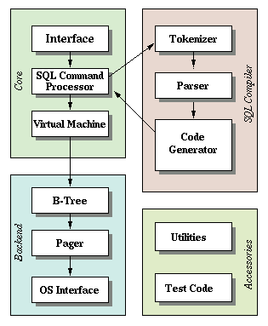

Slide 5
FEATURES

Slide 6
Zero-Configuration
Serverless
Single Database File
Stable Cross-Platform Database File

Slide 7
Compact
Readable source code
Public domain
SQL statements compile into virtual machine code

Slide 8
Appropriate Uses

Slide 9
Embedded devices and the internet of things
Application file format
Websites
Data analysis
Cache for enterprise data
Internal or temporary databases

Slide 10
WELL KNOWN USERS OF SQLite

Slide 11
GOOGLE uses SQLite in their in the Android cell-phone operating system, and in the Chrome Web Browser.
Adobe uses SQLite as the application file format for their Photoshop Lightroom product. SQLite is also a standard part of the Adobe Integrated Runtime (AIR). It is reported that Acrobat Reader also uses SQLite.

Slide 12
Apple uses SQLite in many (most?) of the native applications running on Mac OS-X desktops and servers and on iOS devices such as iPhones and iPods. SQLite is also used in iTunes, even on non-Apple hardware.
The increasingly popular Dropbox file archiving and synchronization service is reported to use SQLite as the primary data store on the client side.

Slide 13
AAJ KE LIYE ITNA KAAFI HAI!
Thank you.

