Slide 1
Artificial Intelligence Fundamentals Project: Evolutionary algorithm for solving the Knapsack Problem
by: Aleksander Kuśmierczyk Mikołaj Słoń Mateusz Szperna Kornel Żaba

Slide 2
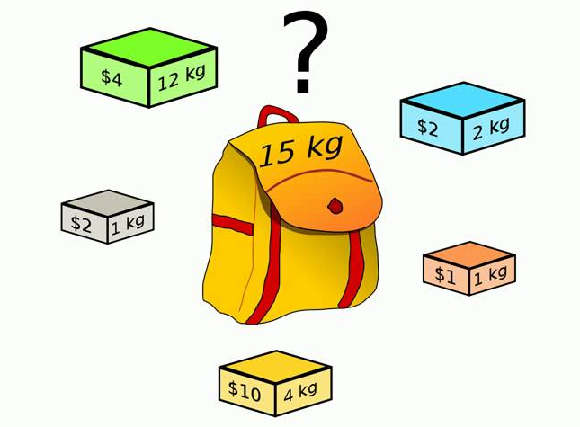
The 0-1 Knapsack problem
Set of items, each with weight and value
Fill the knapsack with items
Maximize total value
Keep total weight within knapsack’s limit

Slide 3
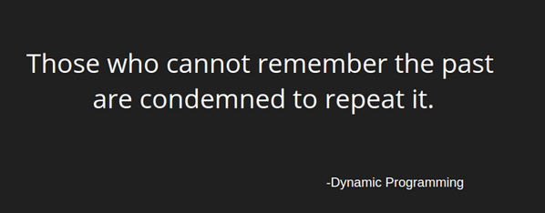
The 0-1 Knapsack problem
0-1 Knapsack problem is a NP hard problem
It may be solved in O(nW) pseudo-polynomial time using a dynamic programming solution:
n – number of items
W – weight limit

Slide 4
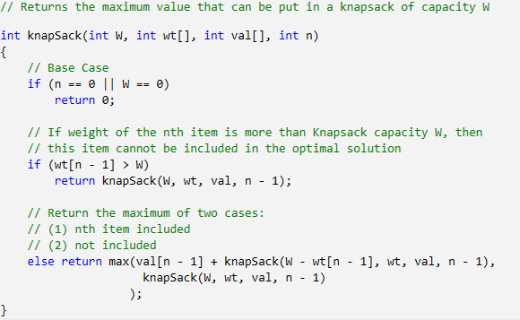
Example dynamic programming solution

Slide 5
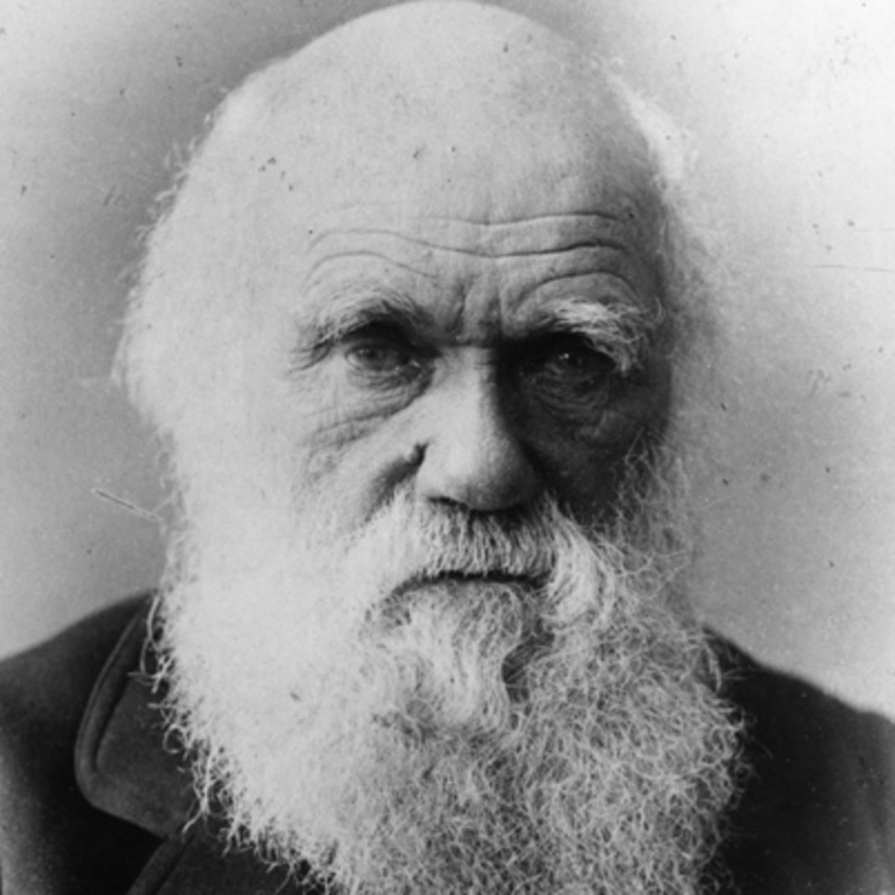
Evolutionary algorithm
Algorithm inspired by biological notion of evolution
Selects solutions based on their fitness
Uses crossover and mutation to introduce variety and create new individuals

Slide 6
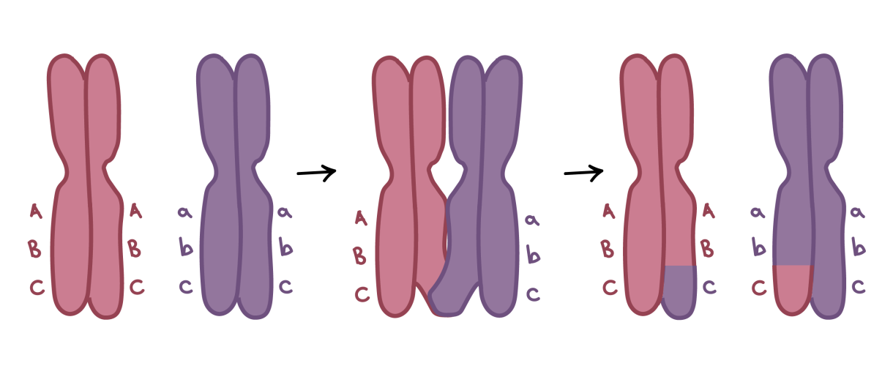
Evolutionary algorithm
Generate a dataset of solutions
While fitness < threshold:
Calculate the fitness of solutions
Keep fitter solutions, discard worse solutions
Modify solutions by mutation
Add new solutions by crossovering fit solutions
Solution with the greatest fitness is the solution to the 0-1 Knapsack problem

Slide 7
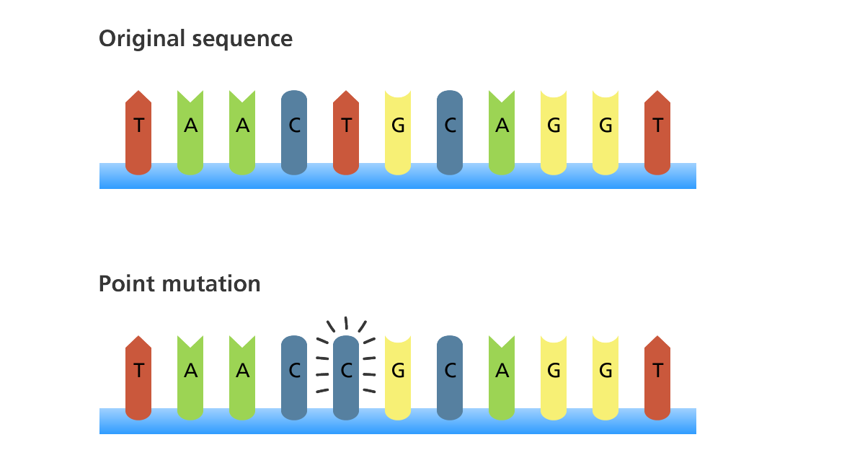
Evolutionary algorithm
Crossover – exchange of genes between solution, creates new solutions
Mutation – random modification of genes in a solution

Slide 8
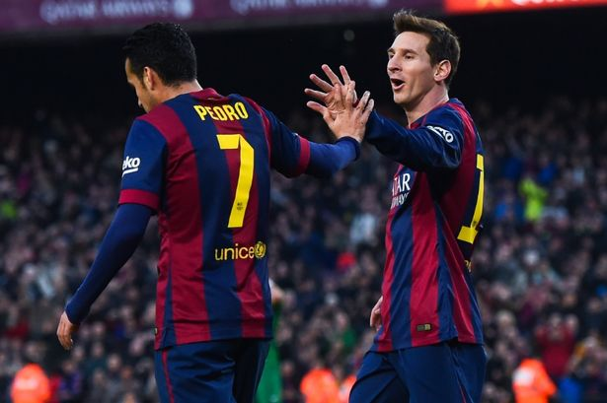
Football Manager as 0-1 Knapsack problem
Select a team of best players without exceeding the budget
Players are defined by their cost, position, as well as dribbling, passing, shooting ability etc.
Quality of the team is a sum of players’ abilities.

Slide 9
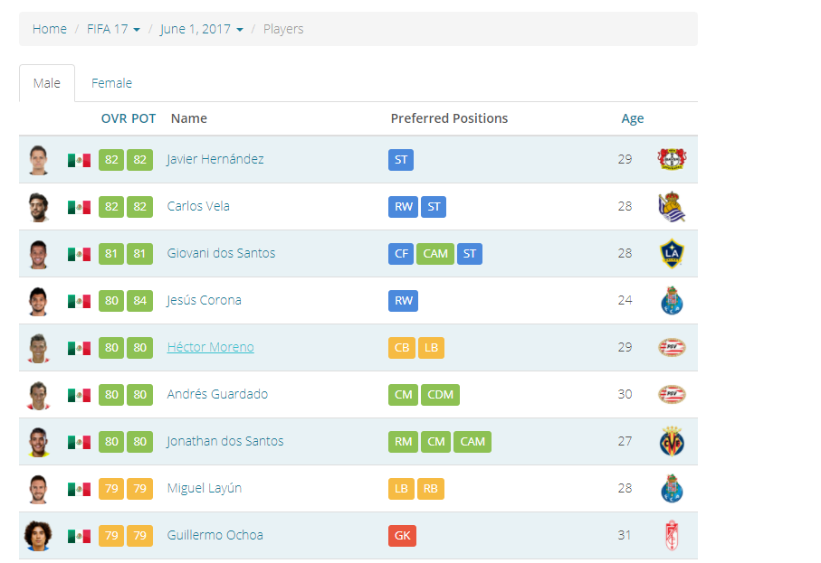
Why we have chosen this problem
Provides solution to many online football manager games: Football Manager, Fantasy Football, FIFA...
Easily obtainable datasets

Slide 10

Evolutionary algorithm solution
Generate a population of teams consisting of players from the dataset
Players are the genes of the teams
Find the team with best players

Slide 11
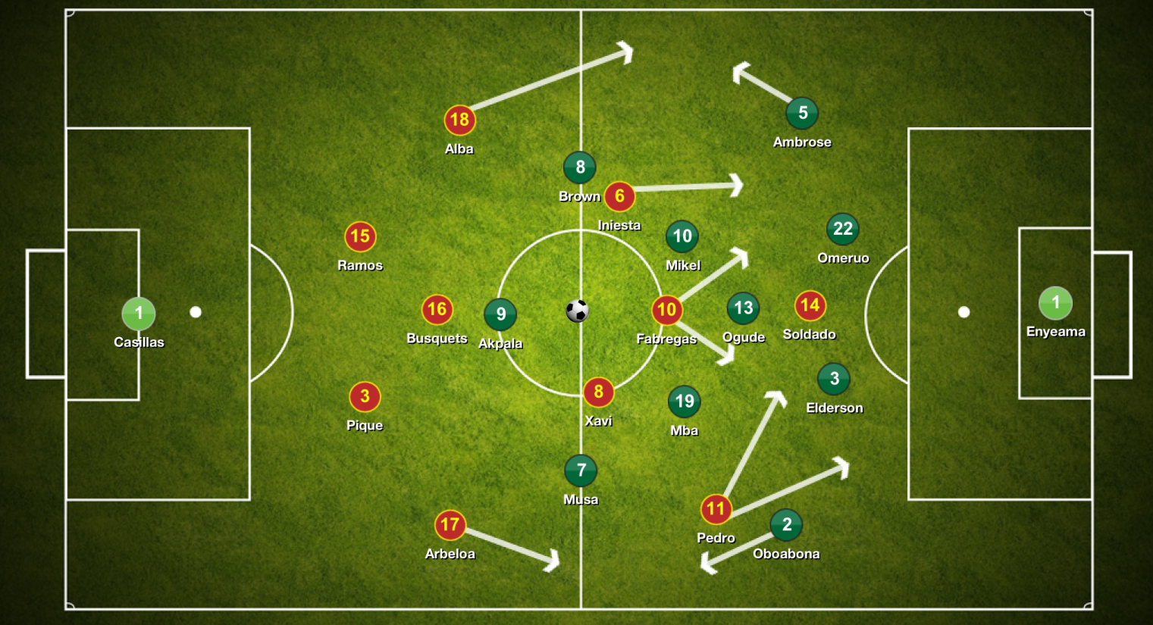
Evolutionary algorithm solution
Additional constraints:
Each team cannot have 2 same players
Each player must play on specific position

Slide 12
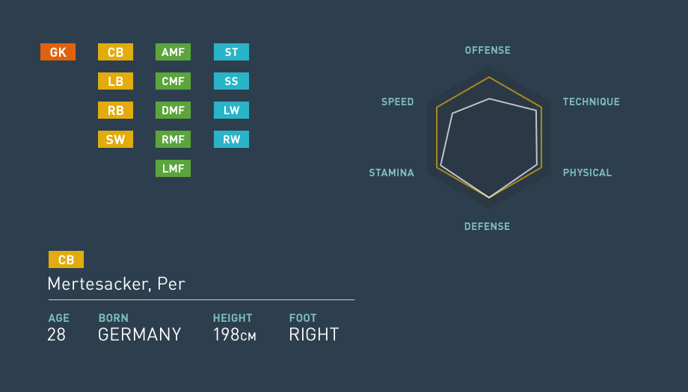
Evolutionary algorithm solution
Player fitness function: average of player’s skills
Each position has defined own fitness function
Fitness function of a team is a sum of fitness of its players

Slide 13

Crossover and mutation in football
Crossover – transfer of players between teams
Mutation – replacement of a player in a team with another player from the dataset
Both operators must take in the account mentioned constraints.

Slide 14
Fantasy Knapsack application
Application implementing Evolutionary algorithm solving the 0-1 Knapsack problem
Designed for the football manager domain
Allows loading of own valid datasets
User friendly and intuitive

Slide 15
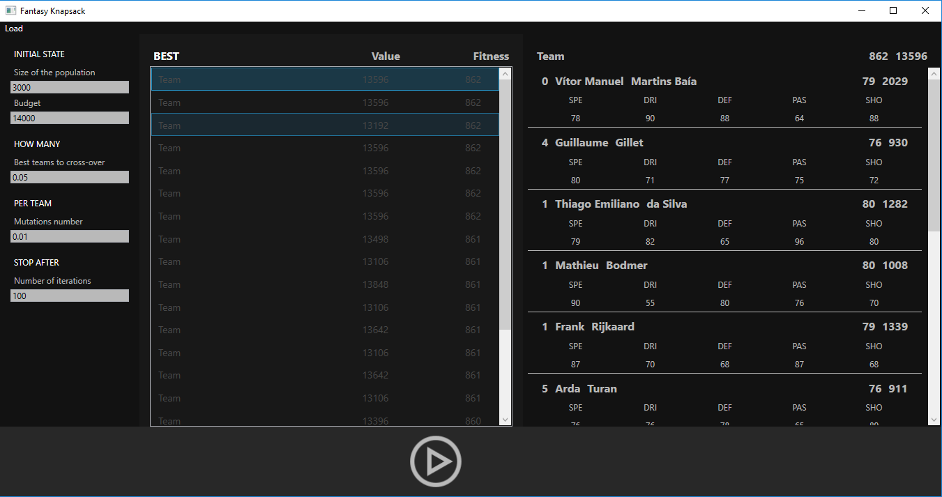

Slide 16
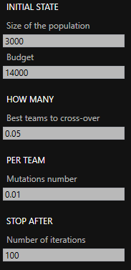
Fantasy Knapsack application
Allows specification of key coefficients
Population size
Team budget
Mutation chance
Crossover rate
Number of iterations

Slide 17

Fantasy Knapsack application
Displays player’ s statistics, fitness and cost
Only key player’s abilities are considered

Slide 18

Application technical specification
Loaded datasets must be in CSV format, described in the documentation
Desktop application requires .Net Framework 4.6 and Windows 10 operating system.

Slide 19
Useful links
Application repository with additional documentation:
https://github.com/Averdose/FantasyKnapsack
Online football datasets:
https://www.fifaindex.com/
https://www.kaggle.com/artimous/complete-fifa-2017-player-dataset-global

Slide 20
Sources
Information:
https://en.wikipedia.org/wiki/Knapsack_problem
http://www.geeksforgeeks.org/dynamic-programming-set-10-0-1-knapsack-problem/
https://www.fifaindex.com/
Images:
http://www.gettyimages.com
eplindex.com
http://nicholasburroughs.com/

