Slide 1
Murphy’s Law
Data gENERATION
Plans for the future
Presented by: Alexander vereen
07/07/2023

Slide 2
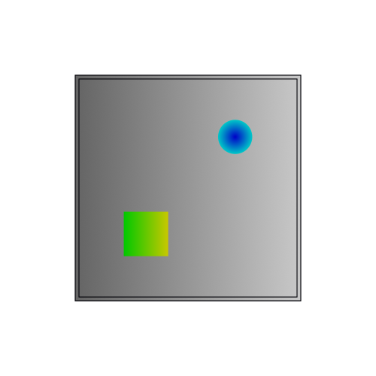
Data generation Update
Image for replicating our data
  Goal mutate this type of image procedurally

Slide 3
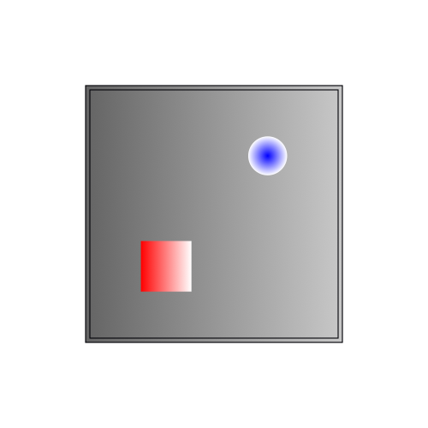
Data generation Update
Image for replicating our data
  Goal mutate this type of image procedurally

Slide 4
Data generation
Outlining the task:
  Decompose the image into prominent features
    Create a mask for transparent regions
    Create a mask for grayscale regions
    Create a mask for color regions
  Mutate the colored regions
    Create a way to change the colors proximally (within a prescribed color space)
    Create a way to mutate the shape of the colored space

Slide 5
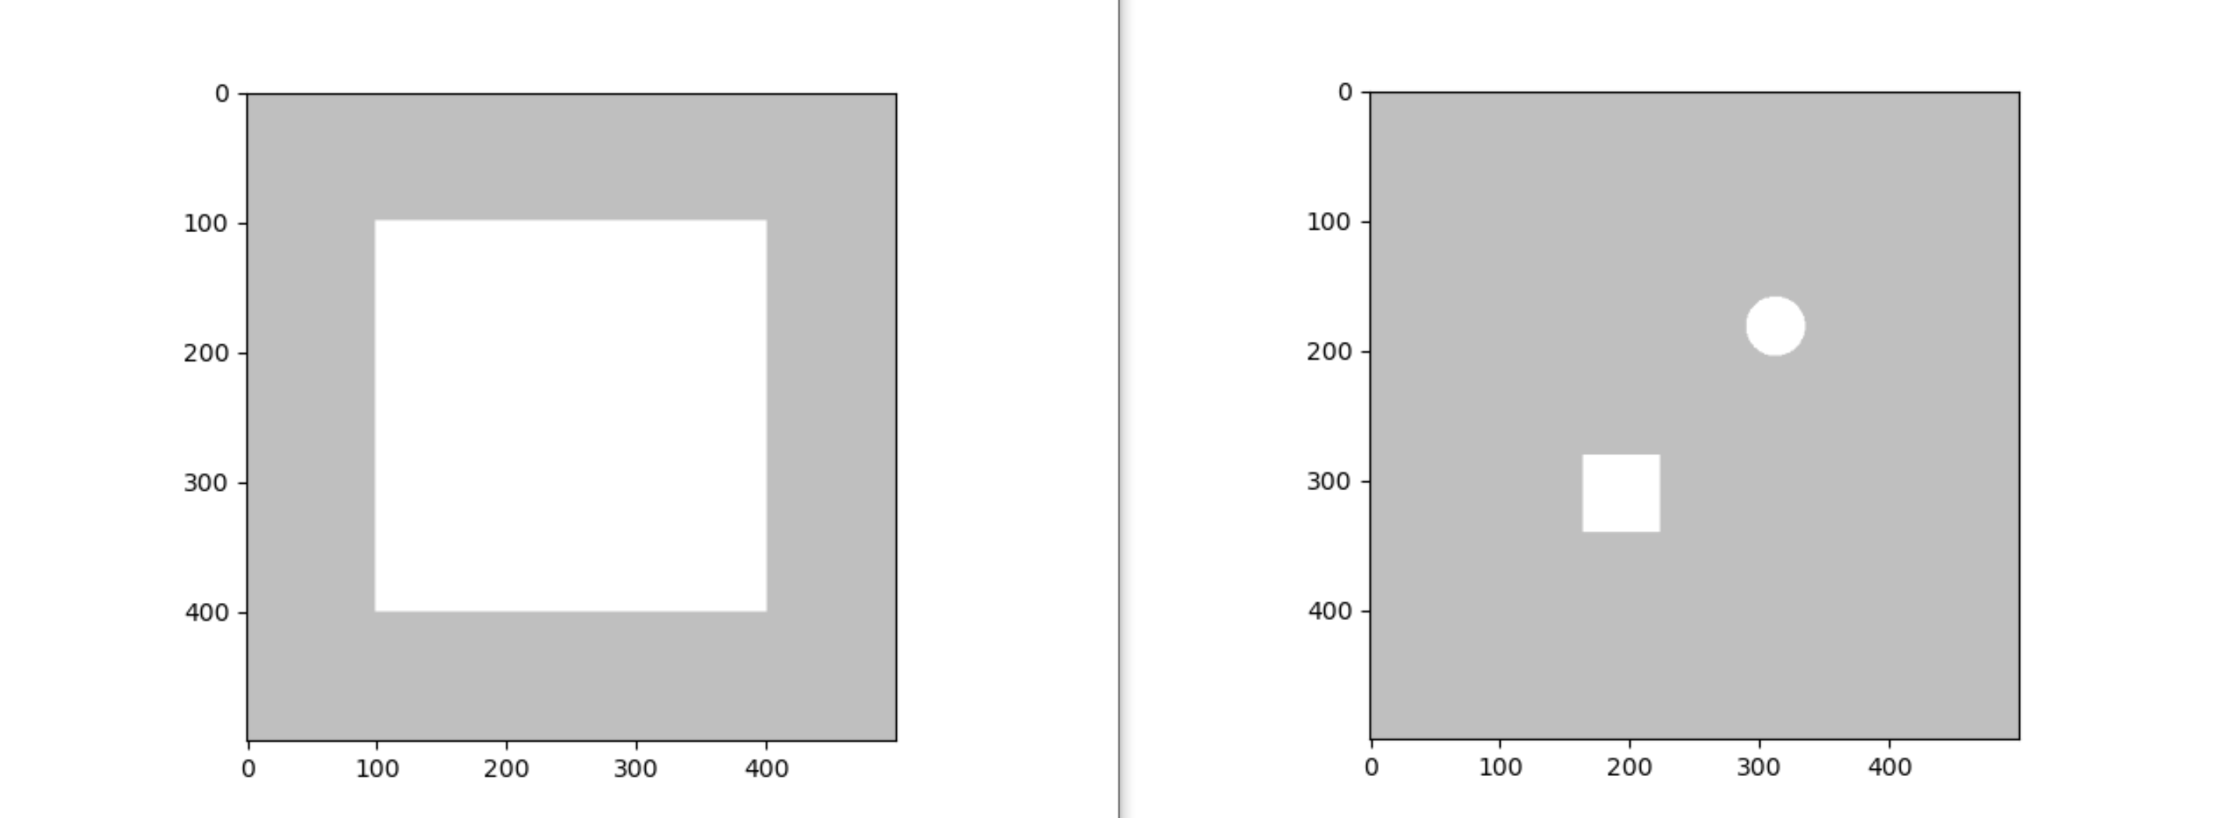
Data generation

Slide 6
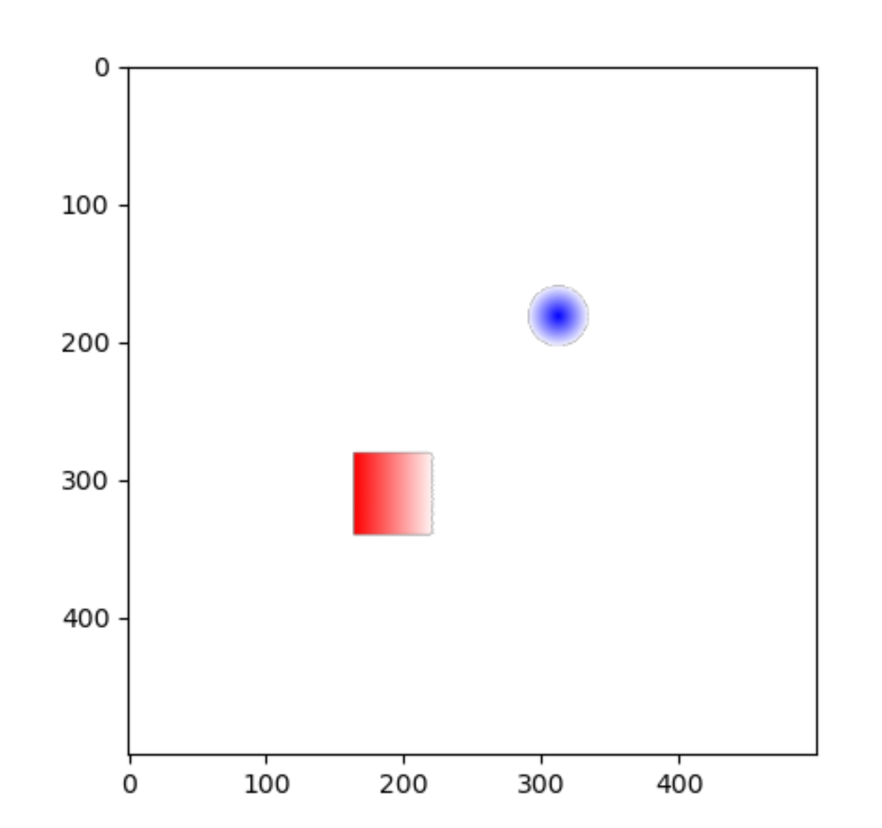
Data generation

Slide 7
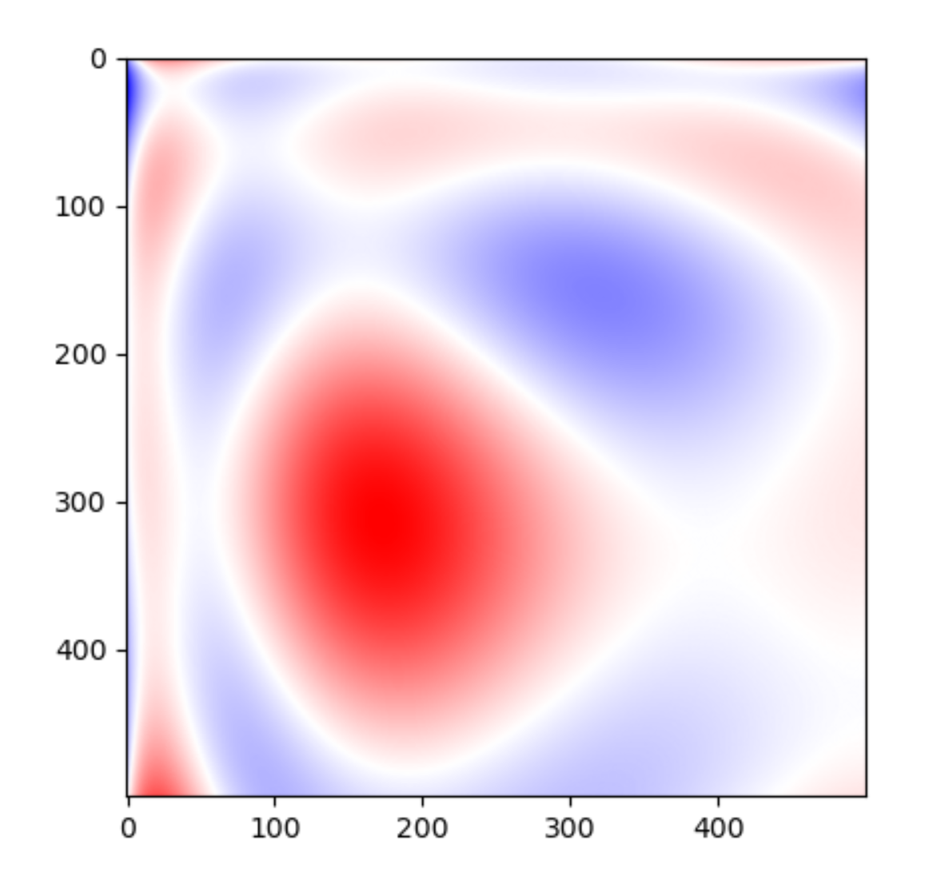
Data generation

Slide 8
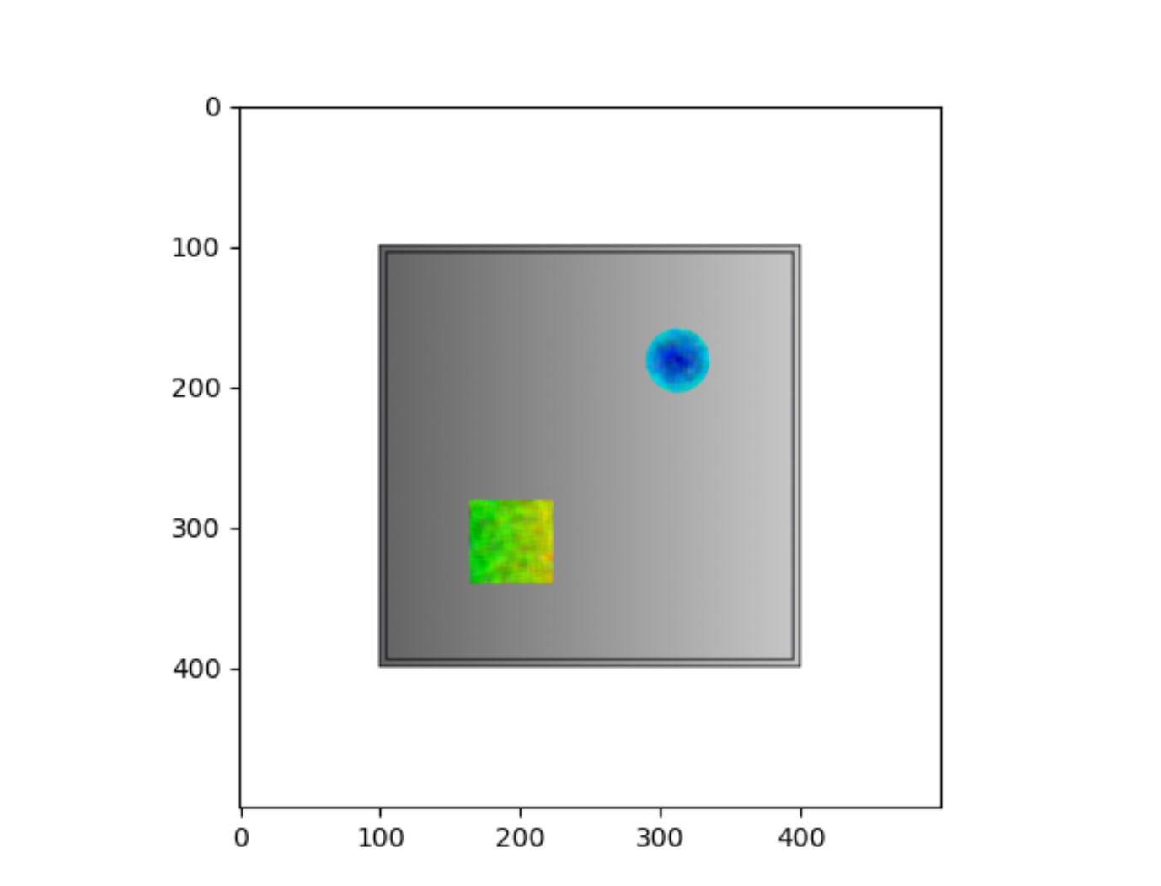
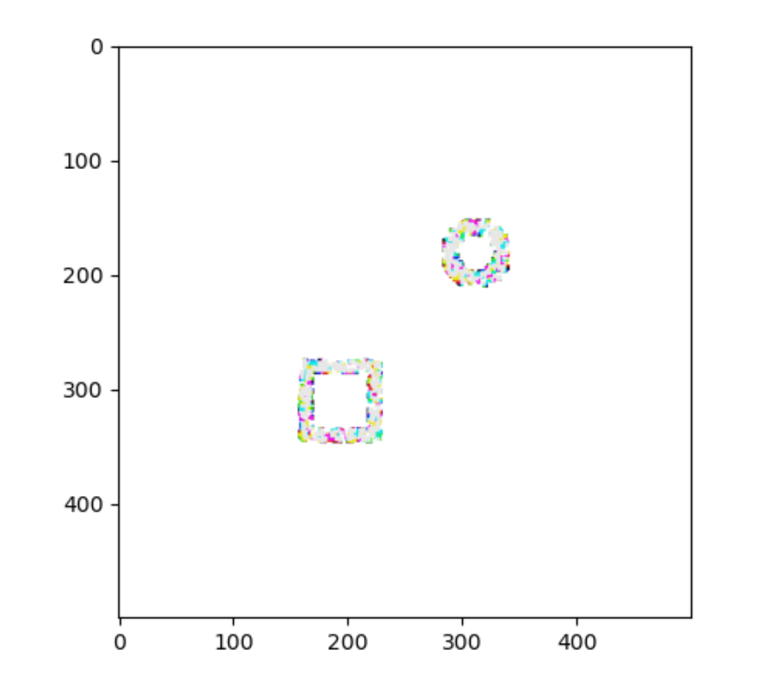
Data generation

Slide 9
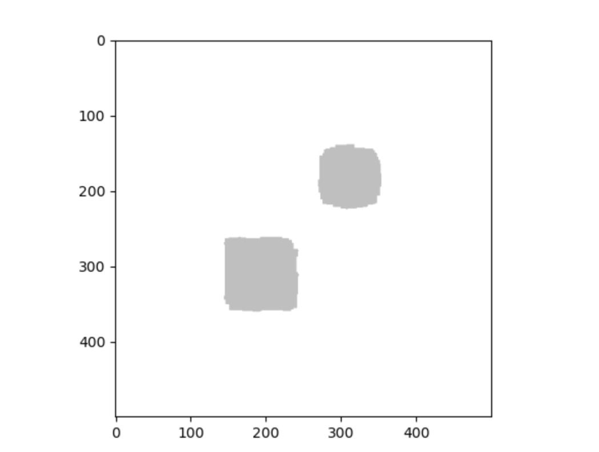
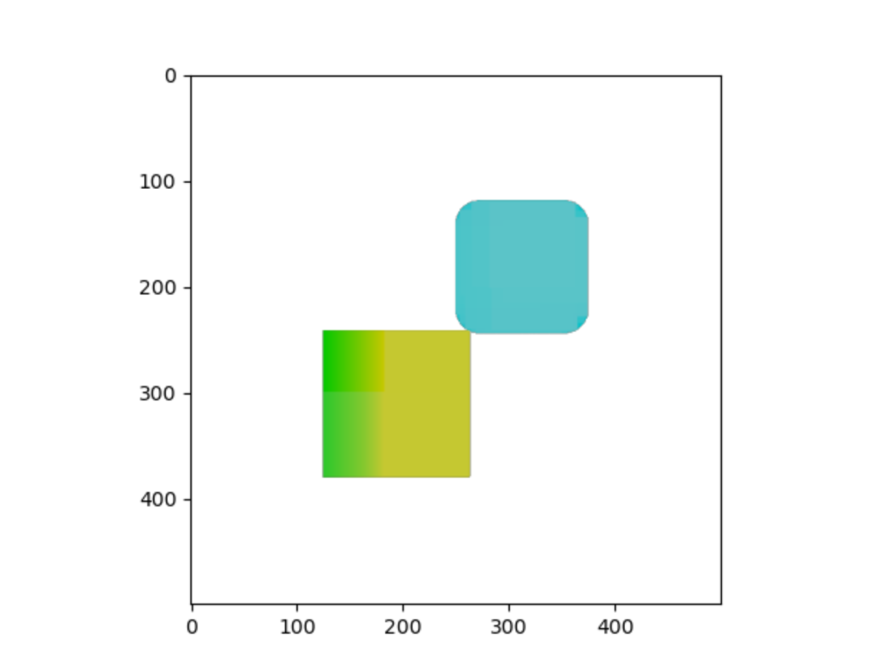
Data generation

Slide 10
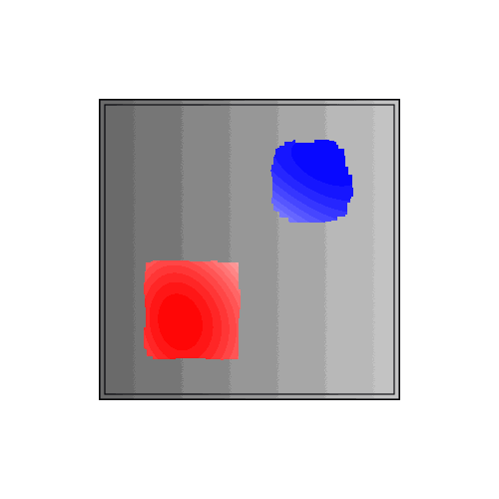
Data generation

Slide 11
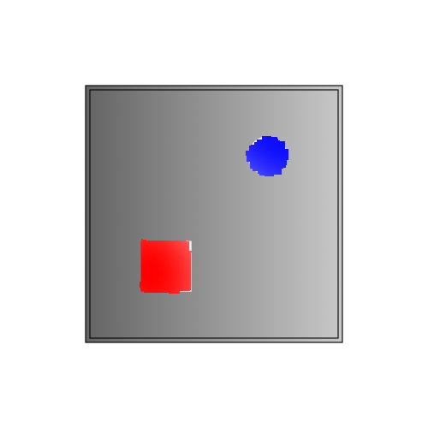
Refining the field approach

