Slide 1
Collect .me
Micah.Averi.Dwight. Collective presents

Slide 2
Contents
Team Intro
Breaking Down of Collect.Me
Technologies Used
Successes
Demo-Time
Challenges
Questions?

Slide 3
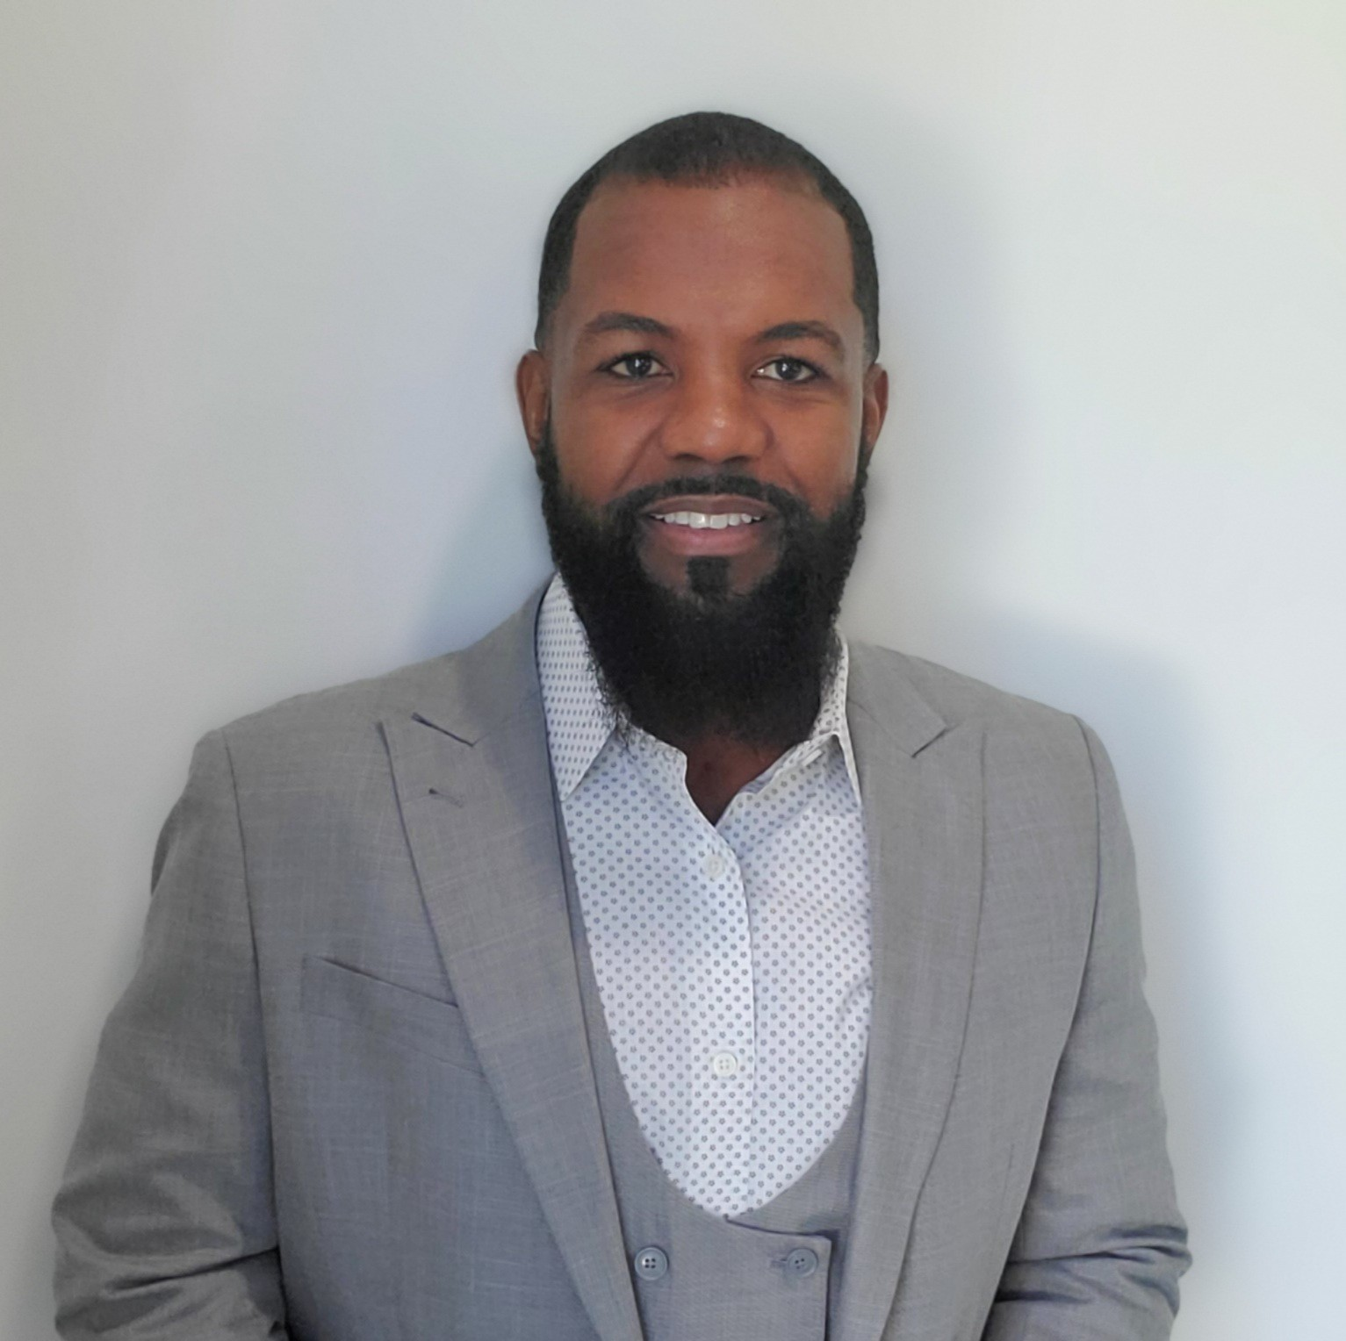
Micah.Averi.Dwight. Collective
Micah Harder
University of Florida
B.S.E.E.
Originally interested in software engineering, when I relocated to Atlanta, I decided to restart my career.
Averi Bean
University of Florida
B.S.E.E.
Originally interested in software engineering, when I relocated to Atlanta, I decided to restart my career.
Dwight C Kornbluth II
University of Florida
B.S.E.E.
Originally interested in software engineering, when I relocated to Atlanta, I decided to restart my career.

Slide 4
Breaking Down of Collect.Me

Slide 5
Technologies Implemented
Front-End (UI):
React.js
JSW
Bootstrap
React-Bootstrap
Stripe-UI
Helpers:
DB Designer
MySQL Workbench
Visual Studio Code
IntelliJ
MS Team
Zoom
Corbos/Dillon-Tuck
Back-End:
Java
MySQL
Docker
TomCat
Stripe-API

Slide 6
Successes: It Works!
Micah Harder
University of Florida
B.S.E.E.
Originally interested in software engineering, when I relocated to Atlanta, I decided to restart my career.
Averi Bean
University of Florida
B.S.E.E.
Originally interested in software engineering, when I relocated to Atlanta, I decided to restart my career.
Dwight C Kornbluth II
Responsiveness
Sidebar: Category Filter
Internal Shopping Cart
Stripe API checkout
Overall UI

Slide 7
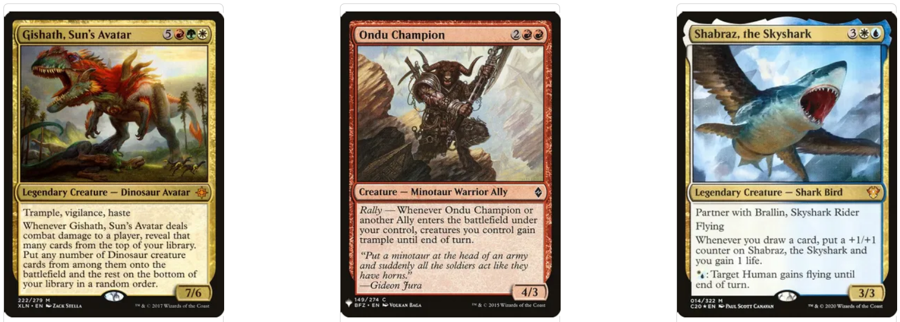
Demo-Time

Slide 8
Challenges: Oh No You Didn’t!
Micah Harder
University of Florida
B.S.E.E.
Originally interested in software engineering, when I relocated to Atlanta, I decided to restart my career.
Averi Bean
University of Florida
B.S.E.E.
Originally interested in software engineering, when I relocated to Atlanta, I decided to restart my career.
Dwight C Kornbluth II
Navbar, Sidebar & Foot co-existing
Stripe API and Shopping Cart connection
Consistency in rendering MainContent
Notes:
e

Slide 9
Questions?

