Slide 1
Collect .me
Micah.Averi.Dwight. Collective presents

Slide 2
Contents
Team Intro
Breaking Down of Collect.Me
Technologies Used
Successes
Demo-Time
Challenges
Questions?

Slide 3

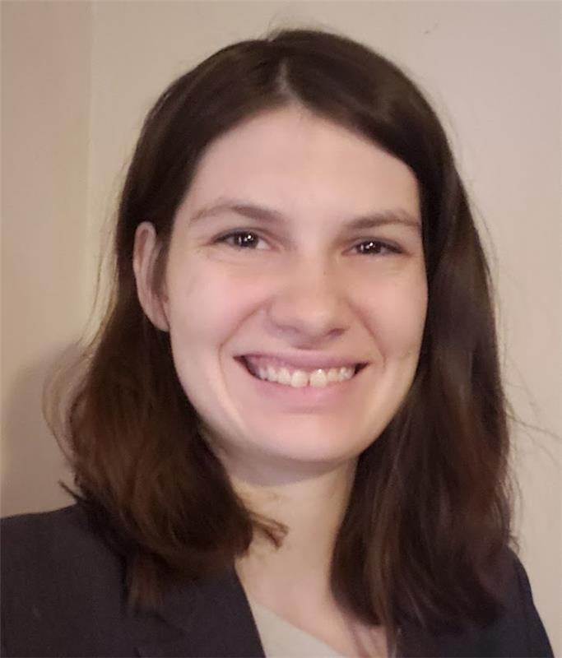
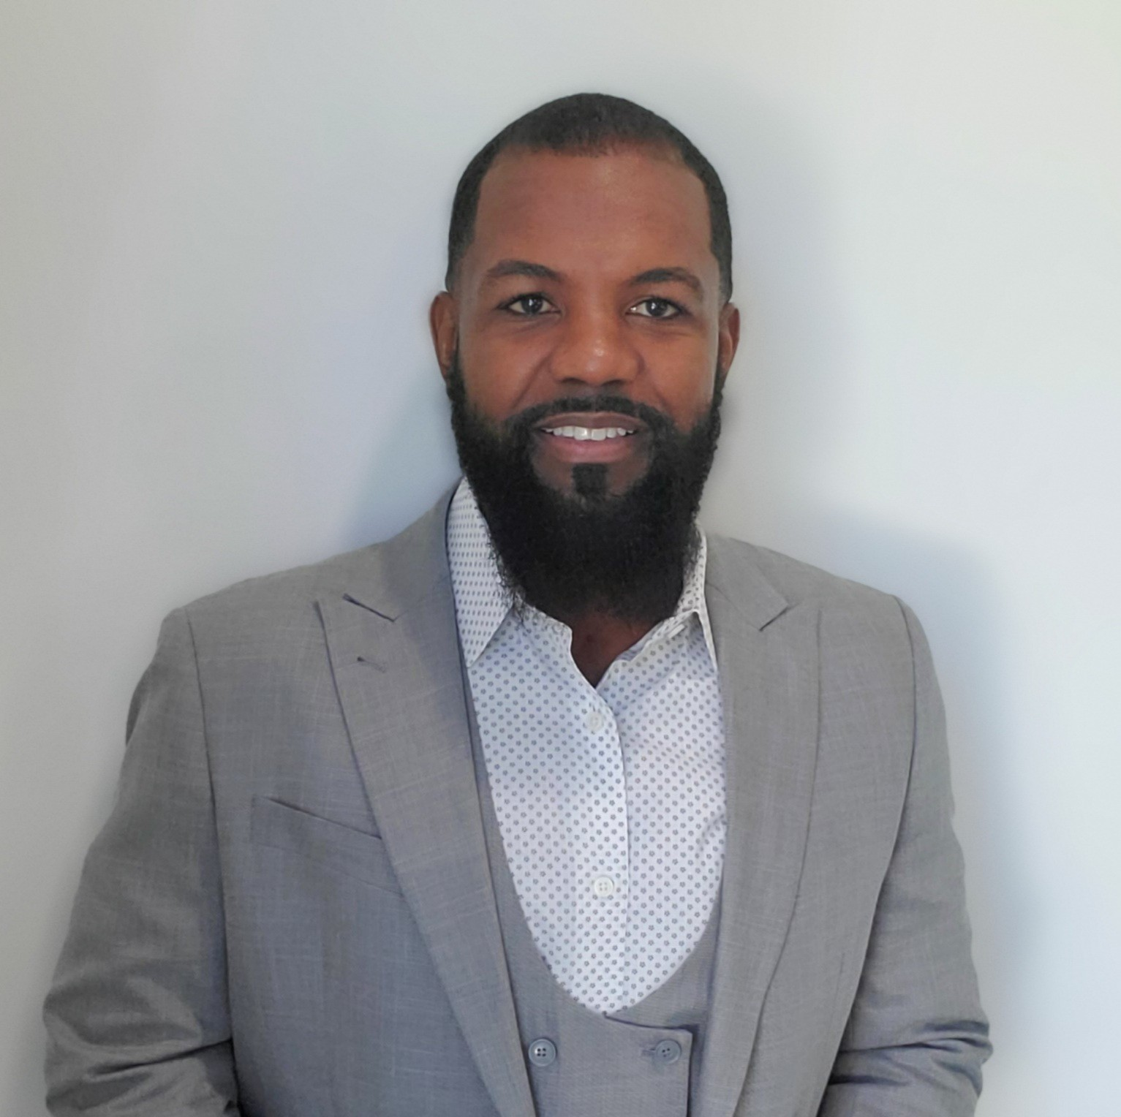
Micah.Averi.Dwight. Collective
Micah Harder
University of Wisconsin Eau Claire
B.S. Biology, minor in medicine
After working in healthcare and transportation, I decided to pivot to software development.
Averi Bean
Michigan State University
B.S. Environmental Geo-Science
I was able to try coding at the end of my college career, and decide to pivot into software development
Dwight C Kornbluth II
University of Florida
B.S. Electrical Engineering
Originally interested in software engineering, when I relocated to Atlanta, I decided to restart my career in the field.

Slide 4
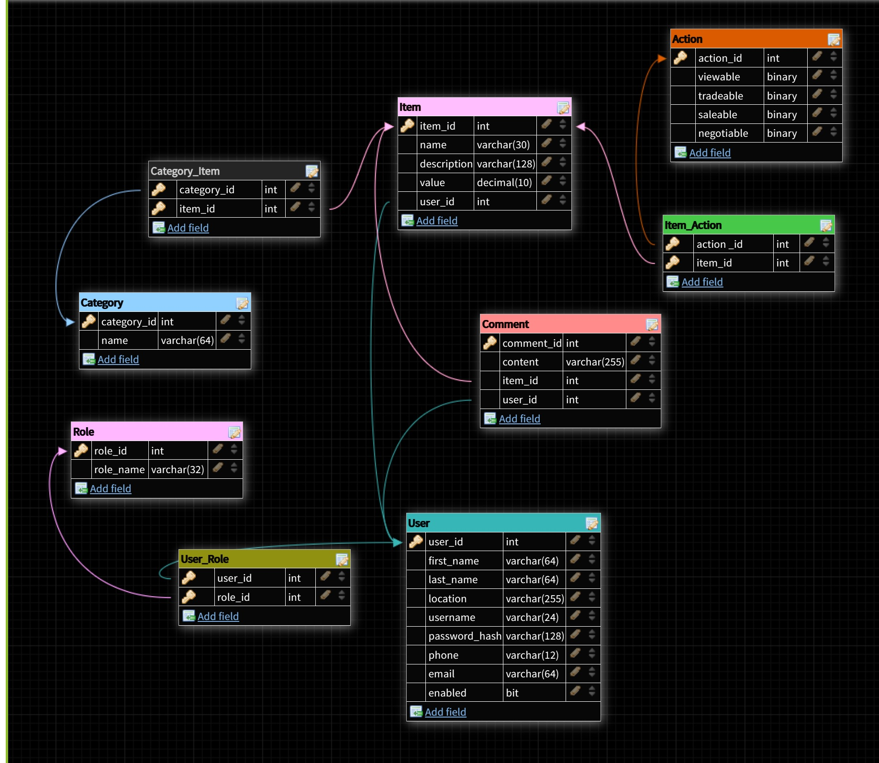
Breaking Down of Collect.Me
Collection site with more than one category
Allows onsite, negotiations, trades and sales for items if allowed by owner
Developed to be a social site allowing users to interact with each other.

Slide 5
Technologies Implemented
Front-End (UI):
React.js
HTML/CSS/JSX
Bootstrap
React-Bootstrap
Font-Awesome
Helpers:
DB Designer
MySQL Workbench
Visual Studio Code
IntelliJ
MS Team
Zoom
GitHub
Corbos/Dillon-Tuck/James
Back-End:
Java
Maven
SpringBoot
JUnit
MySQL
Docker
TomCat

Slide 6
Successes: It Works!
Micah Harder
Implemented image functionality
Images are stored as dataUrL
Contributed to front end components
Wrote SQL DDL and DML
Averi Bean
Implemented Back-End Security
Extended User Profile
Authenticated CRUD for User Profile
Dwight C Kornbluth II
Overall UI
Responsiveness
Sidebar: Category Filter
Internal Shopping Cart

Slide 7
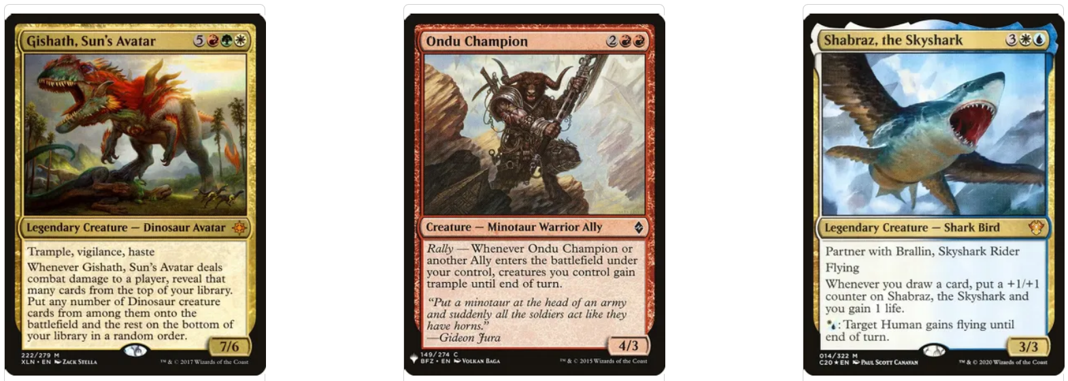
Demo-Time

Slide 8
Challenges: Oh No You Didn’t!
Micah Harder
Getting Images in and out of the SQL database
Used brute force method of dataUrl
Averi Bean
Extend User Profile to Include Security
Authenticating Profile Use/View
Working with CRUD password encryption
Dwight C Kornbluth II
Navbar, Sidebar & Footer co-existing
Consistency in rendering Main Content
Stripe API and Shopping Cart connection
Notes:
e

Slide 9
Questions?

