Slide 1
Plata Credit Risk Prediction
Averil Kan

Slide 2
summary
Goal
We aimed to build a tool that predicts the likelihood of a Lending Club loan not being fully repaid (i.e., defaulting or charging off).
Approach
We analysed over the loan records, identified patterns related to risk, and built a predictive model.
Result
A data-driven model that assigns a "Risk Score" (Probability of Default) to loans, helping distinguish potentially problematic loans from safer ones.
Value
This tool can help reduce financial losses by informing decisions on loan approvals, terms, and portfolio management.

Slide 3
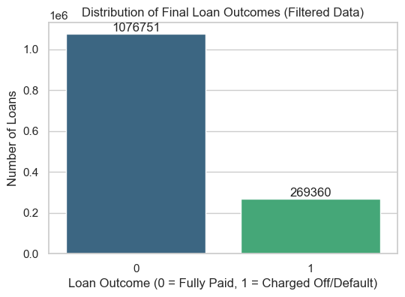
The Challenge: Understanding Loan Risk
Background
Lending money always involves risk. Not all loans are paid back in full.
Loans that "go bad" (Default, Charge Off) result in financial losses.
Challenge
How can we better identify potentially risky loans before they become problems, using the data we have?
Objective
Predict the likelihood (probability) that a new loan application will eventually end in a "Bad" state.

Slide 4
Approach
1. Data Gathering & Prep
Extensive cleaned historical loan data from Lending Club.
Focused on loans with clear final outcomes ('Fully Paid' vs. 'Charged Off'/'Default').
2. Analysis & Insights
Explored the data to understand what factors historically influenced loan repayment.
3. Model Building
Developed a predictive tool (a machine learning model) that learns these historical patterns.
4. Validation & Testing
Ensured the model works reliably on data it hasn't seen before, simulating real-world use.

Slide 5
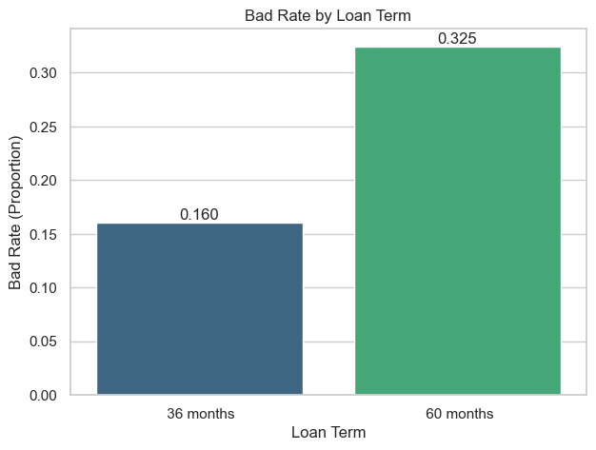
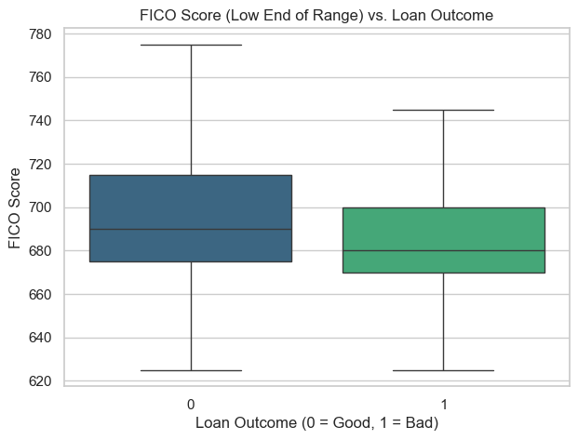
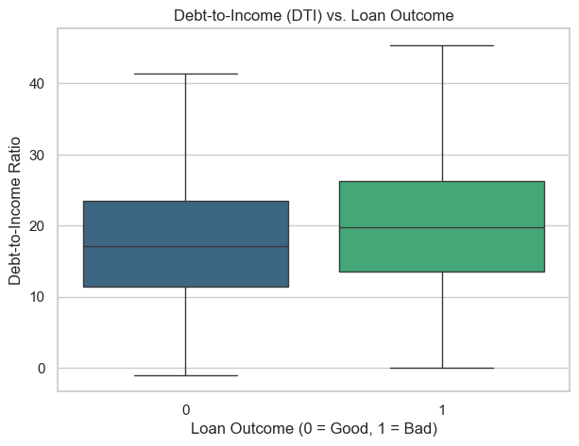
Key insights
Loan Terms Matter
Credit worthiness
Debt Burden
Higher interest rates and longer repayment terms (e.g., 60 months vs. 36 months) are associated with higher risk.
Lower FICO scores and indicators like previous public records increase risk.
Higher existing debt relative to income (DTI) can signal higher risk.

Slide 6
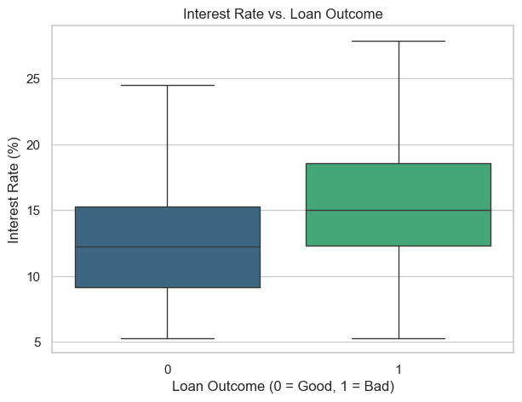
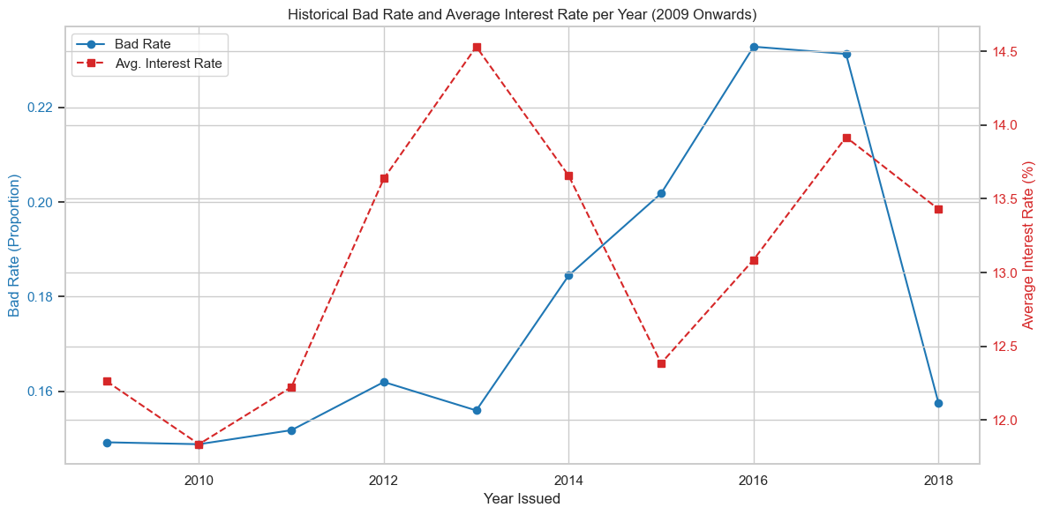
Key insights
Economic Context:
Risk levels aren't static; they change over time with market conditions.

Slide 7
The Predictive Model
We built a tool that takes loan application details as input.
It uses the patterns learned from historical data to calculate a Probability of Default (PD) - essentially a "Risk Score" for that specific loan.
Higher Score = Higher Predicted Risk
This score quantifies the risk before a final lending decision is made.

Slide 8
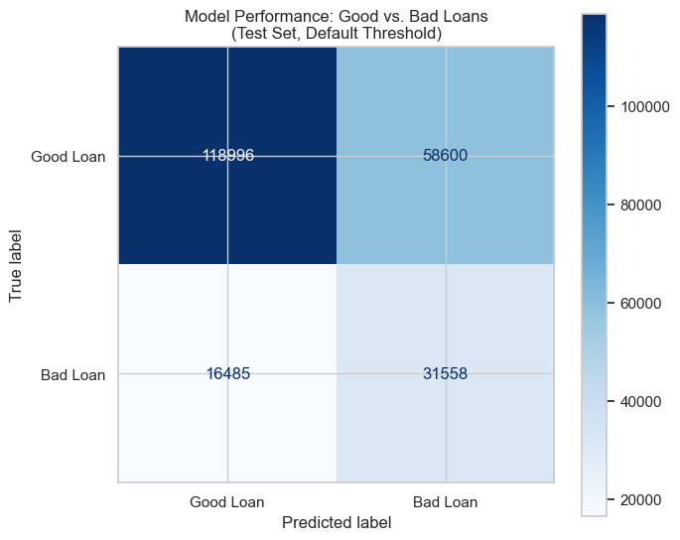
Model performance
The model significantly outperforms random guessing.
It successfully identifies a large portion of the loans that eventually defaulted in our test data.
It also correctly identifies the vast majority of loans that were ultimately paid back successfully.
In essence: It provides a valuable signal to flag potentially risky loans for closer review or adjusted terms.

Slide 9
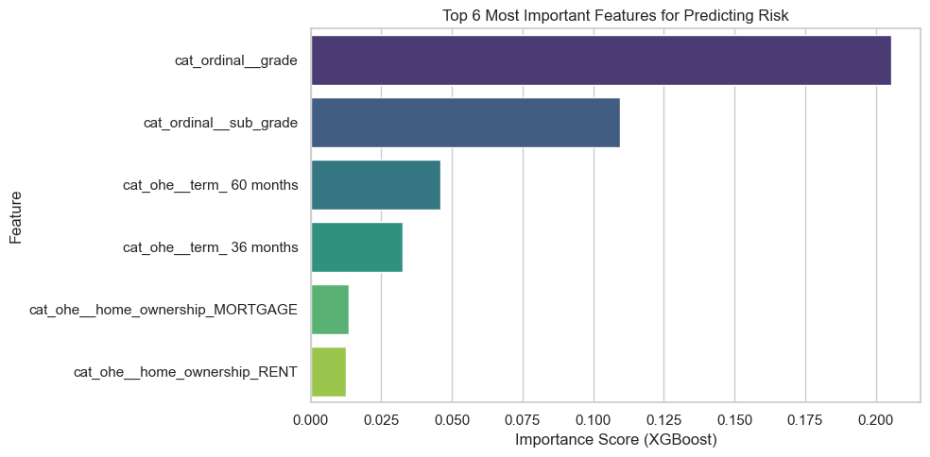
What are the Strongest Predictors of Risk?
Loan Grade/Sub-Grade
The rating assigned by Lending Club itself is a very strong indicator.
Loan Term
Longer terms increase exposure and risk.
Credit History
Factors like homeownership status (Mortgage vs. Rent) and the length/quality of credit history play a role.

Slide 10
How Can We Use This Model?
The Risk Score generated by the model can support several key business functions:
Loan Underwriting: Inform decisions on approving/denying new loan applications.
Pricing/Terms: Help set appropriate interest rates or loan amounts based on risk level.
Portfolio Monitoring: Track the overall risk profile of the active loan portfolio.
Collections Strategy: Potentially prioritize collection efforts on higher-risk active loans.

Slide 11
THANK YOU

