Slide 1
Browser http://slides.sikuli.org/examples/login.html

Slide 2
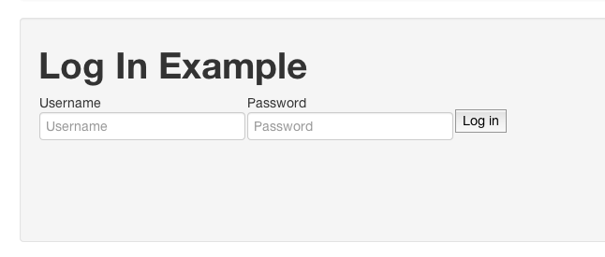
TYPE <username>

Slide 3
TYPE <password>

Slide 4
CLICK

