Slide 1
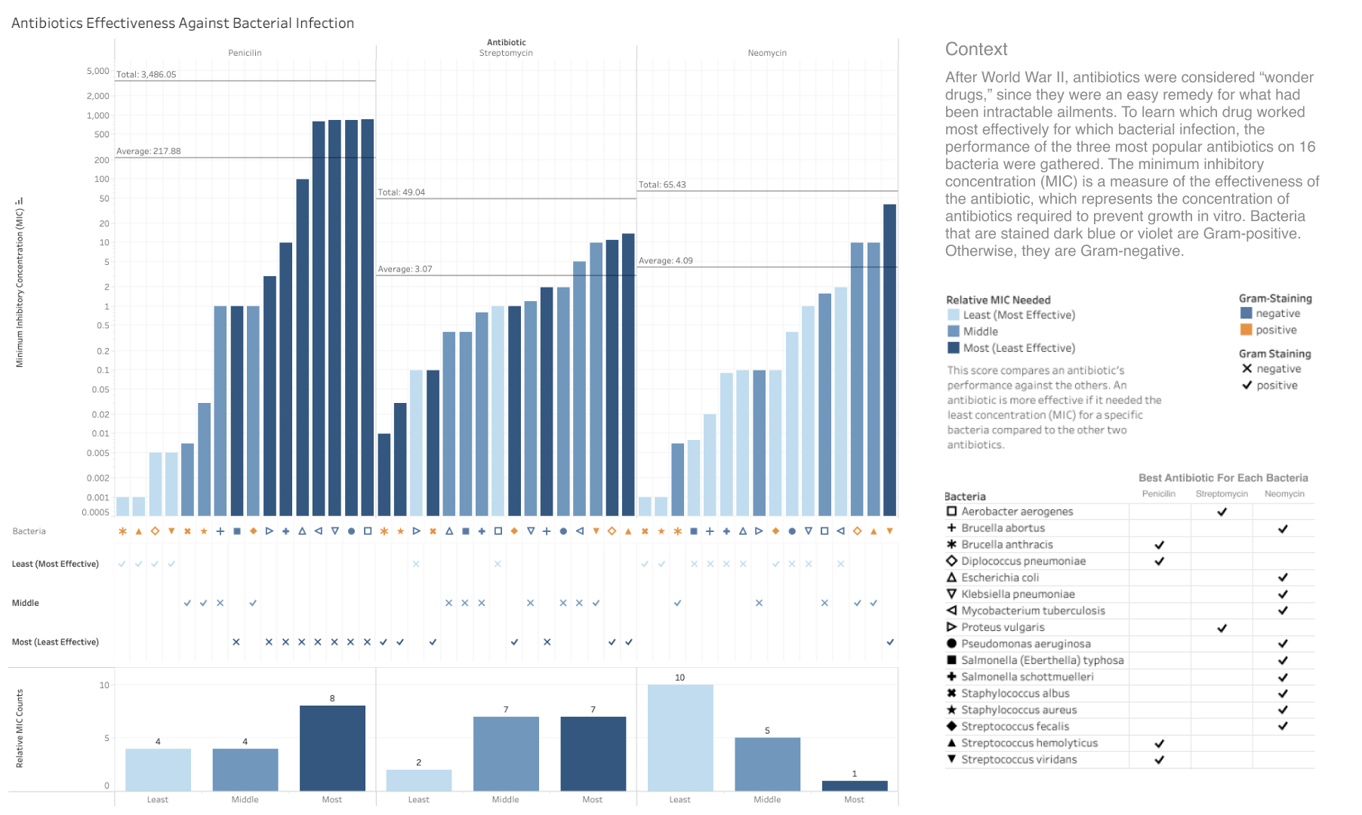

Slide 2
Writeup
With this visual, I attempted to answer two high-level questions: What is the relative effectiveness of each antibiotic in general? What is the comparative effectiveness of each antibiotic for each bacteria? I had four visualizations that composed the final visual. Three shared an x-axis: A bar chart of the MIC measure, a dot plot of relative MIC variable, and a bar chart of the relative MIC score count. Additionally, there was a table of the best antibiotics for each bacteria. The first three visuals answer the first high-level question by allowing comparisons between the three antibiotics overall. The last visual answers the second high-level question directly. Contextually I was uncertain where Gram Staining fit into the story I was trying to tell, so I encoded it throughout the four visuals. I will go through these four visuals sequentially.
The first bar chart was the visual that encoded the raw quantitative data of the MIC measure. On the y-axis with a log scale are the MIC scores (encoded through length). On the x-axis, the data is bacteria grouped by an antibiotic. I chose to encode the MIC measure in this way because length encodes quantitative data well. The bars have color according to a variable I created that represents the MIC needed for an antibiotic compared to the others with a value of [1, 2, 3] or equivalently [Least, Middle, Most]. Lastly, I added the total and average MIC for each antibiotic and sorted within each antibiotic group by MIC score.
The second visualization was a dot plot encoding the relative MIC variable (through position) on the y-axis and shared the x-axis with the first bar chart. The reason for encoding information already encoded in the color of the first chart is because position is a better channel than color to encode an ordinal variable. Also encoded here in symbols (checkmark or 'X') is the gram-straining. Note that the y-axis encodes the bacteria using symbols rather than words because each bacteria occurs three times, making it difficult to read particularly when oriented vertically. The third visual is a simple bar chart to summarize the count of this same variable.
The last visual is separate from the rest. It is a table of the bacteria names with three columns that correspond to each antibiotic. There is a symbol in each cell where an antibiotic is the best for a particular bacteria. This table also doubles as a key for the bacteria symbols. I chose to make this table because specific queries like "what antibiotic is best for bacteria X?" were hard to make using the first three visualizations. You would have to decode the bacteria symbol three times spread over the x-axis and compare the colors of the corresponding bars. This table does require decoding symbols since it doubles as a key and encodes the best antibiotic directly. Additionally, the gram staining information is encoded here for similar reasons.

