Slide 1
Falcon 9 first-stage landing analysis
Data Science Capstone Project
Study period: 2010–2020 | 90 public educational launch records
Report-to-slides conversion — results are descriptive unless marked otherwise
Applied Data Science Capstone | descriptive results from public educational data

Slide 2
Executive summary
• 60 of 90 launches labeled landing success (66.7%).
• Success varies by launch site: 60.0%–77.3%.
• Reused boosters: 78.4% success versus 58.5% not reused.
• Grid fins: 82.9% success versus 10.0% without.
• These historical associations do not establish causality.
Applied Data Science Capstone | descriptive results from public educational data

Slide 3
Introduction and research question
Question: How do launch site, mission orbit, vehicle design and flight history relate to landing success?
Target variable: Class ∈ {0,1}, with 1 denoting success in the supplied dataset.
Goal: collect, clean, query, visualize and model Falcon 9 launch data.
Applied Data Science Capstone | descriptive results from public educational data

Slide 4
Data collection: API and scraping
Planned API workflow:
• Query SpaceX launches and enrich rocket, landing-pad and launchpad identifiers.
• Normalize JSON; record retrieval date and preserve raw source.
Planned web scraping:
• Parse public launch tables; standardize dates, units and outcome labels.
• Reconcile with API data using launch identifiers.
Status: execution of these collection steps has not been verified.
Applied Data Science Capstone | descriptive results from public educational data

Slide 5
Data wrangling
• Parse dates and numeric payload mass; standardize booleans and categories.
• Validate target labels; check duplicate FlightNumber values.
• 26 of 90 records have blank LandingPad entries.
• Class balance: 60 positive versus 30 negative.
• Fit preprocessing on training data only to reduce data leakage.
Applied Data Science Capstone | descriptive results from public educational data

Slide 6
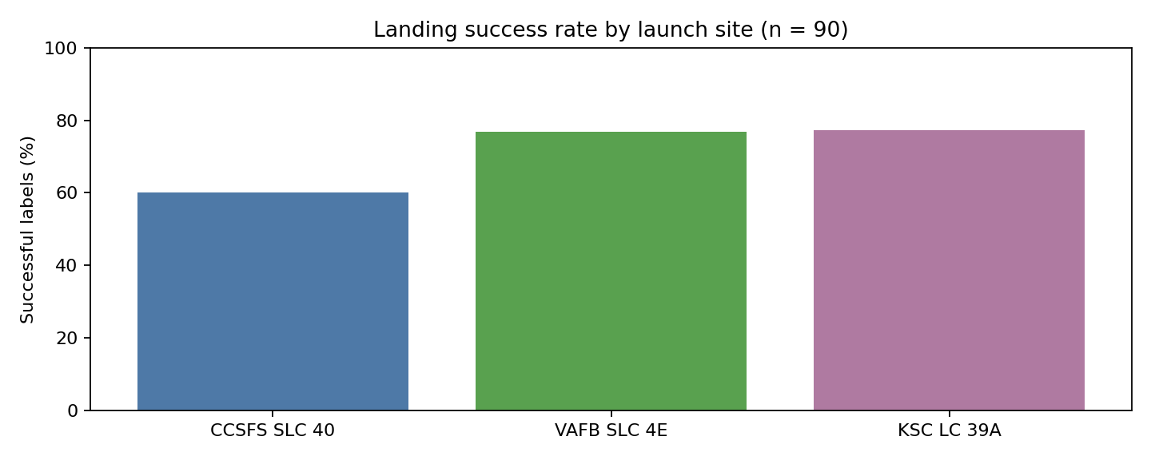
EDA: landing outcomes by site
Applied Data Science Capstone | descriptive results from public educational data

Slide 7
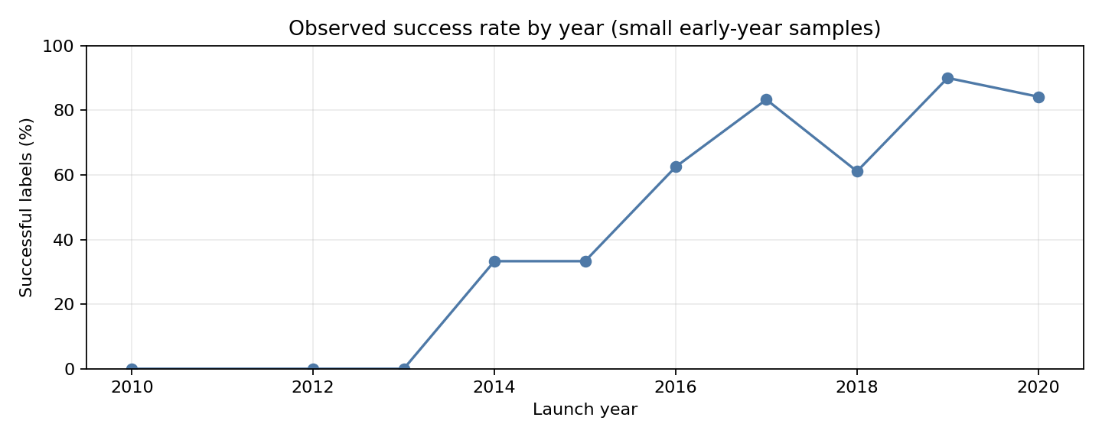
EDA: success rate by year
Applied Data Science Capstone | descriptive results from public educational data

Slide 8
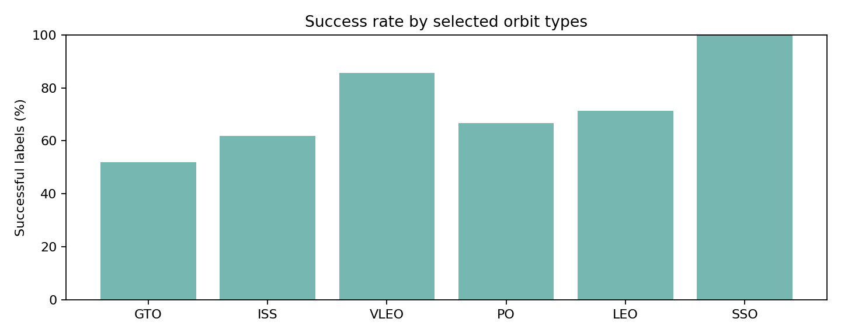
EDA: landing outcomes by orbit
Applied Data Science Capstone | descriptive results from public educational data

Slide 9
SQL exploration
Example query:
SELECT LaunchSite, COUNT(*) AS launches,
SUM(Class) AS successes,
ROUND(100.0 * AVG(Class), 1) AS success_pct
FROM launches GROUP BY LaunchSite;
Observed site success: CCSFS SLC 40 60.0% (33/55); VAFB SLC 4E 76.9% (10/13); KSC LC 39A 77.3% (17/22).
Applied Data Science Capstone | descriptive results from public educational data

Slide 10
Folium geographic analytics
• Create markers for launch sites and popups with counts and success rates.
• Add marker clustering, outcome filters and distance overlays.
• Export as launch_site_map.html.
• Coordinates in dataset include CCSFS SLC 40 and VAFB SLC 4E.
Status: interactive map and proximity analyses have not been executed or verified.
Applied Data Science Capstone | descriptive results from public educational data

Slide 11
Plotly Dash dashboard
Proposed controls and visuals:
• Launch-site dropdown: All Sites or individual launch site.
• Landing success/failure pie chart.
• Payload mass range slider.
• Scatter plot: payload mass versus launch outcome.
• Linked callbacks with consistent filters.
Status: application execution and dashboard screenshots pending.
Applied Data Science Capstone | descriptive results from public educational data

Slide 12
Predictive classification
Proposed classifiers: logistic regression, support vector machine, decision tree and k-nearest neighbors.
Tune with GridSearchCV; evaluate held-out accuracy, precision, recall, F1 and confusion matrix.
Historical majority-class rate: 66.7% (not a test-set model score).
Model execution and comparative metrics remain unverified.
Applied Data Science Capstone | descriptive results from public educational data

Slide 13
Conclusions and limitations
• Historical landing-success rate: 66.7% across 90 sampled records.
• Launch-site, booster reuse, and grid-fin status correlate with outcome.
• Observational relationships may reflect year, configuration and mission mix.
• Dataset ends November 2020; not representative of all launches through 2026.
• Next: run the notebooks, evaluate models, publish project files and capture screenshots.
Applied Data Science Capstone | descriptive results from public educational data

Slide 14
Data attribution and submission status
Dataset: github.com/Abhigyan-RA/SpaceX-capstone/blob/main/dataset_part_2.csv
This presentation summarizes independently computed descriptive findings; original collection, map, dashboard, and model evidence remain to be added.
GitHub project repository for submitter: https://github.com/AveryJan/SpaceX-Data-Science-Capstone.
Assignment source: Mark python(1).pdf (15-point rubric).
Applied Data Science Capstone | descriptive results from public educational data

