Slide 1
What are the modern computational techniques employed for nuclear physics engineering?
By: Avery Vallée-Vézina Class: Advance Topics I, Assignment 4 Date: 2025-12-15
Notes:
Hello everybody,
Today I will be presenting something that always had a little bit of mystery behind it… Especially in terms of computer science. So, I asked myself, “What are the modern computational techniques employed for nuclear physics engineering”?

Slide 2
Agenda
Introduction:
Overview of the physics required for understanding the further sections
Section 1:
LLMs in nuclear physics research
Section 2:
Use case of computational models
Conclusion:
Overview of key findings, scope of my research, and where it’s headed.
Notes:
So, lets go over this presentation’s agenda. We’ll start by introducing what the scope of the presentation is. Then we’ll investigate AI in nuclear physics research.
After words we’ll look at a computational model to simulate possible outcomes of uncertain events.
And we’ll close off with key points of my research, scope of my research, and where it’s headed.

Slide 3
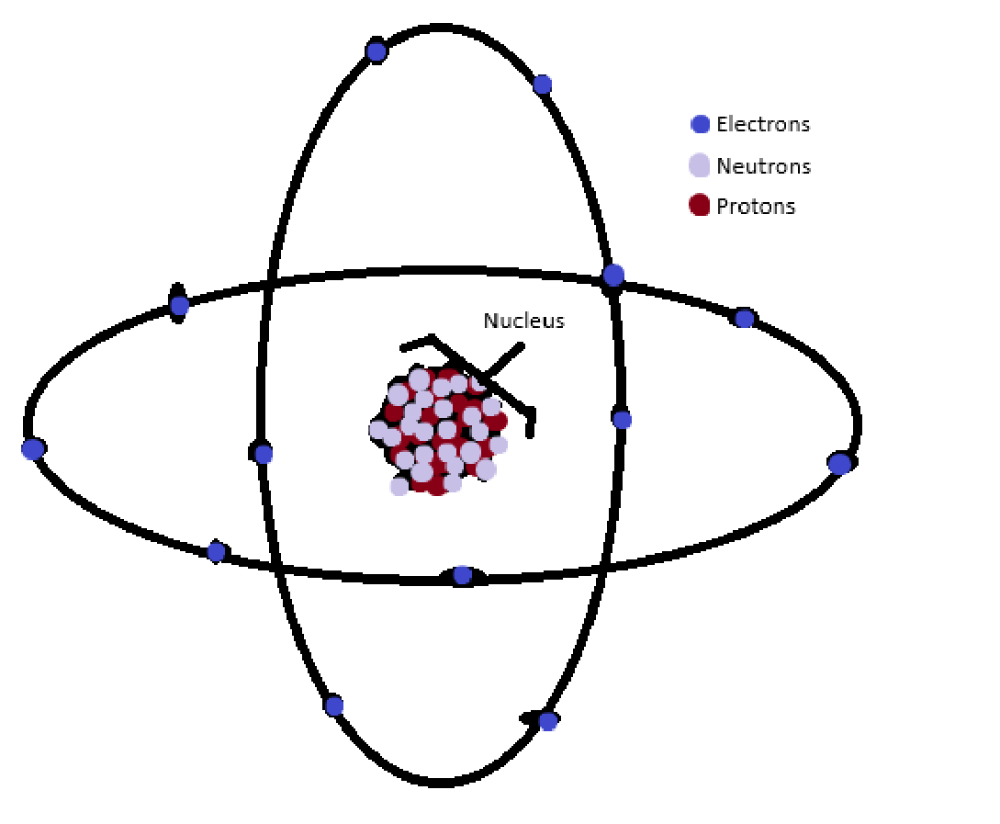
Introduction Dissecting my topic question (Revisit)
Notes:
Let's dissect my topic question for a minute. What do I mean by “Computational methods in nuclear physics engineering”.
To make sense of it, we need to look at it as two distinct items. “Computational methods and how it relates to Nuclear physics”
So, lets start by looking into the specific area of nuclear physics my research revolves around…
We’ll introduce the basic structure of an atom and then analyze its role in producing nuclear power.
If we continuously magnify in the universe, we find that the smallest thing to exist is an atom. - It has electrons, neutrons, and protons.
- And its center mass is called the nucleus (composed of protons and neutrons).
Nuclear physics simply refers to the study of the forces that keep the neutrons and protons bound inside a nucleus. Quote: “These forces are within the nuclei of the atoms” Feynman lecture series Vol 1 page 12-12

Slide 4
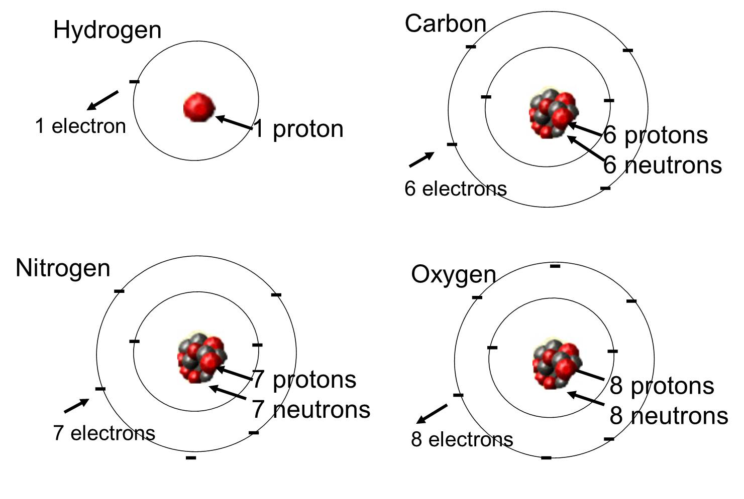
Notes:
There’s a bit more to this, however.
An element is essentially a flavor of an atom. Denoted by their configuration of electrons, neutrons, and protons.
Certain configurations are less stable others, but more on that later.
For the sake of the presentation, we’ll be looking at radioactive elements; in particular, Uranium.
Uranium’s configuration has 92 protons and 143 neutrons

Slide 5
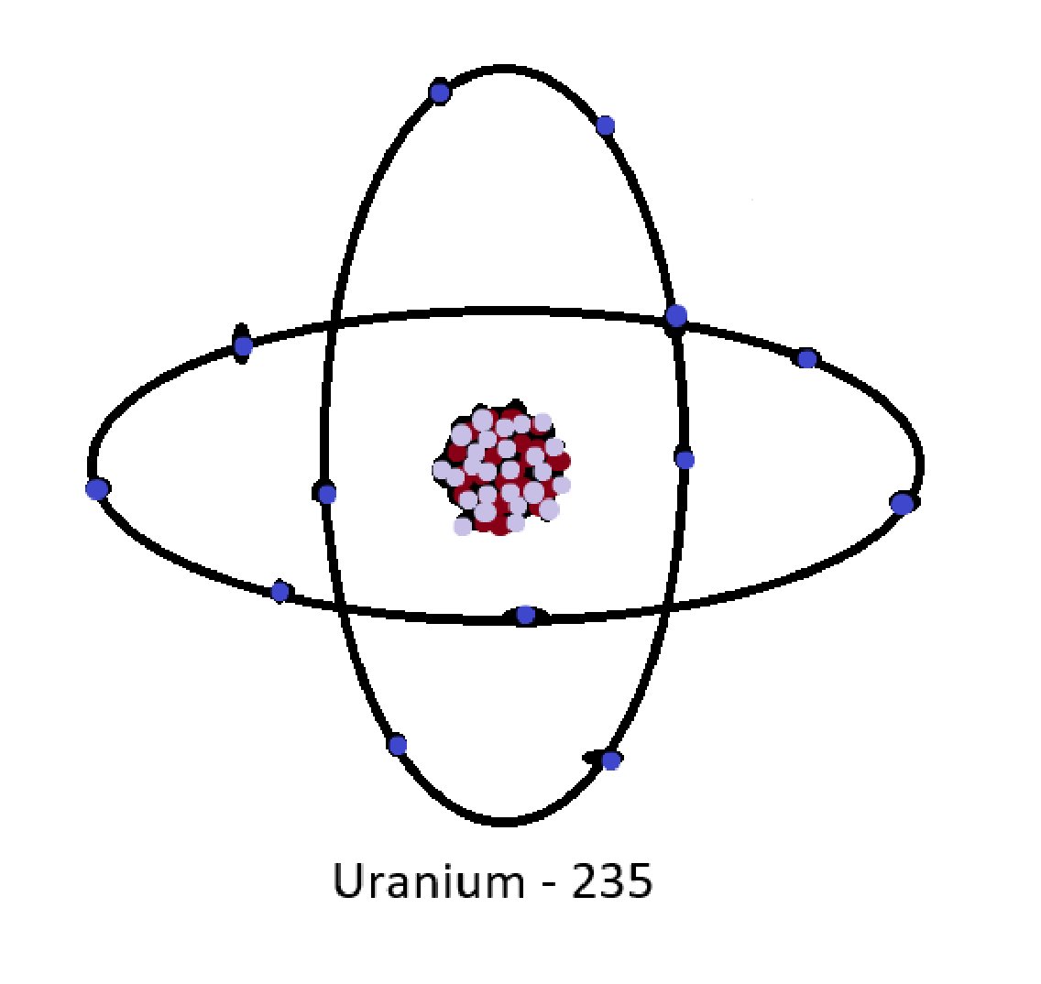

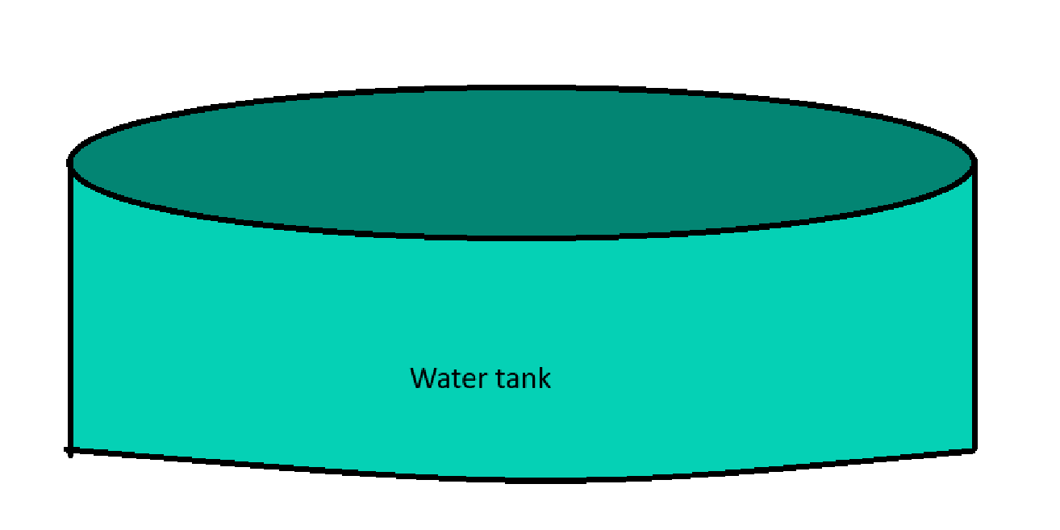
Introduction Scope of my research
Notes:
Although dangerous, radioactive elements produces vast amount of energy.
But how does it do that? We take radioactive materials and create a series of controlled reactions.
- More on controlled reactions in the next section. Each reactions causes energy in the form of heat, which heats up the containing water around it. This creates vapor which rises and spins a big turbine, producing power that we can use. ------- My research will focus on the computational avenues around the controlled reactions of the radioactive material.

Slide 6
Section 1 Large Language Models in nuclear physics research
How are LLM’s useful in nuclear research?
What limitations did they face?
How relevant is LLM to nuclear energy research as a whole?
Notes:
Now a-days you can’t mention computational avenues in computer science without acknowledging AI in some manner or form.
One of my first thoughts on this topic was, “How is this being researched?”.
Turns out… people are already asking that question, no surprise, but the reality is that we are constantly trying to find new ways to optimize workflow, and nuclear researchers are no different.

Slide 7
Section 1 How are LLM’s useful in nuclear research?
Applications ranged from:
Teams employed structured workflows combining
Key findings demonstrate that LLMs excel at early-stages in:
Notes:
How was it used:
- Developing reactor control models.
- Automating Monte Carle simulations (more on that in the next section).
- Material degradation analysis.
- And designing experimental programs for advanced reactors.
Process:
They fed LLM prompts
Did Big R research with the response
Then refined the sample outputs with more prompts
This generated:
- Hypotheses.
- Code prototypes.
- Research strategies.
Successful Results:
- Exploration.
- Literature synthesis.
- Workflow design.
- Successfully identifying research gaps
- and generating plausible experimental frameworks.

Slide 8
Section 1 What limitations did they face?
Data and code access barriers:
Implementation depth:
Data access and validation:
Technical accuracy:
Notes:
However, significant limitations emerged:
Data and code access barriers:
The most significant limitation across projects was the inability to access or process in-house nuclear data.
Teams working with restricted codes could not generate functional inputs despite extensive prompting.
Implementation depth:
While AI excels at high level work, it falls short with detailed implementations; consistently requiring human expertise.
It particularly struggled with Python code generation and mathematical solver development.
Data access and validation:
Literary synthesis was hindered by paywalls, missing datasets, and a constant need for expert validation.
This led to the LLM missing out on state-of-the-art research.
Technical accuracy:
Several projects encountered accuracy issues
e.g.: incorrect parameter values for heat transfer and problems with transparency.

Slide 9
Section 1 How relevant is LLM to nuclear energy research as a whole?
Results of successful outcomes
Practicality of using AI in nuclear physics
Notes:
The successful outcomes resulted:
- Experts treat AI as a tool rather than a replacement for physics-based methods.
Conclusion
The research demonstrated strengths for rapid iteration and cross-disciplinary synthesis.
It still showed a clear need for curated nuclear-specific datasets, workflow automation, and specialized model development.
This shows the initial foundational steps of realistically integrating AI as a tool to nuclear physics engineering.

Slide 10
Section 2 Monte Carlos Simulations
- What is Monte Carlo Simulation?
Notes:
IBM describes it as... " a mathematical technique ... used to estimate the possible outcomes of an uncertain event"

Slide 11
Conclusion

