Slide 1
UAT YouTube Metrics Analysis
March 27, 2025
Avery Willets

Slide 2
Overview
The goal of this project is to analyze YouTube video performance data to better understand patterns within video engagement based on video metadata.
Key Question: Based on the features present in the data, can the performance of a video (in views) be predicted? Which features influence that outcome the most?

Slide 3
Project Objective:
Examine and understand patterns in the data relating to video performance.

Slide 4
Understanding the Data

Slide 5
Video Categories

Slide 6
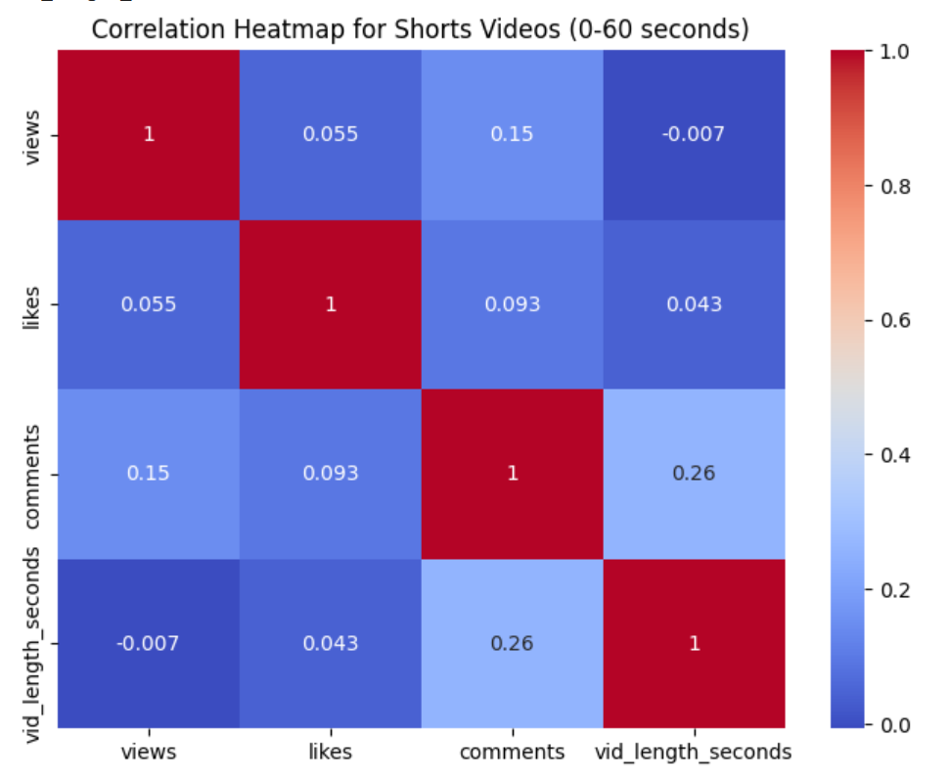
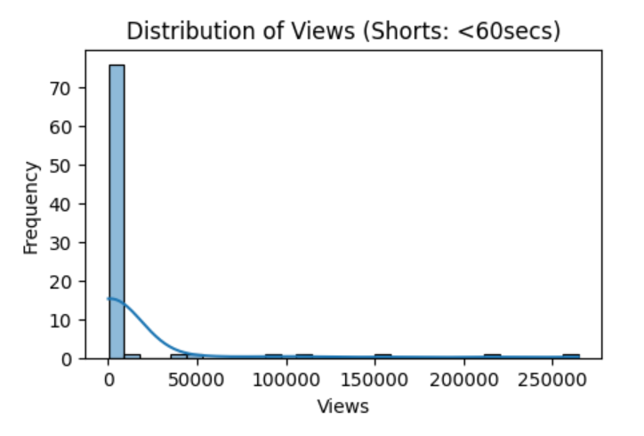
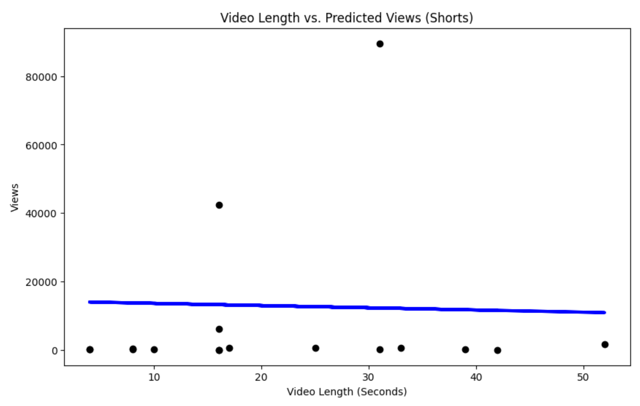

YouTube Shorts (0-1 min)
Fast Facts
Count: 84
Total Views: 1,006,340
Characteristics:
High views
Low engagement (Likes, comments)

Slide 7
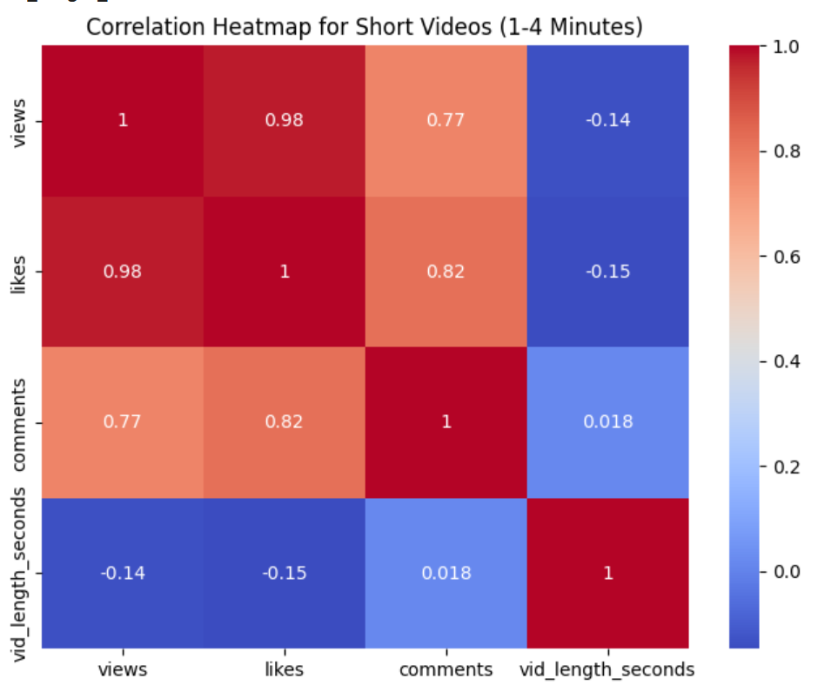
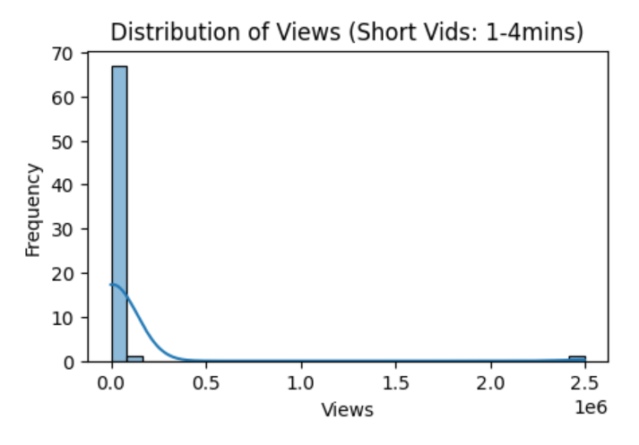
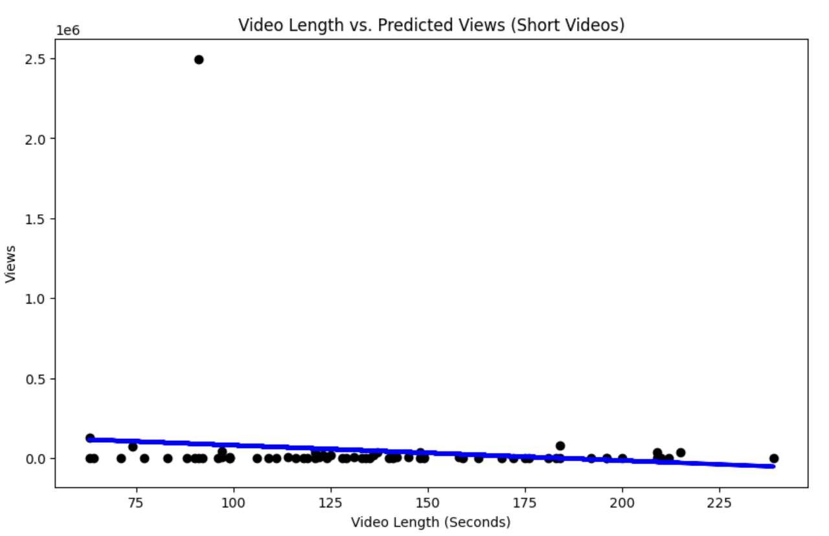

Short Videos (1-4 mins)
Fast Facts
Count: 69
Total Views: 3,112,439
Characteristics:
High views
Higher engagement

Slide 8
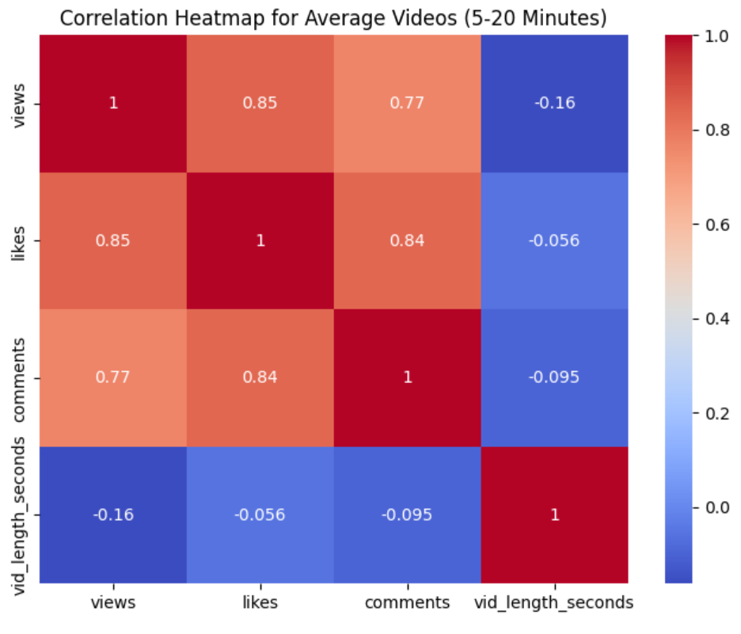
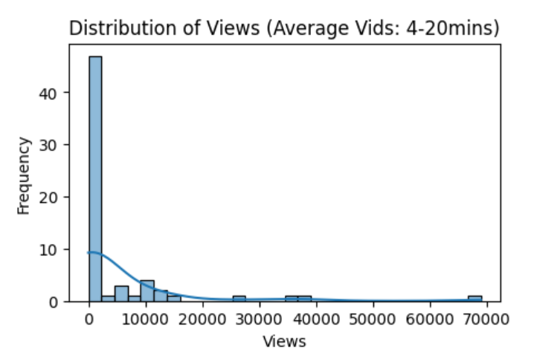
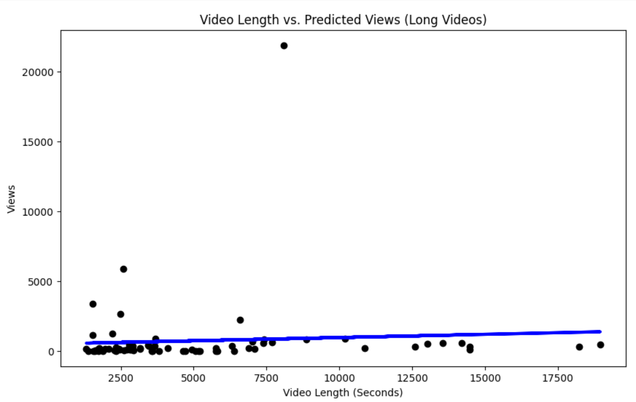

Average Videos (4-20 mins)
Fast Facts
Count: 63
Total Views: 290,514
Characteristics:
Lower views
Higher engagement

Slide 9
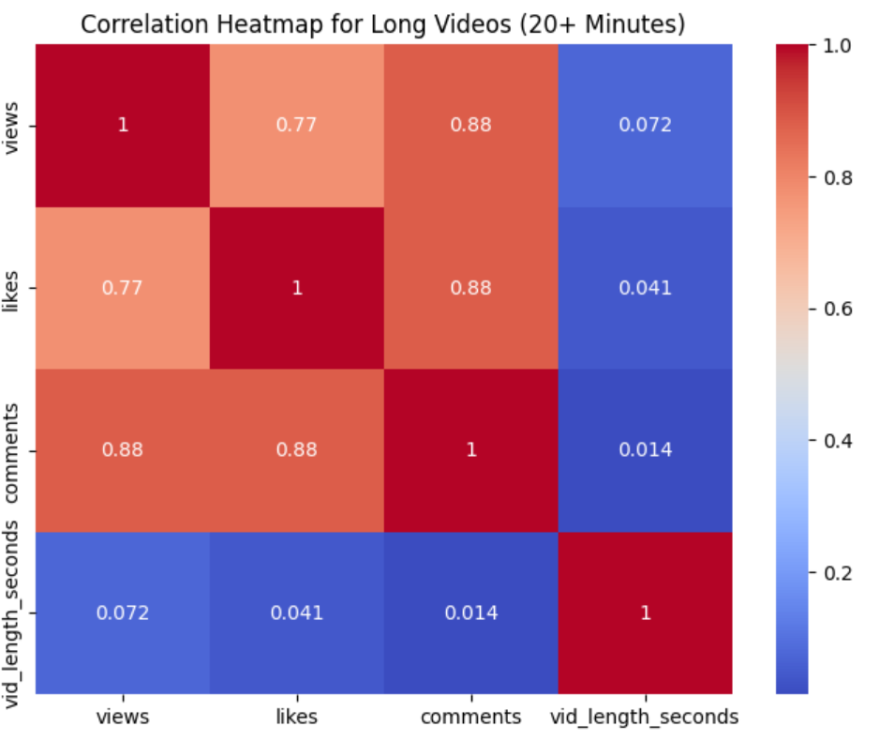
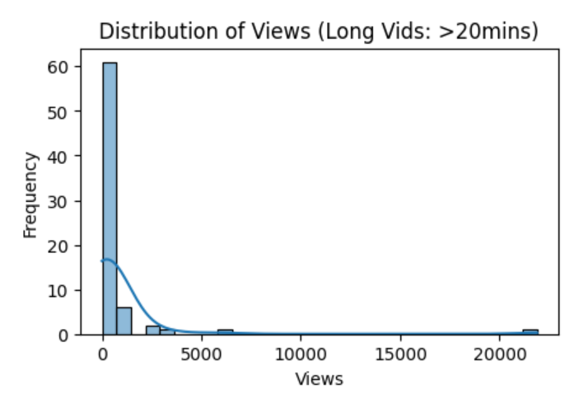


Long Videos (20+ mins)
Fast Facts
Count: 72
Total Views: 52,574
Characteristics:
Low views
Higher engagement

Slide 10
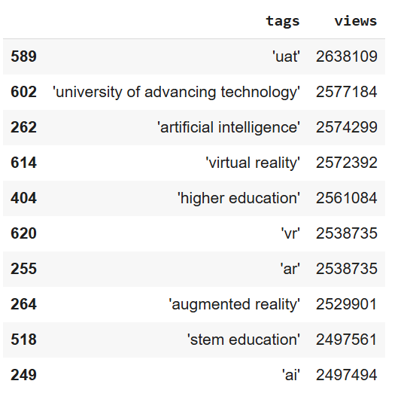
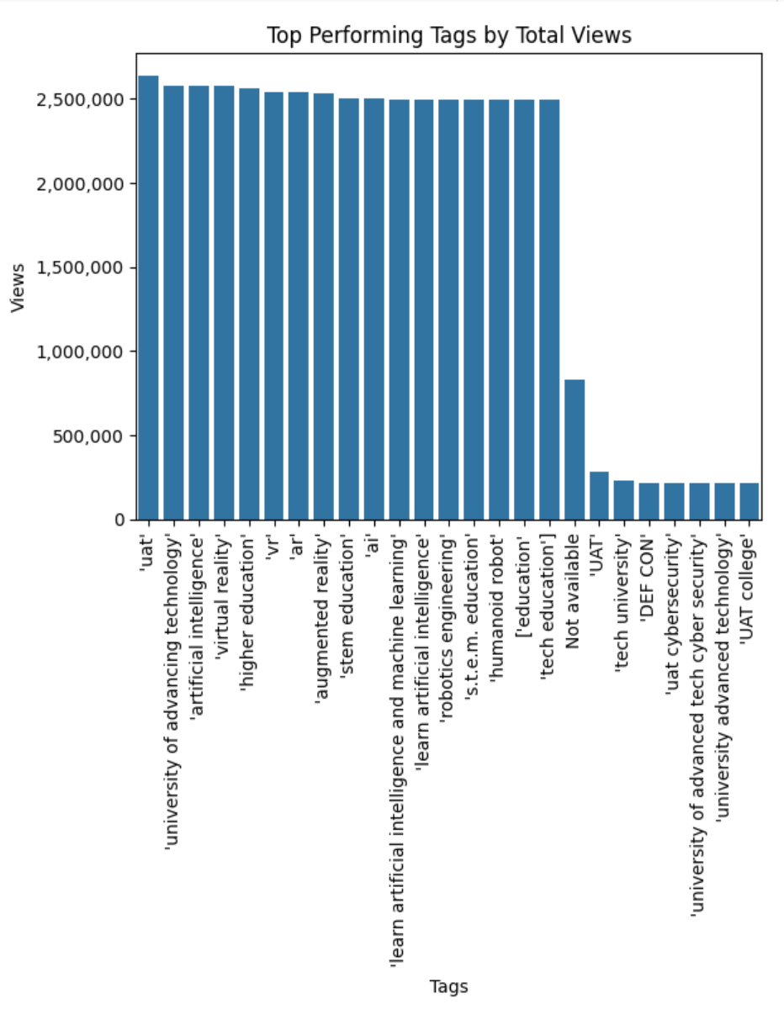
Popular Tags

Slide 11
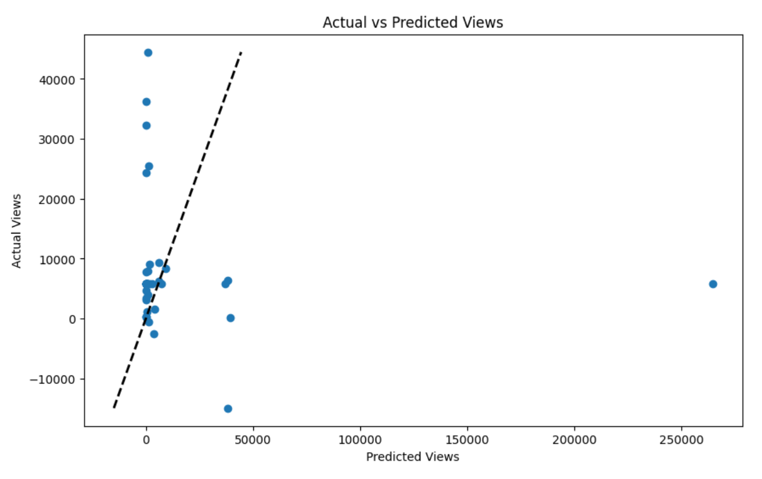

Predicting Views by Tag

Slide 12
Moving Forward

Slide 13
Insights
Short videos get more views.
Short videos (1-4) minutes get the most views of any category. Shorts (0-1) minute is second in this respect.
Client Implications:
Creating more short videos may draw in more views and grow UAT's audience.
However, maintaining engagement (particularly with YouTube Shorts) should not be neglected.
2. 1-4 Minute videos get the most likes.
Short videos (1-4) minutes have the highest correlation of any category between its respective view and like counts.
Client Implications:
Targeting video length towards this timeframe may boost engagement.

Slide 14
Proposed Deliverables
Optimize Video Length
Release a higher concentration of 1-4 min vids
Record results and level of growth
Research Trending Tags
Research trending tags among UAT’s target audience groups
Optimize Tag Usage
Implement trending tags to boost engagement
Record results and level of growth
Stretch: Sentiment Analysis on Comments
Perform sentiment analysis on video comments to understand audience reactions

Slide 15
Thank You

Slide 16
References
YouTube API Documentation: https://developers.google.com/youtube/v3/docs/videos
Pandas Documentation: https://pandas.pydata.org/docs/reference/frame.html
Scikit-learn Documentation: https://scikit-learn.org/stable/supervised_learning.html
Regular Expressions Documentation: https://docs.python.org/3/library/re.html
Seaborn Documentation: https://seaborn.pydata.org/
University of Advancing Technology (UAT) YouTube Channel: https://www.youtube.com/user/UATProductions

