Slide 1
Farm-intellect
By Team DETR

Slide 2
Problem Statement
Hostile mobs in Minecraft exhibit varying behaviors and attack patterns.
Steve wishes to implement Predictive Mob Behavior Analysis to foresee how different mobs might interact with his farm during the night.
The objective is to go beyond simple alerts and proactively optimize farm defense mechanisms based on anticipated mob behaviors.

Slide 3
Our Solution
Image-based Pest Identification:
Uses a model to identify pests in farm images.
Recommends specific pesticides for pest control.
Environmental Condition-based Pest Prediction:
Predicts pest likelihood based on environmental conditions.
Enables proactive defense planning.
Time-based Pest Prediction:
Forecasts pest occurrences based on the number of weeks.
Considers temporal variations for accurate predictions.
Proactive Farm Defense:
Integrates models for pest identification and prediction.
Aims for proactive defense optimization.

Slide 4
In Development
Weather Forecast Integration:
Develop a model for accurate weather forecasting.
Enhance farm planning with weather-based insights.
Wildlife Impact Analysis:
Implement a model to assess potential crop damage by wildlife.
Strengthen farm defenses against wildlife threats.

Slide 5
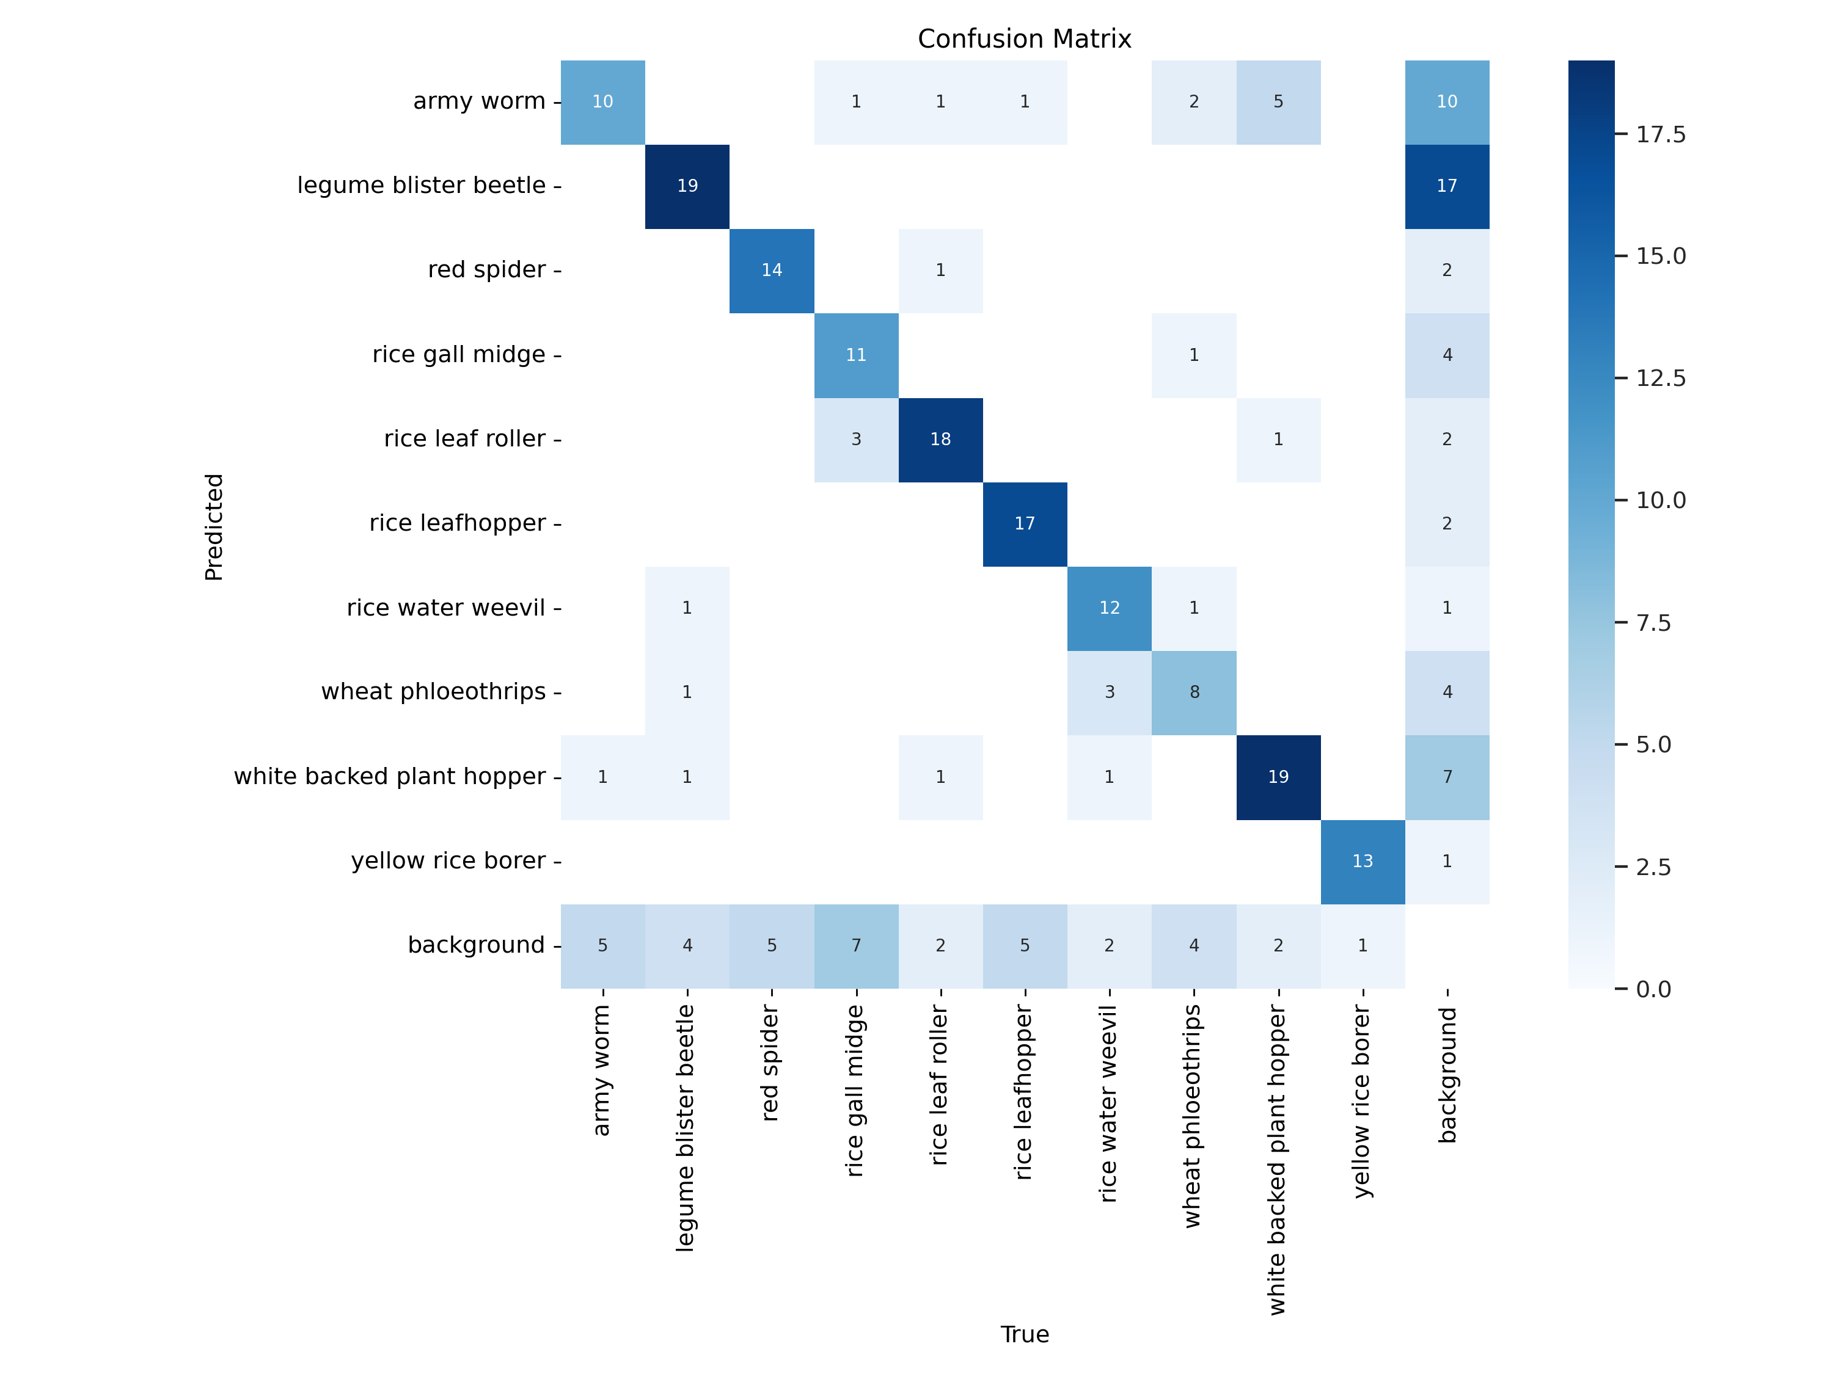

Slide 6
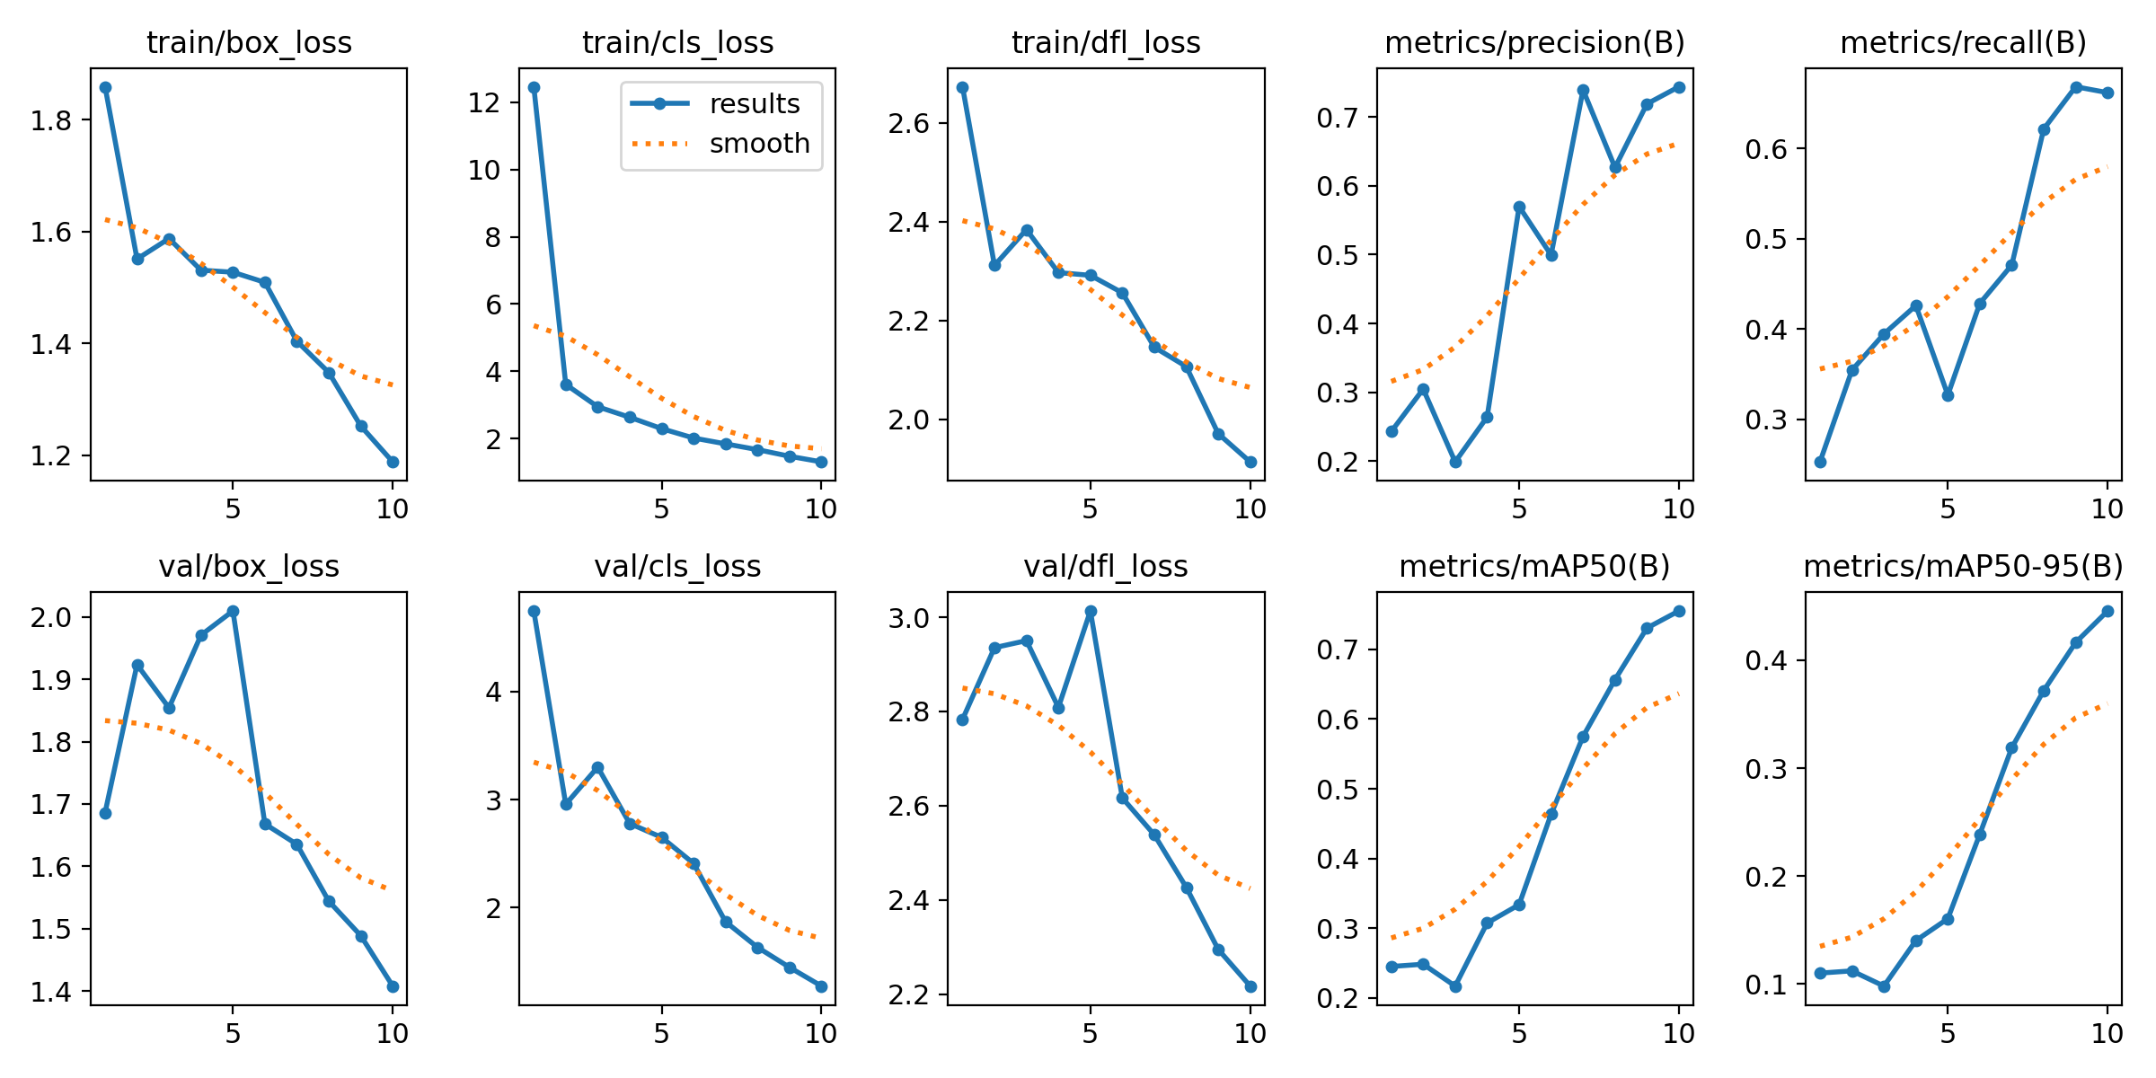

Slide 7
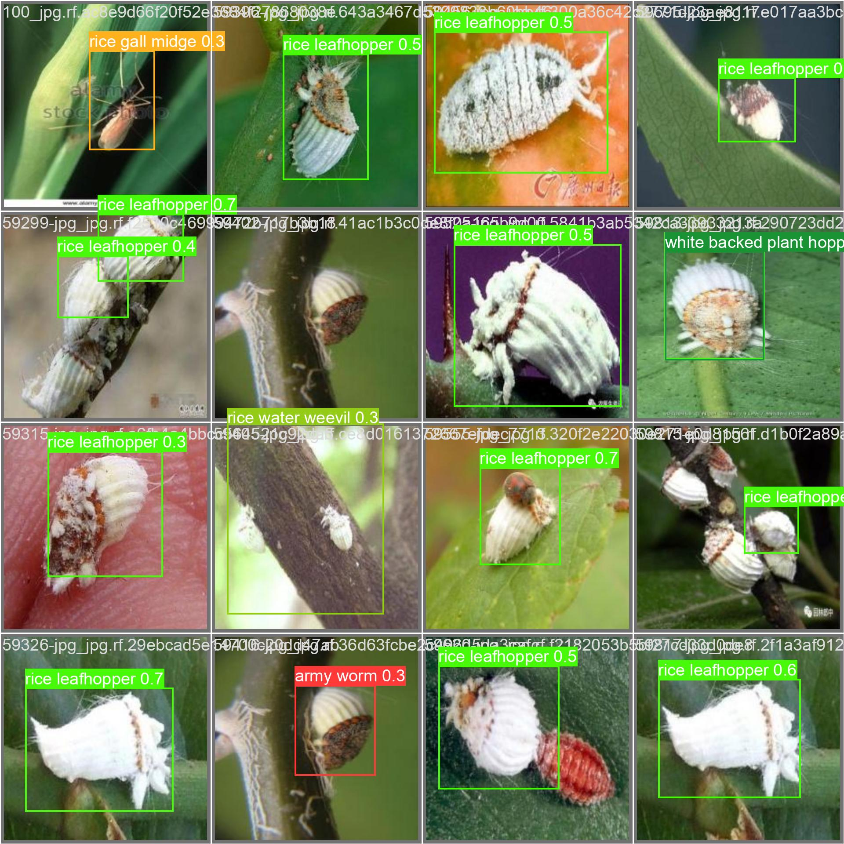

Slide 8
Thank You

