Slide 1
KamNepal “A job Portal”
Sailesh Dahal
Sarayu Gautam
Bhabin Khadka

Slide 2




Tools Used
01

Slide 3
What motivated us?
02
The poverty that is spread throughout the country
Hindrance in development due to poverty
Unemployment being the main cause of poverty
Inadequate job opportunity
Bureaucracy and Corruption during recruit process
Unqualified employee in the market
No respect for qualified jobseeker.
Brain drain

Slide 4
Why KamNepal?
03
Works to solve the unemployment problem
Digitalizes job search
Provides Platform to directly connect employer with potential jobseeker
Easy access to job opportunities and manpower
Helps to keep up with the current demand of the market

Slide 5
Major features of KamNepal
04
Same Place to find and post for a job
Integrated CV creator
Filtered recommendations and timeline
Customized and Updatable profile
Authentication and Verification
Chat, notification and search

Slide 6
Types of users and their relationship
05
Unregistered user can create CV by providing information
Registered user has access to all features of website
Registered User
Employer
Posts
Chat
Jobseeker
Registration
Unregistered user
CV creator

Slide 7
User types
06
Employer
Jobseeker
Can initiate chat to interested jobseeker.
Can post vacancy announcement and information regarding jobs.
Can be interested in posts of Employer
Can write a post regarding qualification and desire to get a job.

Slide 8
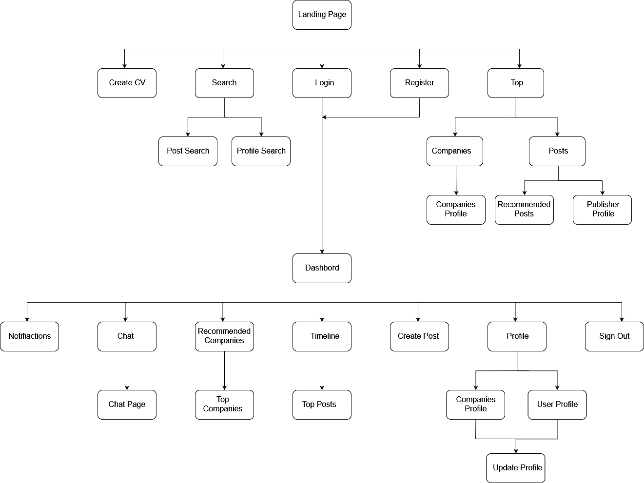
Page flow
07
Landing page
CV Creator
Login Page
Registration Page
Search
Top Companies and Posts
Dashboard
Notification
Search
Chat
Profile
Post Creator
News Feed
Recommendations

Slide 9
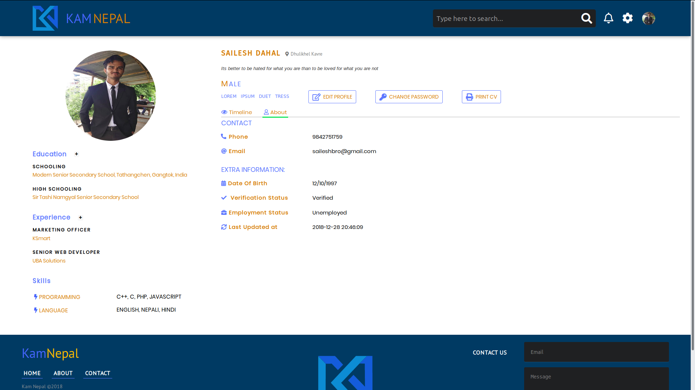
User’s page
08
Profile
Update profile
Change Password
Edit and delete own posts
View Timeline
View Contact Information
Print CV

Slide 10
Limitations
09
Inability to prioritize users
No paid account membership
Freedom to write any content in a post

Slide 11
Future enhancements
10
Paid membership
Priority to users
Tuned recommendations via keywords
Enhanced interaction between Jobseeker and Employer

Slide 12
Summary

