Slide 1

SEHATH
Submitted By
Avhijit Nair (avhijitnair@gmail.com)
Gaurav S ( gauravs260668@gmail.com)
Taha Junaid (taha.junaid3000@gmail.com)

Slide 2
Introduction
Sehath is a web app aimed at helping the population of India in this pandemic situation.
It helps people to check out the availability of critical medicines in their nearby locality for treatment of covid patients as well as patients with other illness that require immediate medical attention.
Apart from helping out people with information about the availability of medicines such as Remdesivir, it also helps local pharmacies to acquire the important and in demand medicines from the main city stock easily.

Slide 3
Technologies Used
HTML
CSS
Bootstrap
Javascript
PHP
MySql

Slide 4
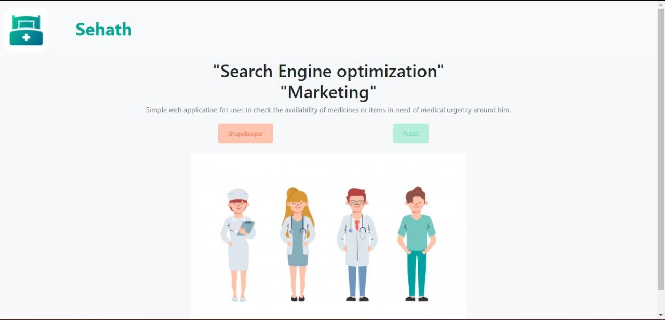
Demo
On homepage, login through Shopkeeper portal if you’re a pharmacy owner else login to Public page if you’re looking for availability of medicines.

Slide 5
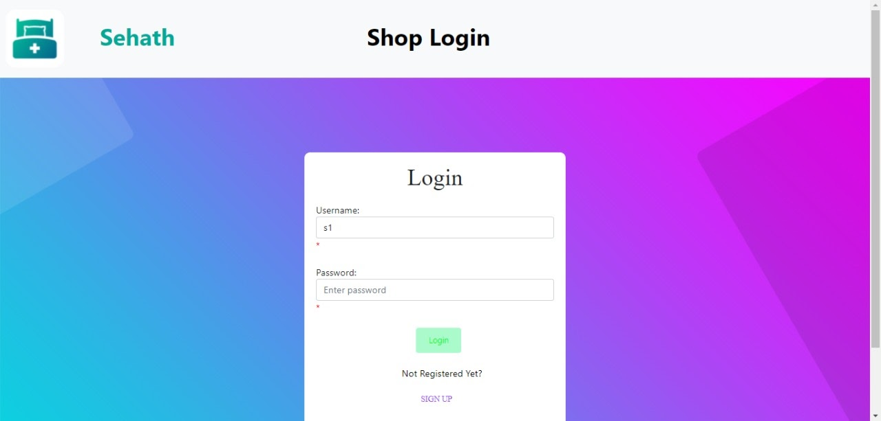
Demo → Shopkeeper Login Page
2) Click on Shopkeeper login. Then you’ll be directed to the Shopkeeper login page.

Slide 6
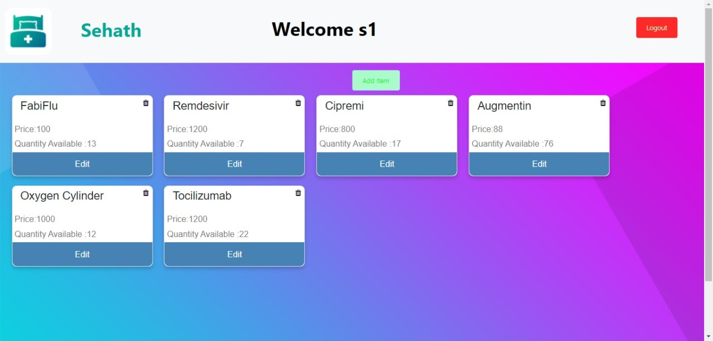
Demo → Shopkeeper Dashboard
3) Now you can access your dashboard where a list of your shop’s inventory is displayed as well as an option to add more items into your list.

Slide 7
Demo → Public Main Page
Search for the medicine that you want as well as the location which is most suitable to you, and then the available medicines will be displayed.

Slide 8
THANK YOU

