Slide 1


Superstore Data Analysis
Final Presentation – Data Manipulation Techniques
Presentation by:
Avhimanhu Sapkota
Student ID: 200547612
Presentation Date:
3 August 2023

Slide 2
Superstore Data Analysis
Introduction to Dataset
A superstore is a large-scale retail establishment that offers a wide range of products, including household goods, clothing, electronics, and food.
The dataset provides valuable insights to identify weak areas in the superstore's operations and develop strategies to increase profitability based on past performance.
The superstore dataset used for analysis, had 13 columns and 9995 rows of data. It was obtained from the Kaggle platform, specifically from the following source: https://www.kaggle.com/datasets/itssuru/super-store
Necessary Data Cleaning and Management:
Imported the dataset with relevant columns
Managed and cleaned the duplicates and null values
Focused on key dimensions and measures for further analysis.

Slide 3
Superstore Data Analysis
Business Questions Identified and Explored
Business Question 1: What are the top-selling product categories with Profits and how do their sales vary across different regions?
Helps identify the most profitable product categories.
Allows tailoring strategies to meet specific demands in different areas.
Enables the store to focus resources and marketing efforts on high-performing products.
Business Question 2: Which shipping mode is most commonly used and how does it relate to sales and profitability?
Evaluates its relation to sales and profitability .
Reveals customer preferences and expectations regarding delivery.
Allows to optimize shipping methods for better customer satisfaction.
Business Question 3: Which customer segment generates the highest sales and profits, and how does it differ across different states or cities?
Maximizes revenue in specific states or cities.
Allows to personalize offerings and promotions.
Helps identify the most valuable customer groups.

Slide 4
Superstore Data Analysis
Data Analysis Tools and Techniques
Power BI
Power BI was utilized to create a visualization, a bar chart and a pie chart showcasing the profitable product categories and total sales respectively.
It offers interactive and dynamic capabilities, enabling effective exploration of data insights.
SQL SSIS and Report Builder SQL Server Integration Services (SSIS)
Employed for data integration and preparation to generate two visualizations.
Report Builder, a component of SQL Server Reporting Services, facilitated the creation of the bar chart displaying total sales and profit based on customer segments.
Excel Visualization
A visualization, a stacked bar chart, was crafted in Microsoft Excel.
Excel's versatility allowed the illustration of customer segment sales and profits across different states.

Slide 5
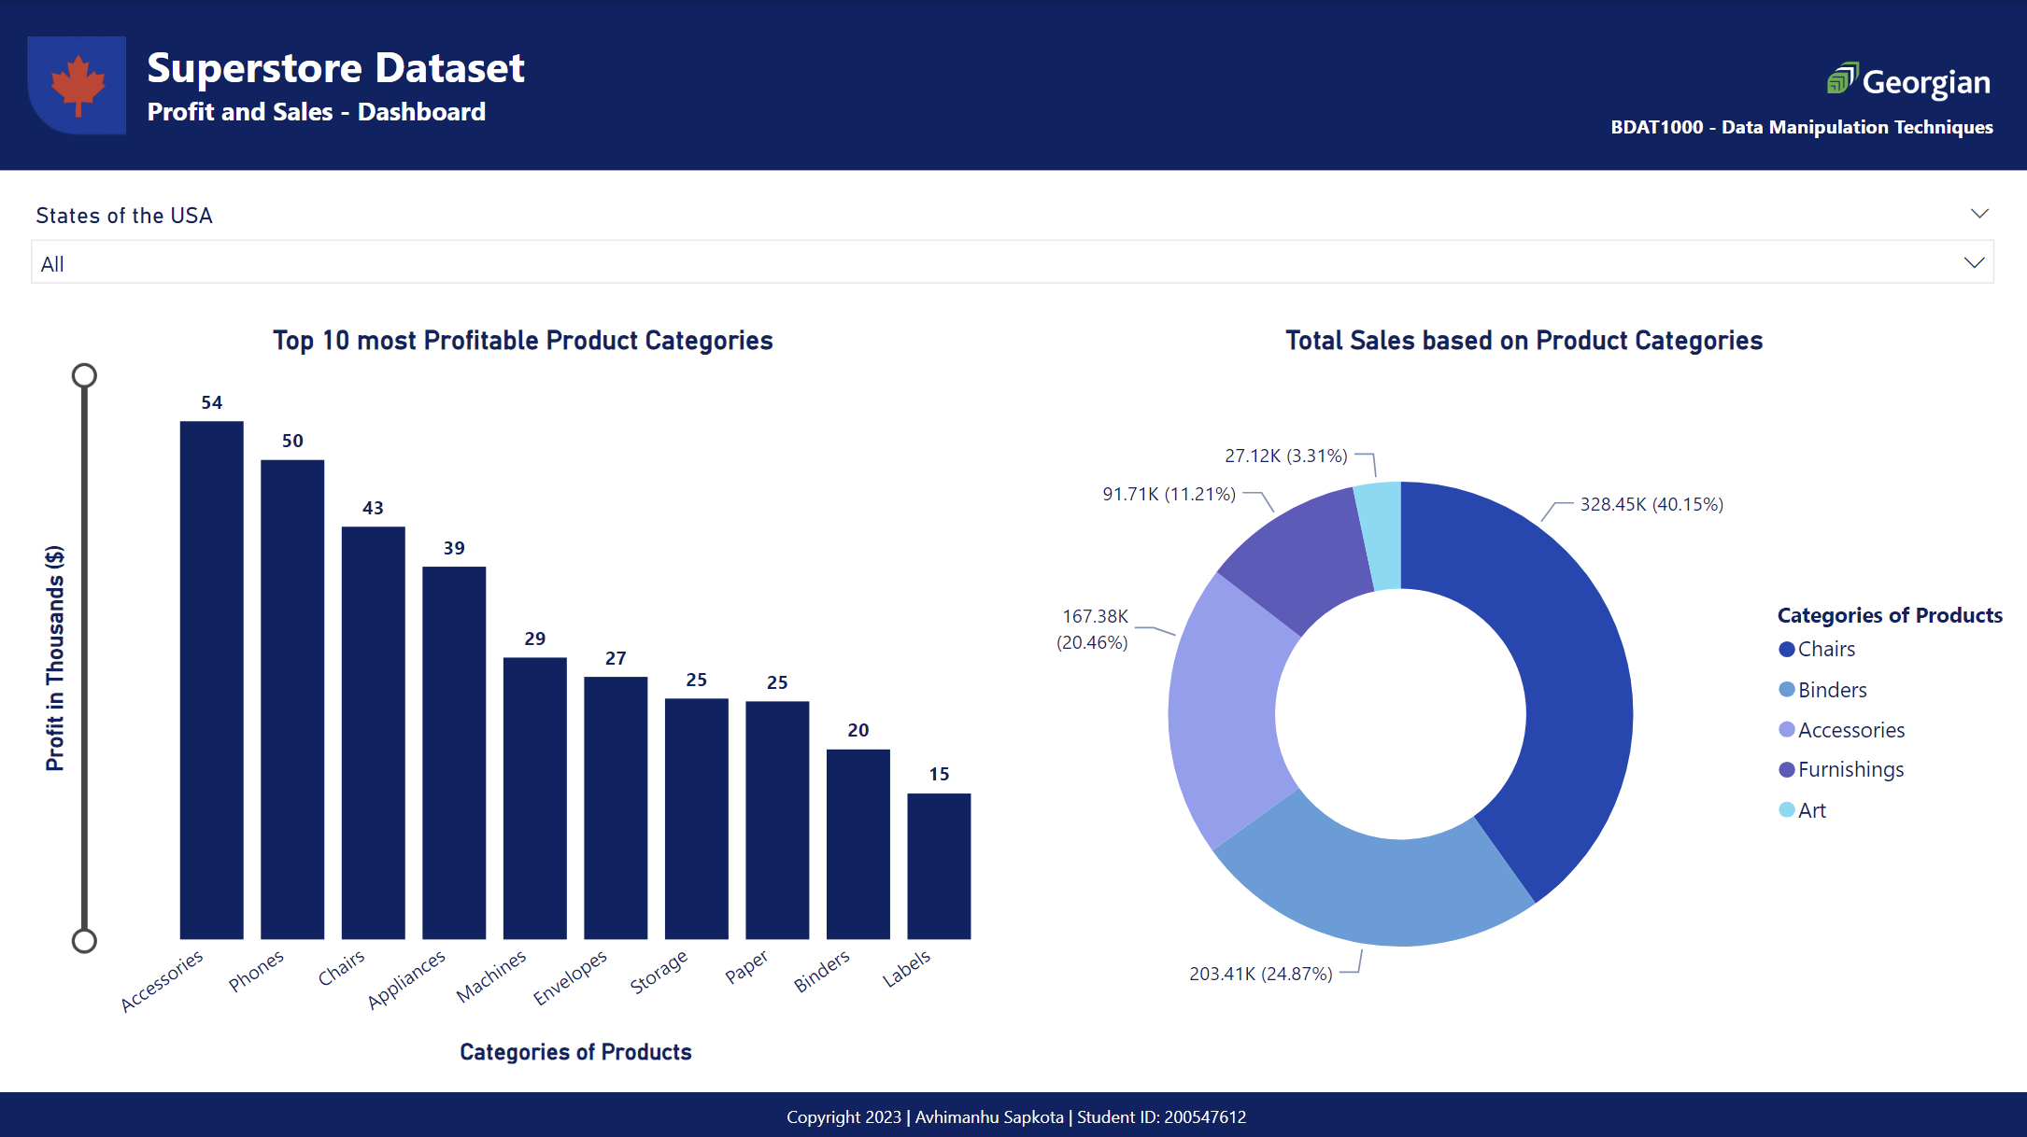
Superstore Data Analysis
Visualization using PowerBI

Slide 6
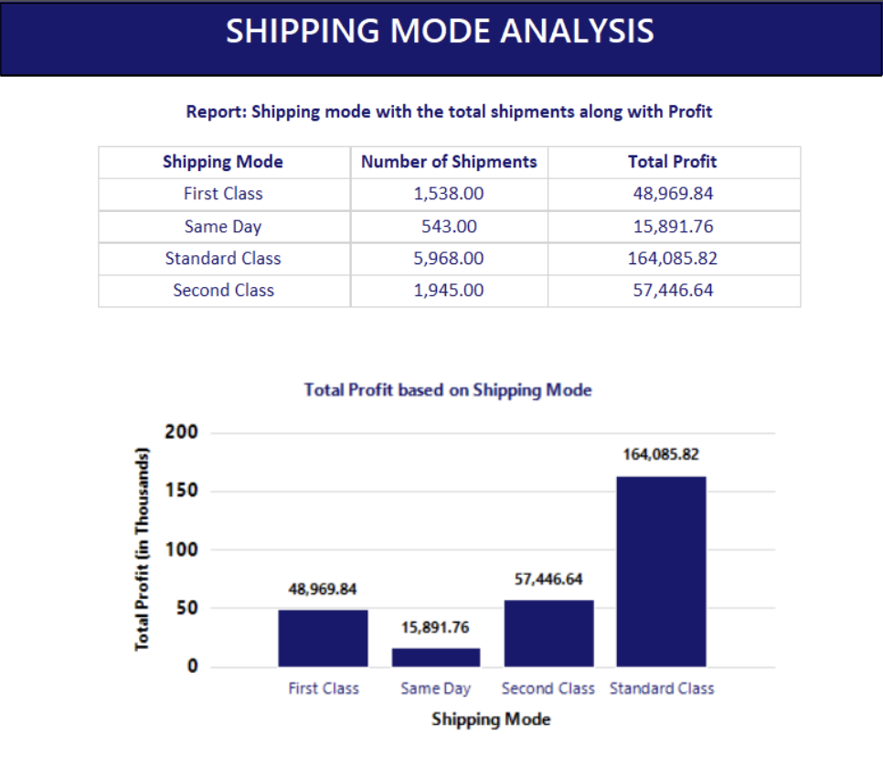
Superstore Data Analysis
Visualization II: Using Report Builder

Slide 7
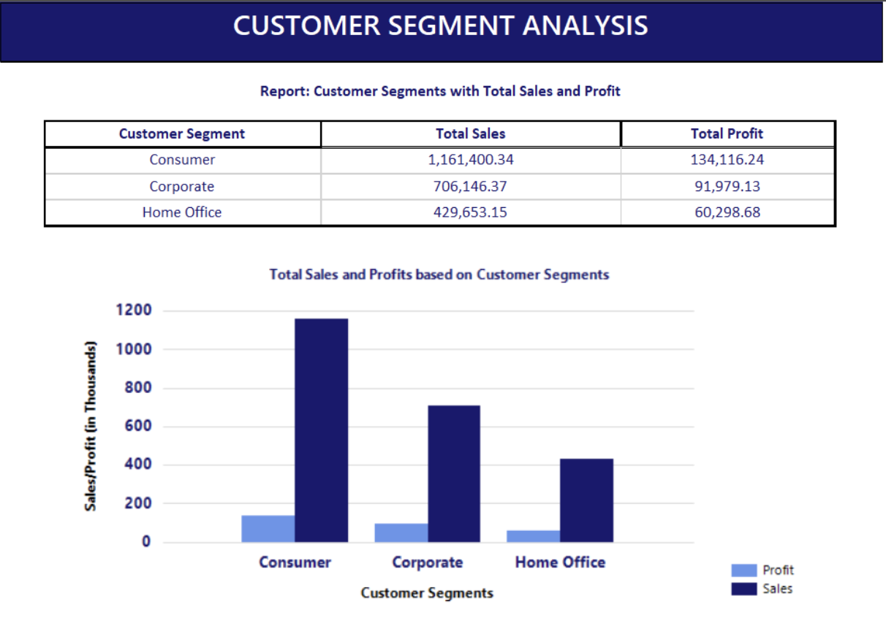
Superstore Data Analysis
Visualization I: Using Report Builder

Slide 8
Superstore Data Analysis
Visualization using Excel

Slide 9
Superstore Data Analysis
Discussion on the Results of the Analysis
Top 10 Most Profitable Product Categories and Total Sales Based on Categories
The data analysis aligns with expectations, identifying Accessories, Phones, and Chairs as the most profitable and top-selling categories with the strong correlation between profitability and total sales reinforces their strategic importance for the superstore. By emphasizing on these, Superstore can capitalize on their success and further enhance profitability.
Total Sales and Profit Based on Customer Segments
The results of the analysis aligns with expectations, identifying the Consumer and Corporate segments as the top sales-generating customer segments. The Consumer segment's leadership in profitability highlights its significance in driving overall profitability for the superstore. Focusing on these high-performing segments allows the superstore to optimize marketing strategies and enhance profitability further.
Total Profit Based on Shipping Mode
This analysis aligns with expectations, identifying the Standard Class shipping mode as the most profitable. The relationship between faster shipping and higher profits confirms the importance of meeting customer delivery preferences. By understanding the impact of shipping mode, the superstore can optimize shipping strategies to drive greater customer loyalty and revenue.
Top 10 States in the US with the Highest Sale
The analysis aligns with expectations, as populous states like California, New York, and Texas are known to have strong economies and consumer markets. The identification of these states as top performers validates the importance of targeting large and economically vibrant regions. By concentrating efforts on these high-sales states, the superstore can enhance its market presence and drive sustainable growth.

Slide 10
Superstore Data Analysis
Conclusion
Key Findings:
Top profitable categories: Accessories, Phones, and Chairs.
Highest sales from Consumer and Corporate segments;
Consumer segment leads in profitability.
Most profitable shipping mode: Standard Class.
Top sales states: California, New York, Texas.
Aligns with expectations:
validating the importance of high-performing categories, segments, and shipping options.
Recommendations:
Optimize marketing and resources based on top categories and segments.
Prioritize efficient shipping options for enhanced customer satisfaction and profits.
Focus efforts in high-sales states for sustained growth and market presence.
In conclusion, the data-driven insights gained from this analysis enable the superstore to make informed decisions, enhance profitability, and strategize for future growth in a competitive retail landscape.

Slide 11
Thank You Any questions?

