Slide 1
Ontologies Working Group Agenda
MGED3
Goals for working group.
Primer on ontologies
Working group progress
Example sample descriptions from different species
Ontology for MIAME/MAML
Working group future

Slide 2
Ontologies Working Group Goals
Collect controlled vocabularies for sample descriptions.
Define microarray concepts and their relationships.
Provide bridge to ontologies from other knowledge domains.

Slide 3
What is an Ontology?
An ontology is a specification of a conceptualization that is designed for reuse across multiple applications and implementations. …a specification of a conceptualization is a written, formal description of a set of concepts and relationships in a domain of interest.
Peter Karp (2000) Bioinformatics 16:269

Slide 4
Ontologies in Gene Expression Databases
Controlled vocabulary
  Define relationships through hierarchy (e.g., taxonomy)
Schema
  Concepts as objects or relational tables
  Attributes and data types provide specification
  Relationships specified through subclassing (objects) or foreign keys (relational tables)
Knowledge representation
  Link to other domains (gene sequence annotation, gene and protein roles, pathways)
  Facilitate data exchange by mapping common concepts

Slide 5
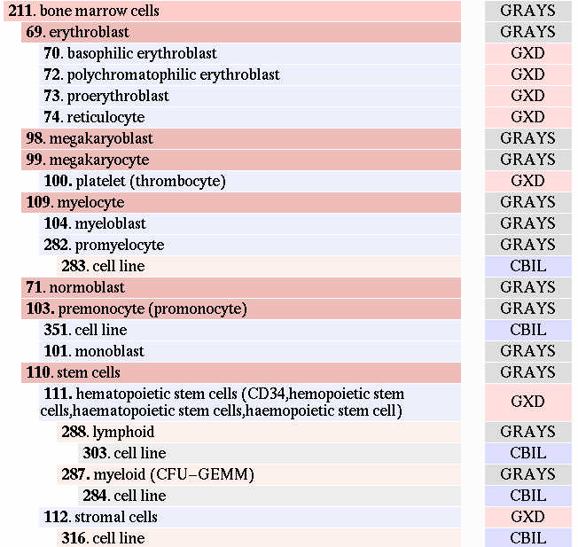
Anatomy Hierarchy

Slide 6
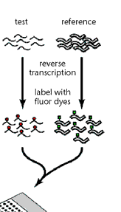

Experiment Tables
Devel. Stage
Disease
Treatment
Anatomy
Sample
Label
ExperimentSample
Taxon
Exp.ControlGenes
Experiment
Hybridization
Conditions
ControlGenes
Groups
ExpGroups
RelExperiments
Notes:
Replace with MAML UML

Slide 7
MAML DTD -> UML mapping:
Array platform

Slide 8
Other Domains
Gene descriptions (Gene Ontology)
  Molecular function
  Biological process
  Subcellular localization
Cellular and biochemical pathways (EcoCyc)
Literature (MeSH)
Phenotypes
Others …
Requires common set of terms (semantic mapping)
Or shared usage of identifiers (e.g. GenBank accessions)

Slide 9
Ontology Working Group Progress
Critical concepts identified
  Alternative relationships discussed
Web site for information
  Beginnings of central repository
Application to sample descriptions
  Different species

Slide 10
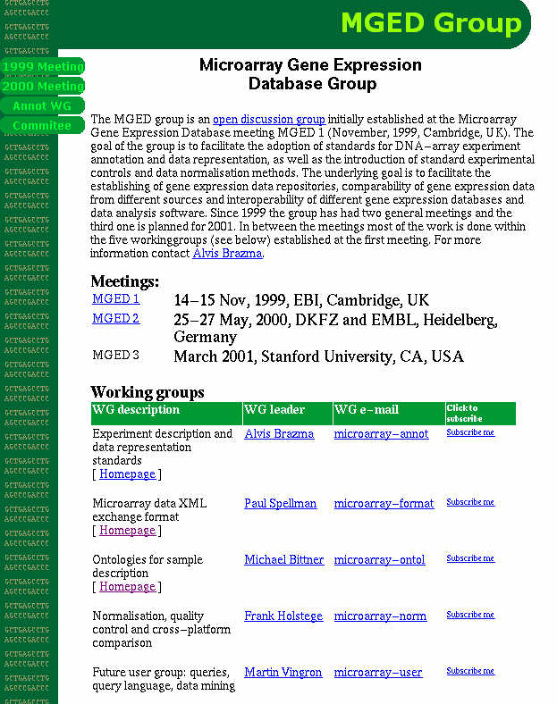
www.mged.org

Slide 11
Example Sample Descriptions
Human
Mouse
Arabidopsis

Slide 12
MIAME Ontology
Define MIAME concepts and their relationships
incorporating MAML.
The goal is to generate a document that will provide a clear and
common understanding of what should be reported and how.
The tables are a draft to form the basis for such a document.
Located at Ontology Working Group home page.

Slide 13
Ontology Working Group Future
Official group leader
Next meeting?
Assignments to group members

