Slide 1
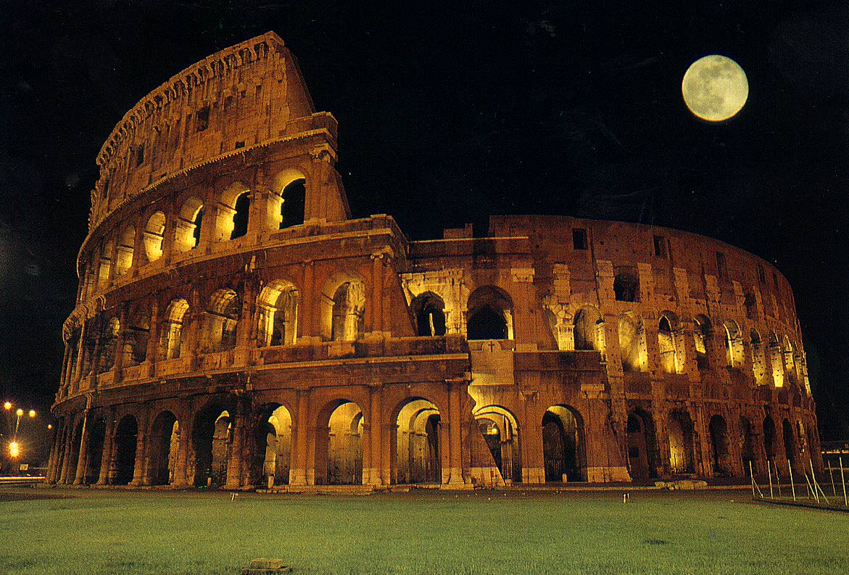
ONTOLOGIES
ELAG Conference, ROME, 19 April
Odile Artur, University of Marne-la-Vallée
Nicholas Crofts, DAEL, Geneva
Patrick Le Bœuf, BnF, Paris

Slide 2
What is an ontology?
Most of available definitions are of little help to the layman:
“An ontology is an explicit specification of a conceptualization”
Thomas R. Gruber
“An ontology is a logical theory accounting for the intended meaning of a formal vocabulary”
Nicola Guarino
“A theory concerning the kinds of entities and specifically the kinds of abstract entities that are to be admitted to a language system”
Webster’s Third New International Dictionary

Slide 3
Some definitions sound a bit more familiar:
“An ontology is a formal explicit description of concepts in a domain of discourse (classes […]), properties of each concept […] (slots […]), and restrictions on slots (facets […])”
Natalya F. Noy & Deborah L. McGuinness
“An ontology is a formal definition of a body of knowledge”
James Hendler
“An ontology is a catalog of the types of things that are assumed to exist in a domain of interest D from the perspective of a person who uses a language L for the purpose of talking about D”
John F. Sowa

Slide 4
What general features can we draw from all of these definitions?
A given field or domain of interest
within the boundaries of which “things” are assumed to exist, to “be”
and about which we wish to “talk”
in a formalized, explicit, and semantically consistent way
Onto-
logy
To talk about what is:

Slide 5
Using the CIDOC CRM ontology
CRM = Conceptual Reference Model
under development since 1996 by ICOM/CIDOC
applies to the field of cultural heritage
currently under consideration as a new ISO standard

Slide 6
What is CIDOC CRM?
a "domain ontology"
based on an object oriented model
composed of entities, organised into a hierarchy and related to each other through property links
Version 3.2 = over 70 entities and nearly 100 property links
Wow!!!
But what can I do with it???

Slide 7
Conceptual reference
CRM = a basis for mutual comprehension between cultural heritage professionals and IT specialists
  Cultural heritage information = a complex and subtle world
  Misunderstandings in the design of information systems = $$$$$$$
  => need for clear and unambiguous communication

Slide 8
Data exchange and archiving
CRM = also a technical reference for use in comparing and evaluating information systems, data schema, &c.
a basis for data transfer between incompatible systems
XML doesn't do this on its own
but CRM can be used for designing a common XML schema
CRM = also a basis for archiving of data (cf. troubles with the 1986 Domesday Project…)

Slide 9
Systems design
CRM can be used as technical specification for the design of new information systems…
… but is not intended to be implemented as is
adaptation: "plug-in" points, guidelines for extension
e.g.: Geneva City’s Musinfo project

Slide 10
Mediation systems
ALM information is rather isolated
Impossible to gather data in a single huge system
Mediation systems aim to federate information sources (=> single interface for users, distributed query systems)
CRM = potential basis for the mediation system's data schema

Slide 11
In short, CRM can be used:
As a methodological tool in IT projects
  to improve communication and help to avoid misunderstandings
As a reference for good practice
  to compare and evaluate existing systems
In a technical context
  to provide a basis for data archiving, exchange and integration

Slide 12

In order to better understand what an ontology is, let’s make one.
"Bring me a cup of tea, please"

Slide 13
What is the specific goal of our ontology?
To describe the process of making tea, in order to have it automated?
To evaluate the quality of a specific cup of tea?
To evaluate the skills of an apprentice tea-maker?
To choose the best type of cup of tea according to time and meal?
To allow tea-houses to share differently structured data?
&c…
The scope of an ontology must be precisely defined

Slide 14
What is required in order to make a cup of tea?
Ingredients: tea, water, milk or lemon, sugar…
Utensils: kettle, tea-pot, tea strainer, cup, spoon…
Actions: boiling the water, pouring the boiling water into the tea-pot, pouring the water out of the tea-pot, simmering some fresh water…
Measurements: temperature of water, duration of the infusing process…
&c…
All of these are the “things” assumed to exist in our domain of interest: “the making of a cup of tea”

Slide 15
Is there a hierarchy among these “things”?
Ingredients
Utensils
Actions
Measurements
Required
ingredients
Optional
ingredients
Kettle
Tea-pot
etc.
Boiling
the water
etc.
Temperature
of water
Duration of
the infusing
process
Tea
Water
Milk
Lemon
Sugar

Slide 16
Are we sure all of us understand these “things” the same way?
What is an “ingredient”?
Please define: …
What is a “required ingredient”?
Please define: …
What is an “optional ingredient”?
Please define: …

Slide 17
How can we describe each of these “things”?
Sugar
origin:
beet? maple? cane?
colour:
brown? white?
form:
caster? lumps? liquid? candy? granulated?
…

Slide 18
What about fructose and Aspartam?
Let’s create new classes and sub-classes:
Sweeteners
Natural
sweeteners
Diet
sweeteners
Artificial
sweeteners
Sugar
origin: …
colour: …
form: …
Fructose
Aspartam
The development of an ontology is an iterative process:
an ontology needs to be evaluated, revised, evaluated, revised, evaluated…

Slide 19
Do we really need all these refinements about sweeteners?
Not necessarily: depends on our purposes
Perhaps we might be just as happy with:
Sweeteners
type:
cane sugar, beet sugar, fructose, Aspartam…
form:
lumps, granulated…
“weightwatchingcally correct?”:
Yes or No
“There is no one correct way to model a domain — there are always viable alternatives”
(N. F. Noy & D. L. McGuinness)

Slide 20
How are these “things” interrelated?
Water
Boiling
the water
Kettle
is passive participant in →
← has passive participant
has as tool →
← is tool of
Are we sure all of us understand these relationships the same way?
What does “is passive participant in / has passive participant” mean?
Please define: …
What does “has as tool / is tool of” mean?
Please define: …

Slide 21

Did you know you knew so many things about a simple cup of tea?
Ontologies are related to the concept of knowledge representation

Slide 22
What is a knowledge representation? (1/2)
a surrogate for what exists in the world
  (unavoidably imperfect)
a set of decisions about how and what to see in the world (“ontological commitments”)
  (a choice, as debatable as any choice)
a fragmentary theory of intelligent reasoning
  (to select a representation technology is also to select an implicit conception of the nature of intelligent reasoning)
R. Davis, H. Shrobe, P. Szolovits (1993)

Slide 23
What is a knowledge representation? (2/2)
a set of ideas about how to organize information in ways that facilitate recommended inferences
a language in which we say things about the world
  (a medium of expression and communication, with debatable accuracy and efficacy)
it is NOT a data structure
R. Davis, H. Shrobe, P. Szolovits (1993)

Slide 24

What about building a web of ontologies?
"Please Mr. Google, could
you bring me a French-speaking
cup of tea?"

Slide 25
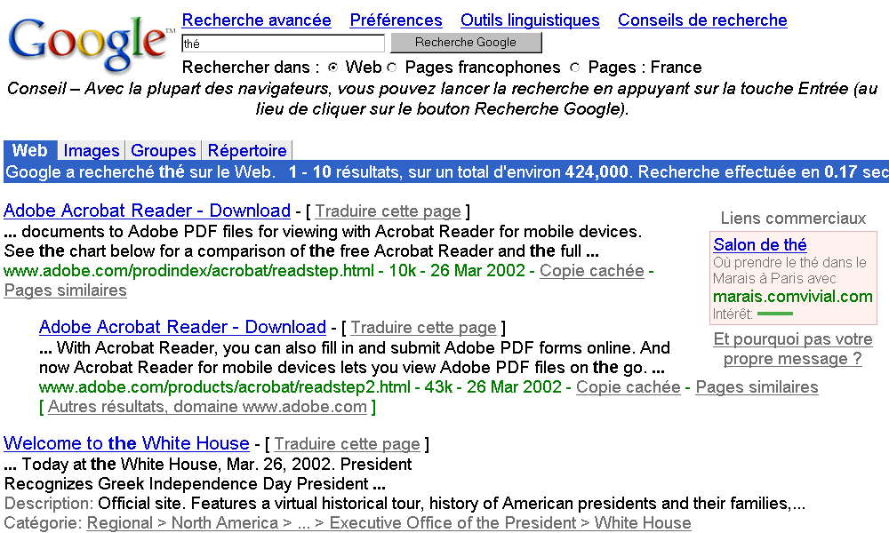
Problem: the current Web does not make a distinction between French thé and the English definite article…

Slide 26
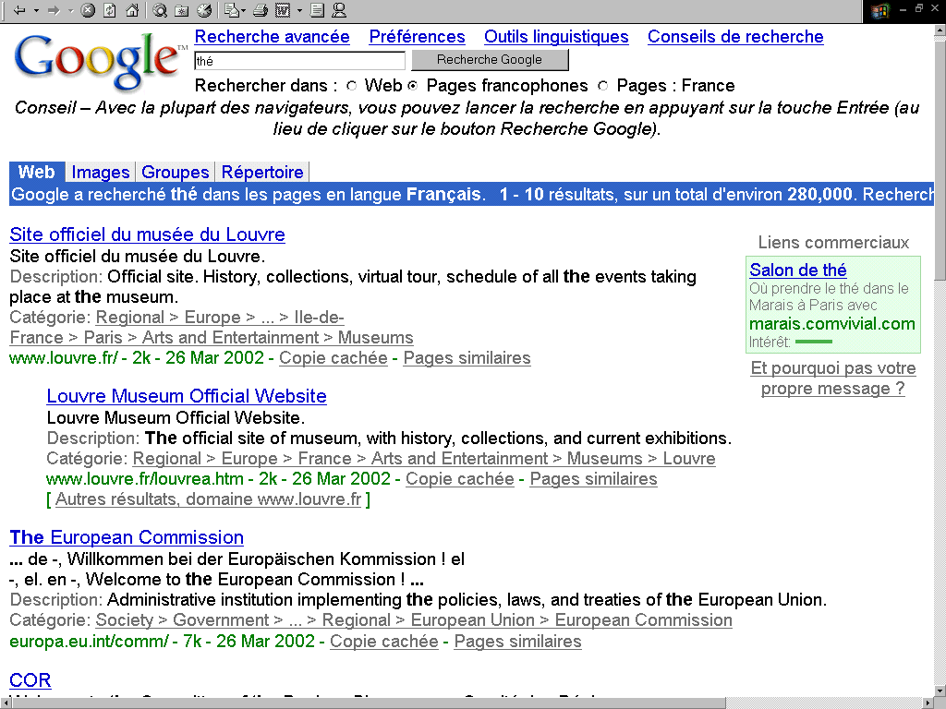
… even when you specify you want “French-speaking pages” only
We miss some semantics here…

Slide 27
Web + Knowledge Representation = Semantic Web
Context
Content
Intelligent searching
What I actually mean
Meaning
My
dorcument
Full text searching
“My” + “Dorcument”

Slide 28
What is the Semantic Web?
Any content may find its own place in a given ontology…
… So, you “just” need to link content to its relevant place in the relevant ontology(-ies)!

Slide 29
How to create such links?
1995: SHOE (Simple HTML Ontology Extension)
    a pointer to an ontology
    added to documents themselves
    pointing to only one ontology at a time
DAML+OIL (DARPA Agent Markup Language + Ontology Interchange Language)
    language based on RDF and XML
    information on separate files (.daml)
    may point to several ontologies
N3 (Notation of Triples)
    simplified language to express DAML+OIL

Slide 30
Who will do this?
Content
Ontology
Document
.daml file
Search
engines
Other
applications
Ontology

