Slide 1
STUDENT CLUB FOR SOCIAL ACTION(SCSA)

Slide 2
STUDENT’S CLUB FOR SOCIAL ACTION
SHIKSHA- A STEP TOWARDS ENLIGHTENNING THE WORLD OF DARKNESS
ROOH- EK MUHEEM

Slide 3

SHIKSHA -A STEP TOWARDS ENLIGHTENING THE WORLD OF DARKNESS
Shiksha functions under the able guidance of -
Dr. Neeraj Kaushik (Prof-In-Charge,SCSA)
Dr. P. C. Tewari (Advisor, SCSA)

Slide 4
SHIKSHA- JOURNEY TILL NOW
SHIKSHA under the aegis of SCSA Nit Kurukshetra, works for providing an enabling environment to kindle the light of education in underprivileged children living in and around the campus.
The root of shiksha dates back to the year 2006 when a bunch of students came up with the initiative to help the children who don’t have access to basic education. It was headed by Veena Goyal and Nikhil Singla.
Earlier, classes were held in M-103 only on weekends.Later as the number of students increased the classes began to take place in MBA block first floor (from 2012) on weekdays.
This torch of education was lit by 2K6 batch and it has been maintained with dignity till now by all the coordinators of Shiksha.

Slide 5
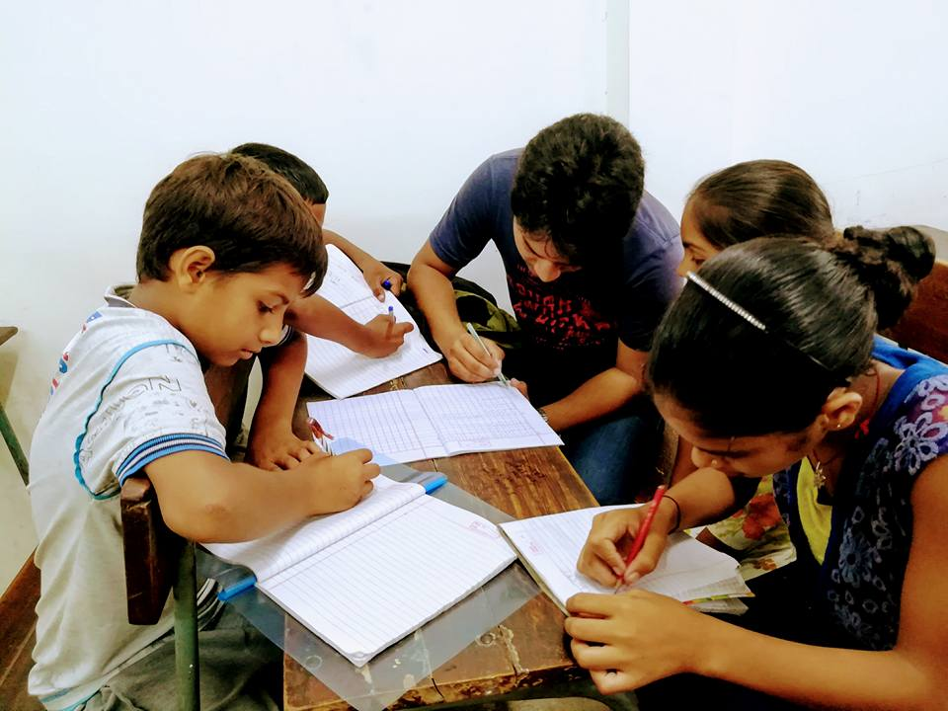
WHAT WE DO ?
Shiksha works for day to day education for the children from underprivileged sections of the society
We help those children for preparing various competitive exams like JEE, NTSE and Navodya.
We maintain the balance between studies and development by organizing cultural workshops and fests.

Slide 6
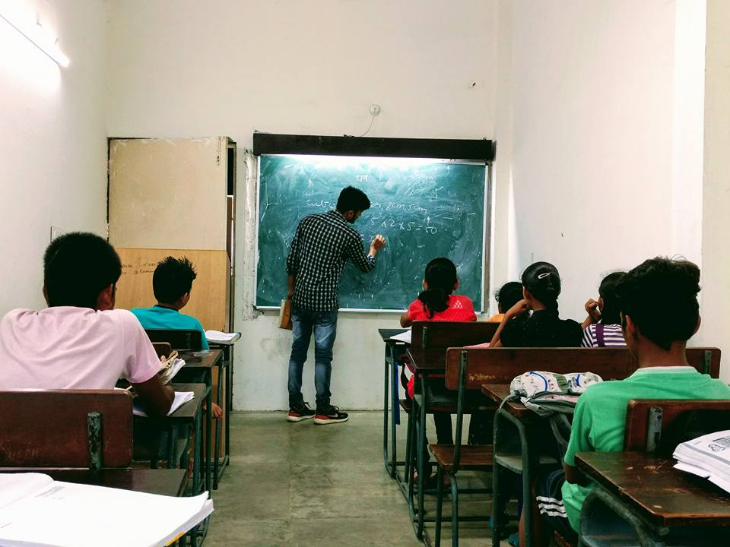
WHAT WE DO ?(CONTD)
For regular improvement of their performance we take monthly tests.
We organize technical workshops for supplementing theory knowledge with practical.
We organize educational tours to museum and planetoriums.
We organize cultural workshops for their overall development.

Slide 7
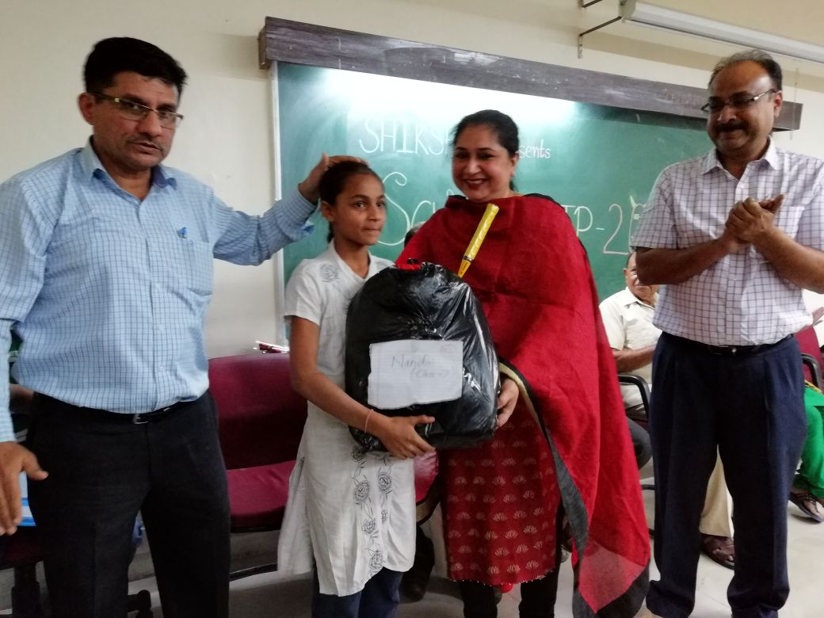
SCHOLARSHIPS AND AWARDS

Slide 8
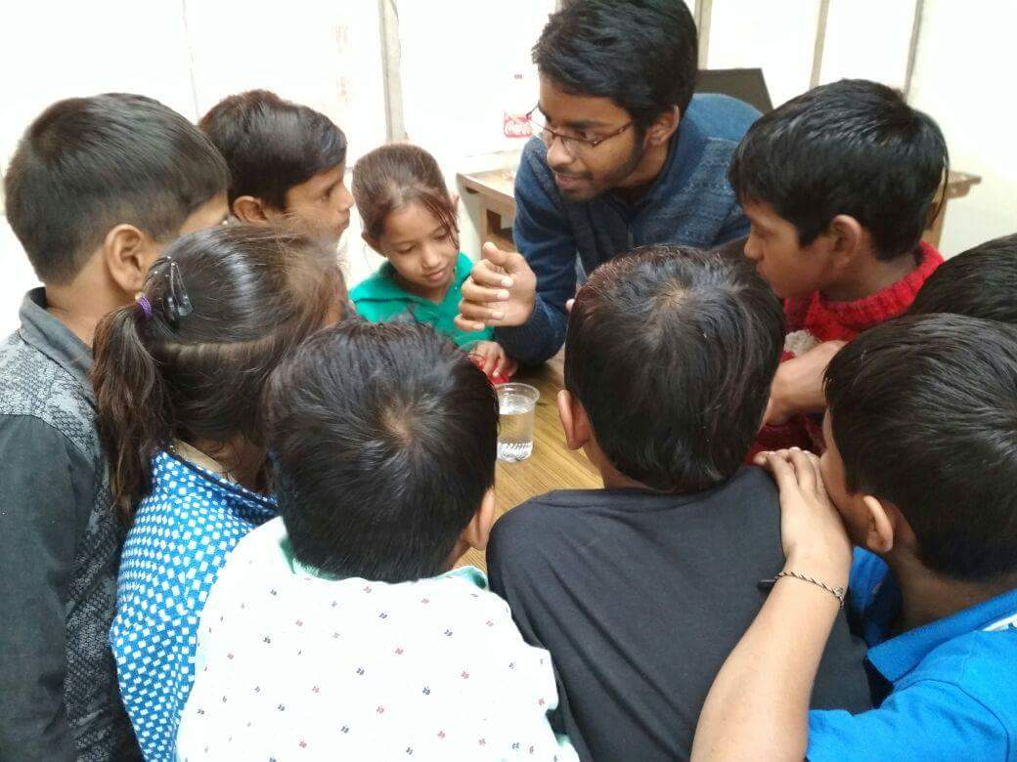
WORKSHOPS
SCIENCE WORKSHOP

Slide 9
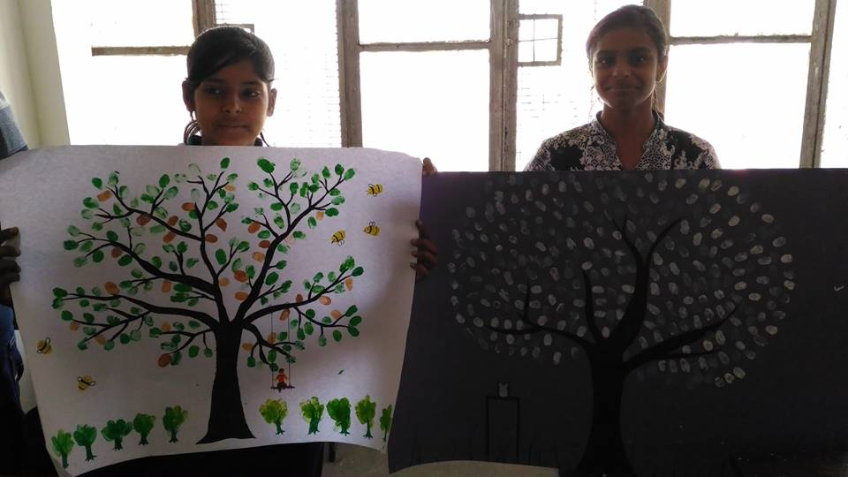
WORKSHOPS
ART AND CRAFT WORKSHOP

Slide 10
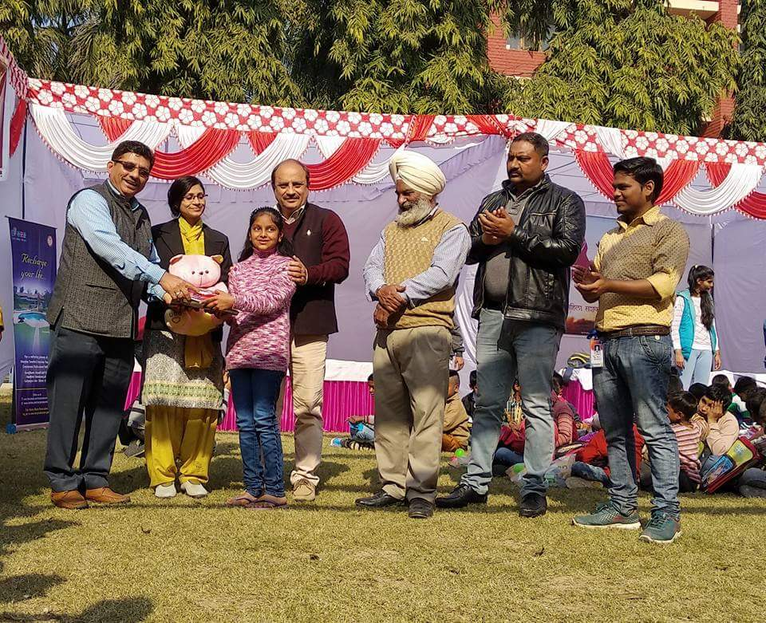
MAKE A WISH

Slide 11
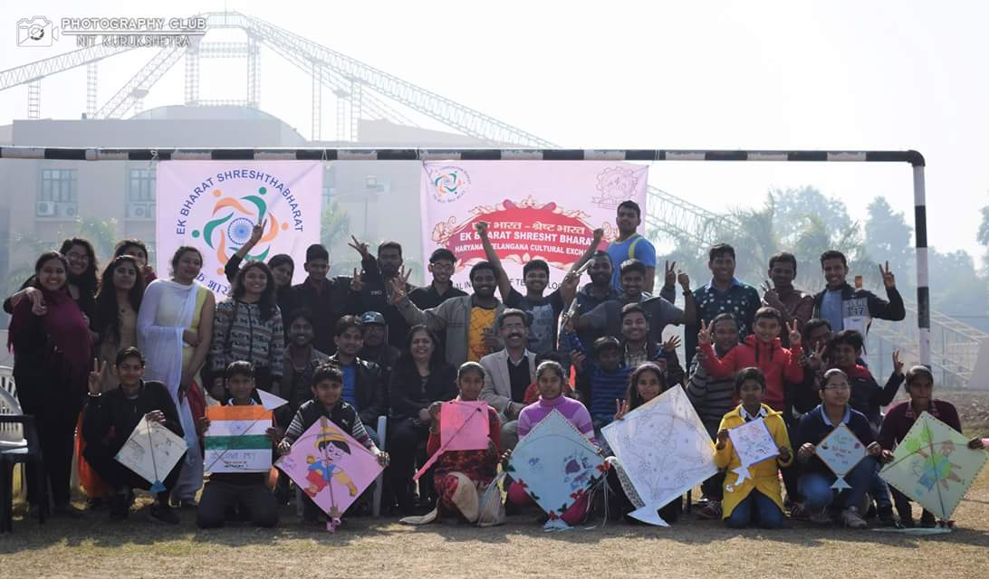
KITE COMPETITION

Slide 12
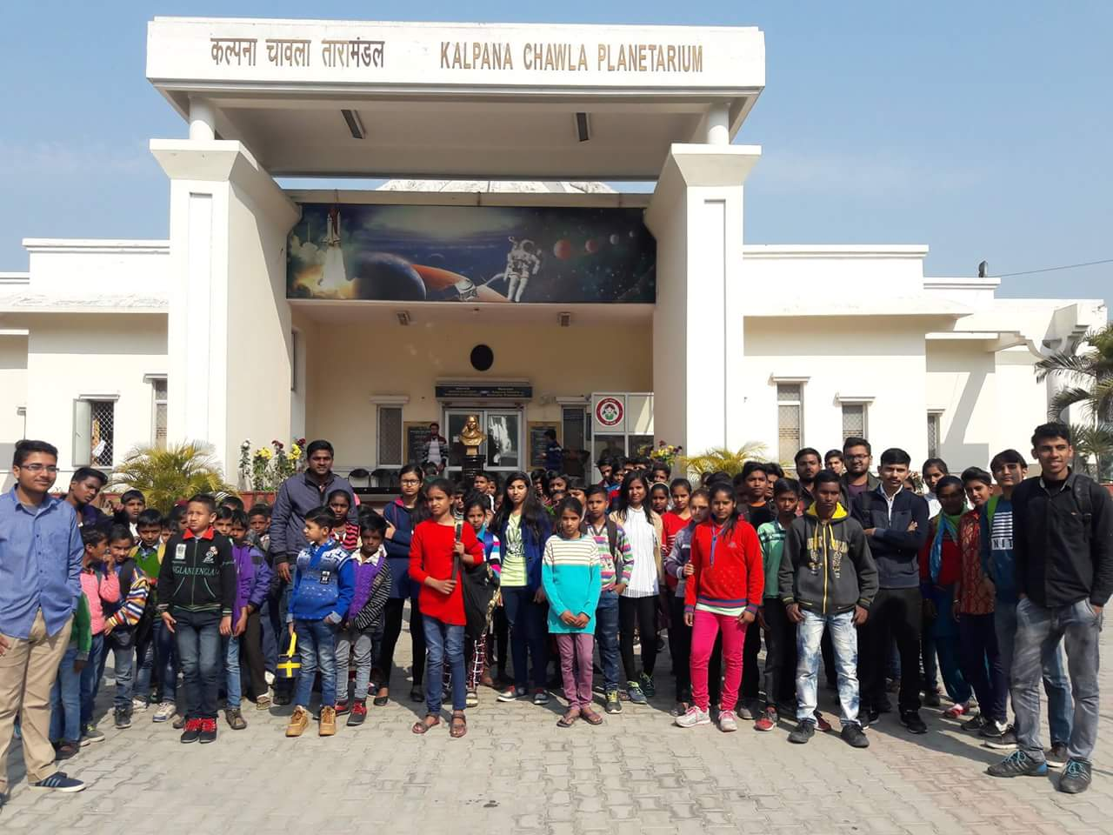
EDUCATIONAL TOUR

Slide 13
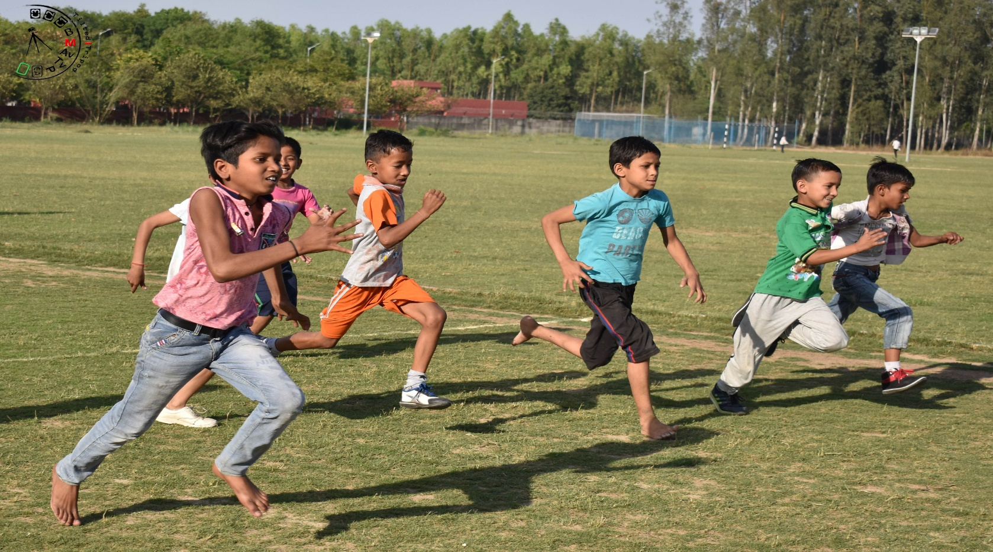
SPORTS DAY

Slide 14
SHIKSHANGAN
QUIZ COMPETITION
DANCE
SINGING
RANGOLI COMPETITION
TREASURE HUNT
FASH-P
POEM RECITATION
DRAMATICS
SPEECH COMPETITION

Slide 15

SHIKSHANGAN

Slide 16
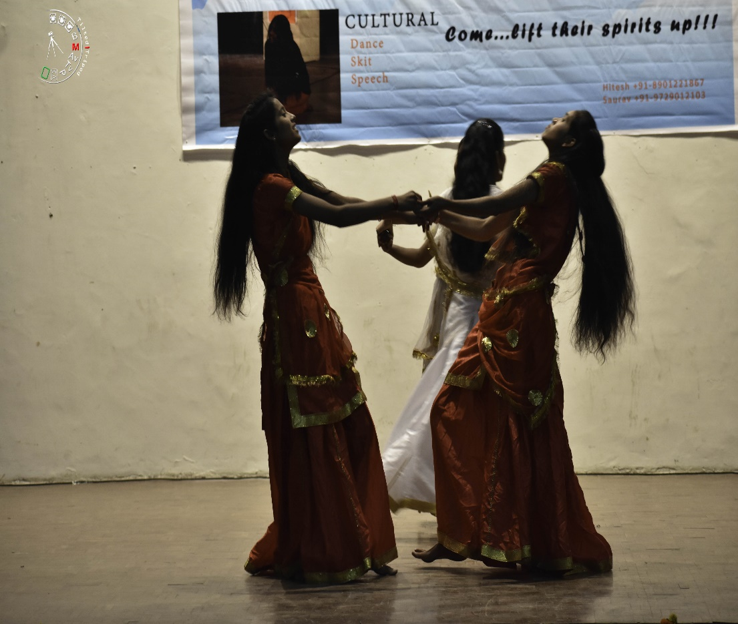
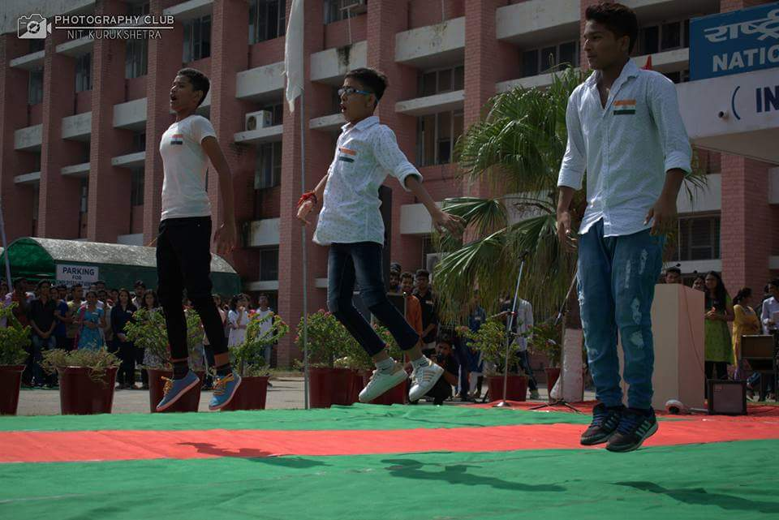
SHIKSHANGAN

Slide 17
ACHIEVEMENTS SO FAR
A rural area student from 2015- 16 batch cleared JEE Mains with Final Rank: 60,200 (OBC: 15,000)
Viraj, a student of class 12th achieved position of district topper class 12th.
Sanjana, a student of class 10th achieved the position of school topper

Slide 18
THANK YOU !

