Slide 1
Group 8
IE406 Machine learning
Topic : Toxic Comments Detection and Classification
Group Members :
1) Satbir Singh - 201701028
2) Avi Patel - 201701147
3) Sagar Nakum - 201701182
4) Bhavik Chaudhary - 201701226

Slide 2
Problem Statement :
Given a set of sentences or paragraphs that a person uses as a message on an online platform, identify it as belonging to the following categories with discrete values (0/1) :
A multi-label classification problem differs from a multi-class classification problem (in which each sample can only be assigned to one of the many-labels). Hence in our problem each comment can belong to more than one label for eg, a comment can be obscene, toxic and insult, all at the same time.
Toxic
Severe-toxic
Obscene
Threat
Insult
identity-hate

Slide 3
INTRODUCTION
The increasing levels of threat and abuse from certain sections of the online community renders a fair degree of inadequacy to facilitate proper conversations. Quite naturally, one area that requires attention is the identification of negative online behavior and consequentially, restricting their scope. This can be done by developing a classification module for the various types of toxic comments that we may be interested in finding.
In this work, we have developed systems using Logistic Regression, Support Vector Machine and Bi-LSTM(RNN) in combination with word embeddings by adapting insights from multiple previous works.We will take data from kaggle for training and testing . 90% data will be use for training part and 10% data will be use for testing part .
The rest of the ppt contains information about dataset, data processing, block diagram, Algorithms, models etc.

Slide 4
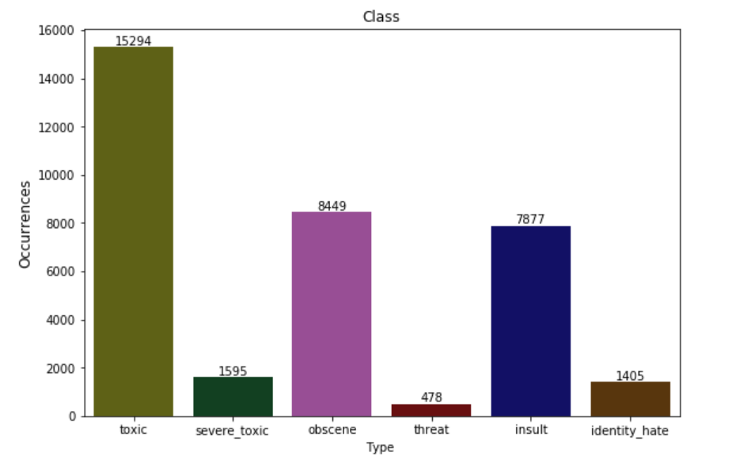
ABOUT THE DATASET
We have used a public dataset provided by the Conversation AI team; a research initiate co-founded by Jigsaw and Google. Wikipedia Talk Page Comments annotated with toxicity reasons is a crowd-sourced dataset including approximately 160,000 manually labeled comments from Wikipedia Talk Pages.
Datalink for training and testing :
https://www.kaggle.com/c/jigsaw-toxic-comment-classification-challenge/data
link for glove : global vectors for word representation

Slide 5
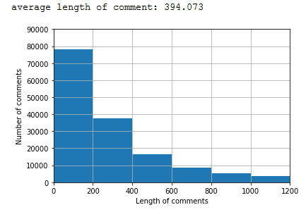
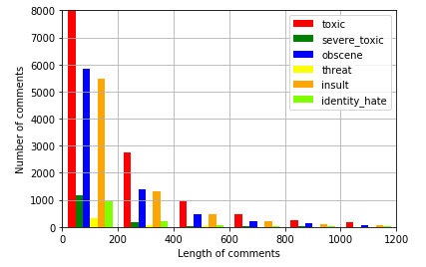
Visualization of dataset
As we can see in graphs, number of comment belong to obscene and insult class are more as compare to others (graph on left side). Average length of comments is 394 characters or 80 words. But for large dataset it’s memory outage may occur. That is why we have decreased it to 80 words as maximum length.

Slide 6
Block Diagram
Convert data to
suitable
input matrix
Fitting data to
models (Training
dataset)
Testing
&
Analysis
Input
Data set
Cleaning
Remove
Punctuations
Tokenization
Logistic
Regression
Stemming & Lemmatising
Padding &
Truncating
SVM
Remove
Stopwords
Word
embedding
Bi-LSTM
(RNN)

Slide 7
Data Preprocessing
It involves removal of irrelevant and redundant data from the Input data(here sentences).
Removal of punctuation marks and digits(. , ! , 1, 2 etc)
Removal of Stopwords (is, this, us etc)
Stemming & Lemmatization ( playing, plays, played play (root word))
Tokenization (converting a sentence string to List of words)
Padding and Truncating ( Taking a standard length of 80 words)
Word Embedding ( Used GloVe.6B.200D- 200 dimension vector representation for each token and such 6B tokens)

Slide 8
Global word to vector embedding & Normalisation
First make the vector containing all distinct word using ‘Tokenization’. Which contain pairs as an element <word,index>.
Glove.6B.200d.txt contains 6 billion words and corresponding (1,200) dimensional vector for each word.
Then make a glove matrix for all words which are there in dataset. This glove matrix used as input in embedding layer of RNN.
Normalisation needed for baseline model like, LR, SVM etc. We sum up all the vectors for each word in a comment. Then normalize it by dividing its value. For neural network models we use normalization layer for normalizing the data.
Dataset’s only features is the comments. Feature vector for each comment can be represented as 80*200 , where 80=number of words in the comment and 200 is for glove word to vector representation.

Slide 9

Applied Models
Logistic Regression: To label all the classes with discrete values(0/1) we used one vs rest classifier.
SVM: To label all the classes with discrete values(0/1) we used one vs rest classifier with different kernels like RBF, linear, polynomial.
Bi-LSTM (Bidirectional - Long Short Term Memory) : Since each word in comments may depend on future words or on past words. We can use Bi-LSTM instead of LSTM. Since RNN networks can not store past information which is far away from current time instance, LSTM networks used to solve this issue. That is the reason behind using Bi-LSTM instead of RNN.
We are using Log Loss/Binary Cross-Entropy as a loss function for all three models

Slide 10
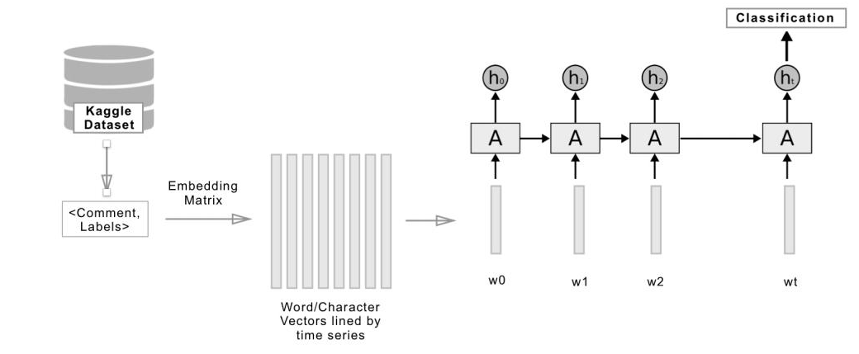
How LSTM is better than baseline models:
One issue in baseline models is that they averaged all word vectors in given comment, thus, losing the valuable word order-related information. Our usage of Bi-LSTM network was meant to overcome that weakness, by providing a model that analyzes a comment word by word. For our Bi-LSTM model we padded/truncated the comment length to 80 words to get better results.

Slide 11
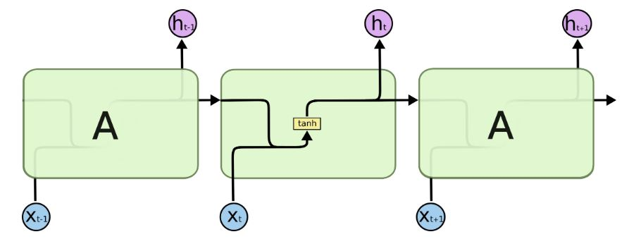
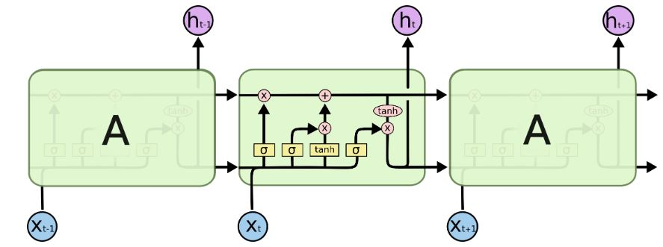
Difference between RNN and LSTM:
RNN: In RNN, single cell contains only one layer.
LSTM: In LSTM, single cell contains four interacting layers.
Image source: http://colah.github.io/posts/2015-08-Understanding-LSTMs/

Slide 12
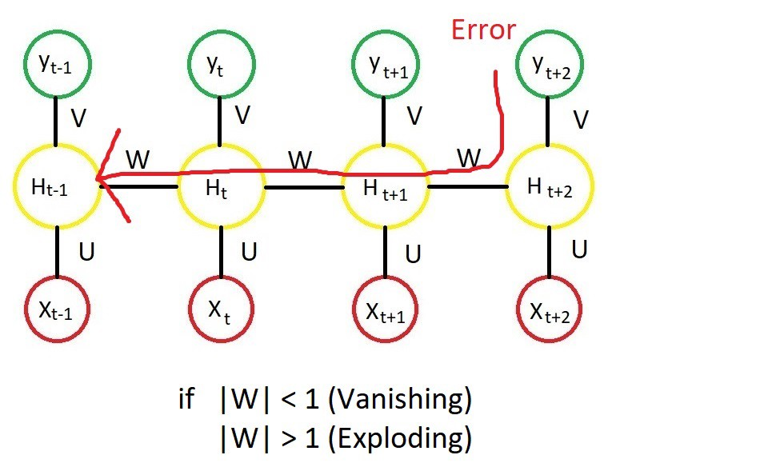
Why LSTM
In RNN networks, the final o/p is the composition of a large number of non-linear transformations. So even if each of these non-linear transformation is smooth, their composition might not be. So the derivative through whole composition will tend to be either very large or very small. So gradient propagated over many stages will eventually explode or vanish.
Image source: https://medium.com/deep-math-machine-learning-ai/chapter-10-1-deepnlp-lstm-long-short-term-memory-networks

Slide 13
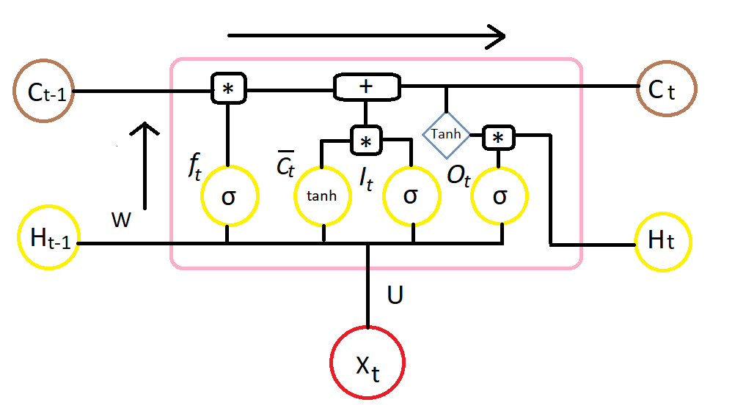
Explanation of LSTM cell:
The key to LSTMs is the cell state, the horizontal line running through the top of the diagram. Cell state holds information of past cells. LSTM can add or remove information from cell state by structures called gates.
f_{t}, It decides what information we are going to throw away from cell state.(value between 0 and 1). A value of zero means “let nothing through,” while a value of one means “let everything through!”.
c_{t}, This tanh layer create a new vector of candidate values, which could be added to cell state.
I_{t ,} This sigmoid layer create new vector which we will update to cell state.
O_{t,} This sigmoid layer create a vector which decodes what part of cell state we are going to output.
For Hidden layers in the cell weights Wf, Wc, Wi and Wo are used and for input layer weights Uf, Uc, Ui and Uo are used.
Finally, two outputs, C_{t} and H_{t} are produced.
Image source: link

Slide 14
Here, ‘+’ and ‘*’ denotes element-wise addition and multiplication.
f_{t} = 𝝈(X_{t} * U_{f} + X_{t-1} * W_{f})
c_{t} = tanh(X_{t} * U_{c}+ X_{t-1} * W_{c})
I_{t} = 𝝈(X_{t} * U_{i} + X_{t-1} * W_{i})
O_{t} = 𝝈(X_{t} * U_{o} + X_{t-1} * W_{o})
C_{t} = f_{t} * C_{t-1} + I_{t} * c_{t}
H_{t} = O_{t} * tanh(C_{t})
Here, X_{t} is input vector, H_{t-1} is previous cell output, C_{t-1} is previous cell state, H_{t} is current cell output and C_{t} is current cell state.

Slide 15
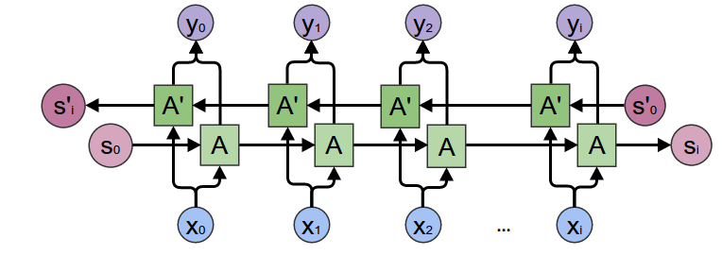
Understanding Bi-LSTM networks:
Bi-Long Short Term Memory networks are explicitly designed to avoid the long term dependency problem. The core idea behind LSTMs is the way the cell state is affected by the input to it and the previous output, and how the cell state, in return affects the present output. This is controlled by three gates: the Forget gate, Reset gate and the Output gate.
Using bidirectional will run your inputs in two ways, one from past to future and one from future to past and what differs this approach from unidirectional is that in the LSTM that runs backward you preserve information from the future and using the two hidden states combined you are able to preserve information from both past and future at any point of time.
Image source : Bi-LSTM image

Slide 16
Implementing Bi-LSTM:
In implementing actual model, we specified maximum input length to the embedding layer of model as 80 which is same as sequence length and made four fully connected layers.
We added bidirectional LSTM network with 100 neurons in starting of model.
Three of four dense layers are defined with ‘ReLu’ as activation function. Each of these three layers have number of neurons equal to 100,70,30 in decreasing order.
Last layer is defined with ‘sigmoid’ as activation function with number of neurons equal to 6. Here we took 6 neuron because we need to classify input to six classes defined in problem statement. And purpose of taking sigmoid as activation function is to push the output range in each neuron to (0,1).
We found that single layer of bidirectional LSTM is not that much non-linear. So to add non-linearity to model and to make model capable of learning non-linearity of data, four extra dense layers are added.
At last we set the loss function to ‘binary cross entropy’ and ‘Adam’ as the optimizer with learning rate 0.01.
We set number of epoch equals to 2 and batch size to 128 (since 64, 128,256 are standard batch sizes).

Slide 17
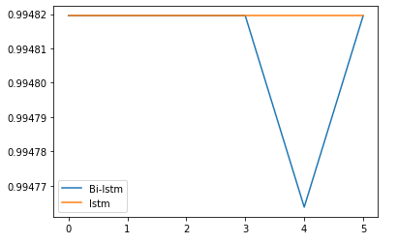
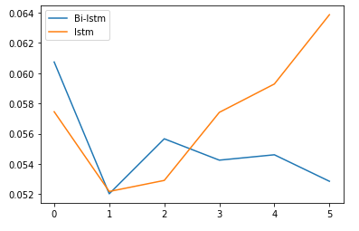
Testing & Analysis:
Data splitting:
Total data : 159571 comments
Train data : 143613 comments (90%) 35903 comments for validation (25% of train data)
Test data : 15958 comments (10%)
We found that keeping more than 2 epoch overfitting the model. So we kept #epoch equals to 2.Below graphs of validation accuracy and validation loss shows that overfitting occuring in model for more than 2 epoch.
val_accuracy
val_loss
Number of epochs
Number of epochs

Slide 18
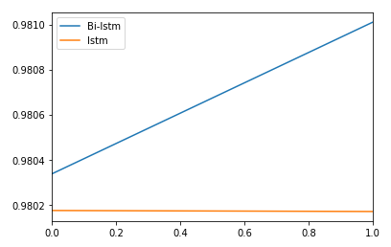
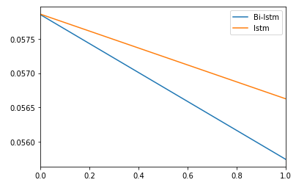
Testing & Analysis (continued…)
Below are the graphs of validation loss and accuracy for Bi-LSTM and LSTM.
val_loss
val_accuracy
Number of epochs
Number of epochs
As graphs shows Bi-LSTM is giving better result for both validation loss and validation accuracy. But as shown in previous slide Bi-LSTM and LSTM overfitting the model after 2 epochs.
Validation Loss
Validation Accuracy
Model | Epoch 1 | Epoch 2
Bi-LSTM | 0.0607378 | 0.0539064
LSTM | 0.0571987 | 0.0600780
Model | Epoch 1 | Epoch 2
Bi-LSTM | 0.9800069 | 0.98094463
LSTM | 0.9800857 | 0.9803087

Slide 19
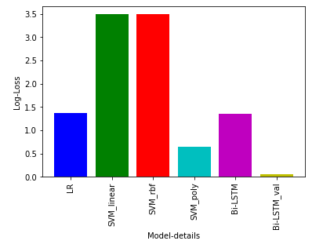
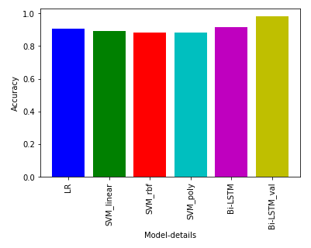
Results
Below graphs shows Log-loss and Accuracy for testing data set.
 | LR | SVM(linear) | SVM(rbf) | SVM(poly) | Bi-LSTM | Bi-LSTM (validation accuracy)
Accuracy | 90.71 | 89.0 | 88.0 | 88.0 | 91.55 | 98.10

Slide 20
References:
https://towardsdatascience.com/exploring-activation-functions-for-neural-networks-73498da59b02
https://medium.com/@nupurbaghel/toxic-comment-classification-f6e075c3487a
https://www.google.com/url?sa=t&rct=j&q=&esrc=s&source=web&cd=&cad=rja&uact=8&ved
https://medium.com/@raghavaggarwal0089/bi-lstm-bc3d68da8bd0
https://medium.com/deep-math-machine-learning-ai/chapter-10-1-deepnlp-lstm-long-short-term-memory-networks-with-math-21477f8e4235
http://colah.github.io/posts/2015-08-Understanding-LSTMs/
https://www.youtube.com/watch?v=AvyhbrQptHk
http://www.wildml.com/2015/09/recurrent-neural-networks-tutorial-part-1-introduction-to-rnns/
https://scikit-learn.org/stable/modules/multiclass.html
https://towardsdatascience.com/multi-label-text-classification-with-scikit-learn-30714b7819c5
https://blog.ekbana.com/pre-processing-text-in-python-ad13ea544dae
http://neuralnetworksanddeeplearning.com/chap2.html
Thank You

