Slide 1
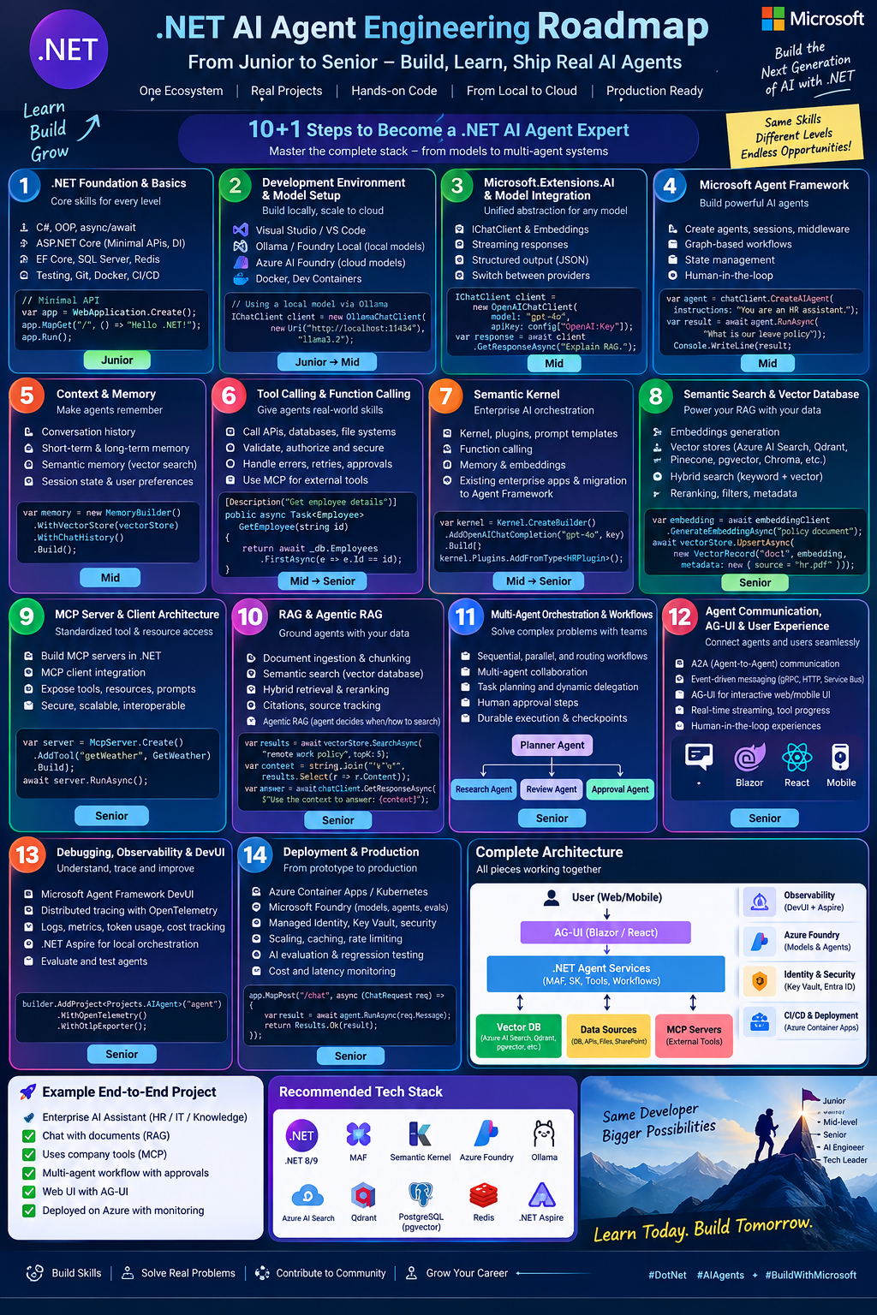
.NET + AI
AI Fundamentals for .NET Developers
From basic AI vocabulary to Generative AI, AI Agents and Agentic AI By :
WebtechInfo
YouTube Series • Episode 1
Learn • Build • Explain • Ship
.NET + AI Development | Episode 1 | 1

Slide 2
What We Will Learn
A beginner-friendly foundation for building AI-powered .NET applications
AI basics
Generative AI
AI building blocks
Modern AI systems
Artificial Intelligence
Machine Learning
Deep Learning
Models
Prompts
Tokens
Context
Embeddings
Vectors
Semantic search
RAG
Agents
Tools
MCP
Memory
Workflows
You do not need to be an AI expert.
C#, ASP.NET Core, Web API and SQL Server are a strong starting point.
.NET + AI Development | Episode 1 | 2

Slide 3
What Is Artificial Intelligence?
AI enables computers to perform tasks that normally require human intelligence.
Understand
Recognize
Predict & Assist
Human language
Questions
Speech
Images
Patterns
Objects
Predictions
Recommendations
Decisions
HR example: “How many annual leave days do I have?”
AI can understand the question and help retrieve relevant information.
.NET + AI Development | Episode 1 | 3

Slide 4
Traditional Applications vs Machine Learning
The key difference is where the behavior comes from.
Traditional application
Machine Learning
Developer writes the rules.
Same input + same conditions → same output.
Example: If an email contains “lottery”, mark it as spam.
Provide data and a learning algorithm.
The model learns patterns from examples.
Example: Estimate a house price from size, location and rooms.
Traditional systems are often deterministic.
Machine Learning systems are often probabilistic.
.NET + AI Development | Episode 1 | 4

Slide 5
Deterministic vs Probabilistic
Probabilistic does not mean random or always incorrect.
Deterministic
Probabilistic
Rules are explicitly written.
The same input generally produces the same output when conditions are unchanged.
The system uses learned patterns and probabilities.
Outputs may vary and are not guaranteed to be correct.
Use AI for understanding and language.
Use reliable C# business rules for calculations such as salary or payroll.
.NET + AI Development | Episode 1 | 5

Slide 6
What Is Deep Learning?
Deep Learning is a type of Machine Learning that uses neural networks with multiple layers.
AI
Machine Learning
Deep Learning
The broad field
Models learn patterns from data
Multi-layer neural networks
Common uses: image recognition, speech recognition, NLP, Generative AI and computer vision.
.NET + AI Development | Episode 1 | 6

Slide 7
What Is Generative AI?
AI that creates new content from an instruction.
Prompt
Model
Output
Create a C# ASP.NET Core Web API for employee management.
GPT
Llama
Qwen
C# code
Email draft
Explanation
Summary
Generative AI can create text, images, audio, video and computer code.
Always review generated code and information.
.NET + AI Development | Episode 1 | 7

Slide 8
AI Model, LLM and NLP
Three related terms used throughout the series.
AI Model
LLM
NLP
A trained computational system that processes inputs and produces outputs.
Examples: GPT, Llama, Qwen.
Large Language Model.
Designed to understand and generate human language: questions, summaries, translations and code.
Natural Language Processing.
AI field focused on text and speech: classification, translation, sentiment and question answering.
An LLM does not automatically know private company data or every current fact.
RAG and tool calling help connect models to business information.
.NET + AI Development | Episode 1 | 8

Slide 9
Prompt and System Prompt
Prompts guide the model; system instructions establish behavior.
Prompt
System prompt
“Explain C# async and await in simple English.”
A prompt may contain a question, instruction, background, examples and output requirements.
“You are a helpful HR assistant. If you do not know the answer, say that you do not know.”
Defines the assistant’s role and behavior.
Prompt engineering means designing and improving prompts for more useful and consistent results.
.NET + AI Development | Episode 1 | 9

Slide 10
Token and Context Window
Models process text in units and within a limited context capacity.
Token
Context window
A unit of text: a word, part of a word, punctuation or another piece.
Tokens affect context limits and usage cost.
A token is not always one word.
Information available in a request:
• System instructions
• User question
• Conversation
• Retrieved documents
• Tool results
If content is too large, split or summarize it.
This is one reason document chunking and RAG matter.
.NET + AI Development | Episode 1 | 10

Slide 11
Embeddings, Vectors and Semantic Search
Text becomes numbers so we can compare meaning.
Text
Embedding / Vector
Search
“I want to apply for annual leave.”
“How can I request vacation days?”
[0.12, -0.45,
0.78, 0.21, …]
Find content with similar meaning.
Often used with a vector database.
Semantic search looks for meaning, not only exact keywords.
Keyword + vector search together is called hybrid search.
.NET + AI Development | Episode 1 | 11

Slide 12
What Is a Vector Database?
A database designed to store and search vector representations.
Examples
Input
Result
Qdrant
Azure AI Search
PostgreSQL + pgvector
1,000 HR policy documents
Question: “What is the maternity leave policy?”
Find semantically related sections and pass them to the language model.
.NET + AI Development | Episode 1 | 12

Slide 13
What Is RAG?
Retrieval-Augmented Generation combines retrieval with text generation.
1. Ask
2. Retrieve
3. Augment
4. Generate
User question
Search policy and data
Add relevant content
Answer using context
RAG helps applications use private or current information without retraining the model.
Typical stack: ASP.NET Core + embedding model + vector database + LLM.
.NET + AI Development | Episode 1 | 13

Slide 14
What Is a Hallucination?
An AI hallucination is incorrect or unsupported information presented with unjustified confidence.
Risk
Ways to reduce risk
The model does not have the actual company leave policy but gives a specific number of leave days.
Reliable source data
RAG and tool calling
Validation
Clear instructions
Human review
Do not blindly trust AI-generated answers in financial, legal, HR or other sensitive processes.
.NET + AI Development | Episode 1 | 14

Slide 15
What Is an AI Agent?
An AI agent uses a model, tools and steps to work toward a goal.
Goal
Understand
Act
Respond
Check my leave balance and explain the policy
Interpret the request
Choose and use tools
Use results to answer
Possible tools: Employee API, leave-balance API, policy search and database.
.NET + AI Development | Episode 1 | 15

Slide 16
What Is Tool Calling?
Tool calling connects an AI model to approved application functions.
1. User
2. Model
3. App
4. Model
Ask about leave balance
Requests the leave-balance tool
Validates and executes C# method
Uses the result to respond
Example function: GetEmployeeLeaveBalance(employeeId)
The model cannot execute a method automatically; the application must expose and govern the tool.
.NET + AI Development | Episode 1 | 16

Slide 17
Memory, MCP and Multi-Agent AI
Modern AI applications connect models with context, tools and specialized agents.
Memory
MCP
Multi-agent
HITL
Short-term: current task or conversation.
Long-term: saved preferences or facts.
Consider privacy, security and retention.
Model Context Protocol.
A standardized way to connect AI applications with tools and resources.
Specialized agents work together.
HR agent • Payroll agent • Leave agent • Approval agent
Human approval for sensitive actions.
.NET + AI Development | Episode 1 | 17

Slide 18
Production AI: MLOps, Observability, Evaluation and Fine-Tuning
Building AI systems requires more than connecting a model.
MLOps
Observability
Evaluation
Fine-tuning
Training
Evaluation
Deployment
Monitoring
Versioning
Retraining
Logs
Traces
Metrics
Token usage
Tool calls
Errors
Correctness
Relevance
Right documents
Rule following
Privacy
Additional training on a specific dataset.
Different from RAG.
For many .NET developers, start with existing models, prompting, RAG and tool calling before advanced training.
.NET + AI Development | Episode 1 | 18

Slide 19
How These Concepts Fit into .NET
A simple architecture for an AI-powered enterprise application.
User Interface
Blazor • React • Mobile
Knowledge + Tools
Enterprise Data
RAG • Vector DB • MCP • Business APIs
SQL Server • HR system • Files • Services
ASP.NET Core API
Auth • Business endpoints • Orchestration
The AI layer connects user requests to models, retrieved knowledge and business capabilities.
AI Layer
IChatClient • Agent • Prompting • Tool calling
.NET + AI Development | Episode 1 | 19

Slide 20
Generative AI vs AI Agents vs Agentic AI
Easy way to remember the difference.
Generative AI → Creates
AI Agent → Acts
Agentic AI → Achieves
Generates content from instructions.
Example: Generate a C# employee API.
Uses a model and tools to complete a task.
Example: Check leave balance through an API.
Works toward a goal through multiple actions and workflows.
Example: Collect data, validate, request approval and send a report.
.NET + AI Development | Episode 1 | 20

Slide 21
Agentic AI: A Goal-Driven Workflow
Agentic systems can plan, act, check results and involve people.
Goal
Plan
Act
Check
Approve
Complete
Prepare monthly attendance report
Decide steps
Read and calculate
Validate and handle errors
Ask manager when required
Deliver report
.NET + AI Development | Episode 1 | 21

Slide 22
Our .NET AI Learning Journey
From simple prompts to production-ready AI systems.
1. Generate
2. Connect
3. Retrieve
4. Act
5. Orchestrate
6. Ship
Call an LLM from C#
Prompts and structured output
Embeddings, search and RAG
Tools and AI agents
Workflows and multi-agent systems
Deploy, monitor and secure
Next episode: Set up the .NET AI development environment and build your first C# AI application.
.NET + AI Development | Episode 1 | 22

Slide 23
Conclusion
You do not need to memorize every term today. Understand the basic idea behind each one.
AI • Machine Learning • Deep Learning
Generative AI • AI Model • LLM • NLP
Prompt • System Prompt • Token • Context
Embedding • Vector • Vector Database • Semantic Search • RAG
Hallucination • AI Agent • Tool Calling • Memory • MCP
Multi-Agent AI • Human-in-the-Loop • MLOps • Observability • Evaluation • Fine-Tuning
Next: build a simple AI application using C# and a language model.
.NET + AI Development | Episode 1 | 23

