Slide 1
GlucoTwin
Personalized glucose forecasting between clinic visits
Team Kryptonite, VESIT
Avinash Gehi (team leader) · Hardik Hinduja
Vivekanand Education Society's Institute of Technology (VESIT), Mumbai
Digital Twin Challenge 2026 · Happiest Health
Student research prototype — not a medical device

Slide 2
The problem: what happens between appointments
• HbA1c summarises ~3 months of glucose; it cannot show short high-glucose excursions (NIDDK).
• WHO identifies continuity of care and diabetes monitoring as ongoing challenges in India.
• Continuous glucose monitors produce ~288 readings a day — too many to review by hand.
• Question for the clinician: “Which monitored patient’s glucose pattern merits review, and what observations support that?”
• Our target: forecast glucose 30 and 60 minutes ahead and warn of a NEW sustained episode > 180 mg/dL (≥ 15 min), for Type 2 diabetes.
2

Slide 3
Use case and boundaries
• Hypothetical example (an illustration, not a deployment): a diabetes educator in Mumbai follows adults with Type 2 diabetes who wear CGMs between quarterly visits, and opens one person’s replay to see forecasts, warnings and the data behind them.
• User: a clinician reviewing a small monitored cohort; secondary user: a reviewer inspecting evidence.
• Workflow (proposed): baseline labs at a visit → CGM + wearable measurements → twin forecasts → a review queue lists replays with unreviewed warnings first (an order of work, not triage) → each person reviewed in their own workspace.
• Shows: observed vs predicted glucose, uncertainty, data freshness, factual reasons, research warnings.
• Never: insulin or medication advice, triage, live device claims, LLM-generated predictions.
• Potential fit with diagnostics + outpatient services is a proposal — no partnership or pilot is claimed.
3

Slide 4
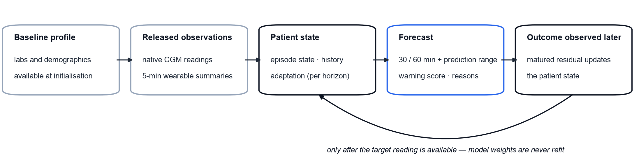
What makes it a twin (operational definition)
• Versioned patient state: baseline profile, episode state, adaptation state, issued forecasts.
• Incoming observations released by a replay clock (only what was available at that time).
• Population forecaster + patient-specific correction learned from that person’s matured forecast errors.
• Measured updates over time — a statistical research twin, not a physiological simulator.
4

Slide 5
Data and provenance
• CGMacros 1.0.0 (PhysioNet, CC BY-NC-SA 4.0): 45 adults, ~10 days, Dexcom G6 Pro + Libre Pro (blinded), Fitbit, meals, screening labs.
• Primary cohort: 14 participants in the dataset’s Type 2 group (HbA1c > 6.4 %); 31 others replayable but excluded.
• Finding: the published 1-minute CGM columns are linearly interpolated. We recover native 5-minute Dexcom readings (integer knots) and never count interpolated rows.
• Undocumented columns reported, not interpreted; documented error codes excluded; dates shifted; timezone unknown → synthetic clock, no time-of-day features.
• Synthetic fictional participants exercise edge cases (gaps, late meal logs, short history) with no download.
5

Slide 6
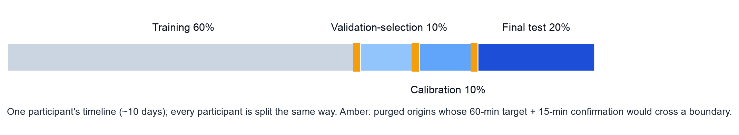
Information availability and leakage controls
• Every record carries observed_at and available_at; a forecast at t uses only records with both ≤ t.
• Meals excluded from the primary model (logging time unknown); tested separately as an optimistic sensitivity.
• Protocol frozen before fitting; model, adaptation, intervals and alert threshold chosen on validation. Results shown (gt-primary-2026-10-13-fusion) re-run gt-primary-2026-10-11-v2's protocol with one change, declared after its test segment had been inspected: the serving model must read the baseline profile and the wearable streams.
• Adaptation uses a residual only after its target reading was available; missing future data is censored, never negative.
6

Slide 7
System architecture: two data streams, one twin
DATA SOURCES
INGESTION
ONLINE · DIGITAL TWIN (LOCAL REPLAY)
Static stream
Replay session
Twin engine (serving model)
Clinician dashboard
baseline profile (EHR-like)
age, sex, BMI, HbA1c
fasting glucose, insulin,
triglycerides, HDL
backend-owned clock
releases a reading
once available_at ≤ t
seek / reset → new
revision
1 causal features, ≤ 180 min history
2 fusion LightGBM: 8 profile + 38 dynamic
3 bounded patient update (±25 mg/dL)
4 80 % range · warning > 180 mg/dL
5 abstain / degraded / stale guards
FastAPI /api/v1 → React
warnings with outcomes
clinician review + note
review ledger (SQLite)
evidence · data quality
Dataset adapter
SHA-256 verified
native readings
observed_at stamp
available_at stamp
Dynamic stream
Dexcom G6 CGM, native 5-min
Fitbit heart rate, METs,
activity minutes
Candidates
research only, offline;
served only if every
release gate passes
same feature + adaptation code
registered model, SHA-256
evidence page
Canonical store
Synthetic patients
Parquet per patient
SQLite index
quality flag per
reading
5 fictional profiles (CC0)
gaps, late meals, short history
OFFLINE · MODEL BUILD
Origin table
Frozen experiment
Evidence + registry
External cohort
causal features
targets +30 / +60 min
split 60/10/10/20
purged boundaries
baselines: persistence, trend, Ridge
LightGBM · CatBoost search
validation-only selection
one final-test run
metrics.json, report
model card, disclosures
checksummed artifacts
rollback to previous
ShanghaiT2DM, 98 people
15-min CGM, research only
Solid arrow: data flow · Dashed line: identical code offline and online · Blue: serving model · Dashed box: research only, not served · CPU only, local, no cloud, no LLM · not a medical device
7

Slide 8
Models and personalization
• Fusion: the serving model reads 38 dynamic features (CGM history, wearable heart rate and activity) and 8 static baseline profile values (age, sex, BMI, HbA1c, fasting glucose and insulin, triglycerides, HDL) in one model.
• Baselines: persistence, bounded linear trend, ridge regression.
• Direct per-horizon gradient-boosted trees: LightGBM (starting point) and CatBoost (challenger), equal 12-trial seeded searches, identical inputs and origins.
• Patient adaptation (same policy for both families): shrunk, bounded, decaying mean of matured residuals vs the frozen population forecast; weights never refit.
• Prediction ranges: split-conformal, target coverage 80 %, calibrated on the calibration segment for the exact serving pipeline.
• Warning: max forecast within 60 min − 180 mg/dL — an uncalibrated score, never shown as a probability.
8

Slide 9
Why this learner: validation-only selection
Candidate | Val. MAE 30 | Val. MAE 60 | Score
lightgbm:dyn-prof-v2 | 13.47 | 21.26 | 17.36
catboost:dyn-prof-v2 | 13.56 | 21.31 | 17.44
lightgbm:dyn-v2 | 13.76 | 21.73 | 17.75
catboost:dyn-v2 | 13.88 | 21.66 | 17.77
ridge:dyn-v2 | 14.13 | 22.44 | 18.28
ridge:dyn-prof-v2 | 14.21 | 22.61 | 18.41
linear_trend:cgm-only-v1 | 15.66 | 26.33 | 20.99
persistence:cgm-only-v1 | 16.51 | 26.32 | 21.42
Declared rule: lowest mean per-participant MAE over both horizons; candidates within 0.5 mg/dL tie → simpler family, then smaller feature set. Eligible for serving: dyn-prof-v2 only (profile + wearable), a constraint added on 2026-10-13 after the test segment had been inspected, to meet the fusion requirement. Selected: lightgbm:dyn-prof-v2 with patient adaptation. Without the constraint the same rule picks lightgbm:dyn-v2 (the earlier model, gt-primary-2026-10-11-v2).
9

Slide 10
Fusion: what the profile adds, and what it does not show
• The brief asks for a model that ingests static EHR-like data and dynamic wearable data. The demo model (LightGBM, dyn-prof-v2) reads 8 baseline profile values and 38 glucose and wearable features in one model.
• Same 14 people, later days (test): profile minus dynamic-only -0.25 mg/dL [-0.43, -0.04] at 30 min and -0.61 mg/dL [-1.15, -0.09] at 60 min (negative = profile better). Profile values are constant per person, so here they can act as an identity code.
• People held out entirely (nested experiment): +0.34 [-0.28, +0.89] mg/dL at 30 min and -0.75 [-2.19, +0.61] mg/dL at 60 min — no reliable benefit for new people.
• Selection: the v2 rule applied only to profile + wearable models — a constraint declared on 2026-10-13, after the test segment had been inspected. Test MAE 12.96 / 20.26 mg/dL vs 13.15 / 20.81 for the dynamic-only model (gt-primary-2026-10-11-v2): retrospective, same people.
• Warnings: margin re-derived by the same F1 rule (-10 vs -30 mg/dL): 1.49 vs 2.95 false alarms per observed day, 61/64 vs 64/64 onsets, forecast lead median 30 vs 55 min. A threshold trade-off, not evidence that the profile helps.
• Our claim: we selected a model that implements the required fusion; we have not established that profile features improve forecasting for unseen patients.
10

Slide 11
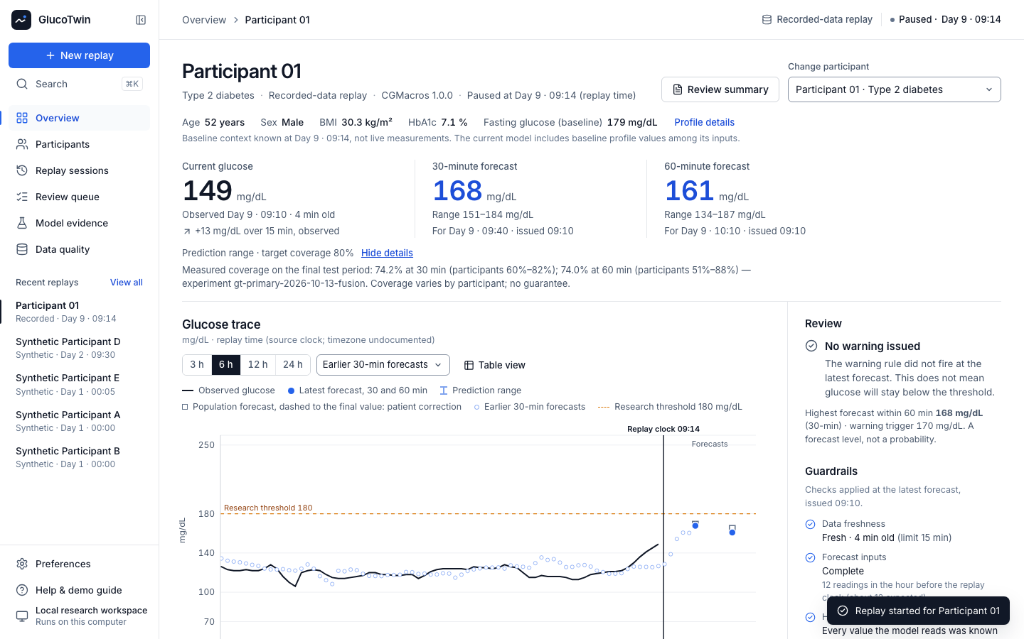
Clinician workflow: the twin workspace
Recorded-data replay in the final test period (later recordings of participants the model was trained on): current glucose, 30/60-minute forecasts with prediction ranges (target coverage 80 %), saved earlier forecasts, research warnings with outcomes, review status and the live safety guardrails.
11

Slide 12
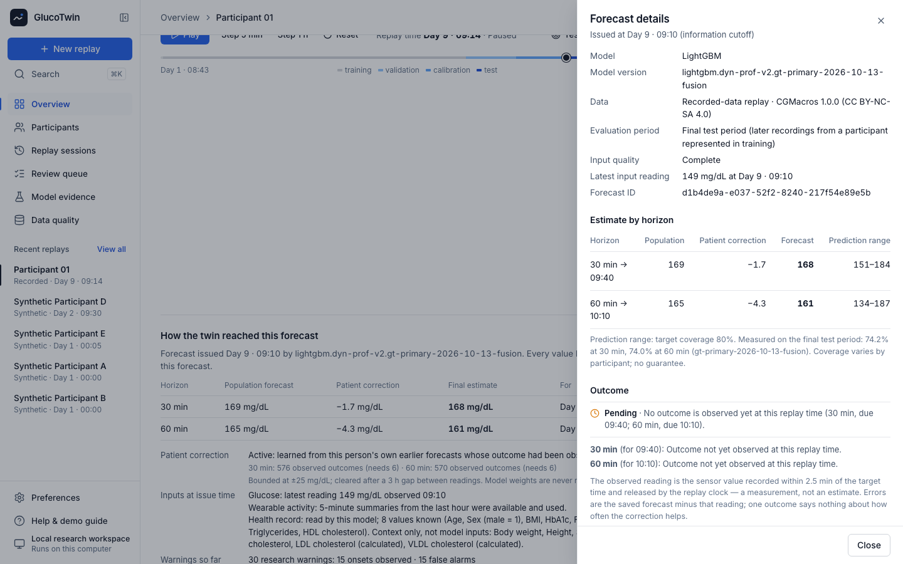
Demonstration: evidence behind a forecast
Each forecast is immutable and inspectable: information cutoff, model version, evaluation segment, population forecast vs patient correction, factual explanations.
12

Slide 13
Safety guardrails built into the twin
• Abstains instead of guessing: no forecast with under 60 min of history, a sparse last hour or no new reading; after 15 min without one the last forecast is marked Stale. Weak inputs (gaps, sensor-limit readings, missing wearable data) are flagged Degraded, with the reason.
• The fusion model abstains when a health-record value is missing or not yet available; no input is used before the time it became available (native CGM readings only).
• Personal correction bounded: learns only from forecasts whose outcome was observed, needs 6, capped at ±25 mg/dL, resets after a 3-hour gap.
• Every warning is a labelled research warning: Outcome pending until it can be judged, then matched to an onset, counted as a false alarm or marked unknown; firings within 30 min merge into one episode.
• Uncertainty and limits shown: 80 % prediction ranges with measured coverage; not a medical device, no treatment advice, replay only.
• Evaluation cannot be quietly re-run: opened tests are locked; research runs cannot change the demo model; the app reproduced all 15,440 saved test forecasts within 0.05 mg/dL.
13

Slide 14
Results at a glance: three kinds of evidence, kept apart
Evaluated on | Model or procedure | MAE 30 / 60 min | Persistence 30 / 60
Serving model — later recordings of the same 14 CGMacros Type 2 people (a test over time, retrospective)
Final 20 % of each recording | Fusion LightGBM + bounded patient correction (serving) | 12.96 / 20.26 | 14.84 / 23.23
Participant-held-out research — 14 CGMacros people, each held out once (internal validation)
Five participant folds (D-032) | CGM-only procedure (Ridge in 4 of 5 folds), not served | 13.88 / 22.30 | 15.34 / 24.47
Same folds (D-053) | Peak-aware constrained fusion selection, not adopted | 13.89 / 22.00 | 15.34 / 24.47
Same 14 people (D-054) | Zero-shot foundation model, CGM only, not served | 14.55 / 22.92 | 15.34 / 24.47
External check — ShanghaiT2DM, 98 people, CGM only; D-045 was the cohort's second opening
98 people, 15-min CGM (D-045) | Separate 15-min LightGBM, CGM only, not served | 10.90 / 19.31 | 12.14 / 20.44
Mean absolute error in mg/dL, averaged equally over participants: an average error, not an accuracy percentage. Each group is a different model and a different test — do not compare across groups. Serving ranges (target 80 %) covered 74.2 % / 74.0 %: under-coverage. Research rows are read from each study's locked summary.
14

Slide 15
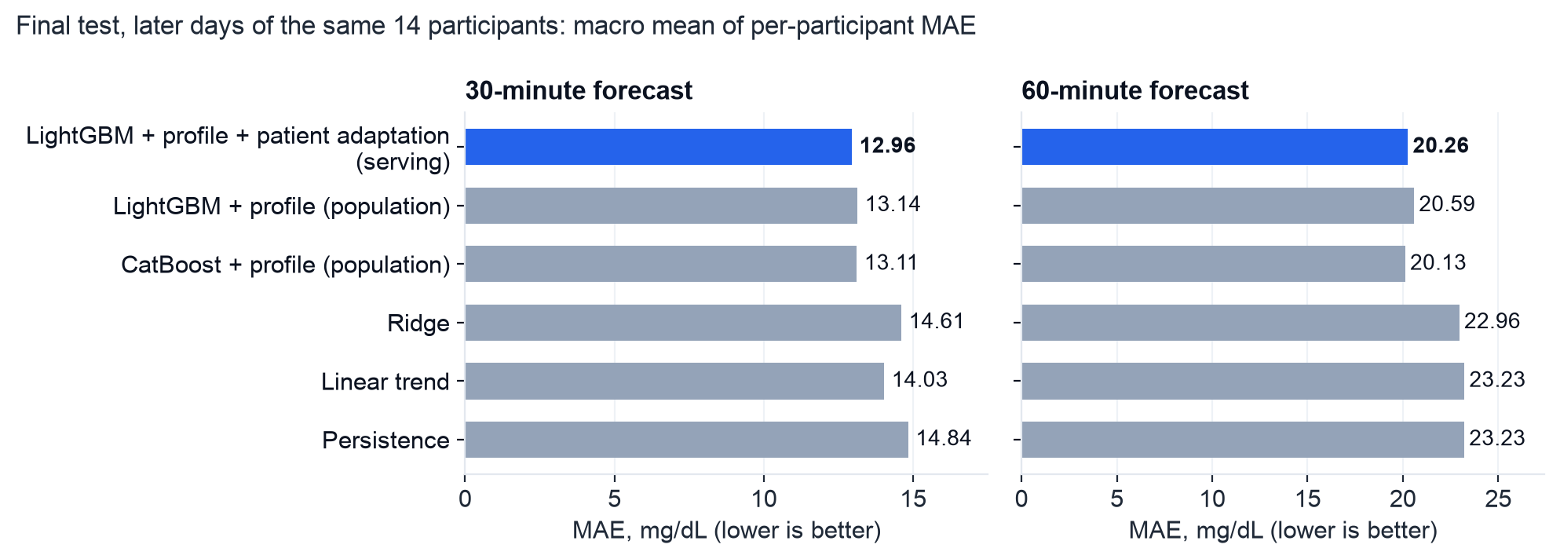
SERVING MODEL · later recordings of the same 14 participants it was trained on — not new people
Measured evaluation: forecast accuracy (later days)
Later recordings of the same 14 participants the model was trained on — not new patients. Serving − persistence: -1.88 mg/dL [-2.53, -1.32] at 30 min, -2.96 mg/dL [-4.34, -1.77] at 60 min. Test origins 7,730 (≈ 644 h); forecasts issued for 99.9 % of origins with a target.
15

Slide 16
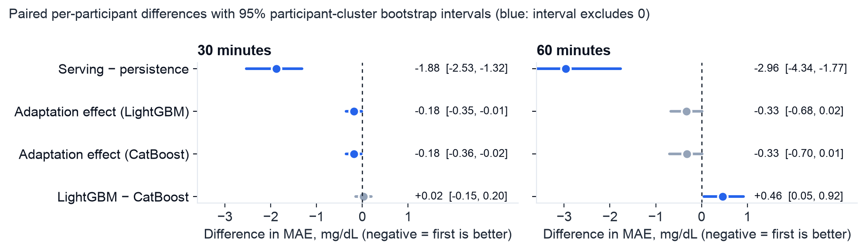
SERVING MODEL · later recordings of the same 14 participants it was trained on — not new people
Measured evaluation: does personalization help?
Adaptation (LightGBM): -0.18 mg/dL [-0.35, -0.01] at 30 min, -0.33 mg/dL [-0.68, 0.02] at 60 min — small; population 13.14 / 20.59, frozen state 13.19 / 20.65, adaptive 12.96 / 20.26 mg/dL. New-participant cold start: 14.66/24.26 → 13.81/22.12 mg/dL with adaptation.
16

Slide 17
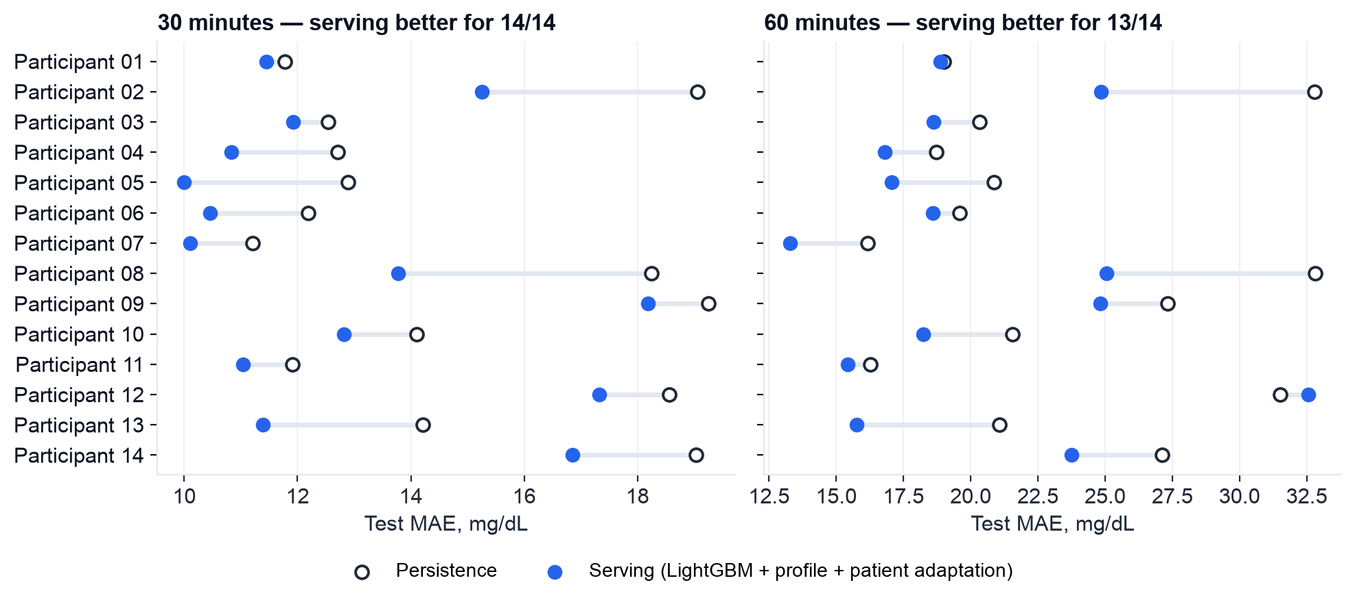
SERVING MODEL · later recordings of the same 14 participants it was trained on — not new people
Measured evaluation: every participant
Per-participant test MAE, persistence vs the serving pipeline. Gains are uneven: large for some participants, none for a few at 60 minutes. Fourteen people cannot establish population-level performance.
17

Slide 18
SERVING MODEL · later recordings of the same 14 participants it was trained on — not new people
Measured evaluation: early warning and uncertainty
• 60-min warning (test, margin threshold -10 mg/dL chosen on validation by F1): 61/64 new onsets detected, precision 0.60, 40 false alarms (1.49 per observed patient-day; 2.28 per eligible day); forecast lead median 30 min among detected onsets (episode start 30 min). Detection is not notice: 48.4 % of all onsets were warned at least 30 min ahead.
• Same procedure on persistence (fires at glucose ≥ 150): 63/64 detected, 70 false alarms (2.61 per observed patient-day; 4.00 per eligible day).
• Prediction ranges (target coverage 80 %) covered 74.2 % (30 min) and 74.0 % (60 min) on test, 60–82 % and 51–88 % per participant — under-covered; no guarantee claimed.
• Optimistic meal logging: 19.07 vs 20.59 mg/dL at 60 min — timely meal data would likely help most.
18

Slide 19
RESEARCH · each participant held out entirely · internal validation · not the serving model
Research: people held out entirely
• Models kept separate: the v2 recipe (LightGBM, dynamic streams only; the demo model when this experiment was declared) and a Ridge five-minute candidate on CGM-only features. Neither is the serving model.
• 145 participants imported; 14 evaluated here (five participant folds, each person held out once, protocol frozen before fitting, D-032).
• Held-out people, 30 / 60 min: candidate 13.88 / 22.30 vs v2 recipe refit 14.52 / 24.25 vs persistence 15.34 / 24.47 mg/dL — but worse on large highs (+2.71 [+0.28, +5.11] mg/dL at 60 min when the target exceeded 180).
• Warnings chosen for ≤ 2 false alarms per day: 301/329 onsets at 1.31 false alarms per observed day (v2 recipe: 329/329 at 2.80).
• Not promoted, and not eligible as the demo model: the Ridge candidate reads CGM only. CGMacros was already inspected, so its folds are internal validation; the next protocol also bounds high-glucose error, missed onsets and false warnings (declared, not run).
19

Slide 20
RESEARCH · each participant held out entirely · internal validation · not the serving model
Research: warning two hours ahead
• The brief's example is a spike predicted 2 hours ahead. Declared before any fit (decision D-043): the people-held-out procedure above, same folds, plus a 120-minute horizon. 14 people, each held out once; not the demo model, nothing promoted.
• Forecast error at 120 min: 30.6 mg/dL vs persistence 35.9 (-5.25 [-6.44, -4.05] mg/dL); at 60 min 22.3 vs 24.5.
• 120-min warning: 315/329 onsets warned, 1.62 false alarms per observed day, median forecast lead 15 min. For comparison, 60-min warning: 313/329 onsets warned, 1.48 false alarms per observed day, median forecast lead 10 min.
• Profile (EHR-like) inputs at 120 min, LightGBM with minus without: -0.86 [-2.60, +1.02] mg/dL (no reliable benefit on people held out).
• Thresholds chosen on development folds only (≤ 2 false alarms per observed day); each test fold opened once. The 14 people were inspected in earlier experiments, so this is internal validation.
20

Slide 21
RESEARCH · each participant held out entirely · internal validation · not the serving model
Research: what we fixed, and what we could not
• We declared each study before its own run. Later studies reused previously inspected participants, so those results are internal validation.
• Fixed — prediction ranges: calibrating on all development people instead of 2 per fold raised two-hour coverage from 76.5 % to 79.8 % (target 80 %; 60 min 78.2 → 79.5 %), ranges 7 mg/dL wider.
• Not shown — earlier warning: 126 vs 123 of 329 onsets warned ≥ 30 min ahead (+0.9 points [-5.5, +6.6]) at the same workload; median lead still 15 min.
• Not shown — health record as a new person's starting correction: -0.53 [-1.57, +0.58] mg/dL at 120 min, -0.93 [-2.74, +0.48] in the first 24 hours; the intervals cross zero, so no benefit is claimed.
• Not adopted — a LightGBM–CatBoost blend (D-048): +0.02 mg/dL at 60 min on development people against a 0.5 target; held-out folds never opened.
• Not adopted — fixed and tuned retraining (D-049, D-051): best 60-min gain +0.41 mg/dL (fixed), -0.37 [-0.63, -0.06] with tuning, below the declared 0.5 bar.
• Not adopted — joint selection (D-052, 1,570 fresh fits): -0.88 [-1.75, -0.13] mg/dL at 60 min vs the refitted serving recipe, but +1.70 on peaks above 180 and +0.60 false alarms/day — gates not met.
• The demo model's ranges are already pooled over all 14 people; its under-coverage most likely comes from drift between time segments, so this fix is not applied to it.
21

Slide 22
RESEARCH · each participant held out entirely · internal validation · not the serving model
Research: peak-aware selection (D-053), a near miss
• Declared before any formal fit; inside each held-out fold, model settings, a training weight on future readings above 180 and the patient correction were chosen on development people only, with a guard on high-reading error. 1,490 fresh fits, 0 failures.
• 60 min, against the serving recipe refitted in the same folds: 22.00 vs 23.20 mg/dL, -1.19 [-2.09, -0.39], lower for 11 of 14 people; 30 min -0.50 [-0.77, -0.24].
• Primary gate not met: error on readings above 180 changed by +1.07 mg/dL against a declared limit of +1.0.
• Warning guardrails passed: 1.15 vs 1.20 false alarms per observed day; 21.9 % vs 16.4 % of onsets warned ≥ 30 min ahead. Exact-predictor 80 % ranges covered 79.4 % / 77.3 % (range guardrails passed).
• Not adopted: one declared gate failed, so the serving model is unchanged.
• Previously inspected people: internal validation. Absolute errors are not comparable with D-052's; only the matched comparison is.
22

Slide 23
RESEARCH · 14 previously inspected people · internal comparison · CGM only · not served
Research: a zero-shot foundation-model baseline (D-054)
• What: amazon/chronos-bolt-tiny (pinned revision, 8.7 M parameters, apache-2.0), zero-shot on CGM only: each forecast origin is its own series of past readings; median forecast fixed in advance. Not fine-tuned, not a fusion model, not served. Its public pretraining data may include CGM recordings.
• Against carrying the last reading forward, on identical origins: -0.79 [-1.01, -0.59] mg/dL at 30 min and -1.54 [-1.81, -1.30] at 60 min (macro MAE 22.92 vs 24.47; lower for 14 of 14 people).
• Against the serving recipe refitted with each person held out (saved from D-052): +0.42 [-0.70, +1.47] mg/dL at 60 min (22.92 vs 22.50) — not better, and clearly worse on readings above 180.
• Declared secondary: the foundation forecast plus a freshly fitted LightGBM residual on the served inputs, -0.46 [-0.72, -0.21] mg/dL at 60 min against the same-code refit. Descriptive only; not a release candidate.
• Declared before any participant forecast; the 14 people were inspected in earlier experiments, so this is an internal comparison, not independent confirmation.
23

Slide 24
RESEARCH · external cohort, CGM only · not the serving fusion model
External check: an independent Type 2 cohort
• Who: 98 adults with Type 2 diabetes in ShanghaiT2DM (China, FreeStyle Libre H, 15-minute readings), never trained on. No wearable or dated labs, so this checks the forecasting core only, not the fusion.
• What: a separate 15-minute LightGBM on CGM-only features, developed on CGMacros. It is not the serving fusion model and not the Ridge candidate.
• 30 / 60 minutes (D-032, the cohort's first opening): -0.99 [-1.21, -0.77] mg/dL at 30 min (clear) and -0.34 [-0.76, +0.10] mg/dL at 60 min (inconclusive), versus carrying the last reading forward.
• Two hours ahead (D-045, declared before any fit; its first 120-minute assessment and the cohort's second opening): 29.6 vs persistence 31.7 mg/dL at 120 min (-2.12 [-2.67, -1.53]), better for 78 of 98 people.
• Nothing was chosen on this cohort; other frozen pipelines were reported but not adopted, because choosing on it would turn it into a tuning set.
24

Slide 25
Project outcomes
• Built: a working personalized glucose twin — replay API with a backend-owned clock, immutable forecasts, research warnings with outcomes — and a clinician workspace (landing page, Overview, Participants, Replay sessions, Model evidence, Data quality).
• Found and corrected a data-provenance problem: the published 1-minute CGM values are interpolated; only native 5-minute readings are used.
• Measured on later recordings of the same participants (retrospective): 14/14 participants improved over persistence at 30 min and 13/14 at 60 min; MAE 12.96 / 20.26 mg/dL vs 14.84 / 23.23.
• Personalization: small gains (-0.18 mg/dL and -0.33 mg/dL). Warnings: 61/64 onsets detected with 40 false alarms (1.49 per observed patient-day); 48.4 % of all onsets warned at least 30 min ahead — the F1 threshold rule ignores review workload.
• Corrected after an independent review (activity-window defect, online warning double-credit; gt-primary-2026-10-11-v1 preserved), then re-run with the fusion constraint (gt-primary-2026-10-13-fusion); the dynamic-only model of gt-primary-2026-10-11-v2 stays registered for rollback.
• Reproducible: synthetic mode needs no download; recorded-data results regenerate from versioned configs; a fresh copy passes the automated backend, frontend and browser tests.
25

Slide 26
Limitations
• 14 participants from one US site; overlapping windows are not independent patients.
• No Indian participants — nothing here establishes performance for patients in India.
• Blinded research CGMs replayed with assumed zero latency; native timestamps known to the minute.
• Medication and insulin use unknown; meal logging time undocumented.
• Profile fusion: profile values are constant per person, so with 14 people they can act as an identity code; no benefit was shown on people held out entirely.
• Prediction ranges under-cover; the warning score is uncalibrated and its threshold rule (F1) ignores review workload; 180 mg/dL is a research threshold, not triage.
• Retrospective replay only: no clinician workflow, outcome or safety study. The foundation-model baseline was zero-shot only; fine-tuning was not run.
• Scores depend on the dataset, prediction task and evaluation protocol; performance on simulated patients does not establish performance on real patients.
26

Slide 27
Next steps: evidence needed for Indian patients
• Prospective, consented Indian cohort with unblinded CGMs, recorded transmission latency, medications and meal logging times.
• Re-evaluate held-out participants (cold start) and per-site calibration; report subgroup performance.
• AI-READI five-minute CGM and wearable data (access not yet requested; steps listed) for a larger new-person evaluation under the declared protocol gt-nested-2026-10-12-v2.
• Clinician usability study of the review workflow; regulatory and data-protection review (DPDP Act).
• Optional: fine-tune a time-series foundation model inside each training boundary and compare it under the same protocol (zero-shot only so far, D-054).
27

Slide 28
Team, links, reproducibility and licenses
• Team Kryptonite — Avinash Gehi (team leader) · Hardik Hinduja. Vivekanand Education Society's Institute of Technology (VESIT), Mumbai.
• Code: public GitHub link — added after the team publishes the repository — MIT license (code only). Quick start: make setup · make synthetic · make dev.
• Demo video (at least 20 minutes): unlisted YouTube link — added after recording and upload. Architecture: docs/submission/GlucoTwin_Architecture.pdf.
• Data: CGMacros 1.0.0, Gutierrez-Osuna, Kerr, Mortazavi, Das (2025), PhysioNet, doi:10.13026/3z8q-x658, CC BY-NC-SA 4.0; ShanghaiT2DM, Zhao, Zhu, Wang, Rao (2022), figshare, doi:10.6084/m9.figshare.21600933.v5, CC BY 4.0.
• Serving results: experiment gt-primary-2026-10-13-fusion, reports/evaluation_report.md. Research (not served): README §7, docs/judge_guide.md, reports/constrained_study.md, reports/foundation_baseline.md, reports/two_hour_external.md. Every selected claim: reports/evidence_manifest.md.
28

