Slide 1
Automated and Secure Job Search System
BE Project – Review 1
By-
Kunal (43248)
Akshay (43242)
Guide - Avinash (43248)
Mrs. R. A. Karnawat Mihir (43265)

Slide 2
Problem Statement
Develop an automated system for detecting potentially fraudulent job listings on LinkedIn through web crawling, aiming to enhance user confidence and safety while searching for jobs on the platform.

Slide 3
Motivation
Addressing a significant concern about the fake jobs or job scams in modern society.
Developing a system that enhances safety and efficiency for users using cutting-edge technologies to create a solution that has a meaningful impact on how individuals navigate the online job-seeking experience.

Slide 4
Objectives
Effectively detect fraudulent job listings on LinkedIn by analyzing job descriptions, company profiles, and other relevant data.
Optimizing Job Search and Streamlining Application Processes for Swift and Efficient Job Hunting.
Ensure the crawler is capable of handling LinkedIn's website structure and is equipped to handle rate limiting and anti-crawling measures.

Slide 5
Literature Survey
No. | Title | Authors | Published Year
1 | Online Recruitment Fraud Detection: A Study on Contextual Features in Australian Job Industries. | S. Mahbub, E. Pardede and A. S. M. Kayes | 2022
2 | Importance of Web Scraping as a Data Source for Machine Learning Algorithms - Review | S. D. S. Sirisuriya | 2023
3 | A Review of Methodologies for Fake News Analysis | M. Tajrian, A. Rahman, M. A. Kabir and M. R. Islam | 2023
Summary Sheet :

Slide 6
Introduction
Web Scrapping –
Methods
HTML Parsing
DOM Parsing
XML Parsing
Regular Expression
Web Scrapping Software
API
Tools
Python Libraries : Scrapy, Selenium, Beautiful Soup, etc.
Java Libraries : JSoup, HtmlUnit, etc.
Software : Parse Hub, Web Scrapper, etc.
API : Scrapping bee, Scrapper API, etc.

Slide 7
Continued…
Web Crawling –
Algorithms
Breadth First Search
Depth First Search
Priority Based
Types
Parallel
Incremental
Hidden
Distributed
Focused

Slide 8
Continued…
Fake Job Detection –
Algorithms
Support Vector Machine (SVM)
Deep Neural Network(DNN)
Random Forest Algorithm
Classification and Regression Tree(CART)
Convolutional Neural Network(CNN)
Long Short Term Memory(LSTM)

Slide 9
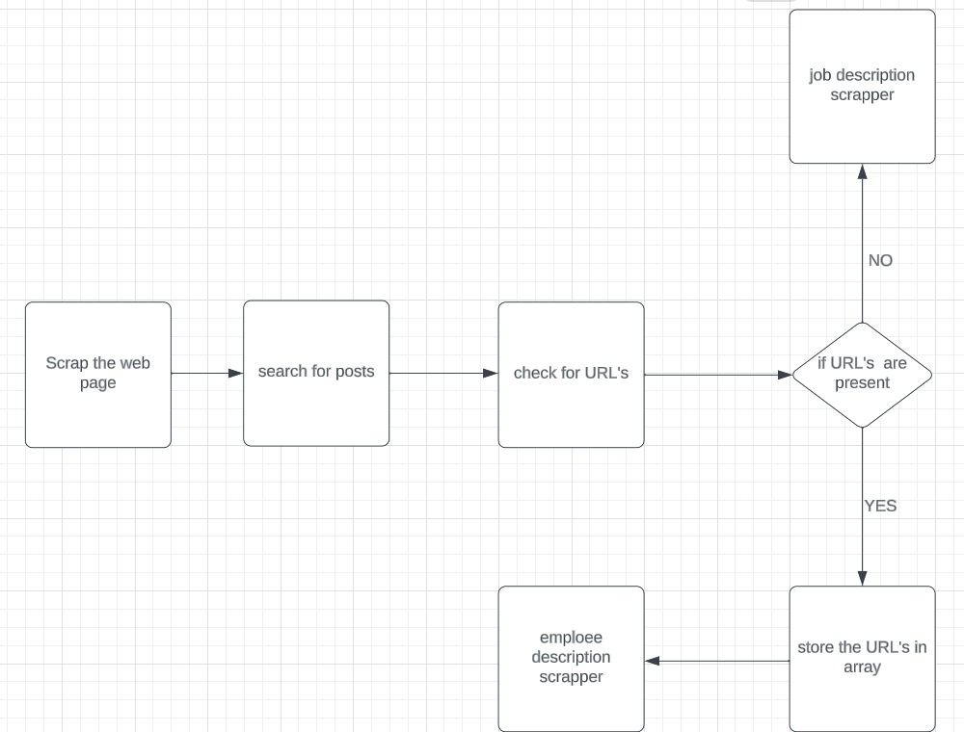
Flow Chart

Slide 10
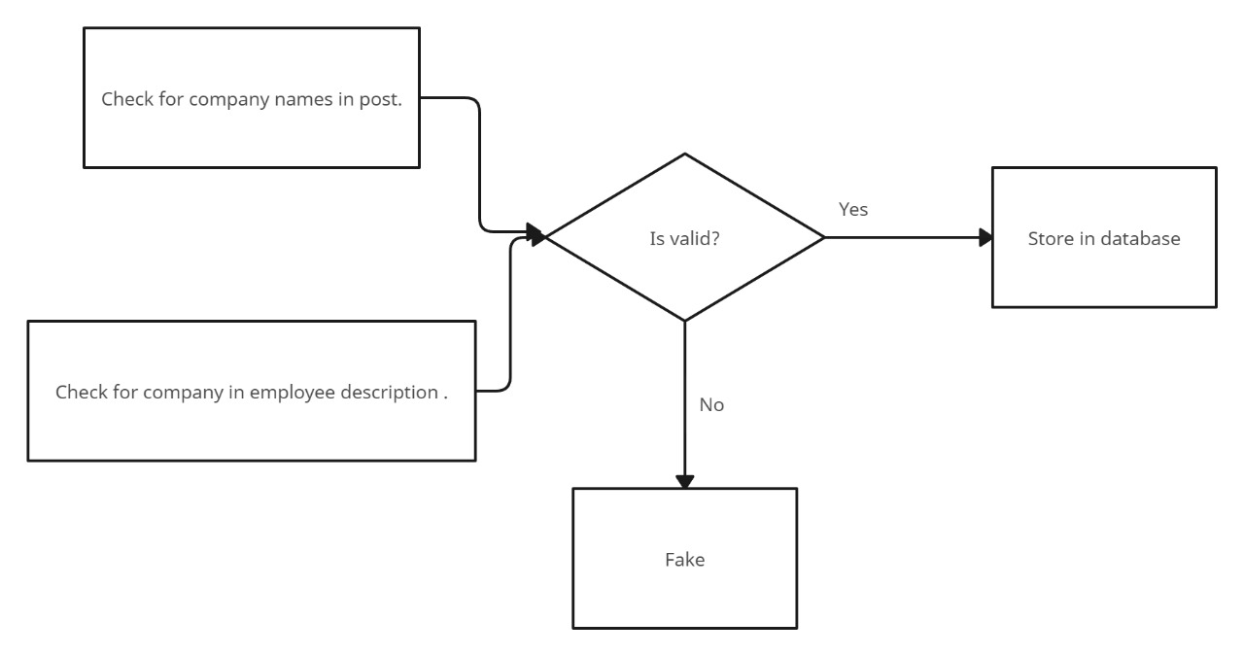

Slide 11
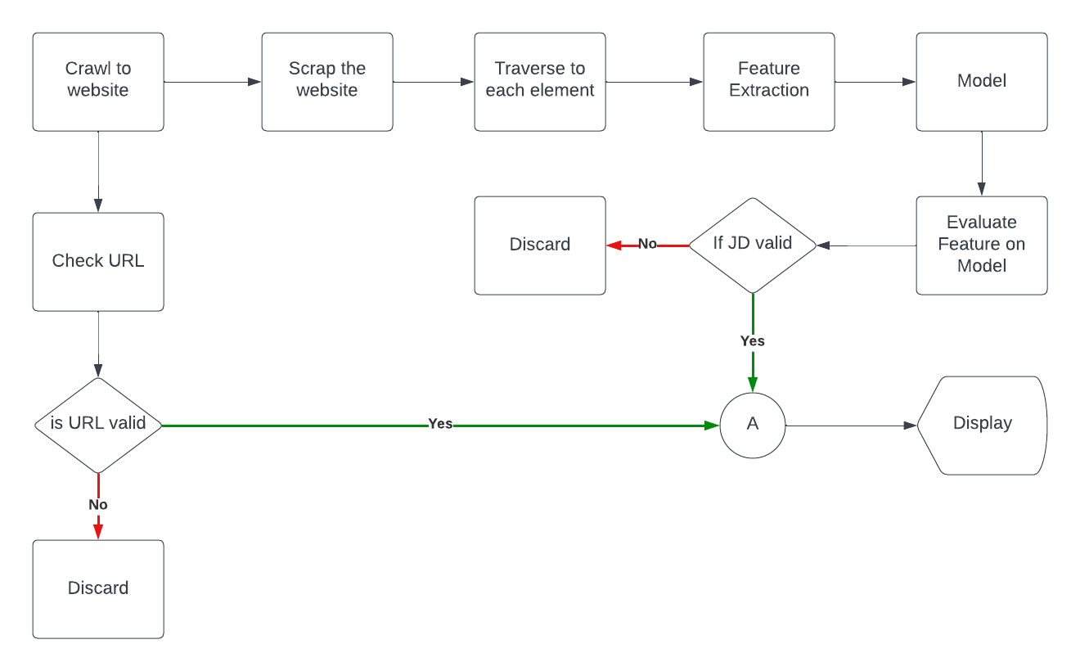

Slide 12
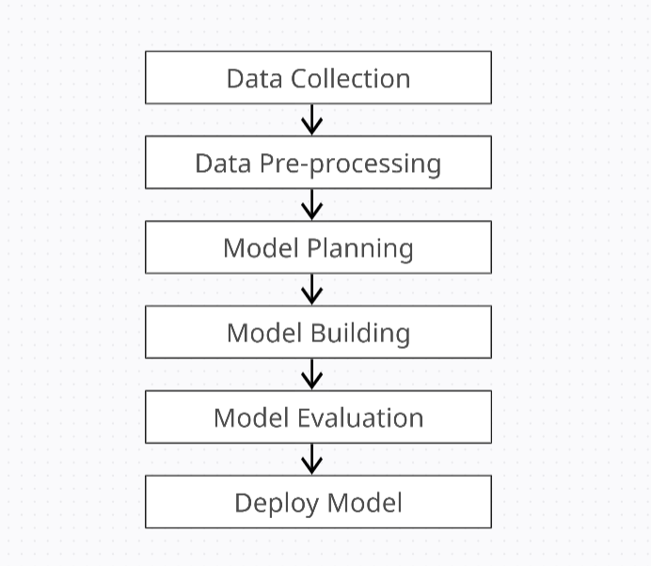

Slide 13
Conclusion
In this presentation we have seen the various aspects of Fake job detection.
Our main focus is to get an idea about how the latest technology can improve the current systems.
HTML Parsing will be used to scrap the web page and BFS(Breadth First Search) for Web Crawling.
Deep Learning models like CNN, DNN, LSTM will be used for detecting fraud jobs.

Slide 14
References
S. D. S. Sirisuriya, "Importance of Web Scraping as a Data Source for Machine Learning Algorithms - Review," 2023 IEEE 17th International Conference on Industrial and Information Systems (ICIIS), Peradeniya, Sri Lanka, 2023, pp. 134-139, doi: 10.1109/ICIIS58898.2023.10253502.
S. Mahbub, E. Pardede and A. S. M. Kayes, "Online Recruitment Fraud Detection: A Study on Contextual Features in Australian Job Industries," in IEEE Access, vol. 10, pp. 82776-82787, 2022, doi: 10.1109/ACCESS.2022.3197225.
Lotfi, Chaimaa & Srinivasan, Swetha & Ertz, Myriam & Latrous, Imen. (2021). Web Scraping Techniques and Applications: A Literature Review. 10.52458/978-93-91842-08-6-38.
Ravish, R. Katarya, D. Dahiya and S. Checker, "Fake News Detection System Using Featured-Based Optimized MSVM Classification," in IEEE Access, vol. 10, pp. 113184-113199, 2022, doi: 10.1109/ACCESS.2022.3216892.
D. Rohera et al., "A Taxonomy of Fake News Classification Techniques: Survey and Implementation Aspects," in IEEE Access, vol. 10, pp. 30367-30394, 2022, doi: 10.1109/ACCESS.2022.3159651.
M. Park and S. Chai, "Constructing a User-Centered Fake News Detection Model by Using Classification Algorithms in Machine Learning Techniques," in IEEE Access, vol. 11, pp. 71517-71527, 2023, doi: 10.1109/ACCESS.2023.3294613.
J. T. H. Kong, W. K. Wong, F. H. Juwono and C. Apriono, "Generating Fake News Detection Model Using A Two-Stage Evolutionary Approach," in IEEE Access, vol. 11, pp. 85067-85085, 2023, doi: 10.1109/ACCESS.2023.3303321.

