Slide 1
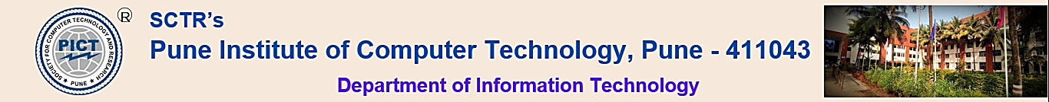
Project Review- Phase-I Automated and Secure Job Search System
Group Id: 28
Group Member:
43235: Kunal Kachare
43242: Akshay Koganur
43248: Avinash Maharnavar
43266: Mihir Rajpathak
Domain: Machine Learning
Guide :
Mrs. R. A. Karnavat
Reviewers:
Mrs. A. A. Patil
Mrs. D. P. Salapurkar

Slide 2
Introduction
In today’s job market to explore how various contextual factors influence the accuracy of automatically detecting online recruitment fraud, this study seeks to highlight the significance of tailoring such fraud detection methods to local contexts. To achieve these goals, the study initially creates a dataset using a local and semi-structured advertising platform. This dataset is then utilized to train a machine learning model, which considers a range of content-based and contextual features. The study’s findings indicate that the incorporation of contextual features enhances the performance of automated online recruitment fraud detection models. The practical implications of this research are twofold. First, the contextual feature generation engine can be applied to diverse data-sets with minimal localization efforts. Second, these machine learning models can be integrated into online job recruitment platforms to identify and prevent online recruitment fraud.

Slide 3
User and System Requirements
User Requirements
Job Search and Filtering
Intuitive User Interface
System Requirements
Data Cleaning and Verification
Scalability and Performance
User Support and Feedback Handling
Maintenance and Monitoring

Slide 4
Functional Requirements.
Classification
Automated web traversal
Robustness

Slide 5
Non-functional Requirements.
Capacity
Performance
Security

Slide 6
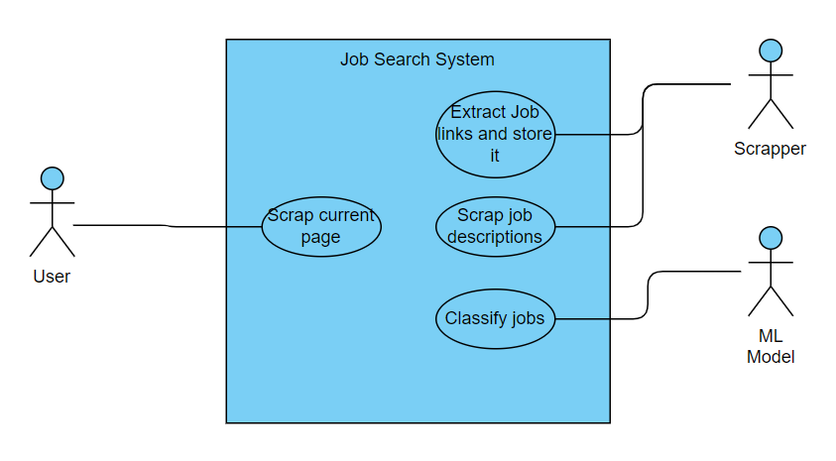
UML Diagram

Slide 7
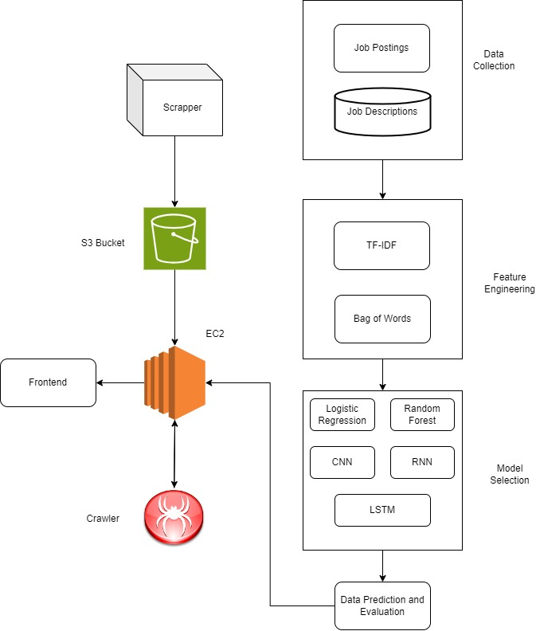
Architecture

Slide 8
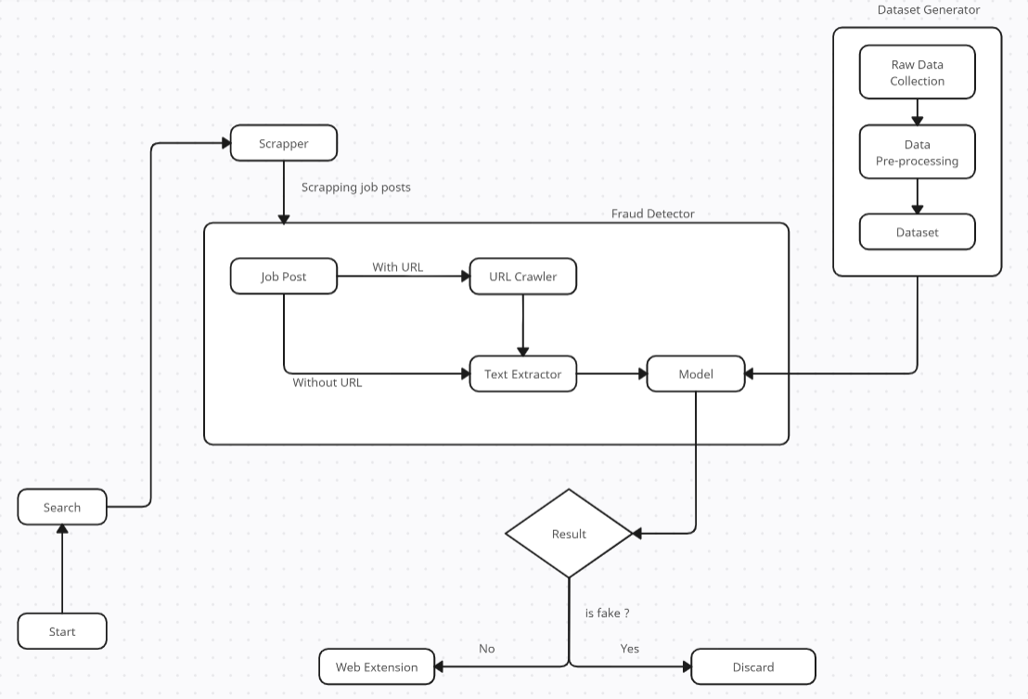
DFD

Slide 9
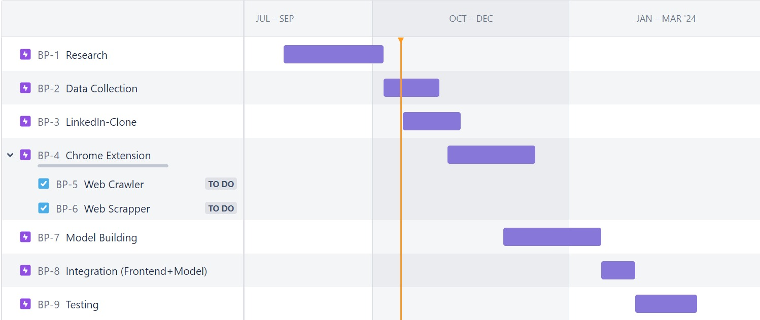
Project Plan

Slide 10
References
S. Mahbub, E. Pardede \& A. S. M. Kayes, "Online Recruitment Fraud Detection: A Study on Contextual Features in Australian Job Industries," in IEEE Access, vol. 10, pp. 82776-82787, 2022, doi: 10.1109/ACCESS.2022.3197225.
Lotfi, Chaimaa \& Srinivasan, Swetha \& Ertz, Myriam \& Latrous, Imen. (2021). Web Scraping Techniques and Applications: A Literature Review. 10.52458/978-93-91842-08-6-38.
S. D. S. Sirisuriya, "Importance of Web Scraping as a Data Source for Machine Learning Algorithms - Review," 2023 IEEE 17th International Conference on Industrial and Information Systems (ICIIS), Peradeniya, Sri Lanka, 2023, pp. 134-139, doi: 10.1109/ICIIS58898.2023.10253502.
Naudé, M., Adebayo, K.J. \& Nanda, R. A machine learning approach to detecting fraudulent job types. AI and Soc 38, 1013–1024 (2023). https://doi.org/10.1007/s00146-022-01469-0.
M. Park \& S. Chai, "Constructing a User-Centered Fake News Detection Model by Using Classification Algorithms in Machine Learning Techniques," in IEEE Access, vol. 11, pp. 71517-71527, 2023, doi: 10.1109/ACCESS.2023.3294613.
A. Altheneyan \& A. Alhadlaq, "Big Data ML-Based Fake News Detection Using Distributed Learning," in IEEE Access, vol. 11, pp. 29447-29463, 2023, doi: 10.1109/ACCESS.2023.3260763.
Ravish, R. Katarya, D. Dahiya \& S. Checker, "Fake News Detection System Using Featured-Based Optimized MSVM Classification," in IEEE Access, vol. 10, pp. 113184-113199, 2022, doi: 10.1109/ACCESS.2022.3216892.
B. -W. On, J. -Y. Jo, H. Shin, J. Gim, G. S. Choi and S. -M. Jung, "Efficient Sentiment-Aware Web Crawling Methods for Constructing Sentiment Dictionary," in IEEE Access, vol. 9, pp. 161208-161223, 2021, doi: 10.1109/ACCESS.2021.3129187.
J. Bergman \& O. B. Popov, "Exploring Dark Web Crawlers: A Systematic Literature Review of Dark Web Crawlers and Their Implementation," in IEEE Access, vol. 11, pp. 35914-35933, 2023, doi: 10.1109/ACCESS.2023.3255165.
B. -W. On, J. -Y. Jo, H. Shin, J. Gim, G. S. Choi and S. -M. Jung, "Efficient Sentiment-Aware Web Crawling Methods for Constructing Sentiment Dictionary," in IEEE Access, vol. 9, pp. 161208-161223, 2021, doi: 10.1109/ACCESS.2021.3129187.
L. Ying, H. Yu, J. Wang, Y. Ji and S. Qian, "Fake News Detection via Multi-Modal Topic Memory Network," in IEEE Access, vol. 9, pp. 132818-132829, 2021, doi: 10.1109/ACCESS.2021.3113981.
A. Mandadi, S. Boppana, V. Ravella \& R. Kavitha, "Phishing Website Detection Using Machine Learning," 2022 IEEE 7th International conference for Convergence in Technology (I2CT), Mumbai, India, 2022, pp. 1-4, doi: 10.1109/I2CT54291.2022.9824801.
J. T. H. Kong, W. K. Wong, F. H. Juwono \& C. Apriono, "Generating Fake News Detection Model Using A Two-Stage Evolutionary Approach," in IEEE Access, vol. 11, pp. 85067-85085, 2023, doi: 10.1109/ACCESS.2023.3303321.
Bandyopadhyay, Samir \& Dutta, Shawni. (2020). Fake Job Recruitment Detection Using Machine Learning Approach. International Journal of Engineering Trends and Technology. 68. 10.14445/22315381/IJETT-V68I4P209S.
W. Shahid, Y. Li, D. Staples, G. Amin, S. Hakak and A. Ghorbani, "Are You a Cyborg, Bot or Human?—A Survey on Detecting Fake News Spreaders," in IEEE Access, vol. 10, pp. 27069-27083, 2022, doi: 10.1109/ACCESS.2022.3157724.
M. Tajrian, A. Rahman, M. A. Kabir \& M. R. Islam, "A Review of Methodologies for Fake News Analysis," in IEEE Access, vol. 11, pp. 73879-73893, 2023, doi: 10.1109/ACCESS.2023.3294989.
Kumar N, Gupta M, Sharma D, Ofori I. Technical Job Recommendation System Using APIs and Web Crawling. Comput Intell Neurosci. 2022 Jun 21;2022:7797548. doi: 10.1155/2022/7797548. PMID: 35774438; PMCID: PMC9239795.
C. Prashanth, D. Chandrasekaran, B. Pandian, K. Duraipandian, T. Chen and M. Sathiyanarayanan, "Reveal: Online Fake Job Advert Detection Application using Machine Learning," 2022 IEEE Delhi Section Conference (DELCON), New Delhi, India, 2022, pp. 1-6, doi: 10.1109/DELCON54057.2022.9752784.
B. Pandey, T. Kala, N. Bhoj, H. Gohel, A. Kumar and P. Sivaram, "Effective Identification of Spam Jobs Postings Using Employer Defined Linguistic Feature," 2022 1st International Conference on AI in Cybersecurity (ICAIC), Victoria, TX, USA, 2022, pp. 1-6, doi: 10.1109/ICAIC53980.2022.9897059.
D. Rohera et al., "A Taxonomy of Fake News Classification Techniques: Survey and Implementation Aspects," in IEEE Access, vol. 10, pp. 30367-30394, 2022, doi: 10.1109/ACCESS.2022.3159651.

Slide 11
Thank you!!!!!!

