Slide 1
Blockchain Based Carbon Credit Trading System
Digital Assignment 1 (DA1) | Blockchain Technology
SDG 13, Climate Action | also supports SDG 7 and SDG 12
Avi Dhandhania (25BCE1207) Shivesh Kumar (25BCE1067)

Slide 2
Agenda
• The problem, our objectives and scope
• What already exists, and the gaps we found
• Why a blockchain, and why Ethereum
• Architecture, workflow and design
• What is new in our design: verifiers put money at risk
• Plan, feasibility and risks

Slide 3
1. The Problem
A market built to cut emissions is letting companies claim cuts that never happened
• One credit = permission to release one tonne of CO2. Companies that pollute less sell what they did not use.
• The same credit gets counted twice, because registries are separate databases that never reconcile.
• A buyer cannot check what it bought. It has to trust a PDF.
• Phantom credits: credits issued for projects that never happened, found out years later if at all.
• Checking is slow and expensive, and the fees eat money meant for climate projects.

Slide 4
1. Objectives and Scope
SDG 13 Climate Action, also supporting SDG 7 and SDG 12
• O1. One credit becomes one token that cannot be copied.
• O2. Mint, sell and retire handled in contract code, so double counting is blocked by the rules.
• O3. A full history anyone can read and nobody can edit.
• O4. Fewer middlemen, so verification is faster and cheaper.
• O5. Separate on chain roles for developer, verifier, buyer and regulator.
• O6. Verifiers lock money before approving, and lose it if the project turns out to be fake.
• Scope of DA1: design only. No registry integration, no real money, no ML impact estimates.

Slide 5
2. What Already Exists
• Toucan Protocol: moved real credits on chain, but everything rests on trusting the bridge.
• KlimaDAO: uses credits as a treasury asset. The goal is financial, not honest accounting.
• IBM and Energy Web: permissioned tracking, so the public cannot read the ledger.
• Verra and Gold Standard: good measurement methods, central databases that do not reconcile.
• Academic surveys 2019 to 2023: mostly concept level, rarely the full lifecycle in one design.

Slide 6
2. The Gaps We Found
What the literature leaves unsolved
• G1. The lifecycle is handled in pieces, so "cannot sell after retirement" is a policy, not code.
• G2. Evidence is loosely attached. A bridged token tells you little about where it came from.
• G3. Public chains give transparency but rarely strict on chain roles.
• G4. Nothing happens to a verifier who approves a fake project. The chain records the lie perfectly, forever, and buyers get nothing back.
• G4 is the one we go after. Everything else assumes the data entering the chain is honest.

Slide 7
3. Why Blockchain, and Why Ethereum
Public Ethereum, not permissioned Hyperledger Fabric
• The test: parties who do not trust each other, no single owner, records that cannot be edited, middlemen worth removing. Carbon trading is yes to all four.
• One registry with one owner and one database is what the market has now, and that is what failed.
• Regulators, journalists and the public need to check the records, which rules out a permissioned ledger.
• ERC-20 and ERC-721 already match "one credit = one token that cannot be duplicated".
• Mature tooling (Solidity, OpenZeppelin, Hardhat, MetaMask, free testnets) means safer, faster building.
• Layer 2 (Polygon, Arbitrum) drops gas to cents, so cost is no longer a real objection.

Slide 8
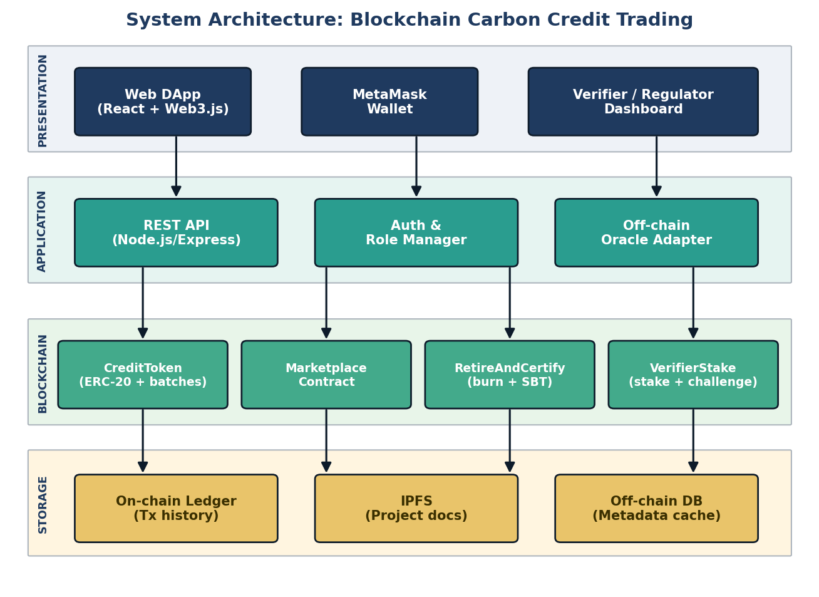
4. System Architecture

Slide 9
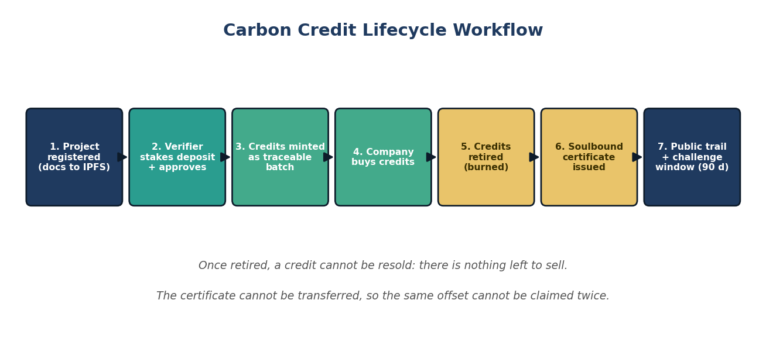
4. The Life of a Credit

Slide 10
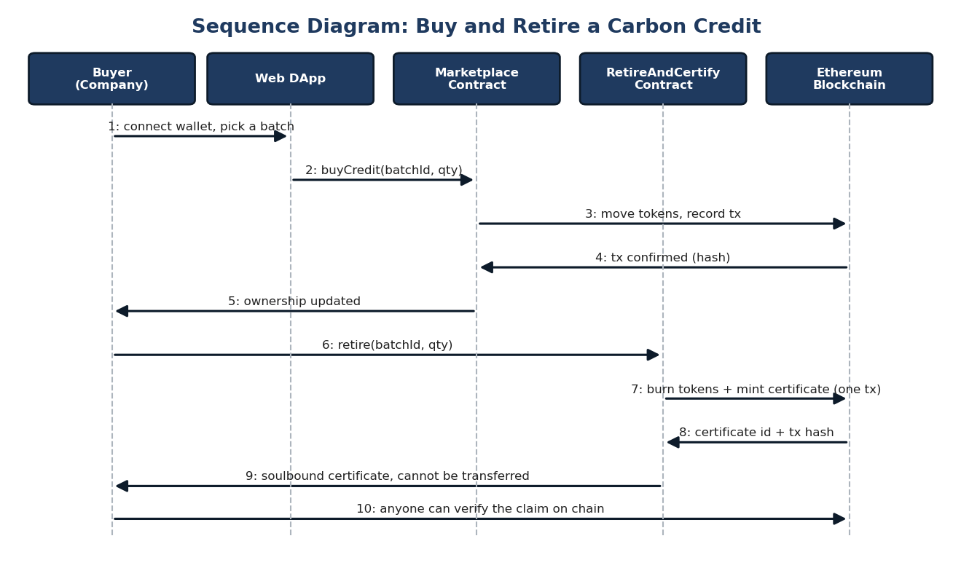
4. Sequence: Buy and Retire

Slide 11
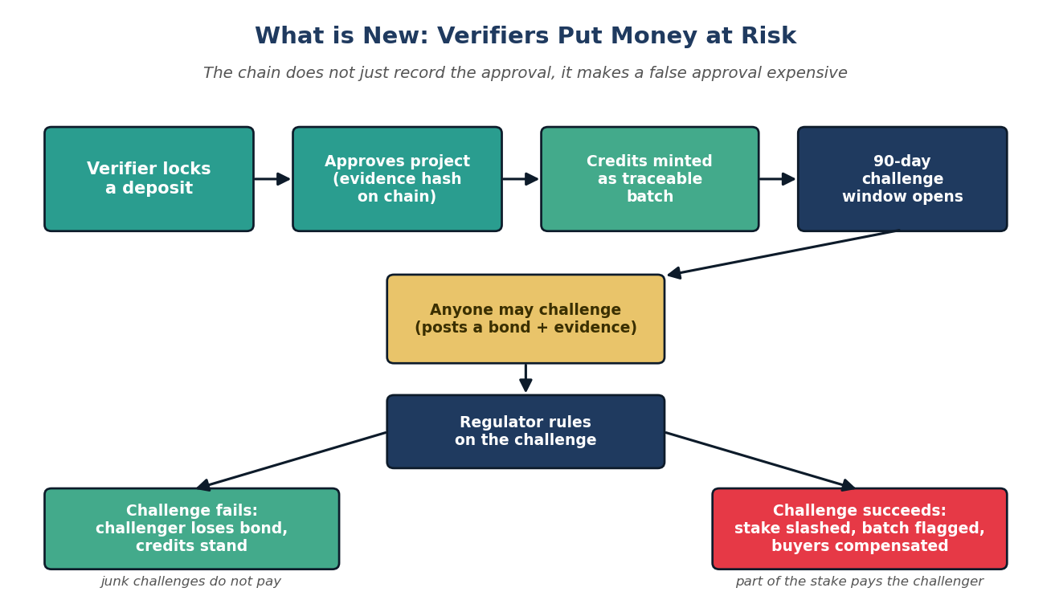
4. What is New: Verifiers Stake Money

Slide 12
4. What is New, in Three Parts
Closing G4: the gap every other design leaves open
• Verifiers put money at risk. A deposit is locked before approval and stays locked for a 90 day challenge window. Anyone can challenge with a bond and evidence. If the challenge wins, the stake is slashed: part to the challenger, part to a pool for the buyers.
• Every credit can be traced and flagged. A batch stores its project, its verifier and the evidence hash, so a fake project's credits can be named and marked instead of quietly poisoning a shared pool.
• The retirement certificate cannot be traded. Burning credits mints a soulbound ERC-721 to the buyer, so an offset claim has a public owner and cannot be resold as proof to a second company.
• The point: the chain stops being only a filing cabinet that records whatever it is told, including lies. Approving a fake project stops being free.

Slide 13
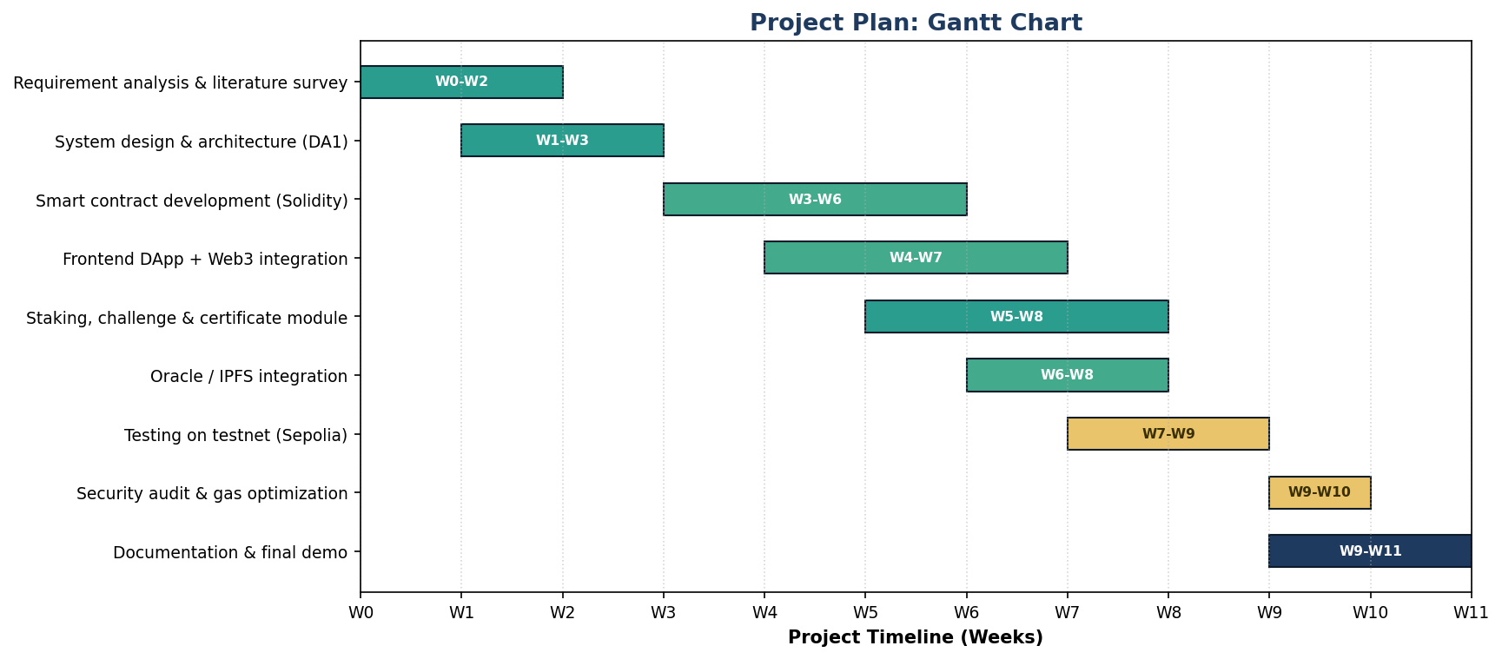
5. Project Plan

Slide 14
5. Feasibility and Risks
• Technical: high. Every piece is open source and proven. Slashing escrow is a known pattern we can copy.
• Economic: high. Testnets and tooling are free, and Layer 2 keeps production gas at cents per transaction.
• Operational: medium. Needs verifiers willing to post a deposit and a regulator to rule on challenges. People problems, not code problems.
• Schedule: high. Eleven weeks fits one semester, with overlap for slippage.
• Honest limits: a verifier may still profit more than the stake, and a regulator role judging challenges is one trusted point in a trustless design.

Slide 15
Thank You
Make the record honest, and make a false record expensive.

