Slide 1
Warehouse and Supply Chain Management System
Digital Assignment 1, Database Management Systems
ER / EER Model and Normalization up to BCNF
Safwaan Mohamed S (25BCE1188) | Avi Dhandhania (25BCE1207) | Priyal Bhalla (25BCE1261)

Slide 2
Agenda
• The problem, objectives and scope
• Entities, attributes and relationships
• The ER model
• The EER model: specialization, generalization and aggregation
• Turning the model into tables
• Sample data and the functional dependencies it reveals
• Normalization: UNF to 1NF to 2NF to 3NF to BCNF
• The decomposition end to end, the final schema, and what comes next

Slide 3
1. The Problem
the trouble is not missing data, it is the same data stored more than once
• A warehouse must always know: what stock is where, who supplies it, and where each order has reached.
• In practice those three answers live in three separate places, and nothing keeps them in agreement.
• So the same fact gets stored twice: a customer's address on every order, a product's name on every order line.
• Correct one copy, miss another, and the data contradicts itself.

Slide 4
1. What That Duplication Costs
• Insert problem: a new customer cannot be recorded until they place an order.
• Delete problem: deleting a customer's last order erases the customer.
• Update problem: renaming a product means editing many rows, and missing one leaves two answers.
• Unreliable stock: the quantity on hand is kept in more than one place.
• These are the insert, delete and update anomalies. Normalization removes them.

Slide 5
1. Objectives and Scope
• Identify the entities, attributes and relationships.
• Draw the ER model, then extend the same model into an EER model.
• Convert the model into relational tables.
• Work out the functional dependencies from sample rows.
• Normalize every table from UNF up to BCNF, showing each step.
• In scope: 9 entities, namely warehouse, product, supplier, customer, orders, shipment, return, inspection and employee.
• Out of scope: SQL and PL/SQL (DA2), and a modern database (DA3).

Slide 6
2. The Nine Entities
the key attribute identifies one row, and is underlined in every diagram
Entity | Key attribute | Other attributes
WAREHOUSE | WarehouseID | WName, City, Capacity
PRODUCT | ProductID | PName, Category, UnitPrice
SUPPLIER | SupplierID | SName, City, Phone (many per supplier)
CUSTOMER | CustomerID | CName, Address (Street + City), Phone
ORDERS | OrderID | OrderDate, Status, TotalAmt (calculated)
SHIPMENT | ShipmentID | DispatchDate, DeliveryDate, Status
GOODS_RETURN | ReturnID | ReturnDate, Reason, RefundAmt, Status
INSPECTION | InspID | InspDate, Result
EMPLOYEE | EmpID | EName, Role, Salary

Slide 7
3. The Twelve Relationships
1:1 means one row on each side, 1:N one to many, M:N many on both sides
Relationship | Between | Type
SUPPLIES | SUPPLIER - PRODUCT | M:N
STORED_IN | PRODUCT - WAREHOUSE | M:N
CONTAINS | PRODUCT - ORDERS | M:N
WORKS_AT | WAREHOUSE - EMPLOYEE | 1:N
PLACES | CUSTOMER - ORDERS | 1:N
SHIPPED_BY | ORDERS - SHIPMENT | 1:N
DISPATCHED_FROM | WAREHOUSE - SHIPMENT | 1:N
MANAGES | EMPLOYEE - WAREHOUSE | 1:1
RETURNED_FOR | ORDERS - GOODS_RETURN | 1:N
RETURNED_TO | WAREHOUSE - GOODS_RETURN | 1:N
CHECKS_SUPPLIER | INSPECTION - SUPPLIER | N:1
CHECKS_PRODUCT | INSPECTION - PRODUCT | N:1

Slide 8
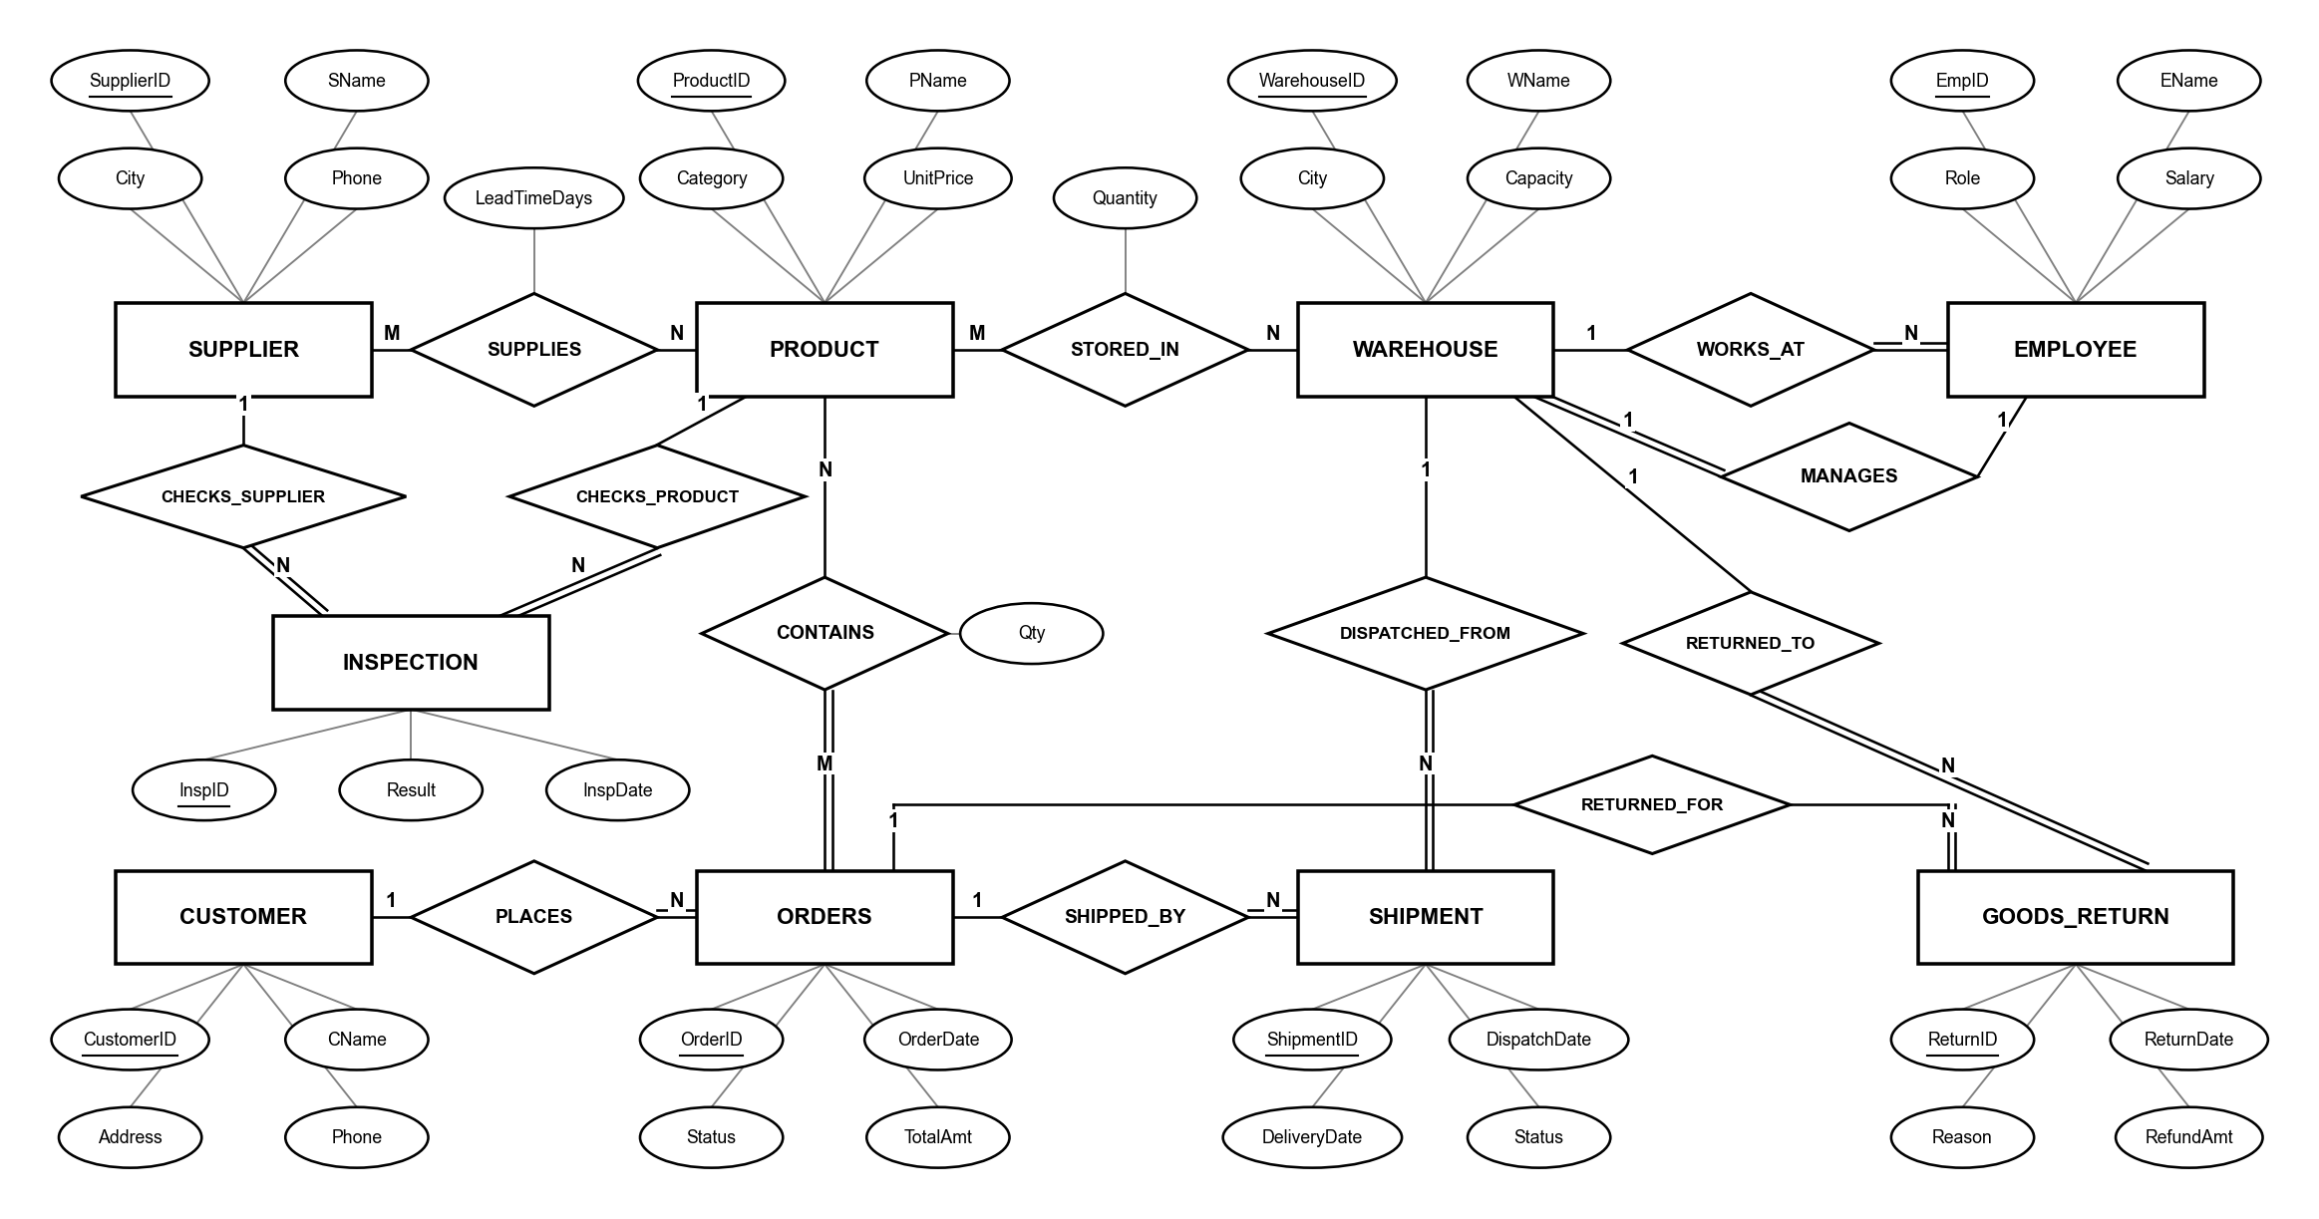
4. The ER Model
MANAGES is the one 1:1 relationship; INSPECTION needs two links because plain ER cannot point at a pair

Slide 9
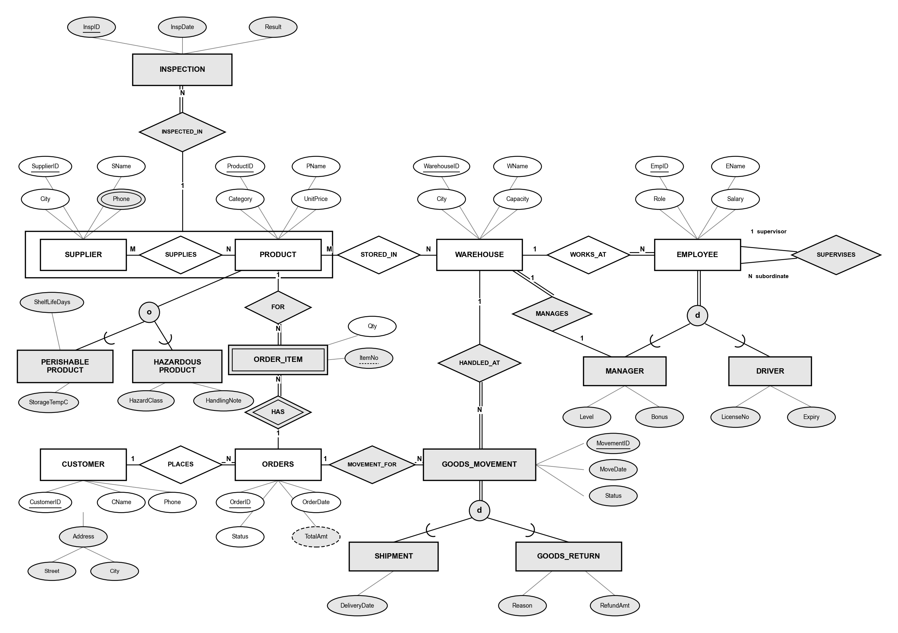
5. The EER Model, the Same Design Extended

Slide 10
5. Specialization and Generalization
the difference is the direction, not the drawing
• Specialization works downwards, from a type we already had to its kinds.
- EMPLOYEE existed; splitting it gives MANAGER (Level, Bonus) and DRIVER (LicenseNo, Expiry). Total and disjoint.
- PRODUCT existed; PERISHABLE_PRODUCT and HAZARDOUS_PRODUCT are partial (most products are neither) and overlapping (a vaccine is both), so that circle is marked o and not d.
• Generalization works upwards, from types we already had to what they share.
- SHIPMENT and GOODS_RETURN were both in the ER model. Both are one order's goods moving on a date with a status, so GOODS_MOVEMENT is created above them.
- Their two links to ORDERS and WAREHOUSE become one each, and ShipmentID and ReturnID collapse into MovementID.
• Same shape on paper, same mapping to tables, opposite directions of reasoning.

Slide 11
5. Aggregation
a relationship treated as one higher-level object
• An inspection is of one supplier's supply of one product.
• Not of the supplier, and not of the product, which is why the ER model needed two separate links and still could not say it.
• So the whole SUPPLIER, SUPPLIES, PRODUCT arrangement is boxed and treated as one object, and INSPECTION joins the box. It is the rectangle at the top left of the EER model.
• In tables: the aggregate is the SUPPLIES table, and INSPECTION carries SupplierID with ProductID as a single foreign key into it.
• An inspection therefore cannot name a pair that is not actually supplied.

Slide 12
5. What EER Added, and Why
each addition describes something plain ER cannot
EER feature | Where
Weak entity | ORDER_ITEM
Specialization (total, disjoint) | EMPLOYEE to MANAGER, DRIVER
Specialization (partial, overlapping) | PRODUCT to PERISHABLE_PRODUCT, HAZARDOUS_PRODUCT
Multivalued attribute | SUPPLIER.Phone
Composite attribute | CUSTOMER.Address
Derived attribute | ORDERS.TotalAmt
Recursive relationship | EMPLOYEE SUPERVISES EMPLOYEE
Generalization (total, disjoint) | SHIPMENT + GOODS_RETURN to GOODS_MOVEMENT
Aggregation | SUPPLIER SUPPLIES PRODUCT, then INSPECTED_IN
1:1 relationship made precise | WAREHOUSE MANAGES to MANAGER

Slide 13
5. The Weak Entity
why ORDER_ITEM is drawn differently from every other box
• ORDER_ITEM cannot exist on its own, an order line means nothing without its order.
• ItemNo (1, 2, 3 and so on) is only unique inside one order, so it is a partial key, shown with a dashed underline.
• Its real key is therefore OrderID + ItemNo.
• Drawn with a double border, and the diamond joining it to ORDERS is a double diamond, meaning that relationship gives it its identity.
• It replaces the M:N CONTAINS relationship from the ER model.

Slide 14
6. Turning the Model into Tables
the standard mapping rules
• Each entity becomes one table, and its key attribute becomes the primary key.
• Each 1:N relationship becomes a foreign key stored on the 'many' side.
• Each M:N relationship becomes a new table whose primary key is the two keys put together.
• Each multivalued attribute becomes its own small table.
• Each composite attribute becomes one column per part.
• A derived attribute is not stored at all, it is calculated when needed.
• A weak entity becomes a table keyed by its owner's key plus its own partial key.
• A specialization becomes one table per subclass, each sharing the superclass's key.
• A generalization is mapped the same way: one table for the superclass and one for each subclass, each subclass keyed by the superclass's key.
• Each 1:1 relationship becomes a foreign key on the side where taking part is compulsory, with a UNIQUE constraint so that one row cannot be claimed twice.
• An aggregation becomes a foreign key pointing at the primary key of the table the aggregated relationship produced.

Slide 15
7. Why Sample Data Comes First
the dependencies drive every split that follows
• A functional dependency X -> Y means: if you know X, then Y is fixed.
- Example, CustID -> CName: once the customer ID is known, the name is decided.
• Each normal form is a rule about which dependencies a table may contain, so the dependencies have to be settled before any splitting starts.
• Data cannot prove a dependency, but two rows can kill one: agree on X, disagree on Y, and X -> Y is gone.
• So every relation gets at least five rows, and every candidate dependency is checked against them.

Slide 16
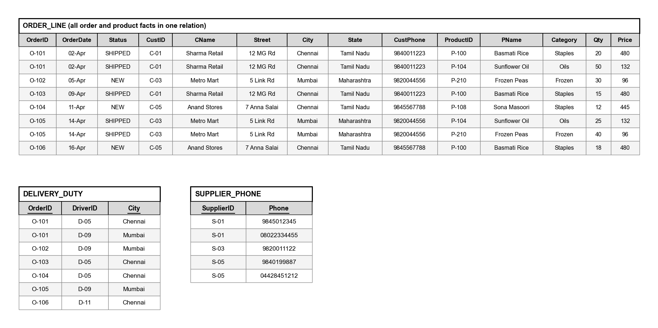
7. The Sample Rows
ORDER_LINE rows are numbered 1 to 8 from the top, and joining the normalized tables gives them back exactly

Slide 17
7. Dependencies That Hold
each one survives every sample row
Ref | Dependency | Read off
F1 | OrderID -> OrderDate, Status, CustID | O-101 in rows 1 and 2, O-105 in rows 6 and 7
F2 | CustID -> CName, Street, City, CustPhone | C-01 in rows 1, 2, 4; C-03 in rows 3, 6, 7; C-05 in rows 5, 8
F3 | City -> State | Chennai is always Tamil Nadu, Mumbai always Maharashtra
F4 | ProductID -> PName, Category, Price | P-100 is 480 twice, P-104 is 132 twice, P-210 is 96 twice
F5 | {OrderID, ProductID} -> Qty | the pair is unique, and neither half works alone
F6 | DriverID -> City | D-05 is always Chennai, D-09 always Mumbai
F7 | {OrderID, City} -> DriverID | no two rows share an OrderID and a City
F8 | Phone -> SupplierID | each number belongs to one supplier

Slide 18
7. Dependencies the Data Rules Out
two rows that agree on the left and disagree on the right
Ref | Rejected | Counterexample
N1 | ProductID -> Qty | Rows 1 and 4: P-100 is ordered 20 times on O-101 and 15 times on O-103.
N2 | OrderID -> ProductID | Rows 1 and 2: O-101 holds both P-100 and P-104.
N3 | City -> CustID | Rows 1 and 5: Chennai holds C-01 and also C-05.
N4 | Category -> ProductID | Rows 1 and 5: Staples covers P-100 and also P-108.
N5 | CName -> OrderID | Rows 1 and 4: Sharma Retail placed O-101 and also O-103.
N6 | City -> DriverID | DELIVERY_DUTY rows 1 and 7: Chennai is covered by D-05 and by D-11.
N7 | OrderID -> DriverID | DELIVERY_DUTY rows 1 and 2: O-101 is served by D-05 and by D-09.
N8 | SupplierID -> Phone | SUPPLIER_PHONE rows 1 and 2: S-01 has two numbers.

Slide 19
7. Candidate Keys
• ORDER_LINE: start from {OrderID, ProductID} and close it.
- F1 adds OrderDate, Status, CustID. F2 adds CName, Street, City, CustPhone. F3 adds State. F4 adds PName, Category, Price. F5 adds Qty.
- All fourteen columns are reached, and neither half works alone (N1, N2), so it is the only candidate key.
• DELIVERY_DUTY: two candidate keys, {OrderID, City} by F7 and {OrderID, DriverID} by F6.
- That second key is exactly why it passes 3NF and still fails BCNF.
• SUPPLIER_PHONE: {SupplierID, Phone}, and Phone alone by F8.

Slide 20
8. The Four Rules
start with one bad table, then split it one rule at a time
• 1NF: every cell holds one value, and repeating groups move out.
• 2NF: no column depends on only part of the key.
• 3NF: no ordinary column decides another ordinary column.
• BCNF: the left side of every dependency must be a key.
• Each step below names the dependency from section 7 that forces the split.

Slide 21
8. Where we start, Unnormalized Form (UNF)
• One wide table, the way a clerk keeps it in a spreadsheet.
• Three cells hold lists: SupplierPhones, Items and Delivery.
• Customer details are copied onto every order row.
• No atomic key, so no dependency can even be written down yet.

Slide 22
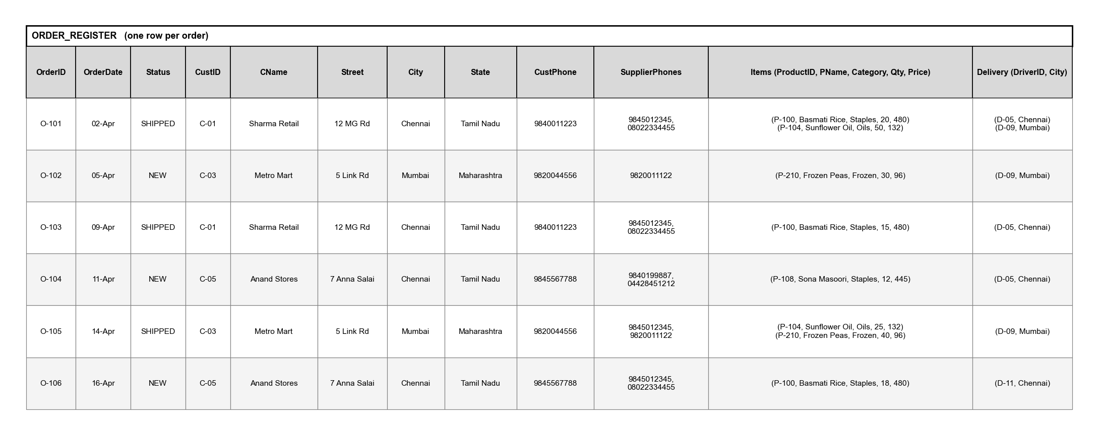
8. The Tables after UNF

Slide 23
8. First Normal Form (1NF)
• Rule: one value per cell, and repeating groups move out.
• Items become ORDER_ITEM, phones become SUPPLIER_PHONE, deliveries become DELIVERY_DUTY.
• ORDER_ITEM is keyed by OrderID + ProductID, because N1 and N2 rule out either column alone.
• DELIVERY_DUTY is keyed by OrderID + City, from F7.
• Still wrong: F4 means PName and Category repeat on every line for the same product.

Slide 24
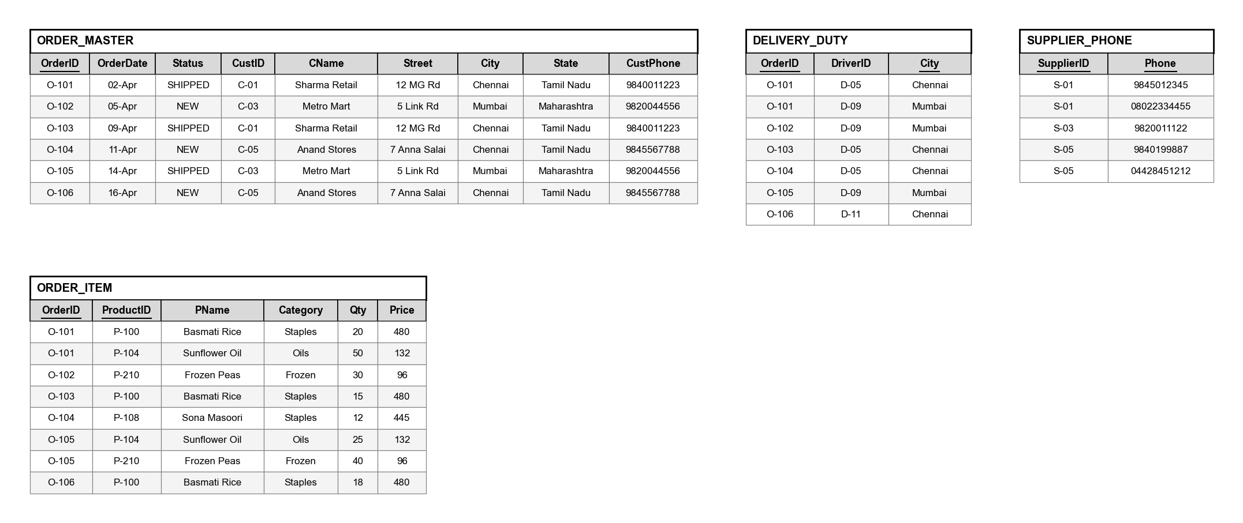
8. The Tables after 1NF

Slide 25
8. Second Normal Form (2NF)
• Rule: no column may depend on only part of the key.
• ORDER_ITEM is keyed by {OrderID, ProductID}, but F4 fixes PName, Category and Price from ProductID alone.
• Those three move to PRODUCT, where Price becomes UnitPrice.
• Only Qty depends on the whole key (F5), so only Qty stays behind.
• Still wrong: F2 and F3 in ORDER_MASTER both start from a non-key column.

Slide 26
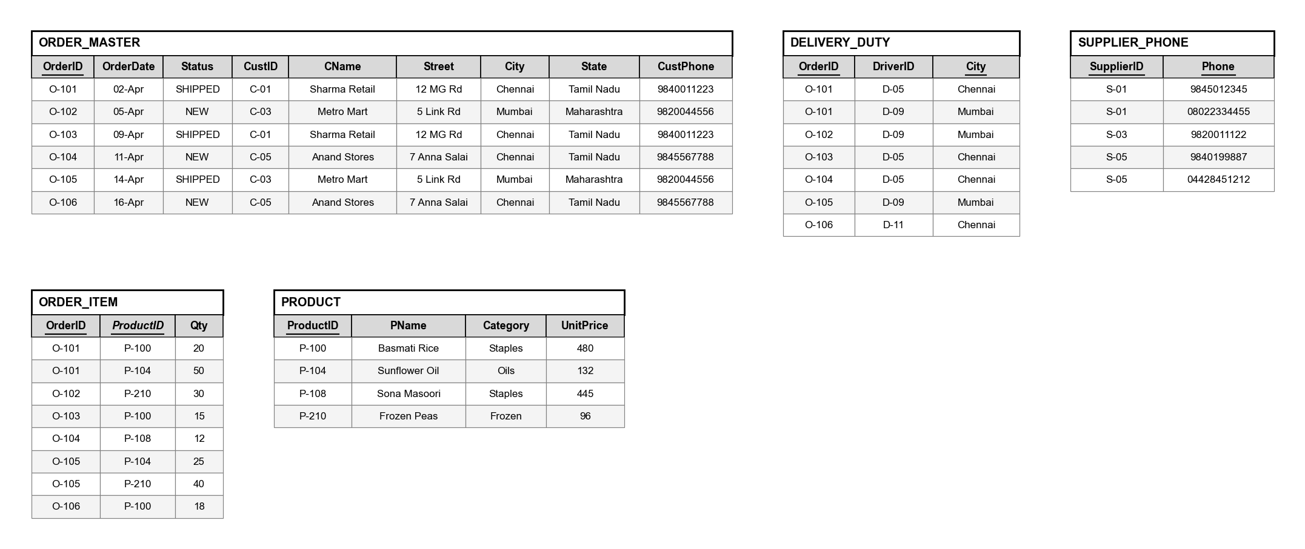
8. The Tables after 2NF

Slide 27
8. Third Normal Form (3NF)
• Rule: no ordinary column may decide another ordinary column.
• F2 (CustID -> CName, Street, City) becomes CUSTOMER.
• F3 (City -> State) becomes CITY.
• What is left of ORDER_MASTER becomes ORDERS, keeping CustID as a foreign key.
• Still wrong: DELIVERY_DUTY passes 3NF only because every column of it belongs to some key.

Slide 28
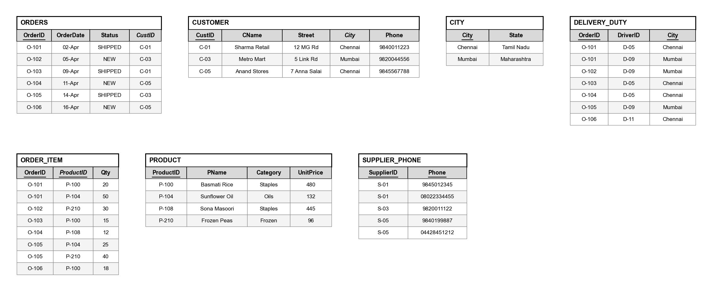
8. The Tables after 3NF

Slide 29
8. Boyce-Codd Normal Form (BCNF)
• Rule: the left side of every dependency must be a key.
• DELIVERY_DUTY has two candidate keys, {OrderID, City} and {OrderID, DriverID}, so F7 is fine.
• F6 (DriverID -> City) is not, because DriverID is not a key on its own.
• 'D-09 covers Mumbai' therefore sits on three rows, and two of them can be made to disagree.
• Splitting on F6 gives DRIVER_CITY and ORDER_DRIVER, and the join on DriverID returns the original rows.
• Every table is now in BCNF.

Slide 30
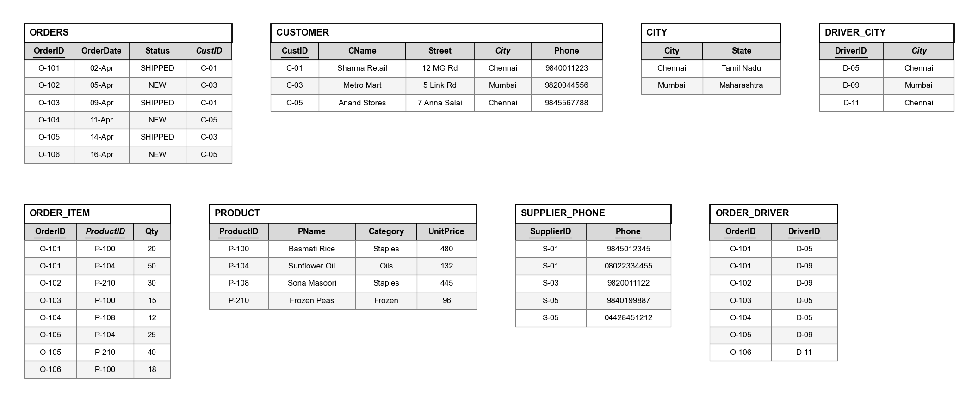
8. The Tables after BCNF

Slide 31
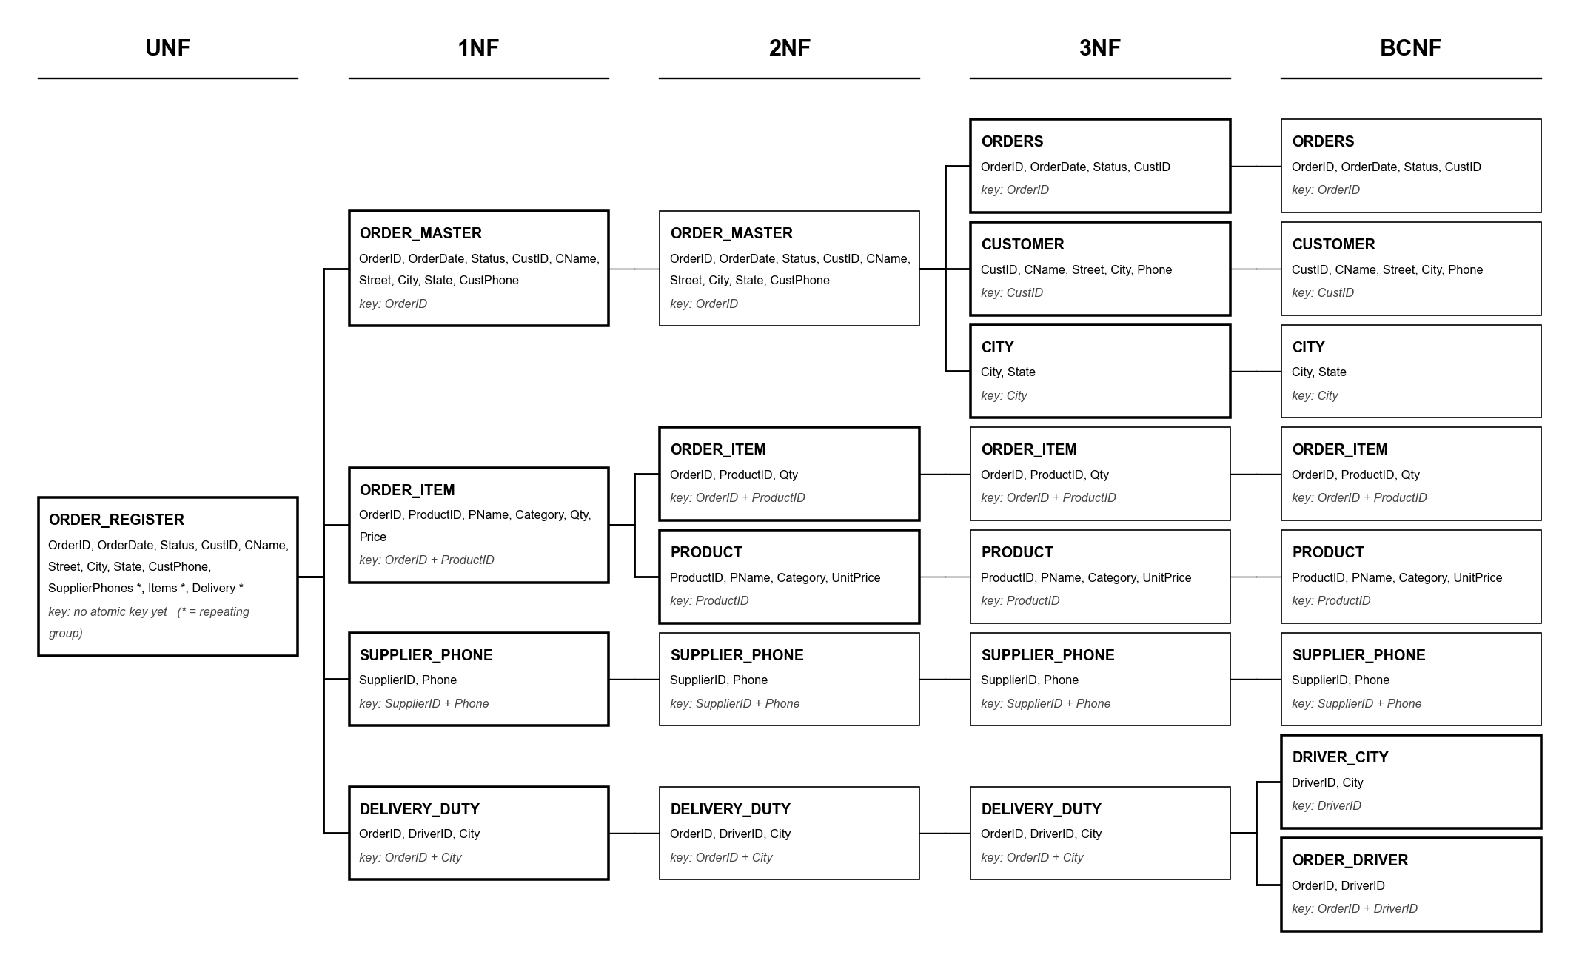
9. The Decomposition, End to End
every relation, every column, at every stage

Slide 32
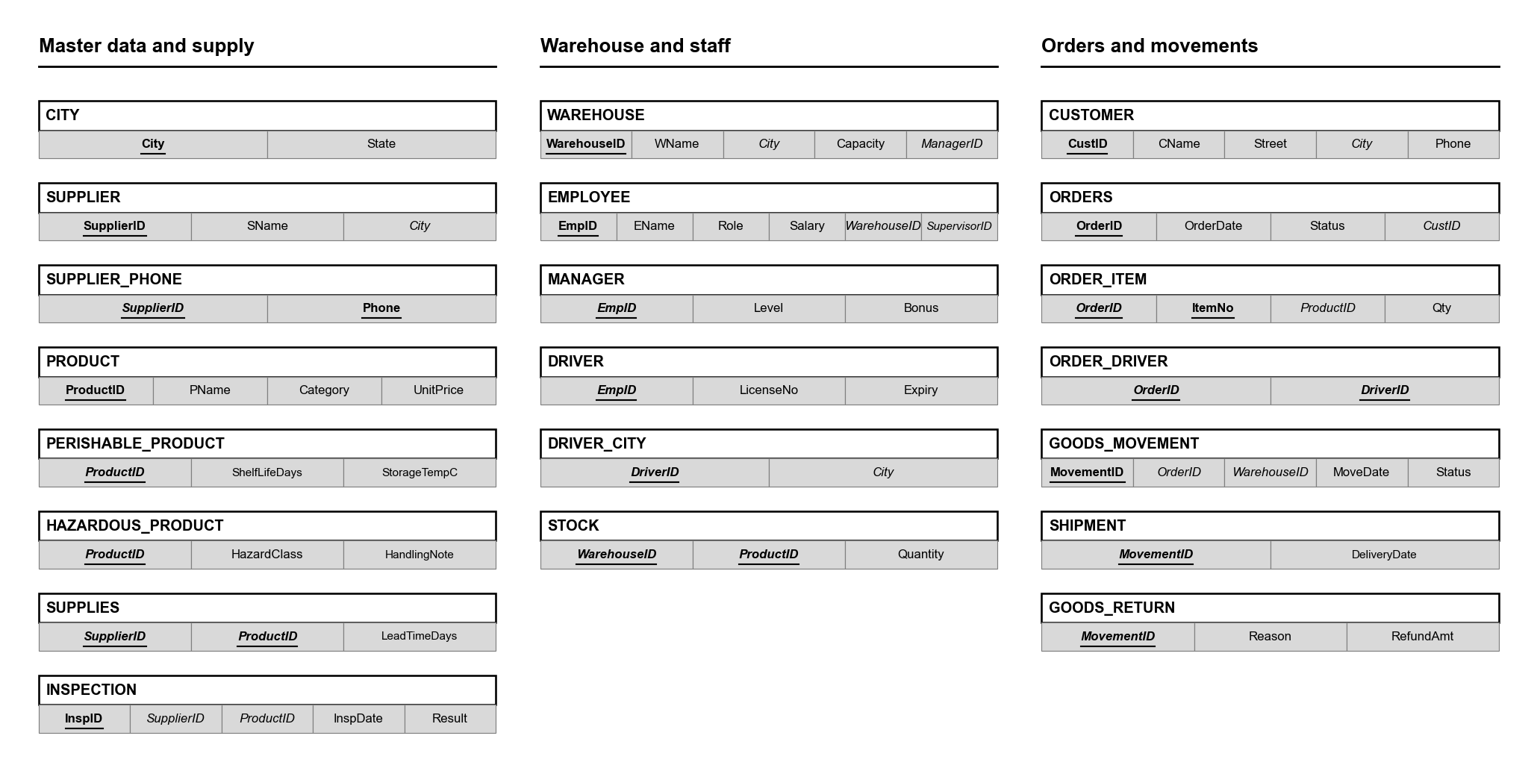
10. Final Schema, 21 Tables, All in BCNF

Slide 33
10. Why the Design Is Now Safe
• Every fact is stored in exactly one place, so two rows can never disagree.
• Correcting a product name, an address or a city's state is a single-row edit.
• A supplier, product or customer can exist before appearing on any order.
• Deleting an order cannot wipe out the customer who placed it.
• TotalAmt is calculated, not stored, so it can never fall out of step.
• A movement is recorded once whether it is a shipment or a return.
• WAREHOUSE has two candidate keys now, WarehouseID and ManagerID, because MANAGES is 1:1. Both are keys, so it is still in BCNF.
• One trade-off: F7, {OrderID, City} -> DriverID, now needs a trigger, which DA2 will add.

Slide 34
11. What Comes Next
• DA2, due 18 September 2026
- Create the 21 tables in SQL with keys and constraints, load sample data, add the BCNF trigger, and write PL/SQL for receiving stock and dispatching orders.
• DA3, due 23 October 2026
- Rebuild on a graph database (Neo4j). Tracing a delivery back through shipment, order, warehouse and supplier is a chain of hops, one line in a graph query but a fresh join for every step in SQL.

Slide 35
Thank You
9 entities, 12 relationships, 21 tables, all in BCNF
Safwaan Mohamed S (25BCE1188) | Avi Dhandhania (25BCE1207) | Priyal Bhalla (25BCE1261)

