Slide 1
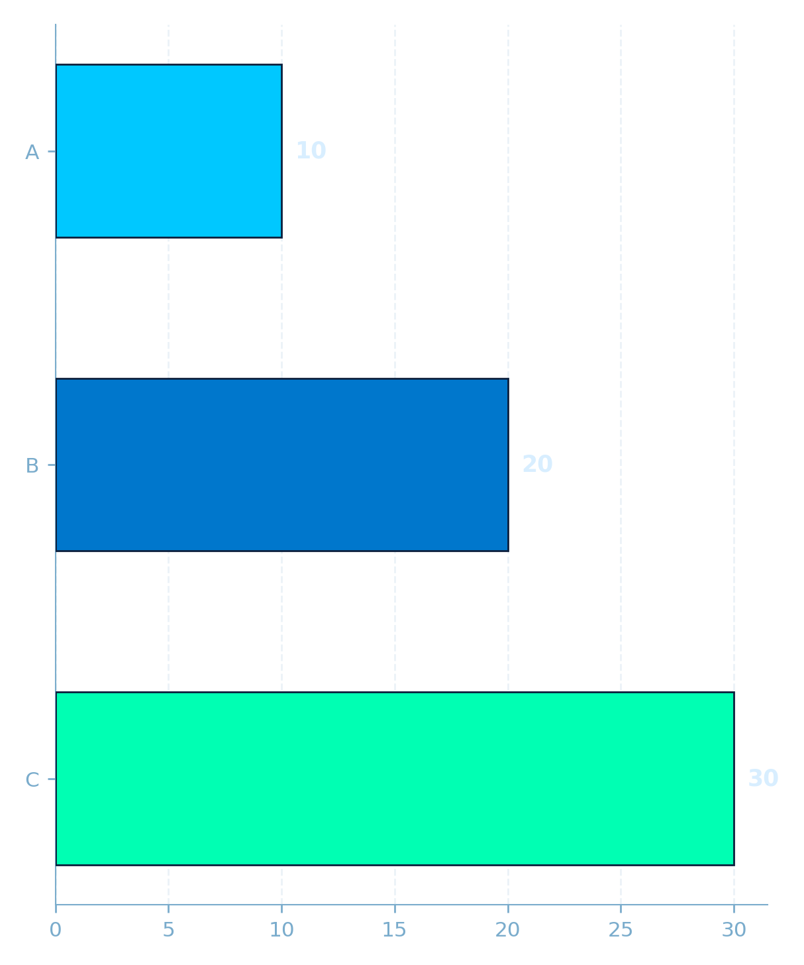
TEST SLIDE
TEST
1
This is a test.
01 / 03

Slide 2
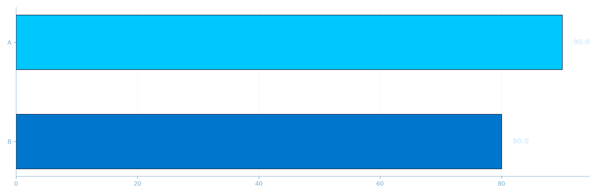
METRICS SLIDE
90%
80%
A
B
02 / 03

Slide 3
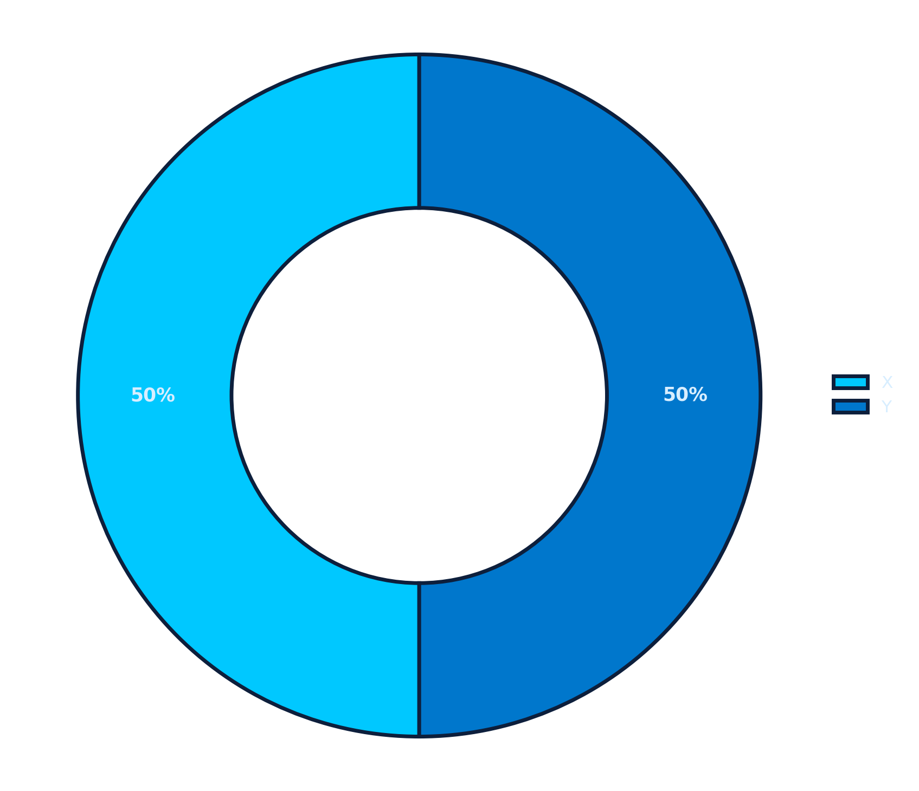
NO TITLE TEST SLIDE
1
Test
Test
03 / 03

