Slide 1

How Average Income affects Life Expectancy
By: Avinash Haritsa

Slide 2
Project Intro
This project aimed to analyze the relationship between average income and life expectancy across the world
My goal was to create meaningful conclusions about the relationship between the two variables through collecting, cleaning, and making insights/visualizations on the data.
The spark of interest arises from my past traveling experiences seeing how different levels of income across the world may or may not have an affect on how long people live

Slide 3
Data Collection Process
My goal was to find databases comprised of data relating to two major categories, life expectancy and average income.
I wanted to find a large database that consisted of the whole world data so we looked at The World Bank, eCharts and Wikipedia.
The data collected would be cleaned and compared to each other.
To ensure all data was accurate I compared the data between two sources of the same topic and created an average to get rid of any discrepancies.
Sources
https://data.worldbank.org/indicator/NY.ADJ.NNTY.PC.CD
https://en.wikipedia.org/wiki/List_of_countries_by_average_wage
https://echarts.apache.org/examples/data/asset/data/life-expectancy-table.json
https://en.wikipedia.org/wiki/List_of_countries_by_past_life_expectancy

Slide 4
Data Cleaning Process
I cleaned the data by sizing it down and focusing on the parts that we needed, removing inconsistencies and creating averages.
The modules I used to clean the data include : csv, requests, pandas, Beautiful Soup, and pprint.
In the data visualization process I also used different modules. These modules include: plotly, statsmodels.api, statsmodels.formula.api, and statsmodels.graphics.regressionplots.

Slide 5


Data Analysis, Insights and Visuals

Slide 6
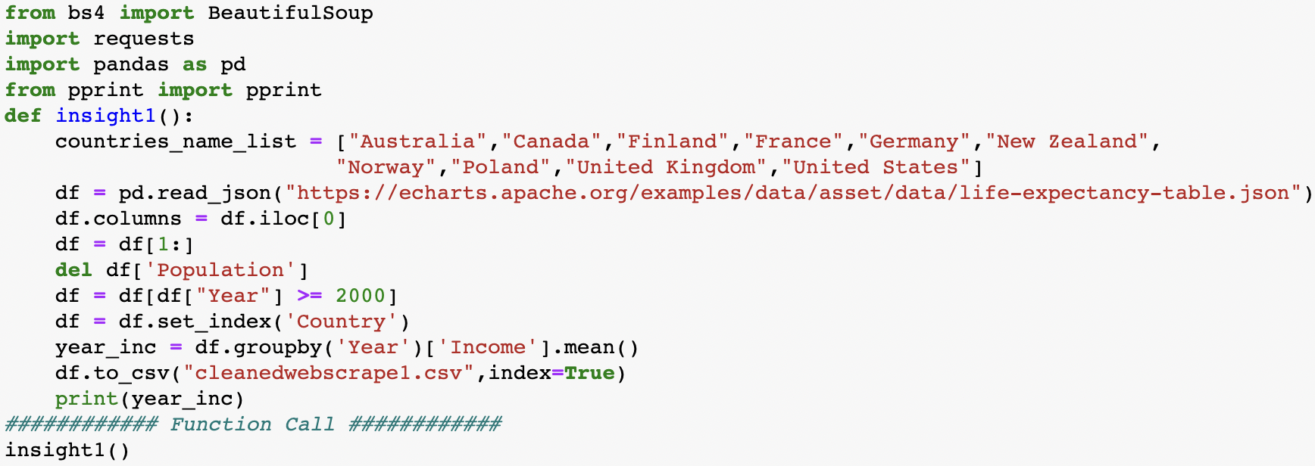
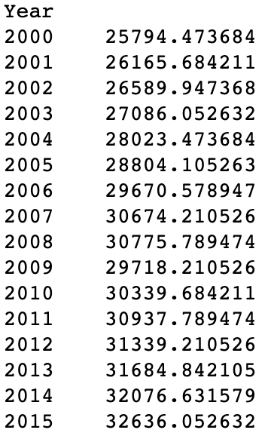
Insight 1
This insight shows the average income across the world from the year 2000 to the year 2015
We can find a trend to see the rate at which average income increased or decreased
This is useful because it allows us to compare the increase with how life expectancy increased or decreased

Slide 7
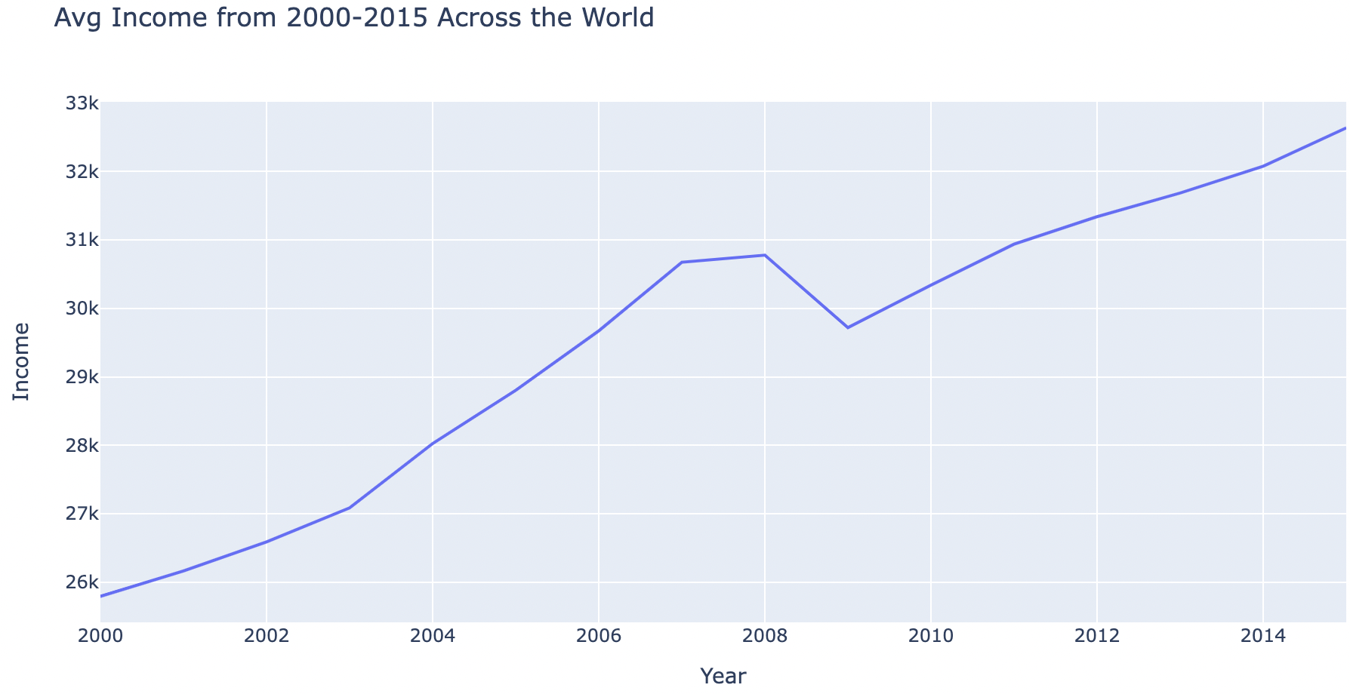
Visualization 1
The line graph links to insight 1 showing the trend in average income over time
This allows me to compare data with life expectancy from other data sets and make predictions by following the curve

Slide 8
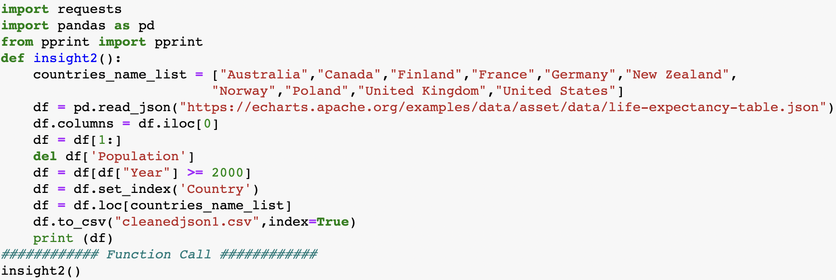
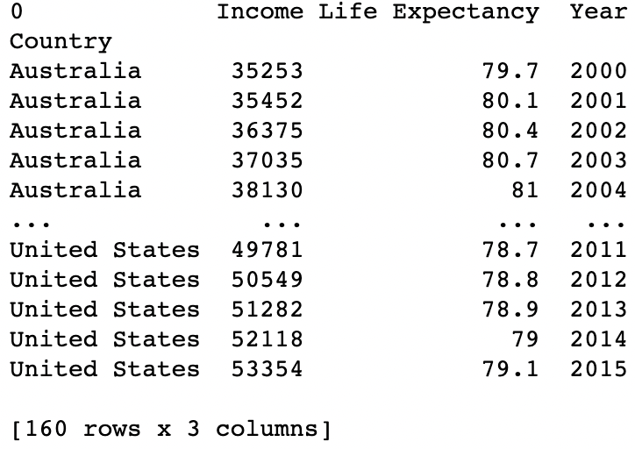
Insight 2
This insight shows the average income AND life expectancy from 2000-2015 for select countries
I thought these countries would show some range and differentiation between each other to compare
I saw that some countries with lower incomes still lived the same length in contrary to what I expected

Slide 9
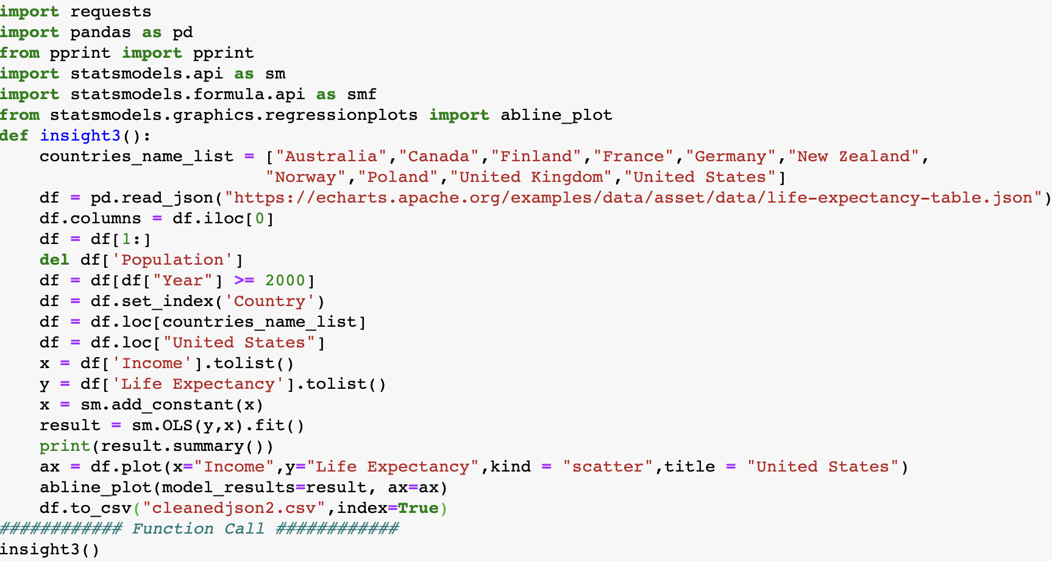
Insight 3
This insight gives regression results from the relationship between average income and life expectancy
The R-squared value was strong with a value of 0.725
There are more stats but I was interested in the correlation mostly to make predictions

Slide 10
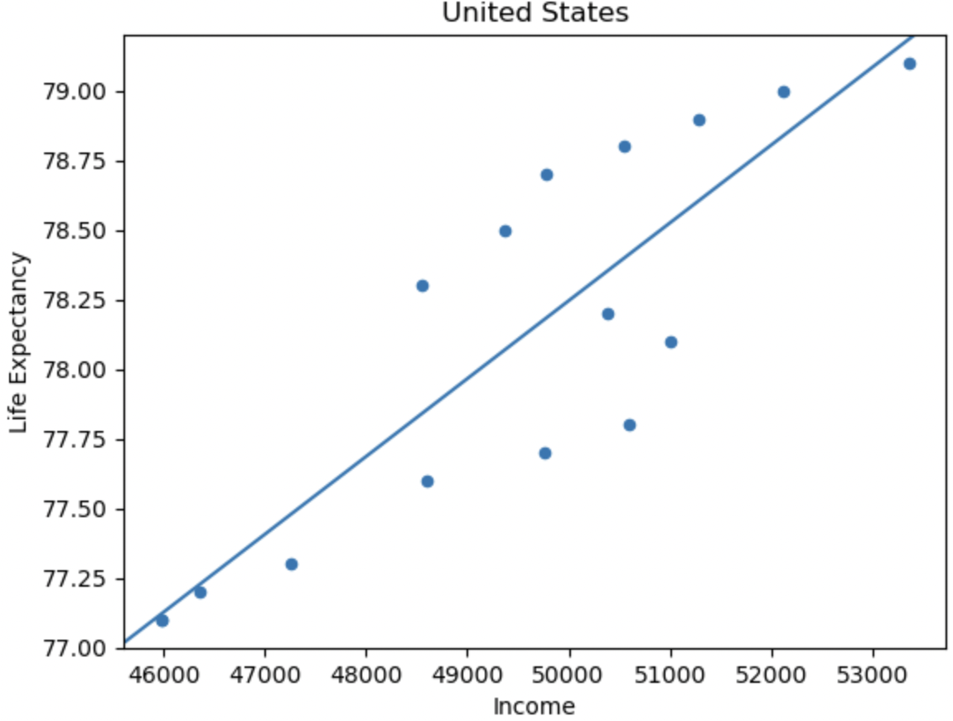
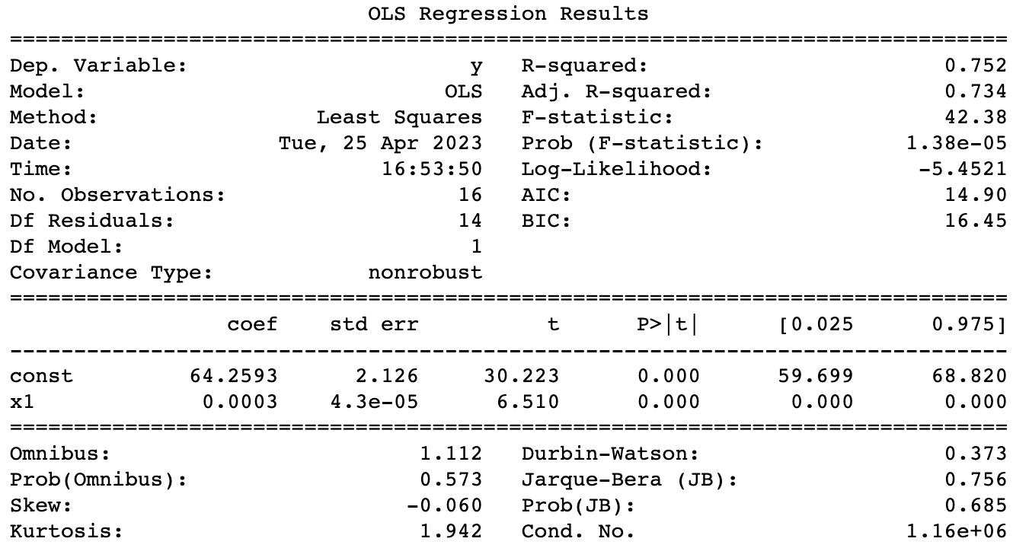
Visualization 2
This ties along with insight 3 with the left picture showing the insights and the right showing the linear regression graph for US
I wanted to see just the US to see where I could predict the income to be when I start making money, like a predictive analysis

Slide 11
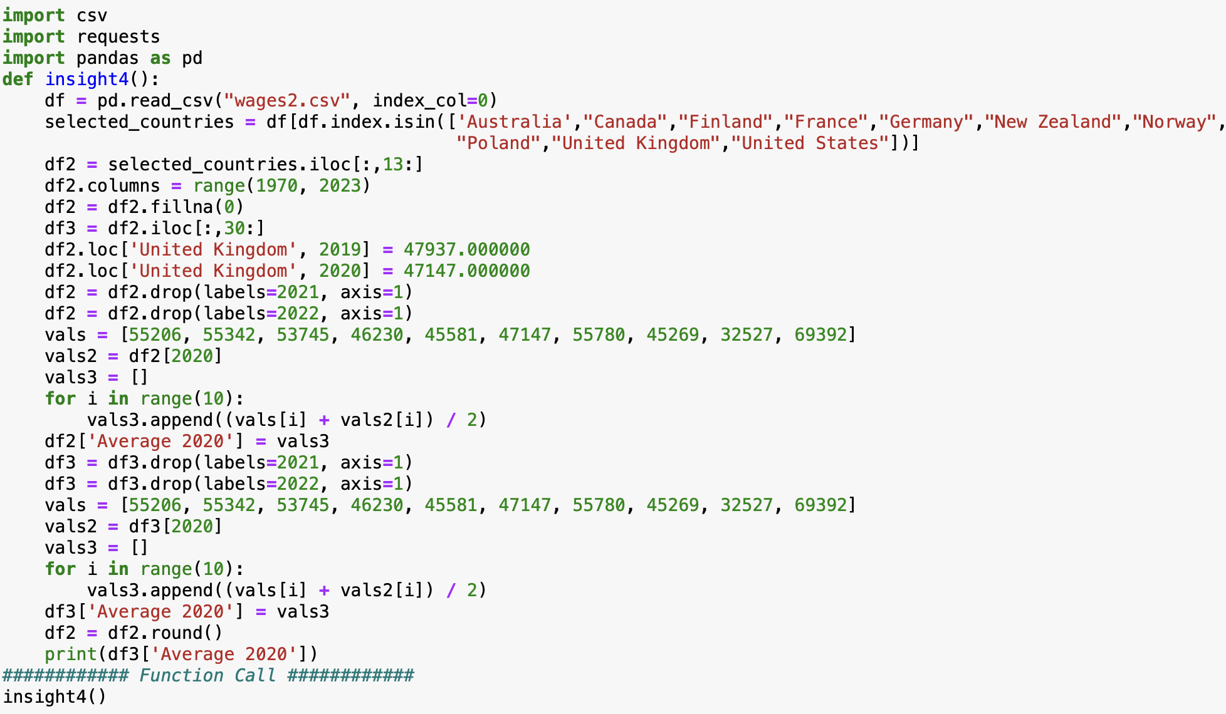
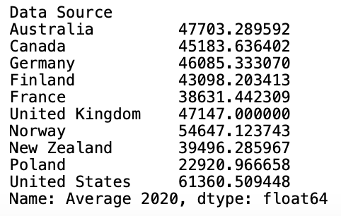
Insight 4
This insight gives the average income for each country in the year 2020.
The was collected from the CSV file and then averaged with the numbers from the Wikipedia file in order to get the most accurate values.
The average value given here can be used to compare each country to itself in its previous years and how the country has grown from an economical standpoint. The main dataset goes all the way back to 1970 so this allows me to see how the country has developed throughout 50 years.

Slide 12
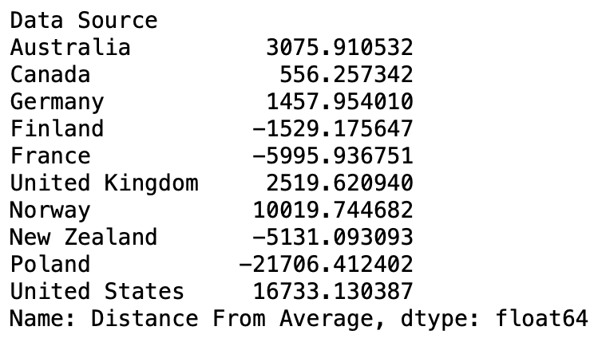
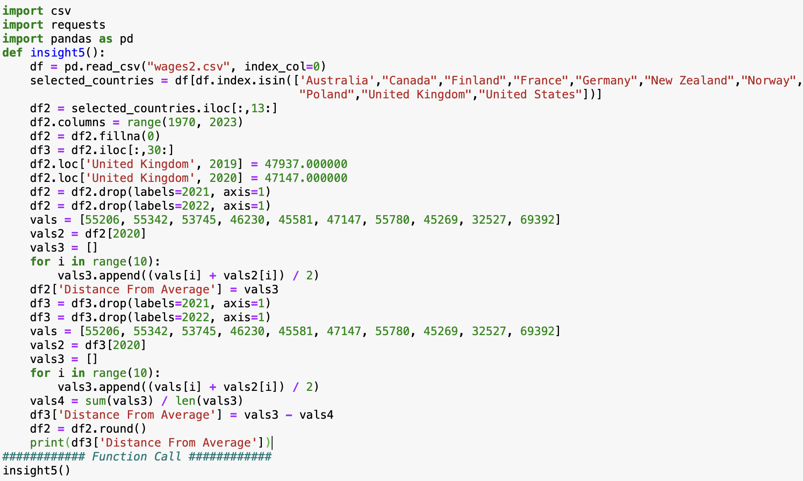
Insight 5
This insight allows me to compare each country to each other.
The average income was taken for each country and then the average for each of the averages was taken.
This allowed me to take the standard deviation of the average income and compare countries based on this metric.
Each country is a developed country and so it shows each country and how powerful they are from an economical standpoint.
The only country that is an outlier is Poland which is a developing country and it allows me to use that one country as a reference when comparing the others.

Slide 13



Overall Results / Conclusion
After going through each countries life expectancy and average income, I came to the conclusion that there is big correlation between the two.
They can be related through external factors such as the money to eat healthier, be safer and have better options for healthcare.
Average income allows for a person to obtain more money and that money can be spent on themselves allowing them to better their current and future needs.

