Slide 1
ML Log Analysis and ML Log Privacy Preserving
CSE 598 - Data Intensive Systems for Machine Learning
Group 21 Avi Mehta - 1225539835 Jay Dinesh Mehta - 1225461367 Kavan Nitin Vasani - 1224885649

Slide 2

Introduction/Background
Logs of open source ML applications are important.
It displays some information about data and parameters used, performance metrics and errors.
Analyzing this information also discloses instances about private information.
ML models make predictions using private data and if these predictions are logged, it can reveal the use of private data.

Slide 3
Problem Statement
Analyzing logs can reveal if private data is being used and if it can be accessed by an end user.
Less protection on private data can lead to privacy breaches and theft.
Important to ensure adequate security of the data in any ML application.
Analyzing the logs and identifying key instances.
Gives the developer an opportunity to implement additional security layers.

Slide 4
Workloads Used
For this project we have used two workloads:
Customer Segmentation - contains sensitive info like Credit card details, Payment methods, Date of Birth, Person information.
Credit Score Classification - contains sensitive info like Social security number, annual income, number of credit cards, number of loans, bank account details.
To simplify, we have used Kmeans clustering algorithm for both the workloads as both are classification problems.

Slide 5
Technologies Used

Slide 6

SPARK
Apache Spark is a unified computing engine and a set of libraries for parallel data processing on computer clusters.
Spark supports multiple widely used programming languages (Python, Java, Scala and R), includes libraries for diverse tasks ranging from SQL to streaming and machine learning, and runs anywhere from a laptop to a cluster of thousands of servers. This makes it an easy system to start with and scale up to big data processing or incredibly large scale.

Slide 7

SCALA
Scala combines object-oriented and functional programming in one concise, high-level language.
Scala's static types help avoid bugs in complex applications, and its JVM and JavaScript runtimes let you build high-performance systems with easy access to huge ecosystems of libraries.

Slide 8
Google DLP
Google's DLP (Data Loss Prevention) is a service that helps users to identify and protect sensitive data in their Google Cloud Platform (GCP) environments.
Google's DLP can also help with logs by scanning log files to identify and protect sensitive information. Log files can contain sensitive information such as IP addresses, usernames, passwords, and other confidential data that can be used to compromise the security of an organization.
DLP can be used to scan log files in real-time, identifying sensitive data and taking actions such as redaction or masking to protect it. This helps to ensure that sensitive information is not exposed in log files, which can be a valuable source of information for attackers.
DLP also provides a set of predefined detectors and rules that can be customized to match an organization's specific needs. For example, users can create custom detectors to identify sensitive data types unique to their organization.
DLP can also help with compliance requirements by ensuring that log files are free of sensitive data. This is important for organizations that need to comply with regulations such as HIPAA, PCI-DSS, and GDPR.

Slide 9
Microsoft Presidio
Microsoft Presidio is a cloud-based security analytics platform that uses machine learning algorithms to detect and respond to cybersecurity threats. Presidio is designed to collect and analyze data from various sources, including log files, network traffic, and endpoints, to detect security anomalies and identify potential threats.
Presidio can help by ingesting log data from various sources such as firewalls, servers, and other devices, and then analyzing the data to identify patterns and anomalies that may indicate a security threat. Presidio can also use machine learning algorithms to identify potential threats .
Additionally, Presidio can help with log management by providing a centralized location for storing and analyzing log data. This makes it easier for security teams to identify potential threats and respond to them in a timely manner.

Slide 10
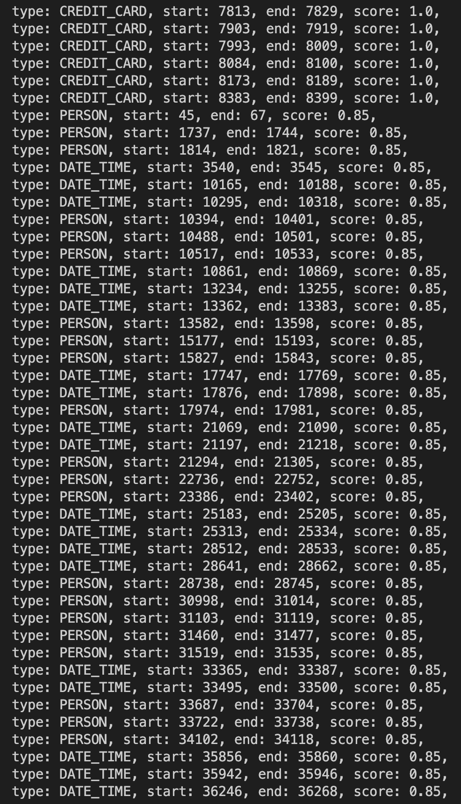
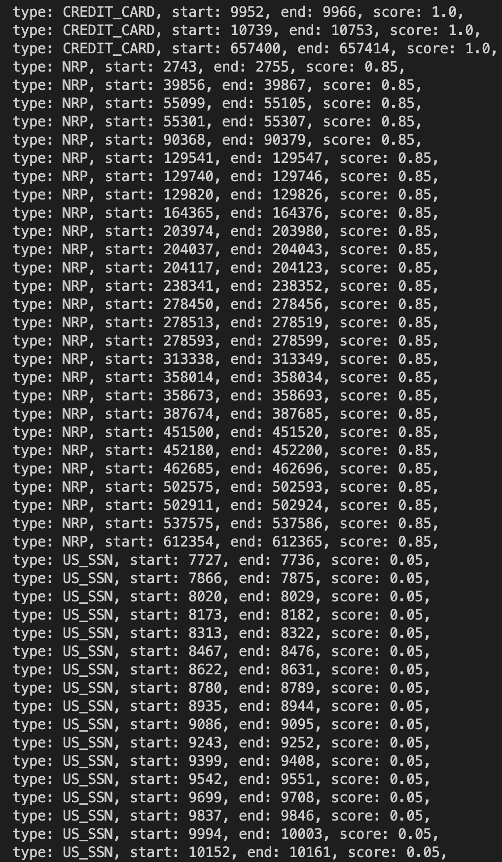
Results
Customer Segmentation
Credit Score Classification
Presidio Results ->

Slide 11
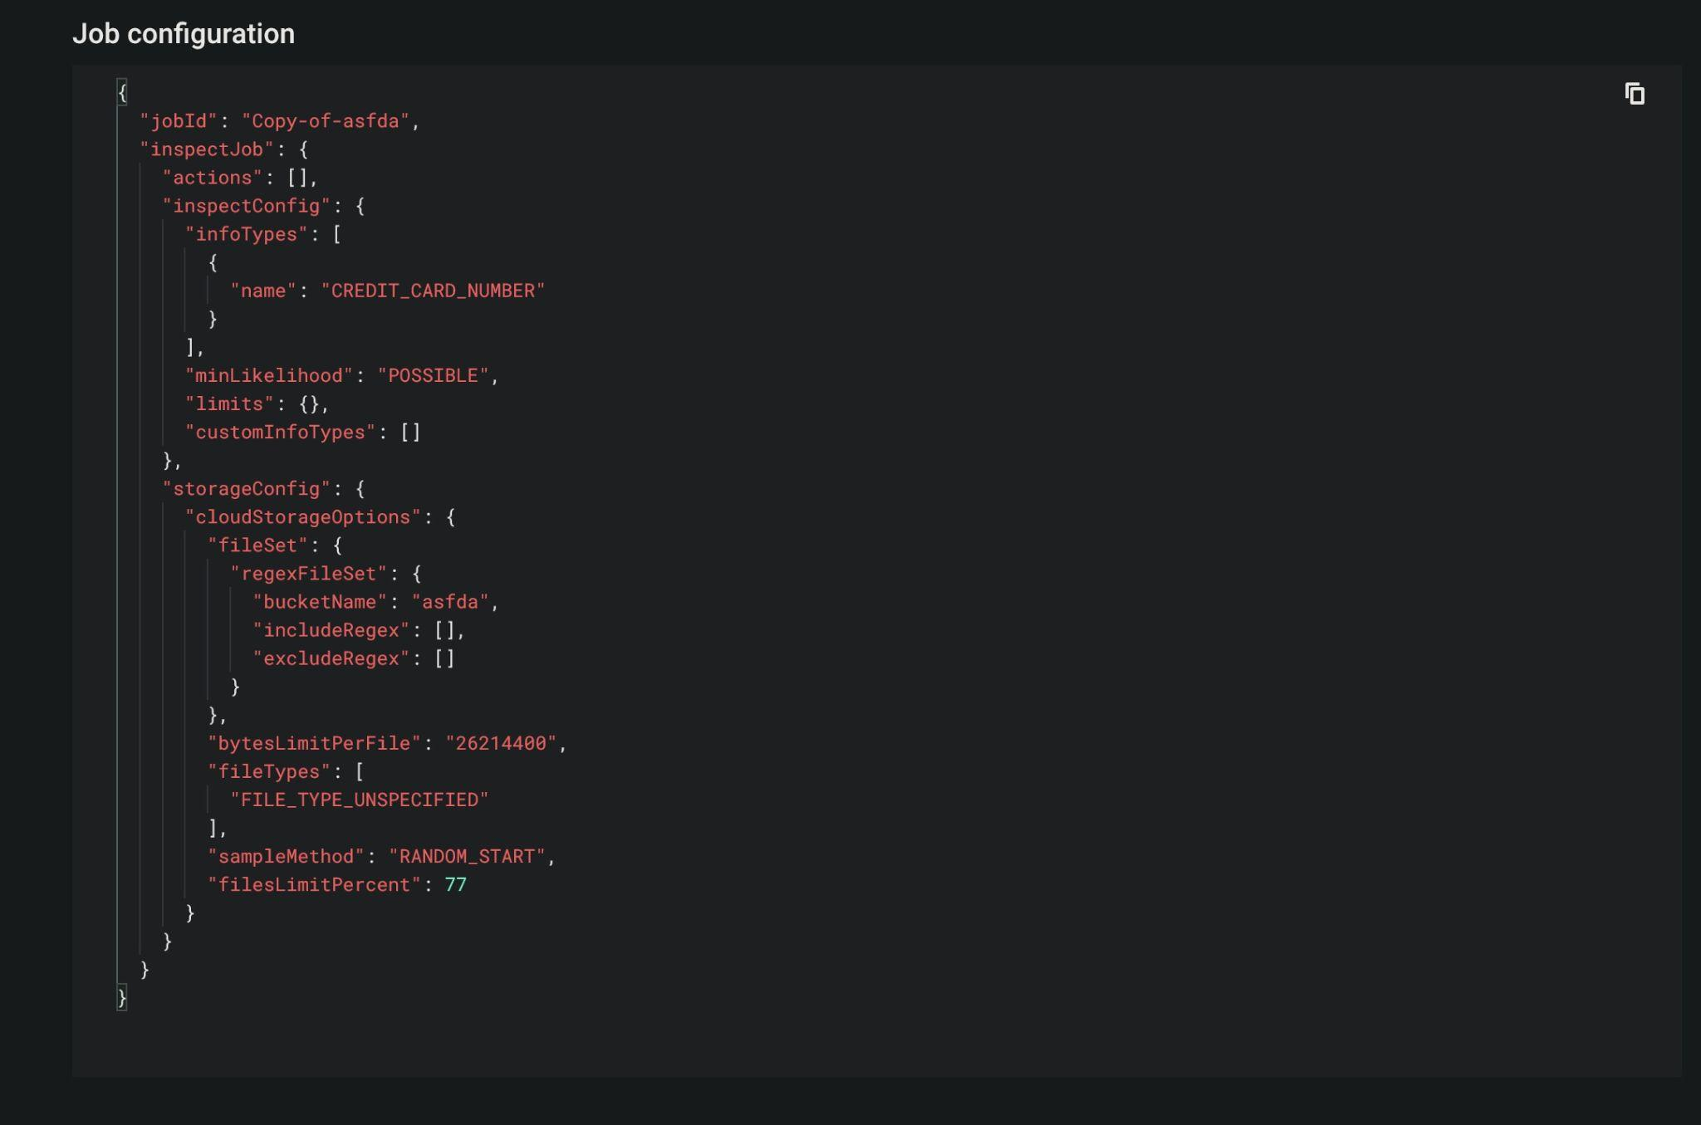
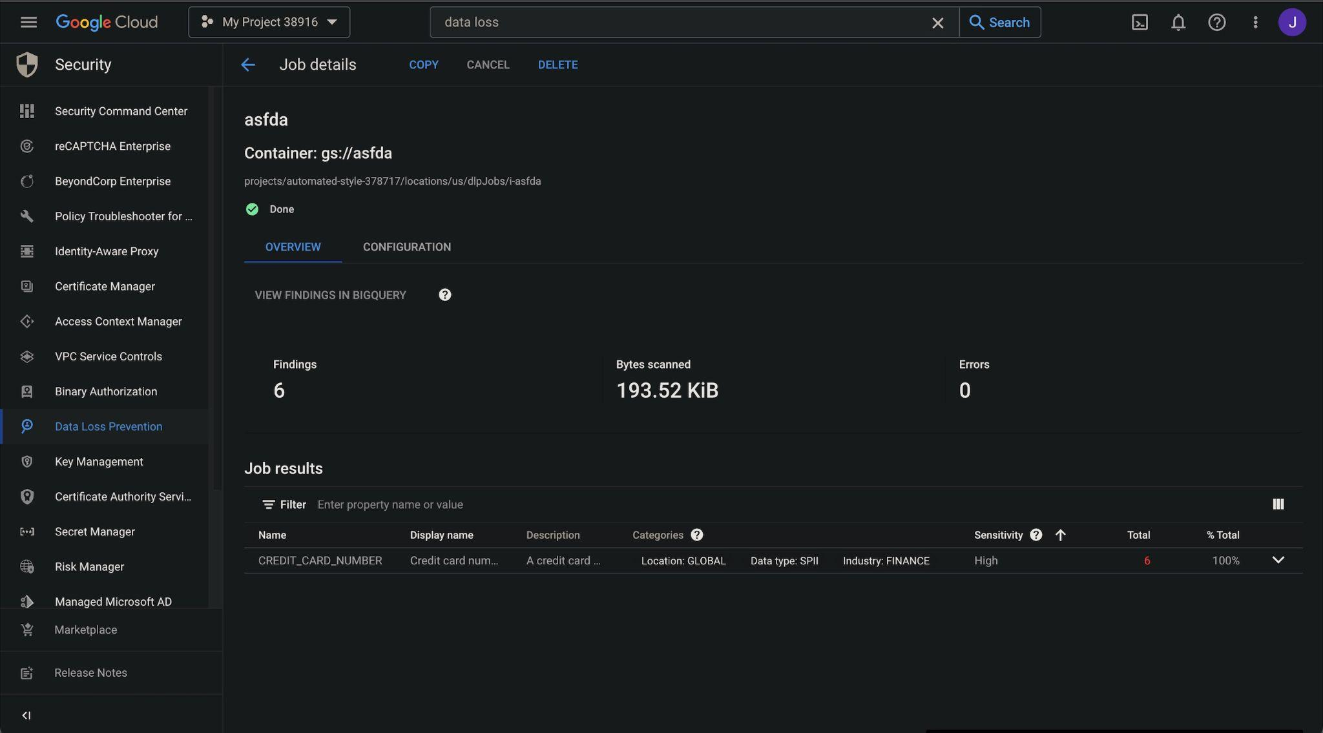
Results - Customer Segmentation

Slide 12
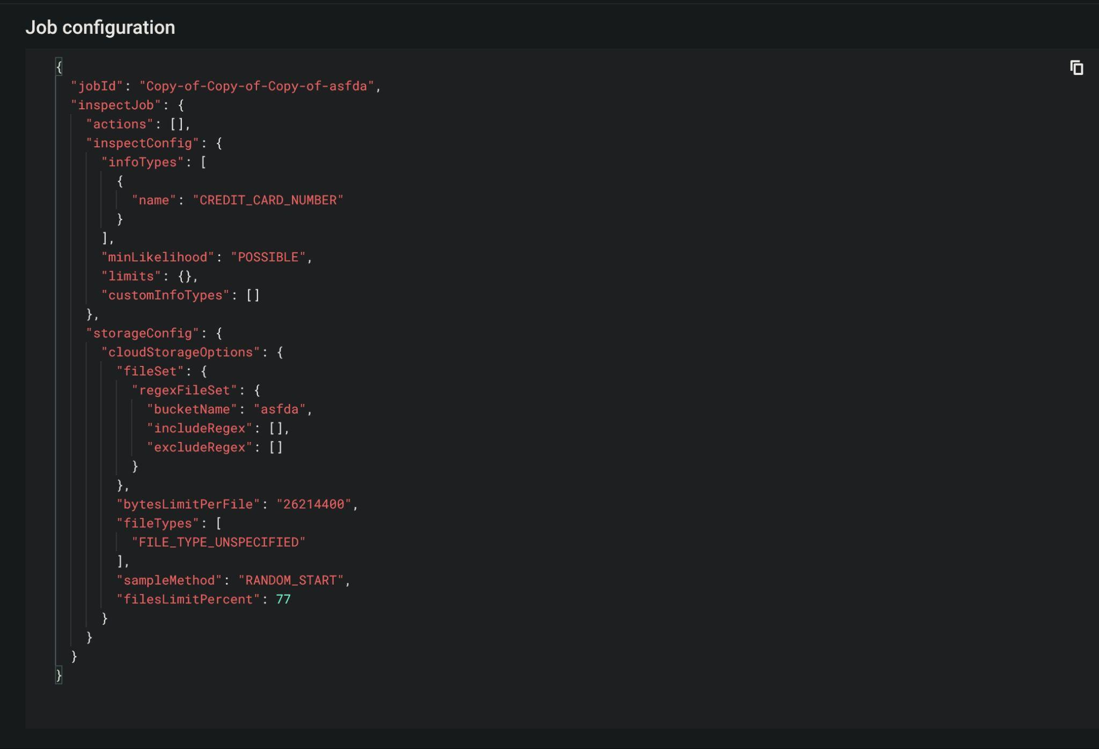
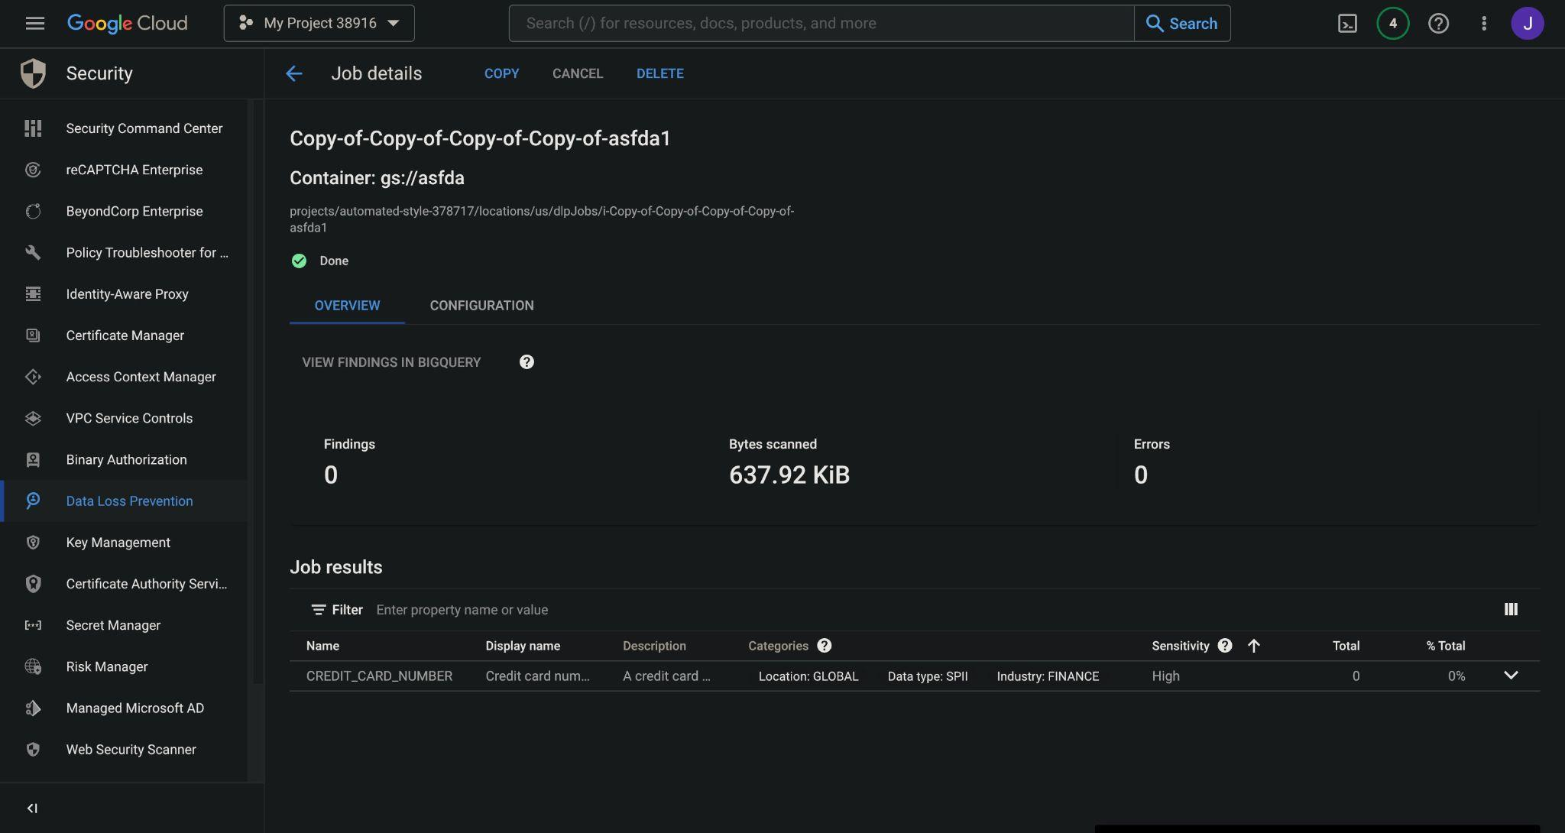
Results - Credit Score Classification

Slide 13
References
https://towardsdatascience.com/data-science-and-machine-learning-with-scala-and-spark-episode-02-03-be74f0590f20 [Scala and Spark]
https://cloud.google.com/dlp [google dlp]
https://microsoft.github.io/presidio/ [ms presidio]

