Slide 1
An efficient Deep learning approach to detect multiclass traffic signal violation using image processing
Group: 35
Presented by -
Avishek Roy Sparsho 20301269
Md. Abid Hossine 20301392
Md. Anik Khan 20301350
Rafiul Islam Mahi 20301324

Slide 2
This group work promises to revolutionize the way we detect traffic signal violations using deep learning techniques in image processing. A dataset of 67,000 images were collected from 40 videos shot in Dhaka city, Bangladesh, and preprocessed to remove noisy and blurry images. The images were then classified into three classes: violation, non-violation, and red light violation. Three deep learning models, ResNet50, VGG19, and Vision Transformer, were implemented and compared.
INTRODUCTION

Slide 3
Summary
Motivation
Increasing concerns over road safety and traffic violations.
Traditional methods are often labor-intensive and less accurate.
Utilizing deep learning for automated and precise detection.
Contribution
Introducing a novel deep learning model for multiclass traffic signal violation detection.
Integration of image processing techniques for enhanced accuracy.
Streamlining traffic law enforcement through automation and efficiency.

Slide 4
Methodology :
USED MODELS : VGG19, RESNET50, ViT(Vision Transformer Model)
Exploratory Data Analysis (EDA):
Investigate the dataset's structure.
Scrutinize for potential missing or corrupted data.
Optimizers:
The models were trained using a batch size of 32 and a learning rate of 1e-3. The training process was repeated for 10 epochs. The loss function used was cross-entropy loss, and the optimizer used was Adam with a weight decay of 1e-4.The optimizer (e.g., Adam with weight decay), learning rate scheduler (e.g., StepLR), and the use of mixed precision optimization (e.g., GradScaler) and early stopping (e.g., PyTorch Lightning's EarlyStopping callback) for efficient training and model selection.
Data Augmentation , Regularization , Normalization:
Introduce image augmentation techniques, like rotation and flipping, to create diverse image variations, augmenting the dataset and enhancing model robustness.
Standardize pixel values to a common scale (e.g., 0 to 1) for streamlined convergence during training.

Slide 5
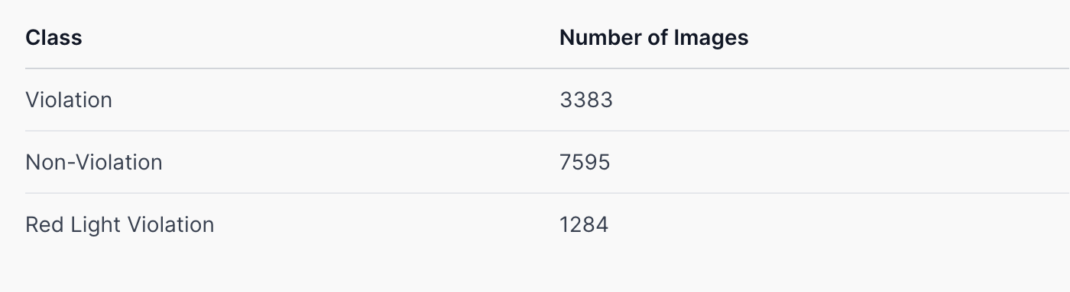

Slide 6
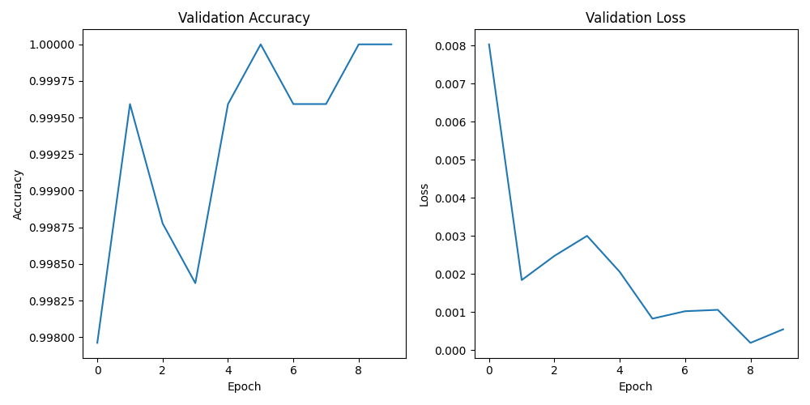
VGG19

Slide 7
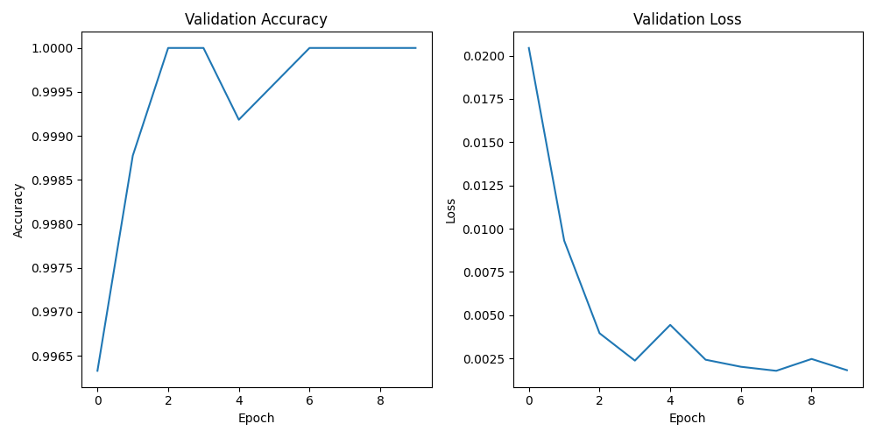
RESNET

Slide 8
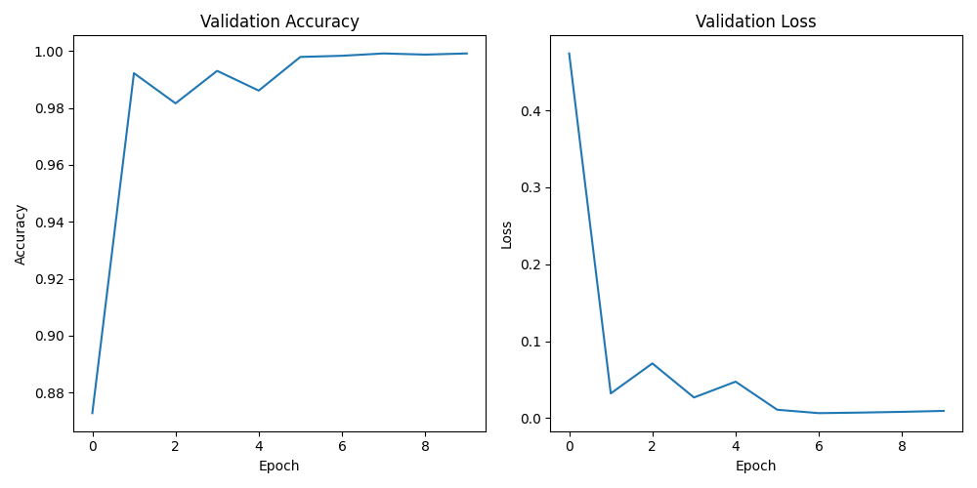
Vision Transformer Model

Slide 9
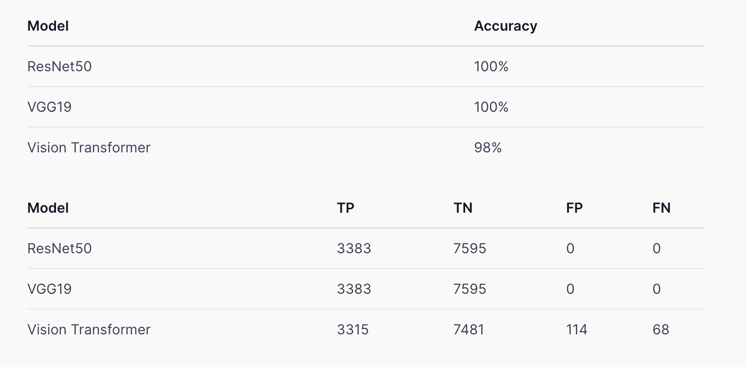
RESULT ANALYSIS

Slide 10
Limitations
First Limitation
Dependency on high-quality training data, which may be limited or biased.
Sensitivity to variations in lighting, weather conditions, and camera angles.
Challenges in generalization across diverse traffic environments.
Second Limitation
Computational resource requirements for training and inference.
Potential latency in real-time deployment, especially in high-traffic areas.
Limited interpretability of deep learning models for regulatory compliance and legal considerations.

Slide 11
Synthesis
Balancing Accuracy and Efficiency: Addressing limitations through data augmentation, robust model architectures, and optimization techniques.
Interdisciplinary Collaboration: Engaging with transportation experts, policymakers, and law enforcement agencies to ensure practicality and ethical compliance.
Continuous Improvement: Emphasizing ongoing research and development to adapt to evolving traffic conditions and technological advancements.

Slide 12
Conclusion
High Accuracy: ResNet50 and VGG19 achieved perfect 100% accuracy in detecting traffic signal violations, demonstrating the robustness of the proposed deep learning approach.
Potential Impact: Implementation of this approach could lead to reduced traffic congestion, enhanced road safety, and increased efficiency in transportation systems through the development of an intelligent traffic monitoring system.
Future Directions: Further research will focus on improving the accuracy of the Vision Transformer model and translating the proposed approach into a real-time traffic monitoring system, aiming to address ongoing challenges in traffic management effectively.

Slide 13
Thanks!

