Slide 1
PROJECT LIGURIA
Genoa to New York
Framing the long-haul opportunity
Prepared for Aeroporto di Genova S.p.A.
29 June 2026
Private and Confidential | DRAFT
AVIA SOLUTIONS
Notes:
Cover slide. Open warmly, thank Francesco and Daniele for the time, acknowledge Fabrizio's introduction. State up front that the call is intended as a working conversation, not a credentials pitch. 30 minutes, structured agenda, leave room for discussion at each major transition.

Slide 2
How we propose to use the next thirty minutes
A working conversation, not a credentials pitch
Rather than walk you through a standard Avia introduction, we thought it would be more useful to share how we would approach the Genoa to New York opportunity in practice, including our early thinking on the data, the operator candidates, and the work that would need to be done to build a persuasive airline case.
1
The shape of the problem
How we see Genoa to NYC and why the sequencing matters
2
The catchment evidence question
What airlines look for, and what the data tells us
3
The addressable market
Italy to NYC, Genoa's position, and the leakage opportunity
4
Operators and aircraft
The realistic carrier shortlist and how it ranks
5
How Avia would approach the work
What Stage 1 would deliver and why it matters
We can come back to formal Avia credentials at any point if useful. The Tampa to Bogota sample case we shared earlier gives a sense of our depth of work.
Project Liguria | Avia Solutions Limited | DRAFT | June 2026
P: 2
Notes:
Frame the call up front. Most senior executives respond well to being told what to expect. The unconventional structure (no credentials block) is signalled openly. If Francesco prefers the traditional structure, the line at the bottom invites him to ask for it. Move briskly past this slide once read.

Slide 3
The shape of the problem as we see it
Three questions, in sequence
1
2
3
Catchment
Addressable market
Operator and aircraft
What can Genoa realistically defend?
What demand does the route need to serve?
Who would fly it, and with what?
Italy to NYC is a large and mature market. The strategic question is not whether demand exists, but how much of the Liguria and adjacent catchment can be retained at Genoa against MXP, FCO and European hub alternatives. This is a question about behaviour, not geography.
Sizing follows the catchment question. Once the defendable catchment is established, the addressable market can be quantified, including a realistic view of leakage recapture from MXP and stimulation from improved access. The shape of demand drives frequency and seasonality.
The carrier shortlist and the aircraft choice follow from the addressable market, not the other way round. Different demand profiles point to different operators and different operating models. Fixing on a single answer too early closes off thinking.
Each question builds on the answers to the one above. Getting the sequence right is what separates a credible airline pitch from a wishful one.
Project Liguria | Avia Solutions Limited | DRAFT | June 2026
P: 3
Notes:
Core methodological framing. This slide does the work of acknowledging Francesco's pushback on premature XLR focus while also signalling Avia's analytical discipline. The three-step structure is genuinely how good route development work proceeds. Pause briefly on the anchor sentence at the bottom; it is the philosophical position.

Slide 4
The catchment evidence question
What airlines look for, and how Genoa would need to demonstrate it
When Genoa approaches a carrier, the first question their network planning team asks is: where do the passengers actually come from? Not stated catchment, not isochrone geography, but evidenced behaviour. Three data sources answer that question.
Sabre point-of-origin
Mobile cell data
Stated-preference surveys
What the airline will see
What the airport sees on the ground
What passengers say they would do
Bookings data linked to point-of-sale location. Shows where ticketed passengers actually originate, by postcode or province. This is the analysis any candidate carrier will run independently. Genoa's pitch needs to align with what this data shows.
Anonymised mobile telephony flow data showing where airport users travel from on the ground. Increasingly standard in serious airport catchment work. Genoa may already have this through Vodafone or TIM, and we have an Italian partner who specialises in this analysis for airports.
Departing-passenger surveys on origin postcode, trip purpose and stated alternatives. Triangulates the booking and cell data. Less authoritative than the first two, but useful for testing willingness to drive and price sensitivity.
Primary evidence
Supporting evidence
Triangulation
A credible airline conversation increasingly uses all three sources in combination.
Does Genoa currently have any of these in place, and if so, in what form?
Project Liguria | Avia Solutions Limited | DRAFT | June 2026
P: 4
Notes:
This is the slide where we surface the question of what evidence Genoa already has. Pause here for discussion. If Francesco has cell data work already done, we adapt the pitch accordingly. If not, this is where Stage 1 starts. Either answer is useful information. The Italian partner reference is intentional: signals we know who to bring in if needed, without committing to any specific firm.

Slide 5
The Italian market to New York in context
A large, mature market. Genoa starts from a small base
What this tells us
Italy to NYC totals 2.37m passengers in 2025, a large and mature market.
FCO and MXP carry 65% of the total between them; Genoa shows 9,278 passengers, almost all routed indirectly.
Genoa grew +12.1% in 2025 against an Italian market that fell 1.6%, with FCO and MXP both down c.6%. Genoa is gaining share as the national gateways soften.
Liguria demand prefers hub feeds over MXP direct: c.50% via Rome, c.27% via Munich, c.22% via Amsterdam. A direct GOA service would compete against the hub options as much as against MXP itself.
Source: Sabre MIDT 2025, bidirectional O&D. NYC = JFK + EWR + LGA. Avia Solutions analysis.
The Italian market is large and mature. Genoa is small but among the small group of Italian airports gaining share against a softening national picture.
Project Liguria | Avia Solutions Limited | DRAFT | June 2026
P: 5
Notes:
Verified Sabre 2025 numbers. The headline finding is the +12.1% Genoa growth against a -1.6% national market and -6% at the two big gateways. This is a properly evidenced share-gain story, not aspiration. Worth pausing on this point and asking Francesco what he attributes it to. If he has a view, useful information for Stage 1. The Liguria routing pattern (c.50% FCO, 27% MUC, 22% AMS) tells us a direct service competes against established one-stop options rather than against MXP. ITA at FCO is the dominant connecting carrier, which means a direct GOA service most directly threatens ITA's existing connecting yield from Liguria.

Slide 6
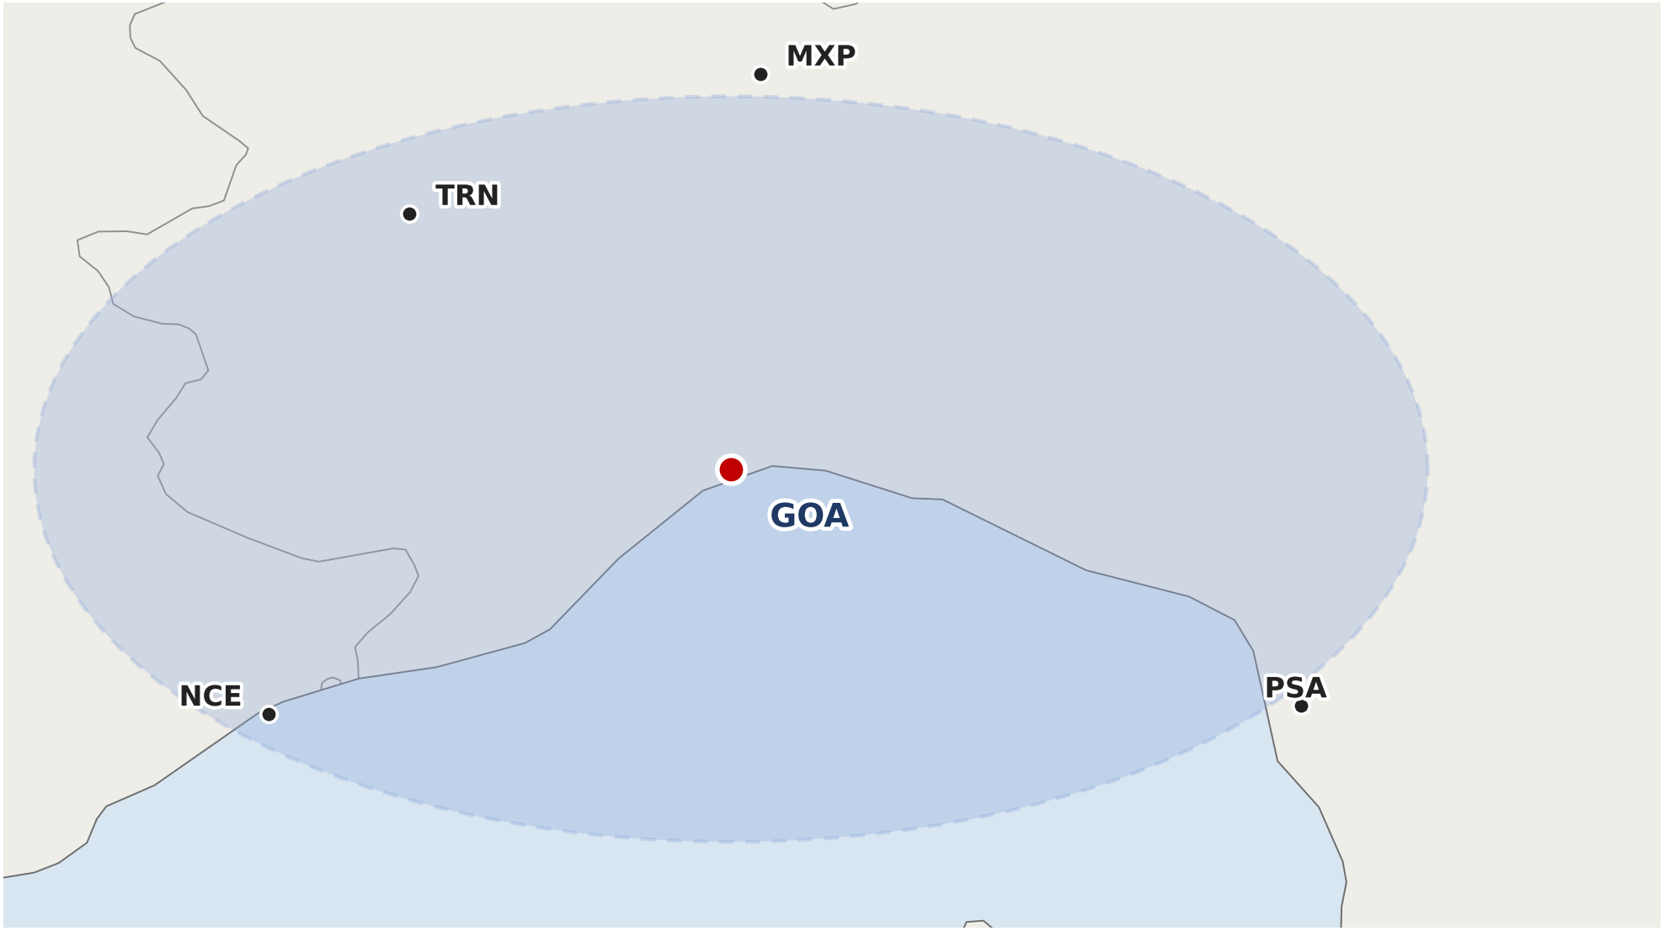
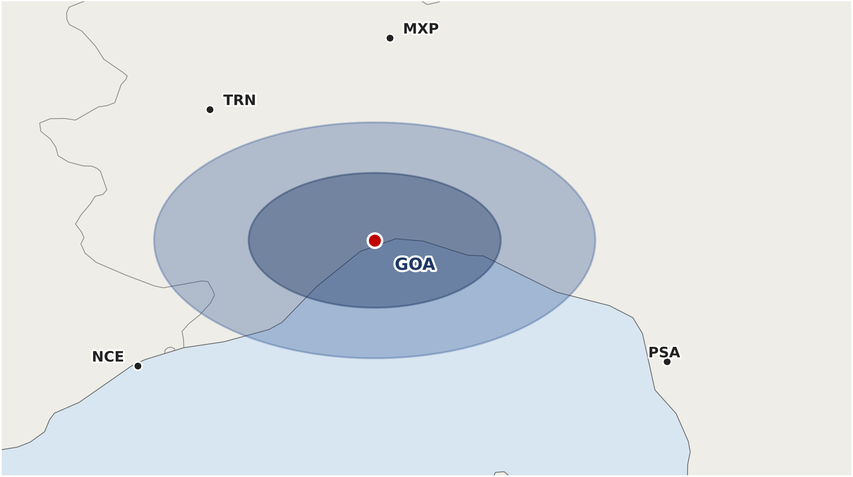
The catchment question
Geographic reach is generous. The defendable share is what matters
Two views of the same catchment matter to airline planners: the geographic reach that defines the addressable population, and the defendable share that defines who would actually use Genoa over the alternatives.
Geographic reach
c.6.5m
Defendable catchment
1.5m / 3.2m
3-hour drive isochrone
60 to 90 minutes by road, the analytical anchor
within 3 hours
at 60 / 90 min
Most of the 6.5m population sits inside MXP's primary catchment, not Genoa's.
Province of Genoa is the largest defendable zone; airline planners can verify with point-of-origin data.
Defendable catchment breakdown
Zone | Drive time | Population | Primary competitor | Defendability
Province of Genoa (primary) | 0-60 min | c.1.5m | None (GOA closest) | High
Inner Liguria (secondary) | 60-90 min | c.1.7m (cumulative 3.2m) | Pisa / Nice at outer edge | Medium-High
Southern Piedmont | 90-120 min | c.1.0m | TRN (domestic feed) | Medium
Milan area | 120-150 min | c.3.5m | MXP / LIN direct | Low
Source: ISTAT population data, Natural Earth, Avia Solutions analysis. Drive-time zones illustrative; Stage 1 would establish using point-of-origin data.
Project Liguria | Avia Solutions Limited | DRAFT | June 2026
P: 6
Notes:
Two-view slide. The 3-hour view shows the geographic reach an airline planner sees first, and immediately recognises is unrealistic because of the competing airports inside it. The 60-90 minute view is the analytical anchor: 1.5m at the inner ring (genuinely defendable because GOA is closest) and 3.2m at the outer ring (defendable to varying degrees against Pisa and Nice on the margins). The Province of Genoa as the largest defendable zone is the single most important point on this slide. Milan is in the catchment geographically but lost commercially.

Slide 7
The leakage hypothesis
Even modest recapture from MXP could multiply Genoa's addressable market
MXP carries 708,000 passengers to NYC each year, 92% of them direct, drawn from a wide Italian catchment. Point of sale confirms Genoa-area leakage but cannot size it. Sizing the repatriable traffic is the Stage 1 question.
9.3k
708k
1,507
GOA-NYC today
MXP-NYC today
Identifiable floor
Annual O&D 2025, all routed indirectly. Growing +12% on 2024
Annual O&D 2025, 92% direct, 2.5 hours from Genoa by road
Genoa-area MXP-NYC tickets by point of sale, 0.2% of total. Floor only; agencies issue in Milan and Rome
Illustrative scenarios
Scenario | Defendable MXP share | MXP recapture rate | Stimulation factor | Indicative annual O&D
Conservative | 5% | 30% | 1.5x | c.40k
Mid | 10% | 40% | 1.8x | c.75k
Optimistic | 15% | 50% | 2.0x | c.115k
Scenarios are illustrative. Comparable launches show the stimulation is real: Catania's NYC market rose c.43% in year one of Delta nonstop (2025). Stage 1 would establish Genoa's own defendable share, recapture and stimulation.
Source: Sabre MIDT 2025 full-year and Milan-NYC point-of-sale extract (Mar 2025-Feb 2026). stimulation cross-checked against comparable secondary-city launches. Avia Solutions analysis.
Project Liguria | Avia Solutions Limited | DRAFT | June 2026
P: 7
Notes:
Critical slide. The three big numbers establish the size of the prize. The third box is the analytical sophistication that distinguishes Avia from a generic consultant. Point of sale shows 1,507 identifiable Genoa-catchment Milan-NYC tickets, just 0.2% of total. Read this aloud as a floor, not the answer. Then explain why: tickets are issued by agencies, OTAs and corporate desks concentrated in Milan and Rome, regardless of where the traveller lives. 26% of Italy-sold tickets carry no town at all. Point of sale collapses the catchment into the booking centres. It confirms leakage exists and sets a hard floor, but cannot size it. Sizing the repatriable traffic needs the drive-time and cell catchment work in Stage 1. The scenarios below are illustrative; read the red caveat aloud. The c.40k Conservative case is around sub-daily narrowbody territory. The c.75k Mid case supports a sub-daily or summer-daily XLR. The c.115k Optimistic case approaches daily XLR. Worth noting that MXP-NYC has Emirates as its largest direct operator on a fifth-freedom service (c.234k, 36% of nonstop). The dominant MXP-NYC operator is not a US or Italian carrier. If Francesco asks about MXP competitive intensity, this is a useful colour point.

Slide 8
Shape of demand and inbound drivers
A leisure-weighted Atlantic profile, peak-to-trough c.1.9x
Italy to New York is a strongly seasonal market. Milan-NYC monthly data, March 2025 to February 2026, gives a fair proxy for the Genoa profile: an August peak at 132 (indexed, 100 = average month), a broad April to September plateau around 109 to 132, and a deep January and February trough at circa 70. A summer-weighted or summer-only operating model maps directly to this shape, supported by three concrete inbound demand drivers that anchor the seasonal case.
Inbound demand drivers
c.2.3m
Cruise passengers
Genoa + Savona combined, 2024. Italy's second cruise hub.
October
Salone Nautico
International yacht trade fair. Datable premium spike.
2027
ENAC concession
Extended through 2027, Erzelli tech park infrastructure plan named.
Source: Sabre point-of-sale extract for Milan-NYC, Mar 2025-Feb 2026 (761,356 passengers, both directions). Avia Solutions analysis.
A 30-week summer operation should be modelled against the April to September plateau, not the annual mean, or load factors and fares will read weaker than the operating reality.
Project Liguria | Avia Solutions Limited | DRAFT | June 2026
P: 8
Notes:
Seasonality now verified from the Sabre point-of-sale extract Mar 2025-Feb 2026. The leisure-weighted shape (August peak 132, January trough 69, peak-to-trough c.1.9x) is the strongest signal for operating model: a summer-only or summer-weighted XLR maps to this profile far better than year-round daily. Pause on the April-September plateau point. The April to September months sit at 109-132, materially above the annual mean of 100. If a 30-week summer operation is modelled against the annual mean it will read weak; modelled against the plateau it reads sensibly. This is the kind of analytical nuance that should land with Francesco. The three inbound demand boxes anchor the seasonal case in real things: 2.3m cruise (Italy's second-ranking hub), October Salone Nautico, ENAC concession with Erzelli named. The strategic band at the bottom is the operating implication of the data.

Slide 9
What comparable cities actually did
Secondary European cities that won nonstop New York, and what it took
Several secondary cities in our market have gained nonstop New York service since 2013. The pattern is consistent: the operators are US majors on widebodies or leisure carriers, and every sustained service launched from a connecting base several times larger than Genoa carries today. Their scale, not their aircraft, is what Genoa would need to match.
+43%
+24%
c.49k
Catania, year one
Nonstop yield premium
The scale gap
NYC market rose 48.6k to 69.5k when Delta launched nonstop in 2025; connecting traffic barely fell.
Italy-NYC nonstop fares run c.24% above connecting; MXP c.28%. Genoa's connecting fare is the market's lowest.
Catania's connecting base when Delta launched in 2025. Genoa carries 9.3k today; closing the gap is the leakage question.
Secondary-city nonstop New York launches
City | Nonstop NYC since | Operators today (aircraft) | Connecting 2025 | Total NYC 2025
Catania | 2025 | Delta (A330/767) | 42.1k | 69.5k
Naples | 2019 | United, Delta (767/A330) | 69.3k | 151k
Nice | 2013 | Delta, United, La Compagnie (A321neo) | 90.9k | 177k
Palermo | 2024 | Neos (787), United | 45.3k | 74.3k
Pisa | 2013-16, withdrawn | none today | 8.5k | 8.5k
Genoa | none | indirect only | 9.3k | 9.3k
Comparators run widebodies because their markets are several times Genoa's, which proves the demand mechanism, not the aircraft. Genoa's thinner market is the case for right-sized capacity, and leakage recapture in Stage 1 sets the scale.
Source: Sabre MIDT 2013-2025, bidirectional O&D, nonstop and connecting by operating carrier. Aircraft indicative; Sabre carries no equipment field. Avia Solutions analysis.
Project Liguria | Avia Solutions Limited | DRAFT | June 2026
P: 9

Slide 10
The operator landscape
Carriers read by the capacity a thin market can fill, not by fleet badge
The realistic shortlist depends on what the demand analysis shows, but the universe of plausible carriers is finite. Below is an early read of carrier fit by capacity model, before the detailed catchment and addressable market work.
Carrier | NYC hub | Aircraft / capacity fit | Italy network | Secondary city appetite | Strategic fit | Tier
JetBlue | JFK base | A321, right-sized | BOS-MXP May 26 | Demonstrated | Strong | 1
United | EWR hub | XLR delivering; 767 today | FCO, MXP direct | Mixed | Strong | 1
American | JFK | A321XLR, right-sized | FCO, MXP direct | Limited | Moderate | 2
ITA Airways | JFK from FCO | A330 + A321neo | Home market | Hub-focused (FCO) | Conditional | 2
Air Canada (YUL) | Not NYC direct | A321XLR via YUL | FCO from YUL | Secondary city XLR strategy | Tangential | 3
Aer Lingus | Via DUB | A321XLR, right-sized | None today | Demonstrated | Limited | 3
Norse Atlantic | JFK, EWR | 787, oversized scheduled | None today | LCC model | Marginal | 3
Tier 1: Most credible candidates | Tier 2: Conditional candidates | Tier 3: Less likely | Tier 4: Unlikely
This ranking is preliminary, based on public fleet data, network strategy disclosures and Avia's read of carrier intent. It would be tested and refined against the addressable market profile in Stage 1, and against direct soundings in Stage 3.
Source: Public fleet and network data, carrier disclosures, Avia Solutions analysis. June 2026.
Project Liguria | Avia Solutions Limited | DRAFT | June 2026
P: 10
Notes:
The big payoff slide. JetBlue is the lead story now: their BOS-MXP launch in May 2026 confirms they are actively entering the US-Italy market with narrowbody, which makes them the natural conversation for a future GOA-NYC service once their Italian base is established. United just took delivery of its first XLR (April 2026) which puts them firmly in play; transatlantic deployment timing is what to watch. American operates one transatlantic XLR (JFK-EDI) so far, with PHL-Porto next, and is opening a New York XLR pilot base. Air Canada is interesting from YUL not NYC, but they have a defined secondary-city XLR strategy worth mentioning. Verified MXP-NYC nonstop volumes 2025: Emirates 233,925 (36%, fifth-freedom JFK), Delta 112,181, American 99,086, United 90,767, Neos 69,061, La Compagnie 38,676, Norse 4,557. Two surprising facts to keep ready if the MXP discussion comes up: (1) the largest single direct operator from MXP to NYC is Emirates, neither US nor Italian. (2) ITA Airways serves NYC from FCO only, not from MXP. So the carrier landscape at MXP is genuinely thinner than it first appears, which strengthens the case for a Genoa direct-service play against MXP rather than weakens it. CRITICAL: caveat the preliminary nature of the ranking explicitly. The big point to land verbally: JetBlue is the most credible first conversation because they have just bought into Italy via MXP, but it is too early to approach them. Stage 1 evidence is what makes that conversation credible.

Slide 11
Aircraft and service model options
Multiple paths to the same destination. Demand needed = annual O&D both ways at an 80% load factor.
Direct narrowbody, daily
Direct narrowbody, sub-daily
Direct widebody, seasonal
Hub feeder agreement
Combination cargo and pax
AIRCRAFT
AIRCRAFT
AIRCRAFT
AIRCRAFT
AIRCRAFT
A321XLR
A321XLR / LR
787-9 / A330neo
Existing narrowbody
Widebody belly
DEMAND NEEDED
DEMAND NEEDED
DEMAND NEEDED
DEMAND NEEDED
DEMAND NEEDED
c.106k (133k seats/yr)
c.30-60k (38-66k seats)
c.84k (106k seats)
Connects to existing demand
Cargo subsidises pax economics
OPERATING SHAPE
OPERATING SHAPE
OPERATING SHAPE
OPERATING SHAPE
OPERATING SHAPE
Daily year-round, US carrier
3-5x weekly, seasonal weighted
Summer-only daily, leisure-led
GOA-FCO / GOA-MXP feed
Genoa port and pharma cargo
FITS WHEN
FITS WHEN
FITS WHEN
FITS WHEN
FITS WHEN
Optimistic catchment
Conservative to mid catchment
Optimistic only; better as a charter
Politically sensitive, fast
If cargo case stacks up
The arithmetic decides the aircraft. A scheduled widebody must fill c.212,000 seats a year, c.170,000 O&D at an 80% load factor, against an optimistic catchment of c.115,000; it is oversupplied year-round and works only as a peak charter. An A321XLR at 4-5x weekly or summer-daily needs c.30,000 to 60,000, inside the conservative-to-mid catchment and matched to the summer peak. The question is right-sized capacity, not the aircraft type.
The XLR is simply the scheduled aircraft this market can fill; the same logic holds for any narrowbody of the size. A runway, terrain and performance review with Airbus Consulting would confirm XLR feasibility from Genoa once the operating model is set.
Project Liguria | Avia Solutions Limited | DRAFT | June 2026
P: 11
Notes:
This slide directly addresses Francesco's pushback. Five distinct operating models, each with different aircraft and demand requirements. The XLR is one option among several, not the only one. The Airbus performance reference at the bottom signals where Patrick fits in without making him central to this conversation. If asked which Avia thinks is most likely, the honest answer is: probably option 2 (sub-daily XLR) based on what we can see, but the catchment work could push it toward 1, 3, or even 5.

Slide 12
How Avia would approach the work
Three stages, each independently valuable, decision point at each milestone
Stage 1
Stage 2
Stage 3
Catchment evidence and addressable market
Operating model and aircraft assessment
Airline targeting and engagement
4-6 weeks
4-6 weeks (can run in parallel)
6-8 weeks following Stage 1
Sabre point-of-origin analysis of MXP NYC traffic, by postcode and province
Catchment evidence package design: Sabre, cell data, survey methodology
Quantified leakage and recapture model
Addressable market sizing under defined scenarios
Operating model evaluation across direct, hub-feed, seasonal and cargo-combination cases
XLR performance study with Airbus Consulting, runway and obstacle environment
Comparator analysis against live secondary-city long-haul launches
Recommended service shape and aircraft positioning
Refined carrier shortlist tested against the Stage 1 demand picture
Bespoke pitch documentation per target carrier
Introductions and pitch support where appropriate
Negotiation and incentive structure advisory
OUTPUT
OUTPUT
OUTPUT
Evidence package and addressable market view that Genoa would take into any airline conversation.
An evidenced recommendation on the right operating model and aircraft for the demand identified.
Active engagement with the carriers most likely to find the opportunity commercially attractive.
Genoa can stop at the end of any stage. Each output is independently valuable.
Stage 1 is the natural starting point and the foundation for everything that follows. We would propose to scope it formally following this conversation.
Project Liguria | Avia Solutions Limited | DRAFT | June 2026
P: 12
Notes:
The work structure. Three stages, each independently valuable. The decision-point-at-each-stage framing protects Genoa from sunk-cost commitment, which is a powerful selling point for a Managing Director making the case internally. Do not commit to fees or specific delivery dates here; those follow in a written proposal.

Slide 13
Where we see this
A genuine opportunity, properly worth the analytical work
1
Demand exists
Italy to New York is a large, mature market. Genoa's question is not whether demand is real but how much of it can be defended.
2
The catchment evidence is the starting point
Sabre point-of-origin, cell data and structured surveys are the foundation of any credible airline conversation. Stage 1 would assemble this evidence properly.
3
Multiple service shapes are plausible
The right answer may be direct narrowbody, summer-led widebody, or a hub-feed arrangement. The demand work determines which, not assumptions about aircraft.
Suggested next step: Avia to scope Stage 1 formally and revert with a short proposal for discussion.
Notes:
Closing slide. State the three key takeaways briefly. Then invite discussion. Do NOT close on the proposal-scoping line; invite Francesco to share his reactions first. The proposal line is a fallback if there is dead silence. If Francesco engages with any of the analysis, follow his lead. Worth ending the call with a clear question to him: what would be most useful for Avia to come back with as a next step from his perspective.

