Slide 1
PolicyBurst: Constraint-First Cloud Bursting Under Cost, Latency and Data Residency
PVT
PUB
Final Review · Project P11 · Cloud Computing
Ramanuj Agarwal · 23BCE1861
Guide: Indra Priyadarshini S. | github.com/AviatorRoyal/cloud-burst

Slide 2
The project in one slide
A bursting controller that never breaks the budget or the residency rule, and is cheaper per unit of service when it matters
0
+80%
2.1×
≈ 0 pp
residency violations and ceiling breaches by PolicyBurst
SLO attainment per ₹ vs threshold-only
the ceiling spent by threshold-only bursting
attainment cost of residency at 30% restricted traffic
227 simulated + 9 testbed runs
repeated bursts, ceiling binding
same workload, no cost check
rises to 32 pp at 70%

Slide 3
The problem
Threshold controllers keep pods running but ignore the rules that govern an institution's bursting decision
# typical production rule
if cpu_util > 0.75 or pending_pods > 0:
add_cheapest_public_node()
allow_any_pod_anywhere()
₹
Monthly spending ceiling
Public spend is paid from an approved budget — a hard cap, not a preference.
ms
Latency objective
Operationally correct — the pods run. Administratively or legally unacceptable — the bill, the SLO and the data's jurisdiction are not checked.
Distant regions add more delay than the 300 ms SLO allows.
IN
Data residency
Post-hoc filters are too late: the capacity is already bought when the rule rejects it.
DPDP Act 2023 §16 and sector rules (e.g. RBI 2018) keep some data in India.

Slide 4
Objectives and how each was met
All four objectives are evidenced in code, on the testbed and in simulation
# | Objective | Evidence | Status
O1 | Controller with cost, latency and residency as explicit inputs | Feasible set per workload, then projected-spend gate (policyburst/decision.py) | Done
O2 | Implementation on private Kubernetes with a public node pool | 5-node k3s cluster, BurstPolicy CRD, tainted public pool | Done
O3 | SLO attainment per unit spend under varying burst intensity | 1.5–4× bursts, 60–300 s, testbed + simulation | Done
O4 | Capacity and cost consequences of residency | Sweep of restricted share 0–70%, with and without residency | Done
Baselines (from the problem statement): B0 no bursting · B1 threshold-only bursting without constraints.

Slide 5
Literature gap
15 papers from 2021 onwards; none enforces all three constraints in a live private + public Kubernetes controller
Work | Hard cost ceiling | Per-destination latency | Data residency | Live private + public K8s
Starburst (ATC'24) | Partial | — | — | Full
Can't Be Late (NSDI'24) | Partial | — | — | Partial
SkyPilot (NSDI'23) | Partial | Partial | Partial | Partial
Liqo (TCC'23) | — | — | Partial | Full
Abdi et al. (FGCS'24) | Partial | — | Partial | —
Xiao et al. (FGCS'22) | Partial | — | Partial | —
K8s edge autoscalers ('21–'22) | — | — | — | Partial
PolicyBurst (this work) | Full | Full | Full | Full
“Partial” = soft objective, manual setting, or simulation only. Full gap table and references in the paper.

Slide 6
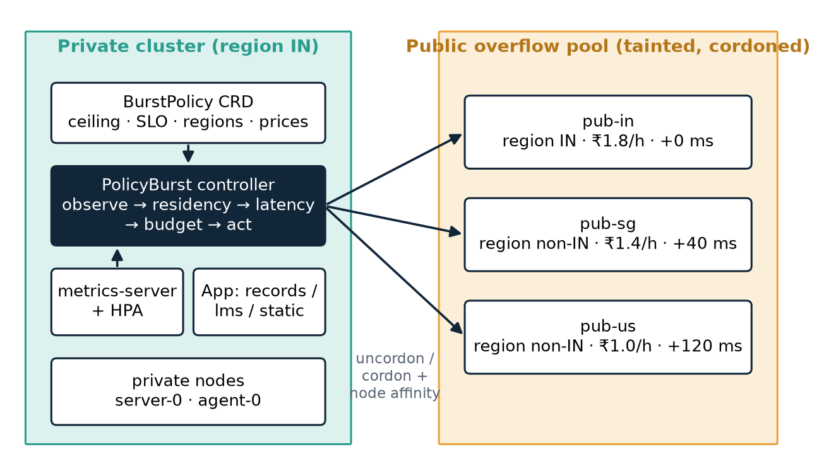
Architecture
Standard Kubernetes primitives only: taints, cordon, node affinity, HPA — runs on any conformant cluster
Policy is a BurstPolicy custom resource; kubectl apply changes it live
Public nodes are tainted and stay cordoned until bought
Each Deployment is pinned to its permissible destinations by node affinity
HPA decides how many replicas; PolicyBurst decides where they may go

Slide 7
Constraint-first decision, every 15 s
Residency and latency define the feasible set before the controller decides to burst
1
2
3
4
5
Observe
Residency
Latency
Budget
Act
Pending pods, private CPU, active nodes, RTT probes
data class → permitted regions; unknown = restricted
2 × RTT + service ≤ 300 ms
spent + next lease ≤ ceiling − reserve
cheapest feasible node, or reject with reason
S(t) + (Σ p(active) + p(d)) · min(lease, T − t) ≤ B − ρ # buy d only if the whole lease fits
S(t) + Σ p(active) · Δ > B − ρ ⇒ release all public # halt before the next interval crosses
release priciest node only if its pods fit on private capacity # safe scale-in (fixes thrash)
no new public node while a Deployment is mid-rollout; evict misplaced pods # rollout guard
The threshold baseline is the same loop with all three constraints switched off — so any difference comes from the decision logic, not the plumbing.

Slide 8
Implementation
github.com/AviatorRoyal/cloud-burst · Python on the official Kubernetes client
cloud-burst/
├── policyburst/ policy · feasibility · cost
│ decision · signals · actuator · main
├── baselines/threshold.py # B1, constraints off
├── deploy/ k3s/ k3d/ crd/ policy/ app/ controller/
├── load/locustfile.py # burst + ramp shapes
├── experiments/run_matrix.py # testbed runs
├── sim/ # simulator, same code
├── analysis/ # metrics, figures
├── paper/ evidence/ results/
└── tests/ # unit tests
Commit history
270e7e3 2026-10-26 Add testbed, simulator, guards and full evaluation
b17414a 2026-10-26 Point decks at the real GitHub repo
0274ee2 2026-10-26 Initial PolicyBurst project: controller, baselines, testbed, experiments
Sample app: records (restricted) · lms (internal) · static (public); 15 ms CPU per request; HPA 60% CPU, 1–30 replicas.

Slide 9
Testbed: a real 5-node k3s cluster
Captured on DEATHSTAR at 2026-10-25 23:55:01 UTC · evidence/20261025-235501/
$ kubectl get nodes -L p11.burst/destination,p11.burst/region
NAME STATUS ROLES AGE VERSION DESTINATION REGION
k3d-p11-agent-0 Ready <none> 3h51m v1.35.5+k3s1 private IN
k3d-p11-agent-1 Ready,SchedulingDisabled <none> 3h51m v1.35.5+k3s1 pub-in IN
k3d-p11-agent-2 Ready,SchedulingDisabled <none> 3h51m v1.35.5+k3s1 pub-sg non-IN
k3d-p11-agent-3 Ready,SchedulingDisabled <none> 3h51m v1.35.5+k3s1 pub-us non-IN
k3d-p11-server-0 Ready control-plane 3h51m v1.35.5+k3s1 private IN
$ ping -c 5 <node-ip> (avg RTT)
k3d-p11-agent-0 172.18.0.5 0.049 ms
k3d-p11-agent-1 172.18.0.3 0.051 ms
k3d-p11-agent-2 172.18.0.6 37.861 ms
k3d-p11-agent-3 172.18.0.4 119.493 ms
k3d-p11-server-0 172.18.0.2 0.060 ms
k3s v1.35.5 via k3d, 2 vCPU per node
Private: server-0, agent-0 (region IN)
pub-in IN · pub-sg +40 ms · pub-us +120 ms (netem)
Public nodes tainted, cordoned until bought
Locust load from the host, 4 processes
Same topology can be built from real VMs over Tailscale with deploy/k3s/ (planned upgrade).

Slide 10
Evaluation method
Two layers: measure on the cluster, explore the parameter space in a simulator that runs the same decision code
1
Testbed (measured)
2
Simulation (same Decider + CostMeter)
B0, B1, PolicyBurst · 2× burst, 180 s · 3 repetitions
Per-request logs from Locust, including the serving node
Capacity calibrated: largest load with ≥ 95% SLO attainment
227 runs: 5 burst sizes × 3 durations, ablation, residency sweep
Models HPA, scheduler, pod start-up, CPU limits, closed-loop users, queues
Checked against the testbed at the shared 2× point
Metric | Definition
SLO attainment | share of all requests that succeed within 300 ms (failures count as misses)
Attainment per ₹100 | attainment points ÷ shadow-priced spend × 100
Residency violations | restricted requests served by a non-IN node (from client logs)
Residency penalty | attainment without residency − attainment with residency (pp)

Slide 11
Testbed results (measured)
2× private capacity for 180 s, 3 repetitions per configuration, mean ± 95% CI
Config | Attainment (%) | p95 (ms) | Spend (₹) | Per ₹100 | Violations
B0 No bursting | 66.7 ± 14.5 | 1782 | 0.0 | — | 0
B1 Threshold-only | 92.8 ± 3.5 | 362 | 44.4 | 210 | 7163
PolicyBurst | 88.3 ± 14.0 | 658 | 41.0 | 229 | 0

Slide 12
Does the simulation agree with the testbed?
Same configurations at the one point both cover; the simulation is then used to explore the rest
Largest gap 32 pp: 4-core testbed private pool vs 7-core model, real start-up timing
Agree: bursting beats no bursting on both platforms
PolicyBurst vs threshold: −5 pp on the testbed, +9 pp in simulation
Testbed caught what the model cannot: restricted pods leaked abroad during affinity rollouts (62 and 126 requests in early runs) — fixed with rollout + placement guards
Why: emulated pub-us is ≈120 ms RTT on the testbed (fits the SLO, so the latency filter removes nothing) but 148 ms in the model (misses it)

Slide 13
O3: attainment per ₹ across burst sizes
PolicyBurst +41% at 1.5×, +23% at 2×, but −13% at 2.5× (simulation, 180 s bursts)
Notes:
Why PolicyBurst loses at 2.5x: the static latency filter skips pub-us. At heavy overload, local queueing delay exceeds the 300 ms pub-us would add, so slow capacity would still help. Fix: a queue-aware latency filter.

Slide 14
The ceiling holds
Five 2× bursts in one compressed billing month: threshold-only spends ₹257, PolicyBurst ₹109 (ceiling ₹120)
Threshold-only: 2.1× the ceiling
PolicyBurst stops when the next lease would cross ceiling − reserve
Later bursts: private capacity only, rejections logged with reason “budget”
Ceiling breached: 100% of B1 runs, 0% of PolicyBurst runs

Slide 15
Ablation: where the gain comes from
With the ceiling binding, PolicyBurst gets +80% attainment per ₹; the cost accumulator is the main source
− cost accumulator
spend ₹251, ceiling breached every run
− latency filter
buys slow pub-us: attainment 60.1% vs 65.9%
− residency filter
57,186 restricted requests abroad per run

Slide 16
O4: what residency costs
About zero up to 30% restricted traffic; 6 pp at 50% and 32 pp at 70%, once pub-in is saturated
Rule of thumb: compliance is cheap while in-country capacity (private + pub-in) can absorb the restricted share of peak demand.

Slide 17
Hypotheses: final verdict
Reported against the hypotheses as stated, including where the data disagrees
≥ 25% per ₹ holds at 1.5× (+41%) and with a binding ceiling (+80%); +23% at 2×; fails at 2.5× (−13%) where the static latency filter forgoes pub-us.
H1
Partly supported
PolicyBurst: 0 residency violations and no ceiling breach in 227 simulated and 9 testbed runs. Threshold-only served 7163 restricted requests abroad per testbed run and breached the ceiling in 100% of repeated-burst runs.
H2
Supported
Penalty at 30% restricted: -5.7 pp (bound 10 pp). Not true beyond: 5.9 pp at 50%, 31.9 pp at 70%.
H3
Supported at 30%

Slide 18
Threats to validity
What this setup cannot prove
!
Simulation model
!
One host, emulated WAN
!
Cost is modelled
Fluid queues and M/M/1-style service; checked against the testbed at one burst size.
All nodes share a machine; foreign regions are netem delay, not real links.
Free tier bills ₹0: shadow prices, month compressed into 1 h, rates ×100.
!
Synthetic load
!
Residency ≠ legal compliance
!
Small scale
Square-wave bursts; real demand ramps, overlaps and follows daily cycles.
Pod placement only; logs, backups and control plane may still cross borders.
5 nodes, 3 services, 3 repetitions; wide CIs at 2–2.5×.

Slide 19
Conclusion and future work
Making constraints inputs, not filters, lets a bursting controller honour them at little cost in service
Contributions
Next
Constraint-first bursting: feasible set per workload, projected-spend gate, safe scale-in
Open-source controller with a BurstPolicy CRD, baselines in the same code path
Evaluation on a real k3s cluster and in a simulator running the same decision code
A measured cost of residency compliance and a rule of thumb for institutions
1
Queue-aware latency filter
admit a slow region when local queueing is worse — fixes 2.5×
2
Real public node
free-tier VM in an Indian region over Tailscale
3
Beyond placement
residency for logs, backups and storage

Slide 20
Key references
[1] Luo et al., Starburst: A cost-aware scheduler for hybrid cloud, USENIX ATC 2024
[2] Yang et al., SkyPilot: An intercloud broker for sky computing, NSDI 2023
[3] Wu et al., Can't Be Late: Optimizing spot instance savings under deadlines, NSDI 2024
[4] Iorio et al., Computing without borders: The way towards liquid computing, IEEE TCC 2023
[5] Abdi, Ashjaei & Mubeen, Deadline-constrained security-aware workflow scheduling in hybrid cloud, FGCS 2024
[6] Xiao, Zhou, Yang & He, Privacy-preserving workflow scheduling in geo-distributed data centers, FGCS 2022
[7] Stoica & Shenker, From cloud computing to sky computing, HotOS 2021
[8] Wiesner et al., Let's wait awhile, Middleware 2021
[9] Ju, Singh & Toor, Proactive autoscaling for edge computing systems with Kubernetes, UCC 2021
[10] Sukprasert et al., Carbon-aware temporal and spatial workload shifting, EuroSys 2024
[11] Digital Personal Data Protection Act 2023; RBI circular on storage of payment system data, 2018
[12] Kubernetes documentation (HPA, taints, node affinity); k3s; k3d; Locust; NetEm (Hemminger 2005)

Slide 21
Thank you — questions?
Residency, latency and budget decide where work may go — before the controller decides where it should go.

