Slide 1

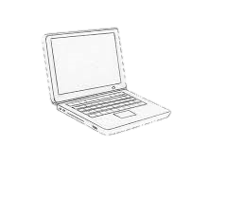
Datacenter Extension Deployment
Amazon Web Service (AWS)
Container: project-1
AZ-A
Private
Public
Private
Public
Enterprise Network
Router/
FW
AZ-B
CIDR:10.16.16.0/20
192.168.1.0/24
internet
Secure tunnel
Container: project-2
AZ-A
Private
Public
Router
Private
Public
10.16.0.0/16
AZ-B
CIDR:10.16.32.0/20
Secure tunnel
Container: project-3
CloudN
AZ-A
Private
Public
Private
Public
AZ-B
CIDR:10.16.48.0/20

