Slide 1
FO_REVIEW_KICKER_1
FO_REVIEW_TITLE_1
5.5% gross conversion
FO_REVIEW_BODY_1
FO_REVIEW_FOOTER_1

Slide 2
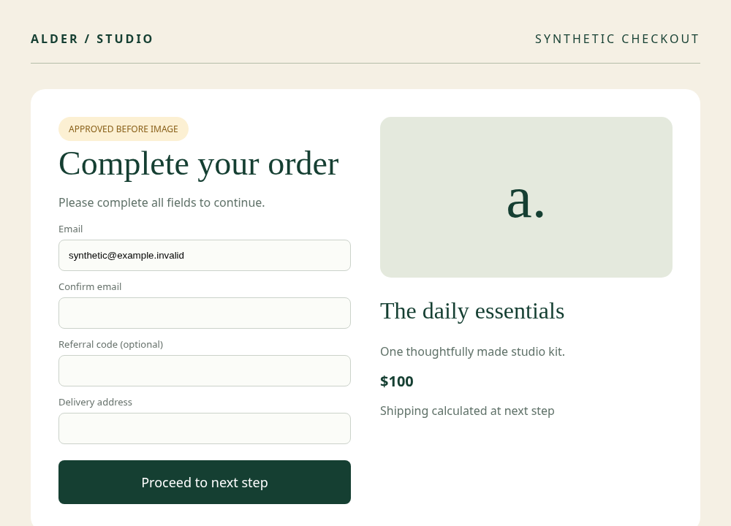
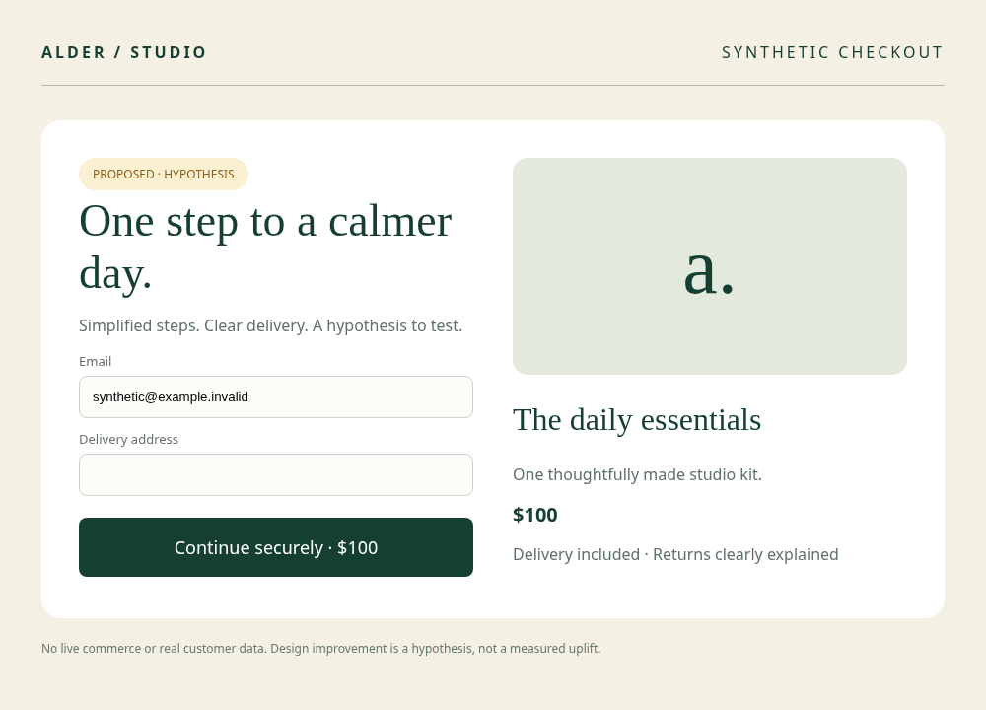
FO_REVIEW_KICKER_2
FO_REVIEW_TITLE_2
FO_REVIEW_BODY_2
FO_REVIEW_FOOTER_2

Slide 3
FO_REVIEW_KICKER_3
FO_REVIEW_TITLE_3
FO_REVIEW_BODY_3
FO_REVIEW_FOOTER_3

